Slide 1
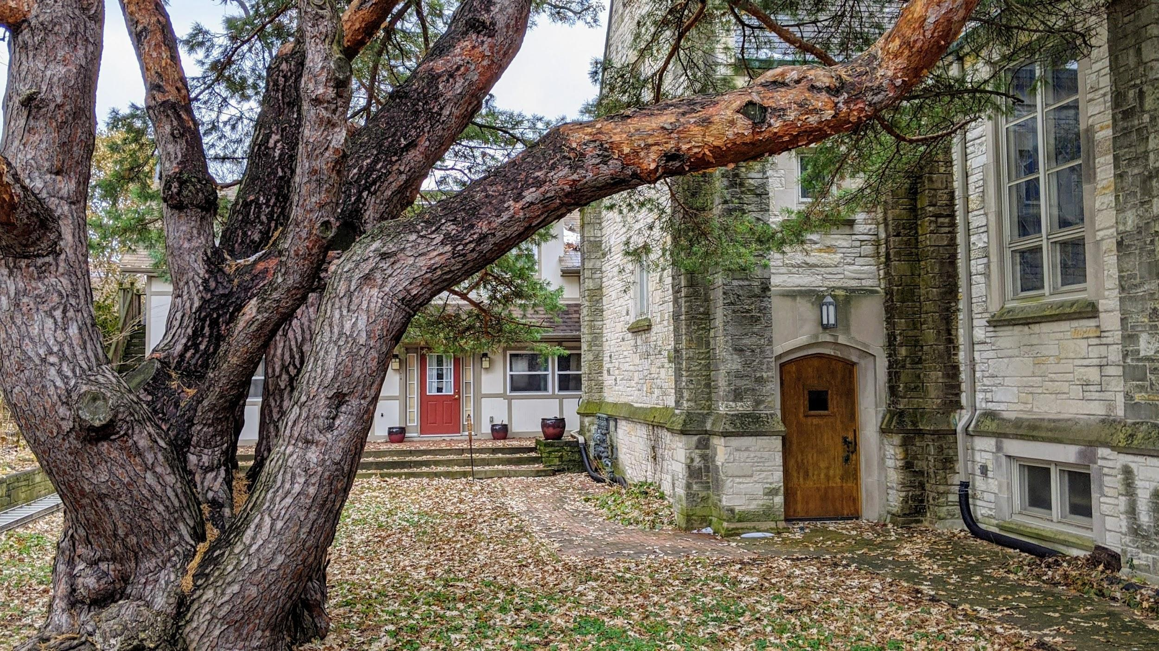
Nonhierarchical Interdependence & the “Eternal Newness” of the Church-Cosmos Ecosystem
Stephen L. Hawkins
University of Wisconsin – Milwaukee’s
Religious Studies Conference April 2020

Slide 2

The Church & 4 Characteristics of Ecosystems
Diversity
Interdependence
“Nestedness”
Continuous Feedback/“Eternal Newness”
The Apostle Paul
Sallie McFague
Pope Francis

Slide 3
“Nestedness”
Specialized
Generalized

Slide 4
The Church & 4 Characteristics of Ecosystems
Diversity
Interdependence
“Nestedness”
Continuous Feedback/“Eternal Newness”
The Apostle Paul
Sallie McFague
Pope Francis

Slide 5
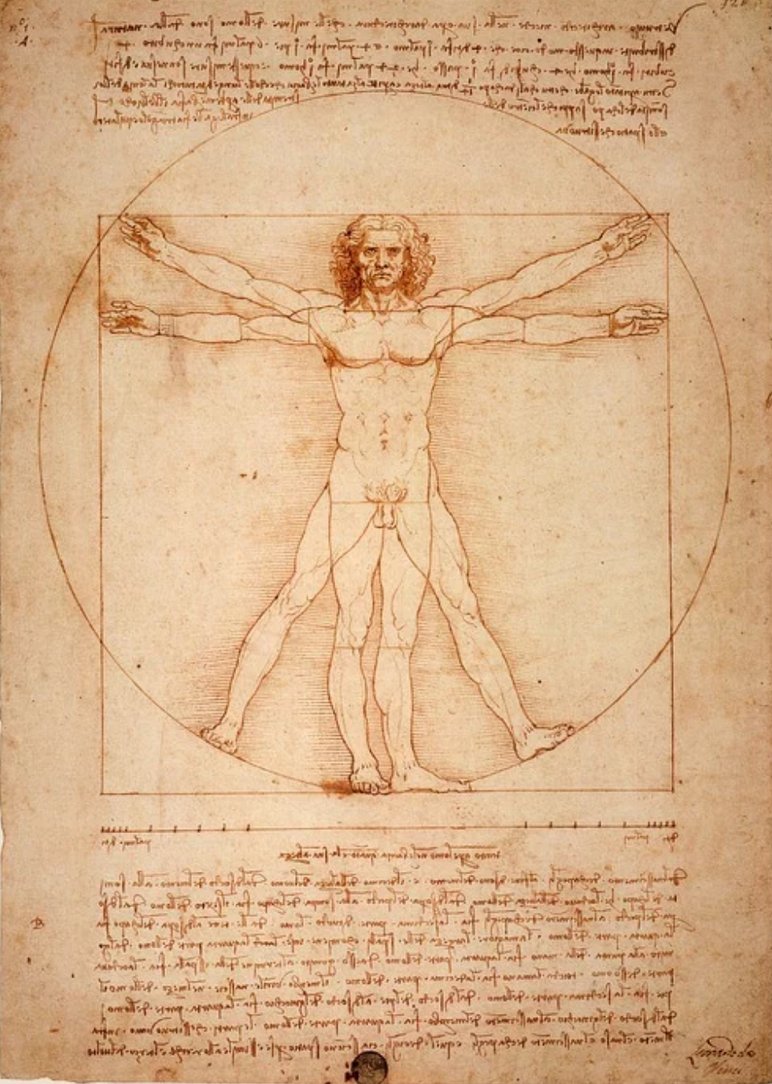
Leonardo da Vinci’s “Vitruvian Man” (circa 1490)
Notes:
https://cdn.pixabay.com/photo/2016/01/06/21/57/leonardo-da-vinci-1125056_960_720.jpg

Slide 6
“Nestedness”
Universe
God

Slide 7
The Church & 4 Characteristics of Ecosystems
Diversity
Interdependence
“Nestedness”
Continuous Feedback/“Eternal Newness”
The Apostle Paul
Sallie McFague
Pope Francis

Slide 8
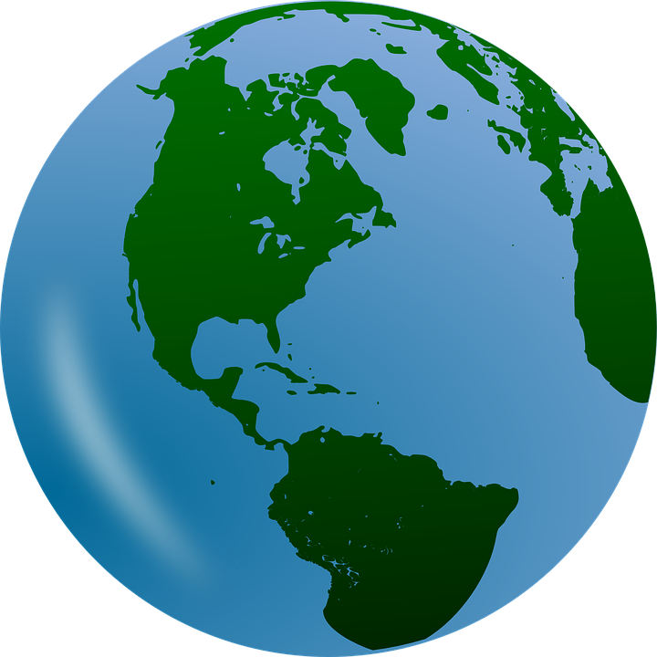

Continuous Feedback/”Eternal Newness”

Slide 9
“Nestedness”
Bread/Christ
Church
World/Cosmos
God

Slide 10
The Church & 4 Characteristics of Ecosystems
Diversity
Interdependence
“Nestedness”
Continuous Feedback/“Eternal Newness”
The Apostle Paul
Sallie McFague
Pope Francis

Slide 11
“The Congregation’s Oldest Member”
Underwood Memorial Baptist Church; Wauwatosa, WI
126-year-old Scots Pine
Notes:
Hawkins, S. (Fall 2019) “The Congregation’s Oldest Member”

Slide 12
The Church & 4 Characteristics of Ecosystems
Diversity
Interdependence
“Nestedness”
Continuous Feedback/“Eternal Newness”
The Apostle Paul
Sallie McFague
Pope Francis

