Slide 1

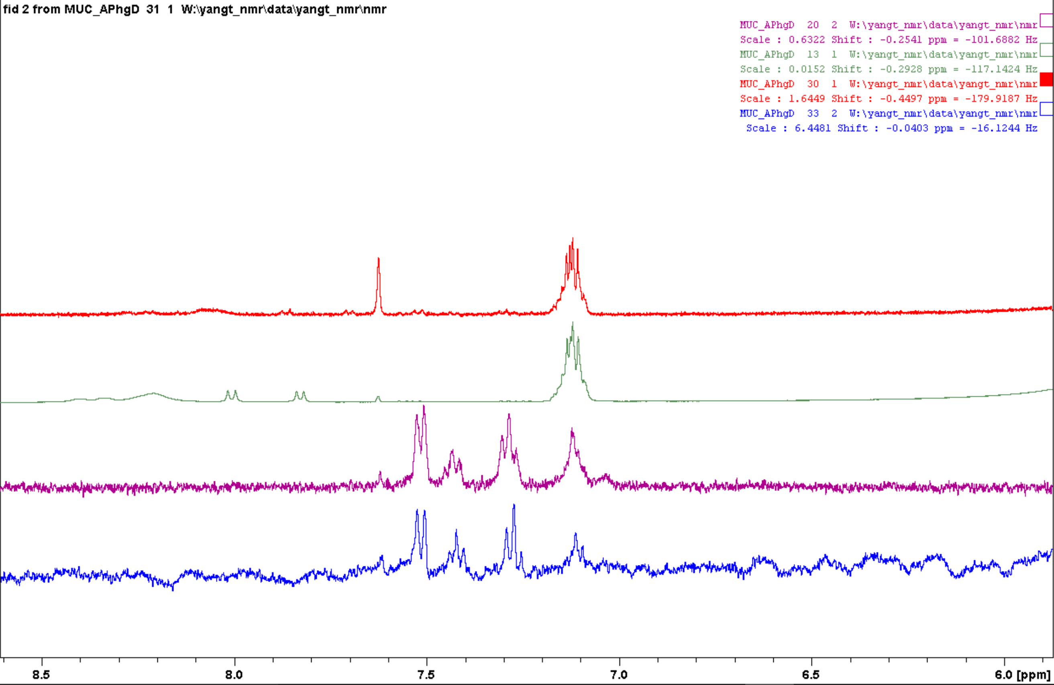
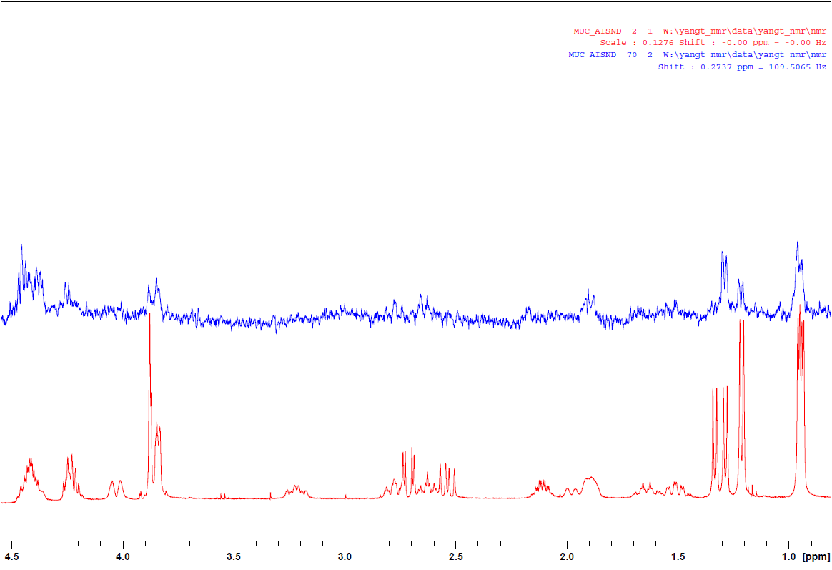
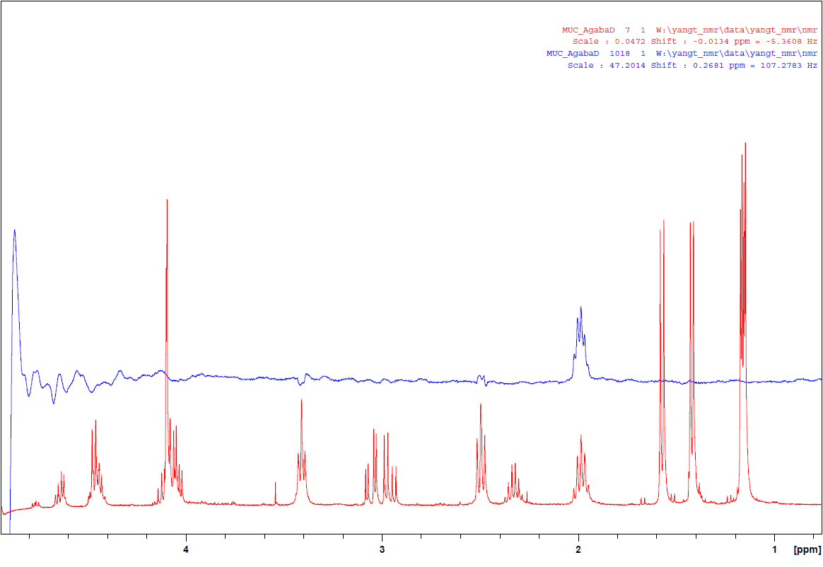
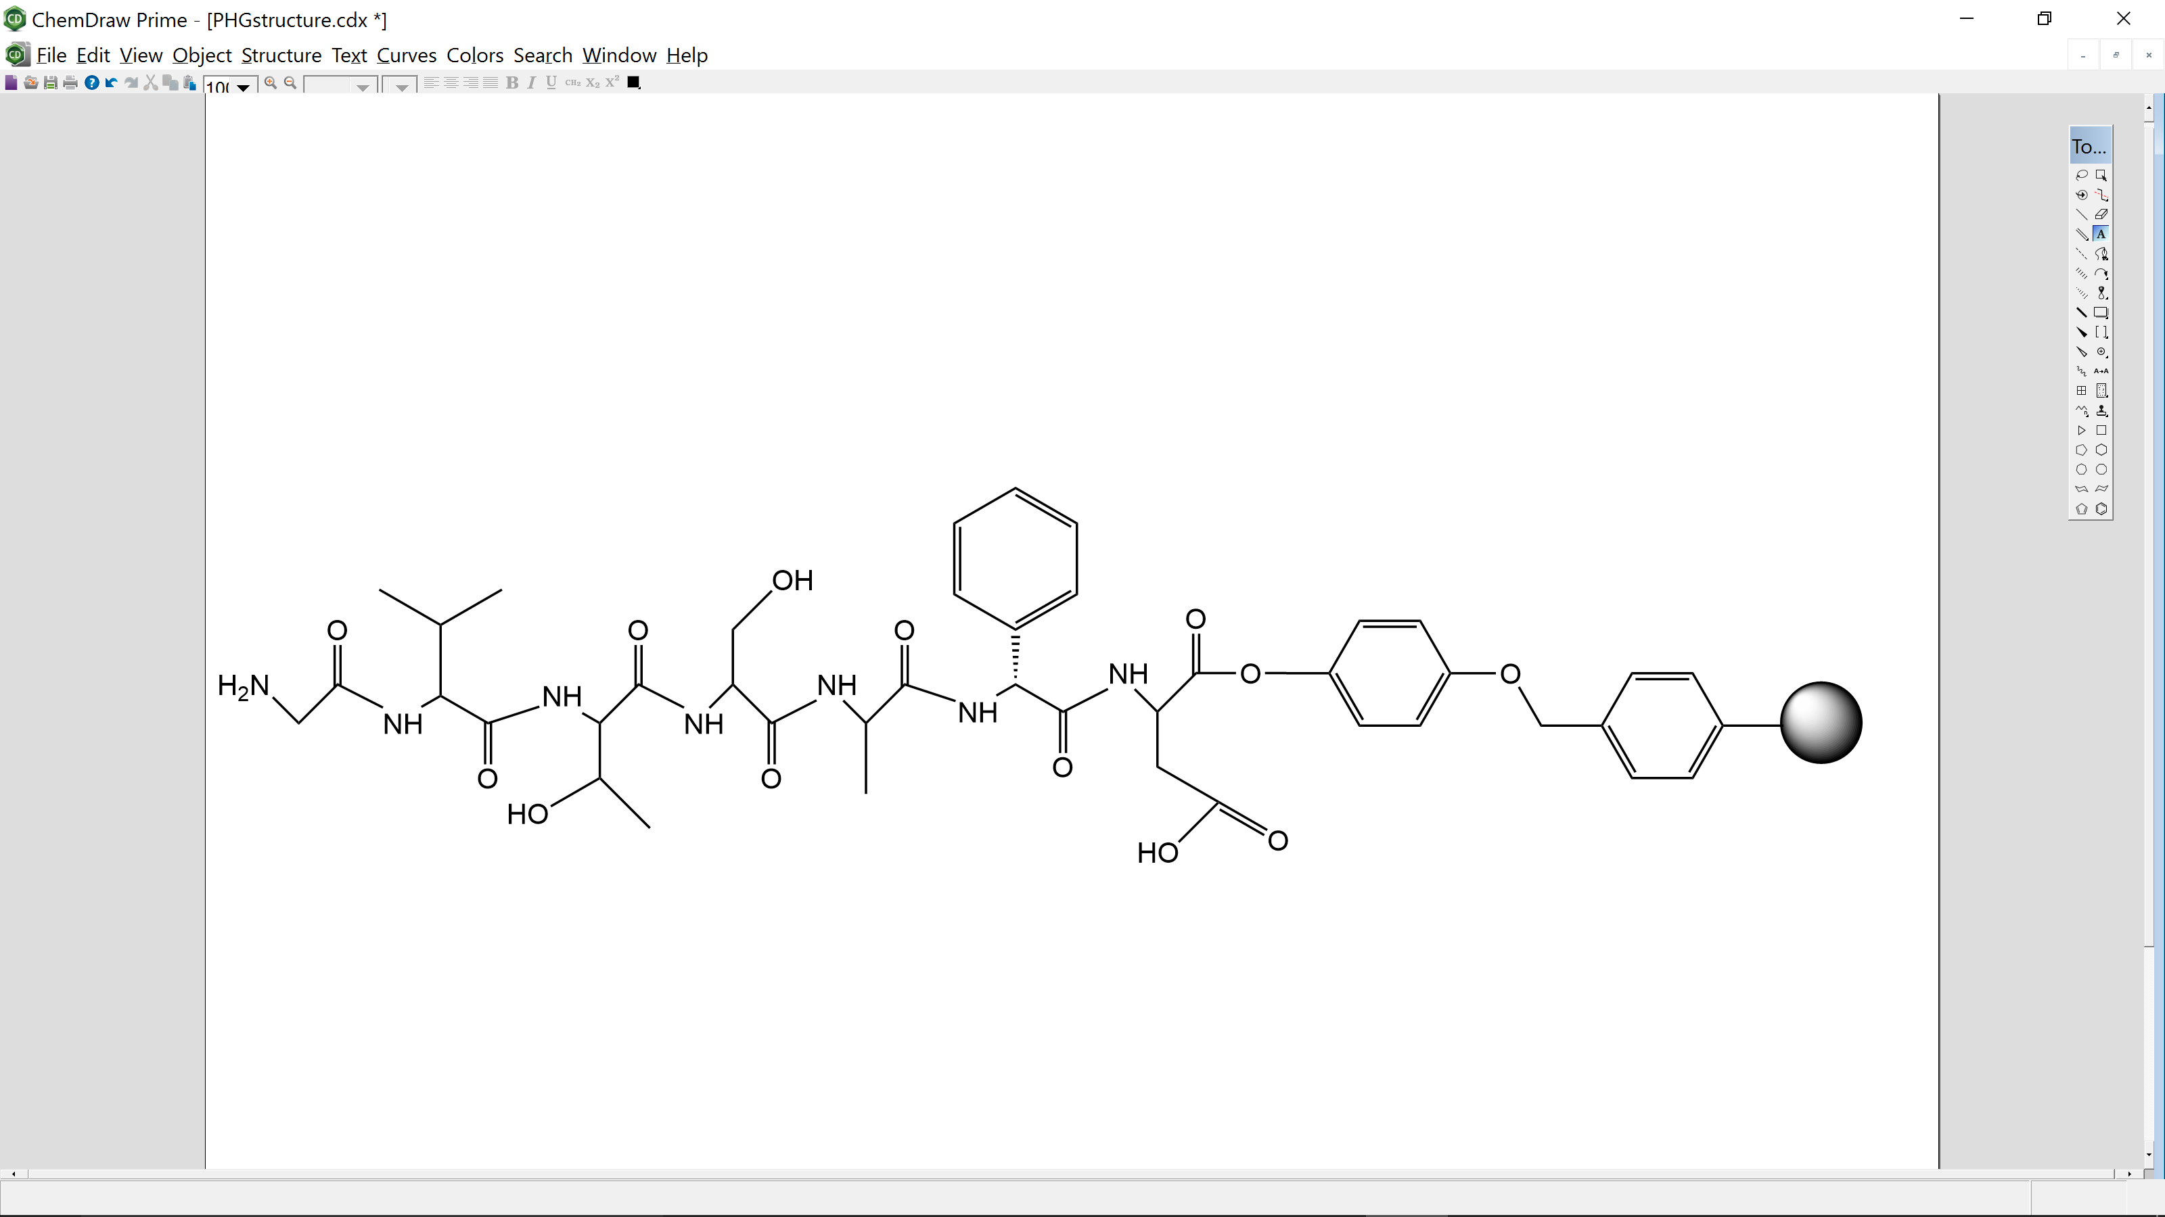
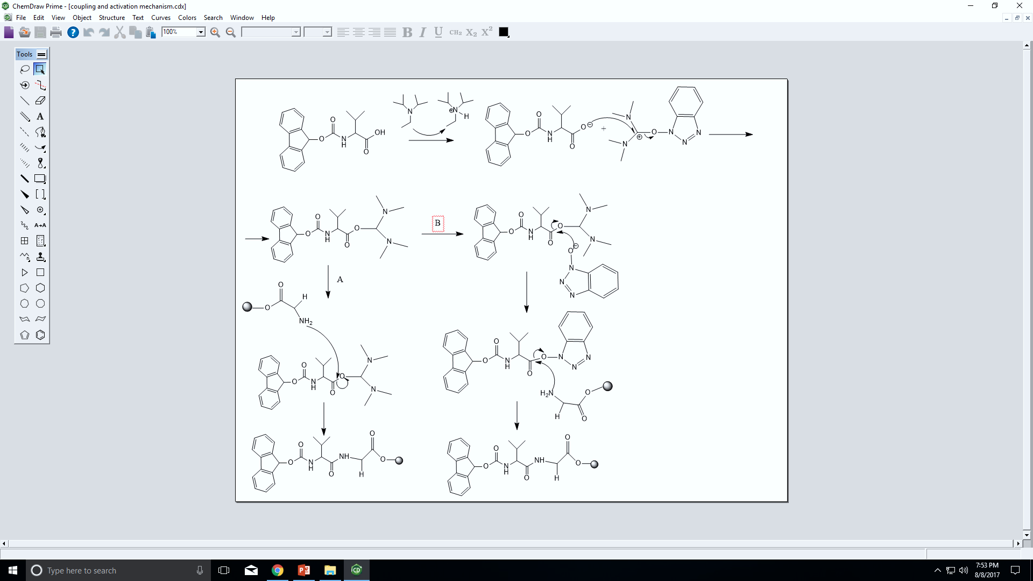
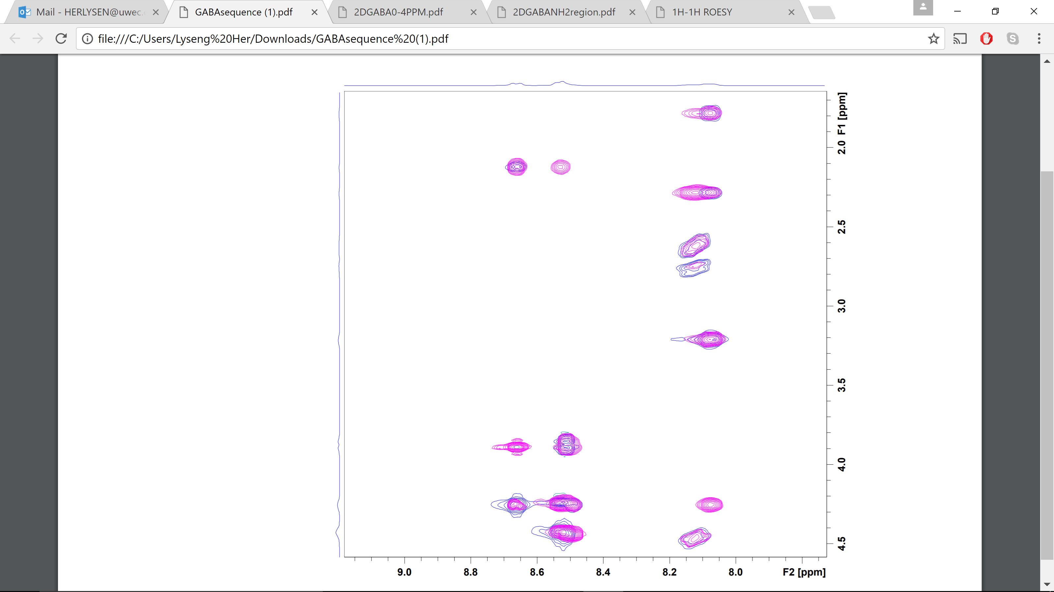
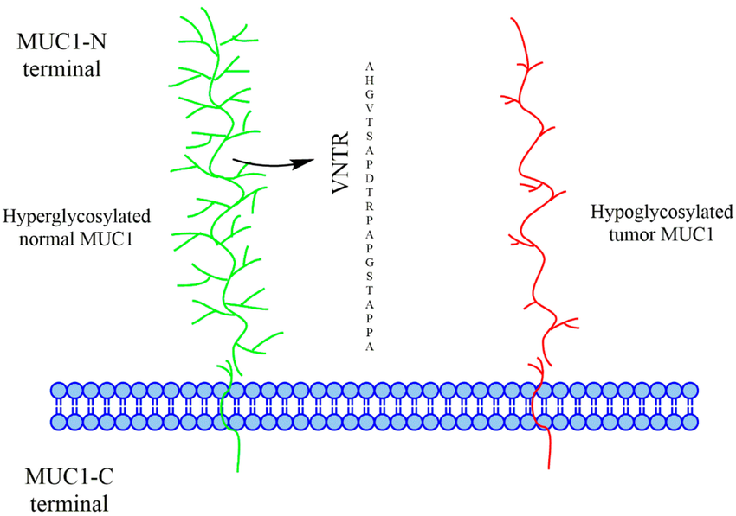
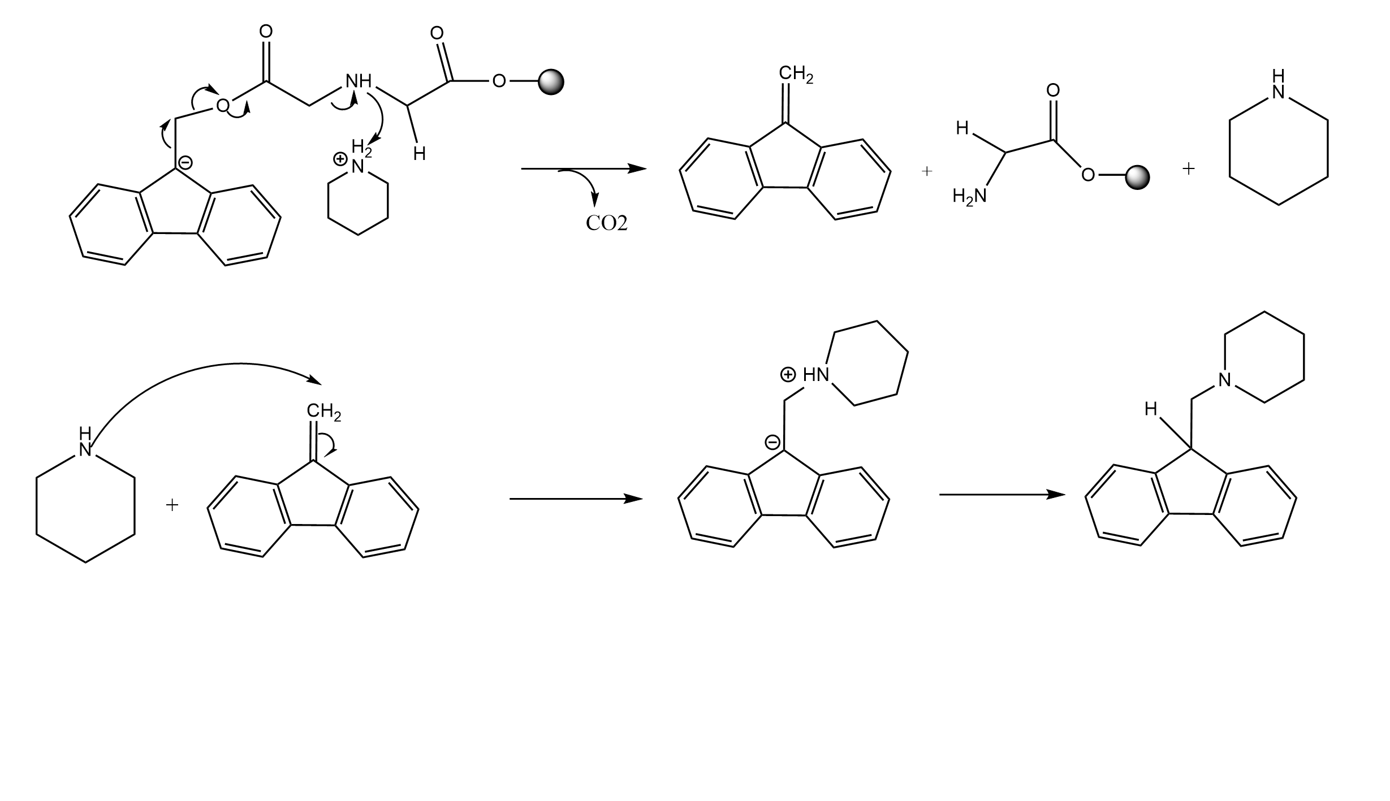
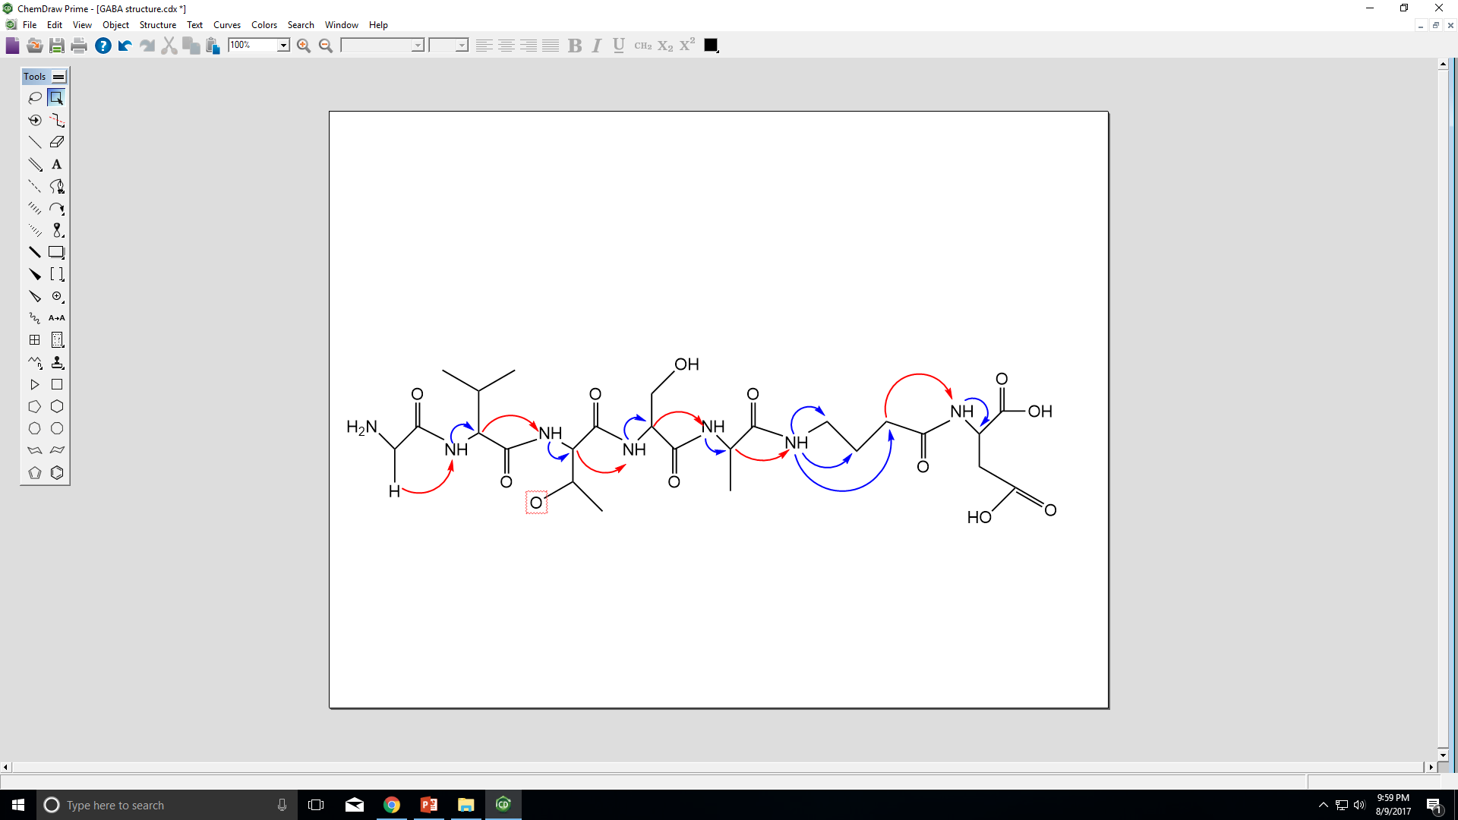











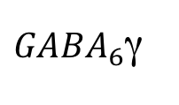


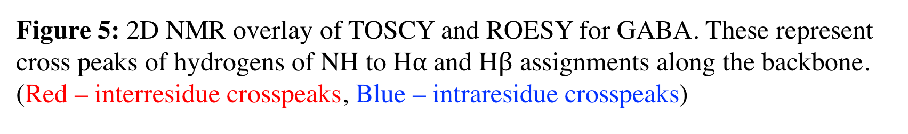
Synthesis of Mucin Peptide Epitopes Lysengkeng Her, Derek J. Miller and Thao Yang Celebration of Excellence in Research and Creativity Activity (CERCA), Dept. of Chemistry, University Wisconsin-Eau Claire, Eau Claire WI, May 2-4, 2018 (Supported by National Science Foundation Research Experiences for Undergraduate, NSF REU)
Abstract
Objective
Results
The MUC-1 mucin is a heavily glycosylated transmembrane protein found on the apical surface of the epithelial cells that contains a short cytoplasmic end and a long extracellular domain consisting of multiple 20-amino acid tandem repeat domains. In tumor cells, muc1 mucin has an alteration of the glyco chains, which makes it no longer restricted to the apical surface of the membrane and covers the entire cell surface. This study focusses on synthesizing mucin peptide epitopes that can possibly interact with the mucin monoclonal antibody. Three mucin epitopes were synthesized based on the tandem repeat domain sequence GVTSAPD, with the proline residue substituted with gamma-aminobutyric acid (GABA), D-α-phenylglycine (D-PHG) and L-α-phenylglycine (PHG). The LC-MS displayed one single peak for GABA (634.3073u) and two separate peaks for D-PHG (682.3399u and 682.3331u), and PHG (682.3092u and 682.3134u). The two separate peaks of PHG and D-PHG are due to the two different steric conformers of L- and D-PHG. 2D proton NMR was used to confirm the peptide sequence. Antibody-epitope binding studies showed that the PHG derivatives can bind the antibody at the aromatic residues.
The purpose of this study is to successfully synthesize all peptide epitopes based on the sequence GVTSAPD. The 6th position, proline residue was substituted with unnatural amino acids; GABA, beta-Ala, ISN, PHG and D-PHG. The STD-NMR technique is then used to study the binding of mouse monoclonal antibody with the synthesized peptide epitopes. Mucin peptides that have binding ability to MUC1 antibody may provide useful additional epitopes toward designing such agents.
$${PHG}_{6}AR$$
$${ISN}_{6}γ1$$
$$A_{5}β$$
$$V_{1}γ$$
$$G_{1}α$$
$$S_{4}β$$
$${ISN}_{6}α1$$
$${ISN}_{6}α1$$
$${ISN}_{6}β1$$
$$T_{3}γ$$
${GABA}_{6}$γ
$${GABA}_{6}a$$
$${GABA}_{6}β$$
Figure 2: Structure of GVTSAphgD with “Wang” resin represented and drawn from Chemdraw.
Figure 8: STD-NMR of peptide with PHG with mouse monoclonal antibody (blue) mixture. ¹H NMR of peptide (GVTSAphgD) in D₂O (red). Labeled peaks represents binding of PHG from STD-NMR.
Figure 9: STD-NMR of peptide with ISN with mouse monoclonal antibody (blue) mixture. ¹H NMR of peptide (GVTSAisnD) in D₂O (red). Labeled peaks represents binding of ISN from STD-NMR.
Figure 10: STD-NMR of peptide with GABA with mouse monoclonal antibody (blue) mixture. ¹H NMR of peptide (GVTSAgabaD) in D₂O (red). Labeled peaks represents binding of GABA from STD-NMR.
Methods
Introduction
Peptide Synthesis: All peptides were synthesized by solid phase peptide synthesis using FMOC-chemistry. The last amino acid is bonded to Wang resin beads. A fluorenylmethyloxycarbonyl group (FMOC) is also present as the amine protective groups. During synthesis a peptide bond is formed between its active carboxyl end and the amino end of resin-bound amino acid. The process is then repeated for each addition of amino acid (4).
Protons Assignments by 2D NMR (TOCSY)
2D total correlation spectroscopy (TOSCY) and rotating-frame overhauser spectroscopy (ROESY) were used to complete the ¹H NMR assignments of the synthesized peptides. TOSCY and ROESY were used to confirm structure of peptides.
Conclusions
MUC1 mucin is an epithelial transmembrane glycoprotein which the extracellular domain exhibits a repeating 20 amino acid sequence (GVTSAPDTRPAPGSTAPPAH), which is also known as the tandem repeat domain (1). In normal mucin proteins it is highly glycosylated with carbohydrates which aid in carrying in the normal cellular functions of MUC1 mucin, that includes cell-cell interaction, lubrication and protection of the cells surface of the epithelial surface. In tumor cells, MUC1 mucin has an alteration of the glyco chains, which makes it no longer restricted to the apical surface of the membrane and covers the entire cell surface. Cancer cells, such as adenocarcinomas overexpress MUC1 with aberrant glycan chains which can cause a immune response producing antibody against it. The tandem repeat domain (TRD) has been studied extensively and tested as potential cancer vaccines. In this study we specifically study the amino acid sequence GVTSAPD (a section of the TRD) by replacing the proline residue with various unnatural amino acids (2,3).
The mucin peptides GABA, D-PHG, PHG, ISN and β-Alanine were successfully synthesized. Based on the results of STD-NMR studies, the ISN, PHG, and GABA peptides bind to the mouse monoclonal antibody. Most aromatic residues were found to bind but surprisingly the non-aromatic GABA peptide was also able to bind at the β hydrogen position of GABA. PHG mostly shows binding at the aromatic ring. Finally, ISN shows bindings at six different positions. This suggests that the mAb does not have absolute specificity and induced fit binding model is possible. It is important to continue to study more mucin peptides that could possibly bind to mAb, which can be developed as antigens (vaccine) against certain tumors.
12
1. $G_{1}α−V_{2}NH$
2. $V_{2}αNH$
3. $V_{2}α−T_{3}NH$
4.${ T}_{3}αNH$
5. $T_{3}α−S_{4}NH$
6. $S_{4}αNH$
7. $S_{4}α−A_{5}NH$
8. $A_{5}αNH$
9. $A_{5}α−{GABA}_{6}NH$
10.${ GABA}_{6}γNH$
11.${ GABA}_{6}αNH$
12.${ GABA}_{6}βNH$
13. ${GABA}_{6}α−D_{7}NH$
14. $D_{7}β−D_{7}NH$
15. $D_{7}β−D_{7}NH$
16. $D_{7}αNH$
All peptides were synthesized using solid phase peptide synthesis; FMOC-chemistry.
13
11
14
15
10
References
1
1. Cheng Her & Thao Yang, (Department of Chemistry, University of Wisconsin – Eau Claire, Eau Claire, WI). “Synthesis of a MUC1 Mucin Cyclic Dimer Peptide and Its Antibody Binding Properties as Revealed by STD-NMR.” Amer. J. Undergrad. Res. (AJUR), November 2015, Vol. 12, Issue 4, 79-91. www.ajuronline.org.
2. Thao Yang, Cheng Her, Andrew R. Lynch, Ronald J. White, Ming Wang, and William M.Westler. “SHORT PROLINE-SUBSTITUTED MUC1 MUCIN PEPTIDES CAN BIND TO MOUSE MUC1 MONOCLONAL ANTIBODY AS REVEALED BY STD NMR.” Journal of Undergraduate Chemistry Research, 2015, 14(1), 5-11.
3. Md Kamal Hossain and Katherine A. Wall, Immunological Evaluation of Recent MUC1
Glycopeptide Cancer Vaccines, Vaccines 2016,4, 25; doi:10.3390/vaccines4030025.
4. Benoiton, N. Leo, Chemistry of peptide synthesis, CRC Press, Taylor & Francis Group LLC, Boca Raton, 2006.
Figure 3: Mechanism of activation step and addition of amino acid, used Diisopropylethylamine (DIPEA), hexafluorophosphate benzotriazole tetramethyl uronium (HBTU) and hydroxybenzotriazole (HOBT) as activators (4).
2
3
7
8
9
4
5
6
16
Figure 5: 2D NMR overlay of TOSCY and ROESY for GABA. These represent cross peaks of hydrogens of NH to H$α$and H$β$ assignments along the backbone. (Red – interresidue crosspeaks, Blue – intraresidue crosspeaks)
2
3
6
7
10
13
16
1
4
5
8
9
12
11
1
Figure 6: peptide structure of GVTSAgabaD. Arrows correlates with 2D NMR of TOSCY over lay with REOSY to confirm correct synthesized peptide.
Figure 1. Representation of a normal mucin protein (Green) with the core protein consisting of tandem repeat domain (TRD) and heavily O-linked glycosylated in the extracellular domain compare to tumor mucin protein (Red), which is hypoglycosylated (3).
LC-MS Analysis: Chromatogram was acquired to characterized all synthesized peptide fractions to determine whether the high intensity band is the actual peptide. Mass spectra was also used to obtain the masses of each peptide (not shown).
Acknowledgements
Figure 4: FMOC removal mechanism, used piperidine to remove the protecting group (FMOC).
We thank and acknowledge the support of UWEC Office of Research and Sponsored Programs (ORSP) for providing the Diversity Mentoring Program grant, the UWEC Chemistry Dept. for use of the NMR spectrometer and other instruments, and also the Blugold Commitment for printing this poster. This research is supported by the NSF REU grant #1460728.
Peptide | Theoretical mass (Da) | Experimental mass [M+H] | Yield % | Purity
GVTSAgabaD | 633.6544 | 634.3073 | 62% | 92%
GVTSAdphgD | 681.6930 | 682.3092, 682.3134 | 118% | 95%
GVTSAphgD | 681.6930 | 682.3399, 682.3331 | 85% | 85%
GVTSA[βA]D | 619.590 | 620.2811 | 84.1% | 60.1%
GVTSA[ISN]D | 659.73 | 660.4211 | ------------ | 91%
This study examines the different derivatives of the MUC1 mucin epitopes with unnatural amino acids; gamma-amino butyric acid, beta-alanine, phenylglycine and piperidine-4-carboxylic acid. Peptides were synthesized using solid phase peptide synthesis method and characterized by liquid chromatography mass spectroscopy (LC-MS) and 2D NMR TOSCY and ROESY. This project aims to predict whether these peptides can bind with monoclonal antibody by the substitution of an unnatural amino acid, and using saturation-transfer difference nuclear magnetic resonance (STD-NMR) to determine whether the peptide epitopes are capable of binding.
Table 1: Theoretical mass [M] and peptide mass [M+H] are given to compare the two. Crude percent yield of all synthesized peptides along with purity are shown. Purity was calculated using chromatogram of figure 7.
Figure 7: Chromatogram of mucin peptide with GABA. Masses were also computed and shown in table 1.

