Slide 1


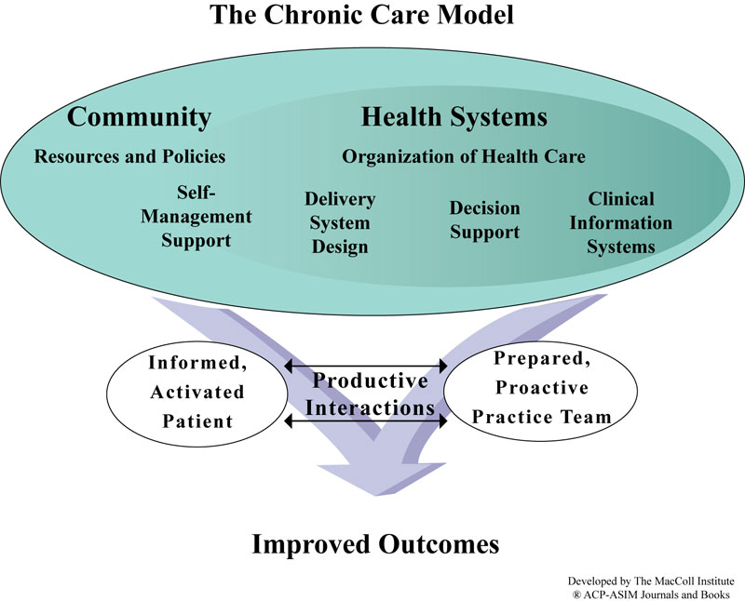


Framing Community-Based Aphasia Services
Using the Chronic Care Model
April Kramer, B.S., Tom Sather, PhD/CCC-SLP
University of Wisconsin – Eau Claire | Communication Sciences and Disorders
What is aphasia? (Aphasia, 2017)
A language disorder typically the result of stroke and/or brain injury that impacts language processing and/or expression on a continuum.
Aphasia can result in difficulty with…
Understanding spoken language or writing language
Communicating through speaking, writing and/or gesturing
Chronic conditions
World Health Organization (2002) defines chronic conditions as:
Noncommunicable conditions
Persistent communicable conditions
Long-term mental disorders
Ongoing physical/structural impairments
Examples: cardiovascular diseases, cancer, chronic respiratory diseases, diabetes, and stroke.
Chronic Care Model Implemented with Chronic Conditions
Chronic Condition | Chronic Care Model Effect
Diabetes | Stellefson, Dipnarine, and Stopka (2013): diabetes care under the CCM “is effective in improving the health of people who have diabetes and receive care in primary care settings.” Diabetes care changes under the CCM improved:
 | Piatt et al. (2006): “found that a CCM-based intervention was effective in improving clinical, behavioral, psychological/psychosocial, and diabetes knowledge outcomes in patients with diabetes.”
Asthma | Coleman, Austin, Brach, & Wagner (2009): “more likely than patients whose practices did not redesign care to monitor their peak flows and have a written action plan, and their quality of life improved”
Congestive heart failure | Coleman et al. (2009): “compared to patients in controlled practices, patients of providers actively participating in the congestive heart failure (CHF) collaborative were more knowledgeable, used recommended therapies such as lipid-lowering and angiotensin-converting enzyme (ACE) inhibition therapy more often, visited the emergency department (ED) less often, and experienced 35 percent fewer days in the hospital.”
The quality of diabetes care
Rates of eye examinations
HbA1c levels
Blood pressure
Cholesterol
Weight
Self-management
Aphasia
Chronic Conditions
Lower quality of life (Hilari, 2011; Franzén-Dahlin, Karlsson, Mejhert, & Laska, 2009; Darrigrand et al., 2011) | Chronic obstructive pulmonary disease (COPD) (Rubio, 2018) Heart failure (Franzén-Dahlin, 2009)
Experiences of depression (Lanyon, Worrall, & Rose 2018) | COPD (Rubio, 2018; Kunik et al., 2005) Diabetes mellitus, arthritis, asthma, chronic lung disease, angina, stroke Lotfaliany, Bowe, Kowal, Orellana, Berk, & Mohebbi,2018)
Feelings of isolation (Darrigrand et al., 2011) | COPD (Kunik et al., 2005)
Impairments in activities of daily living, social functioning, psychological functioning, and recreational activities (Darrigrand et al., 2011) | COPD (Kunik et al., 2005)
Chronic Disease Models
Chronic disease models support the patients that are in need of longer or more frequent attention by taking on a proactive approach, rather than reactive with patient care.
Chronic Disease Self-Management Program (Sobel et al., 2002; Self-Management Resource Center, 2019) A program that consists of group courses for individuals with chronic disease lead by trained leaders that focuses on an interactive and participatory approach to support patient self-management. Component: Self-management – Developing confidence in patients’ ability to manage their medical conditions through: Using medications properly Gaining skills to monitor and report changes in their condition Advocating for themselves | Chronic Care Model (Bodenheimer et al., 2002a; Bodenheimer et al., 2002b; Coleman et al., 2009; Piatt et al., 2006; Towfighi et al., 2017) This model was developed as a proactive approach for improving care for individuals with chronic conditions through involvement of the patient, the hospital, and the community. It is implemented through education and involvement of the patient and their partnerships with a prepared team of both physicians and non-physicians. Components: Self-management support Clinical information systems Delivery system design Decision support Health care organization Community resources and policies.
Transitional Care Model (Hirschman et al., 2015; Naylor et al., 2018) The model takes on a collaborative approach towards avoidance of preventable hospitalization of at risk older adults with chronic conditions. Components: Delivering services from hospital to home Screening at risk older adults Relying on advanced practice nurses (master’s prepared nurse) Promoting continuity Coordinating care Maintaining relationships Collaborating with patients, caregivers, and team Engaging patients and caregivers Managing symptoms and other risks Educating and promoting self-management
 | Innovative Care for Chronic Conditions Framework (World Health Organization, 2002; Nuño et al., 2012) The framework is an expansion of the Chronic Care Model and serves as a guide to redesigning the health care system to improve the prevention and management of chronic conditions. Components: Support a paradigm shift Manage the political environment Build integrated health care Align sectoral policies for health Use health care personnel more effectively Centre care on the patient and family Support patients in their communities Emphasize prevention
Wagner, E. H. (1998). Chronic disease management: What will it take to improve care for chronic illness? Effective Clinical Practice, 1(1), 3.
“The management of aphasia as a temporary or curable condition instead of a
chronic condition has resulted in significant long-term stress and suffering for those living with aphasia”
Simmons-Mackie, 2018, p. 104
Select Sources
Bodenheimer, T., Wagner, E. H., Grumbach, K. (2002a). Improving primary care for patients with chronic illness. American Medical Association, 288(14), 1775-1779.
Bodenheimer, T., Wagner, E. H., Grumbach, K. (2002b). Improving primary care for patients with chronic illness: The chronic care model, part 2. American Medical Association, 288(15), 1909-1914.
Coleman, K., Austin, B. T., Brach, C., & Wagner, E. H. (2009). Evidence on the chronic care model in the new millennium. Health Affairs, 28(1), 75-85. doi: 10.1377/hlthaff.28.1.75
Piatt, G. A., Orchard, T. J., Emerson, S., Simmons, D., Songer, T. J., Brooks, M. M., ... Zgibor, J. C. (2006). Translating the chronic care model into the community: results from a randomized controlled trial of a multifaceted diabetes care intervention. Diabetes Care 29(4), 811-817.
Towfighi, A., Cheng, E. M., Ayala-Rivera, M., McCreath, H., Sanossian, N., Dutta, T....Vickrey, B. G.(2017). Randomized controlled trial of a coordinated care intervention to improve risk factor control after stroke or transient ischemic attack in the safety net: Secondary stroke prevention by uniting community and chronic case model teams early to end disparities (SUCCEED). BioMed Central Neurology, 17(24). doi: 10.1186/s12883-017-0792-7
Simmons-Mackie (2018). Aphasia in North America. Aphasia Access Whitepaper.
Wagner, E. H. (1998). Chronic disease management: What will it take to improve care for chronic illness? Effective Clinical Practice, 1(1), 2-4.
Notes:
2.4 in.
H: 6.02
W: 6

