Slide 1

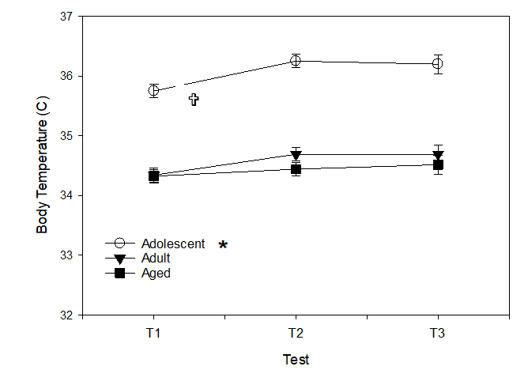
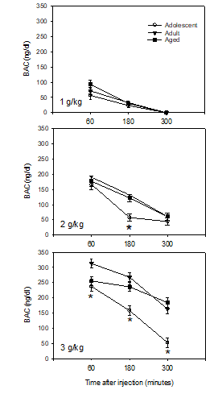
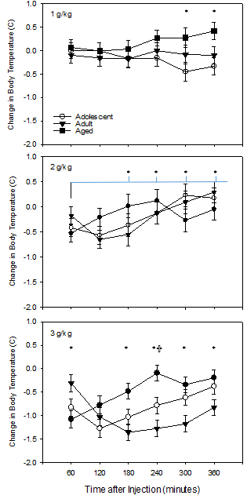
Ethanol Induced Hypothermia and Clearance Curves Across the Ages
Schneider, A., Kastner, A., Scaletty, S., Trapp, S., Turgeson, B., Szenay, R., Benes, A., Adler, S., Schreiber, A., Matthews, D. B.
Introduction
By the year 2030, 20% of the US population will be over the age of 65, providing a potential strain to the health care system (U.S. Census Bureau). A large segment of older individuals consume alcohol at dangerous levels with up to 3% meeting the diagnostic criteria for an alcohol use disorder (AUD). 33% of the elderly with an alcohol use disorder did not begin risky drinking until later in life, often following a major life change. These individuals have been termed Type 1 alcoholics. Little is known about the consequences of alcohol use in later life due to few animal studies investigating alcohol in aged rats. Previous research has shown that adolescent and adult rats have significantly different patterns of ethanol-induced hypothermia that varied by dose (Ristuccia & Spear, 2008). The current experiment investigates the effect of ethanol on hypothermia and aging by assessing adolescent, adult and aged rats following ethanol injection.
Figure 1: Basal core body temperatures vary by age. The core body temperature of rats determined prior to a specific ethanol test. It was found that adolescent rats had significantly higher core body temperatures than either adult or aged rats. In addition, core body temperature were lower the first time tested. X-axis indicates test times (separated by 7 days) while Y-axis indicated core body temperature. Data presented are mean and error bars indicate standard error of the mean. * indicated adolescent rats significantly greater than adult or aged rats (p < 0.05) while V indicated T1 core body temperatures lower than T2 or T3 (p < 0.05).
Methods
Subjects: In the first experiment (figures 1-3), twelve adolescent (postnatal day 28 on arrival), 12 adult (postnatal day 70 on arrival) and 12 aged (postnatal age 19 months on arrival) male Sprague-Dawley rats were used to investigate the effects of acute ethanol exposure on hypothermia as measured by anal core body temperature via a digital physiotemp monitor (Physiotemp Instruments, 154 Huron Avenue, Clifton, NJ 07013 USA). In the second control experiment (figure 4), six adult animals were used to assess core body temperature following saline injection.
Ethanol exposure: In the first experiment, animals were randomly assigned into one of three alcohol dose sequences (n=4 per sequence per age). Animals received an i.p. injection of 1.0 g/kg, 2.0 g/kg, or 3.0 g/kg of ethanol once every seven days for 21 days (i.e. a total of three i.p. injections over 21 days). The order of alcohol dose injection over the 21 days was counterbalanced so that three sequences of injections existed to remove any potential carryover effects of previous alcohol administration. Animals were first tested on postnatal day 30, postnatal day 72 and approximately postnatal age 19 months.
Testing: On the first test day, a baseline core body temperature was collected immediately prior to injection. Following alcohol administration, core body temperatures were re-determined every 60 minutes for the next 360 minutes. Seven days and 14 days later, animals were re-injected with the appropriate ethanol dose according to the counterbalanced sequence following baseline core body temperature readings and tested in the same manner.
Blood alcohol levels over time: To determine the effect of age on blood alcohol levels, subjects had their tails knicked 60 minutes post alcohol injection and a plasma sample was collected at 60 minutes, 180 minutes and 300 minutes later. Blood alcohol levels were determined via an AM1 Analox machine via manufacture specifications.
Figure 3: Blood ethanol levels following ethanol injection vary by age. X-axis shows minutes following an i.p. injection of ethanol while the Y-axis shows blood ethanol levels. Figure 3 Top: Blood ethanol levels following the 1.0 g/kg ethanol injection. Data presented are average blood ethanol level while error bars indicated standard error of the mean. No significant difference by age was found. Figure 3 Middle: Blood ethanol levels following the 2.0 g/kg ethanol injection. Data presented are average blood ethanol level while error bars indicated standard error of the mean. * indicate p < 0.05 between adolescent and adult and aged rats. Figure 3 Bottom: Blood ethanol levels following the 3.0 g/kg ethanol injection. Data presented are average blood ethanol level while error bars indicated standard error of the mean. * indicate p < 0.05 between adolescent and aged (60 minutes) and adolescent and adult/aged rats (180 and 300 minutes).
Discussion
Following administration of a moderately high dose of alcohol, aged rats demonstrate greater alcohol-induced hypothermia and greater blood alcohol concentrations compared to adult or adolescent animals. In addition, while blood ethanol levels 60 minutes following the i.p. injection are similar between aged, adult and adolescent rats, the aged rats had significantly greater blood alcohol levels over the six hour experiment. Given the continued increase in the overall age of the population and the increased alcohol intake in this demographic, the current research highlights a particular health risk in the aged population. Additional research and targeted educational programs are needed to better understand the impact of alcohol across various ages and disseminate this information to health care providers and the population in general.
Figure 2: Changes in Basal core body temperatures following ethanol injection vary by age. X-axis shows minutes following an i.p. injection of ethanol while the Y-axis shows changes in core body temperature (e.g., a score of 0.0 reflects no change in the core body temperature following ethanol injection). Figure 2 Top: Change in basal core body temperature following a 1.0 g/kg ethanol injection. Data presented are average core body temperature while error bars indicated standard error of the mean. * indicate p < 0.05 between adolescent and adult rats. Figure 2 Middle: Change in basal core body temperature following 2.0 g/kg injection. Data presented are average core body temperature while error bars indicated standard error of the mean. * indicate p < 0.05 difference of time points to the first time point tested. Figure 2 Bottom: Change in basal core body temperature following a 1.0 g/kg ethanol injection. Data presented are average core body temperature while error bars indicated standard error of the mean. * indicate p < 0.05 between adolescent rats and aged rats while V indicate p < 0.05 between adolescent and adult rats.

