Slide 1

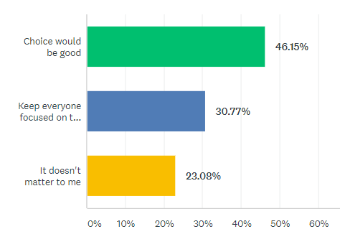










Improving Student Engagement in Online Discussion Forums Steven M. Baule, UW-Superior, Dept. of Education sbaule1@uwsuper.edu
Average Word Count per Post
Introduction
Methodology
According to the Best Colleges.com (2018) survey of online programs, fully online programs have increased by approximately 31% between 2016 and 2017. At the same time, new online students are worried about the potential lack of quality in online programs and the perceived lack of interaction and community among classmates and with the professor.
Beyond the desire to more strongly engage our students, another goal is to ensure that discussion prompts are creating the necessary level of rigor in online courses and that the focus of the discussion is on the topics identified by the course objectives. To that end, the second prong of this research will be to analyze the transcripts of the discussion threads to determine the effectiveness of the thread prompts. This will build off of the earlier work of Fu, van Alst & Chan (2016) and O’Riordan, Millan, and Shultz (2016) to determine the best methods of analyzing course artifacts to analyze the level of engagement of the discussion methods implemented in our asynchronous online courses.
This study conducted an ex-post facto analysis of the student responses to weekly discussion prompts in multiple sections of asynchronous online graduate courses. Some of the discussion prompts provided students choice in what to discuss and others did not provide for student choice. The initial review was a brief analysis of the number of posts per student and the overall word counts of those responses. The fact of whether or not students were asked to participate in a video introduction to their classmates was considered as a potential factor in developing student engagement (RQ1 & RQ3).
In addressing encouragement of higher order thinking skills (RQ2), a qualitive analysis student responses to the weekly discussion prompts was conducted by coding responses to their alignment with Bloom’s Taxonomy.
Student Video Exemplar
Average Points Missed in Discussion Posts
Data Analysis
Complete Survey & Results
Average Points Missed in Discussion Posts
Findings (So Far)
Queried students in the Graduate Education Online (GEO) program:
Would you prefer to have a couple of questions to select from or continue to have everyone in the class respond to the same questions?
Responses in Figure 1
The average word count for postings increased when students were allowed choice. In some cases, around of a quarter of students, selected to respond to all of the options which would definitely have an impact on longer posts.
Introductory student videos in asynchronous online courses improves engagement as measured by discussion participation.
Students appear to feel more connected in courses with introductory videos.
Instructors feel students are more engaged in courses with introductory videos and with choice.
Students appear to be more engaged when allowed choice in discussion threads.
Students appreciate choice in discussion threads.
Average No. of Posts per Student
Word cloud based upon discussion thread with choice in EDAD 711
Figure 1
Yet undetermined:
Does choice raise the level of discussions as measured by Bloom’s Taxonomy?
Student
Voices
Instructor
Voice
Research Questions
References
What do you think?
(Provide Feedback)
RQ1: Does student choice in asynchronous online discussion boards generate more student engagement? (Student engagement)
RQ2: Does providing differentiation for students in choosing how to respond to the weekly prompts generate more higher order responses as measured by Bloom’s taxonomy? (Application and transfer of knowledge)
RQ3: Does the addition of a video-based introduction requirement increase student engagement? (Student engagement)
Allen, E. & Seaman, J. (2017). Distance learning compass: Distance education enrollment report 2017. Babson Survey Research Group. Retrieved from https://onlinelearningsurvey.com/reports/digtiallearningcompassenrollment2017.pdf.
Anderson, L. W., & Krathwohl, D. R. (2001). A taxonomy for learning, teaching, and assessing: A revision of Bloom's taxonomy of educational objectives. New York: Longman
BestColleges.com. (2018). 2018 online education trends report. Houston, TX: Higher U Education. Retrieved from https://res.cloudinary.com/highereducation/image/upload/v1/BestColleges.com/Online-Education-Trends-Report-2018.pdf.
Fu, E. L., F., van Aalst, J., Chan, C. K., & K. (2016). Toward a classification of discourse patterns in asynchronous online discussions. International Journal of Computer-Supported Collaborative Learning, 11(4), 441-478. https://link.springer.com/article/10.1007%2Fs11412-016-9245-3
O'Riordan, T., Millard, D. E., & Schulz, J. (2016). How should we measure online learning activity? Research in Learning Technology, 24 https://journal.alt.ac.uk/index.php/rlt/article/view/1761/pdf_40

