Slide 1
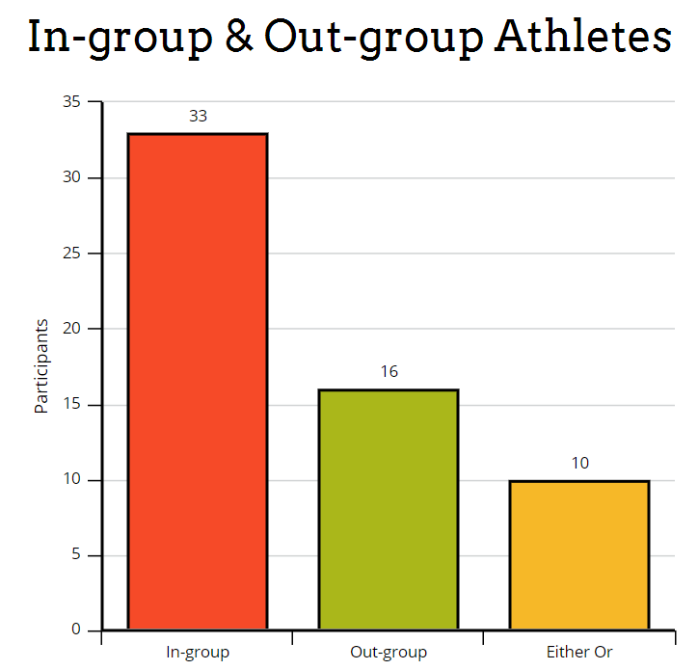
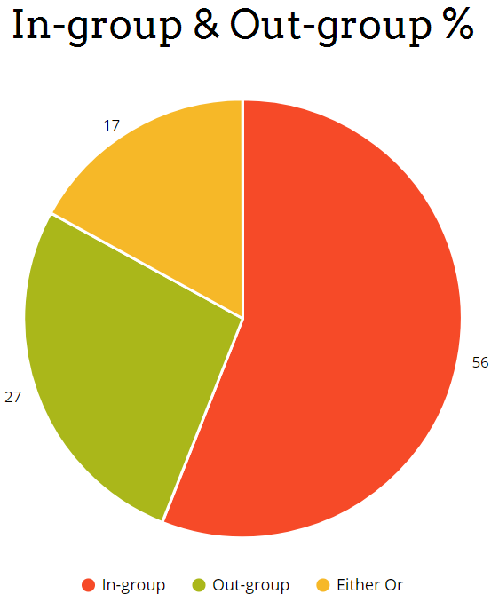

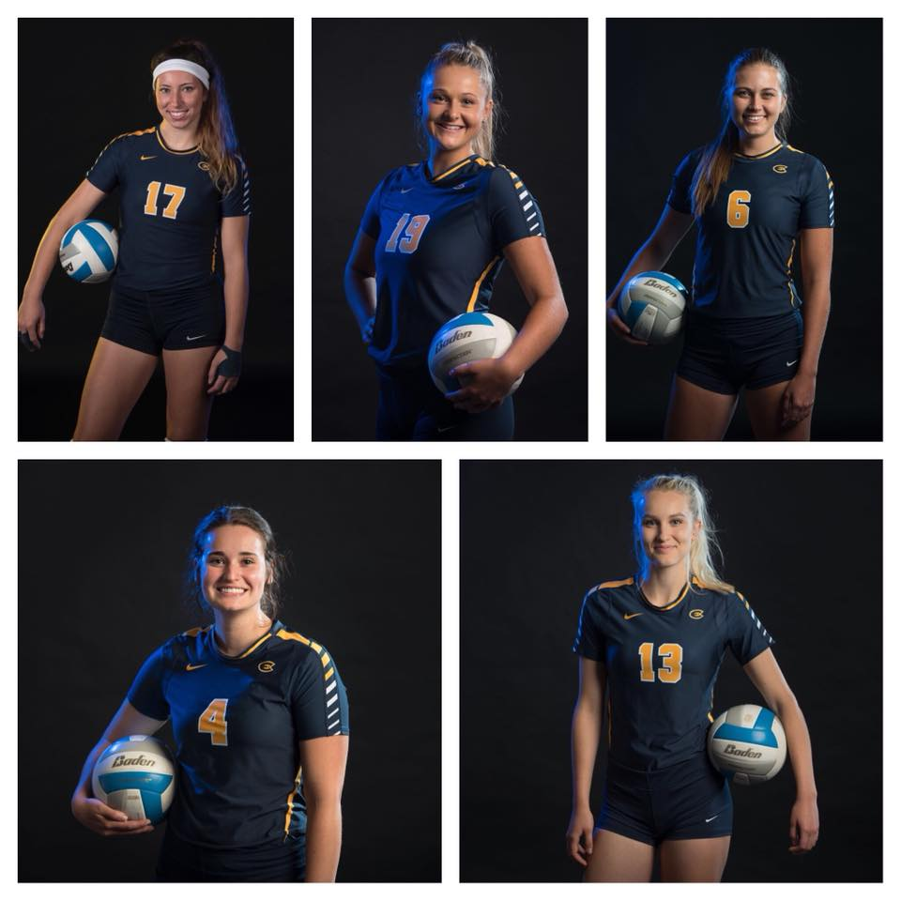
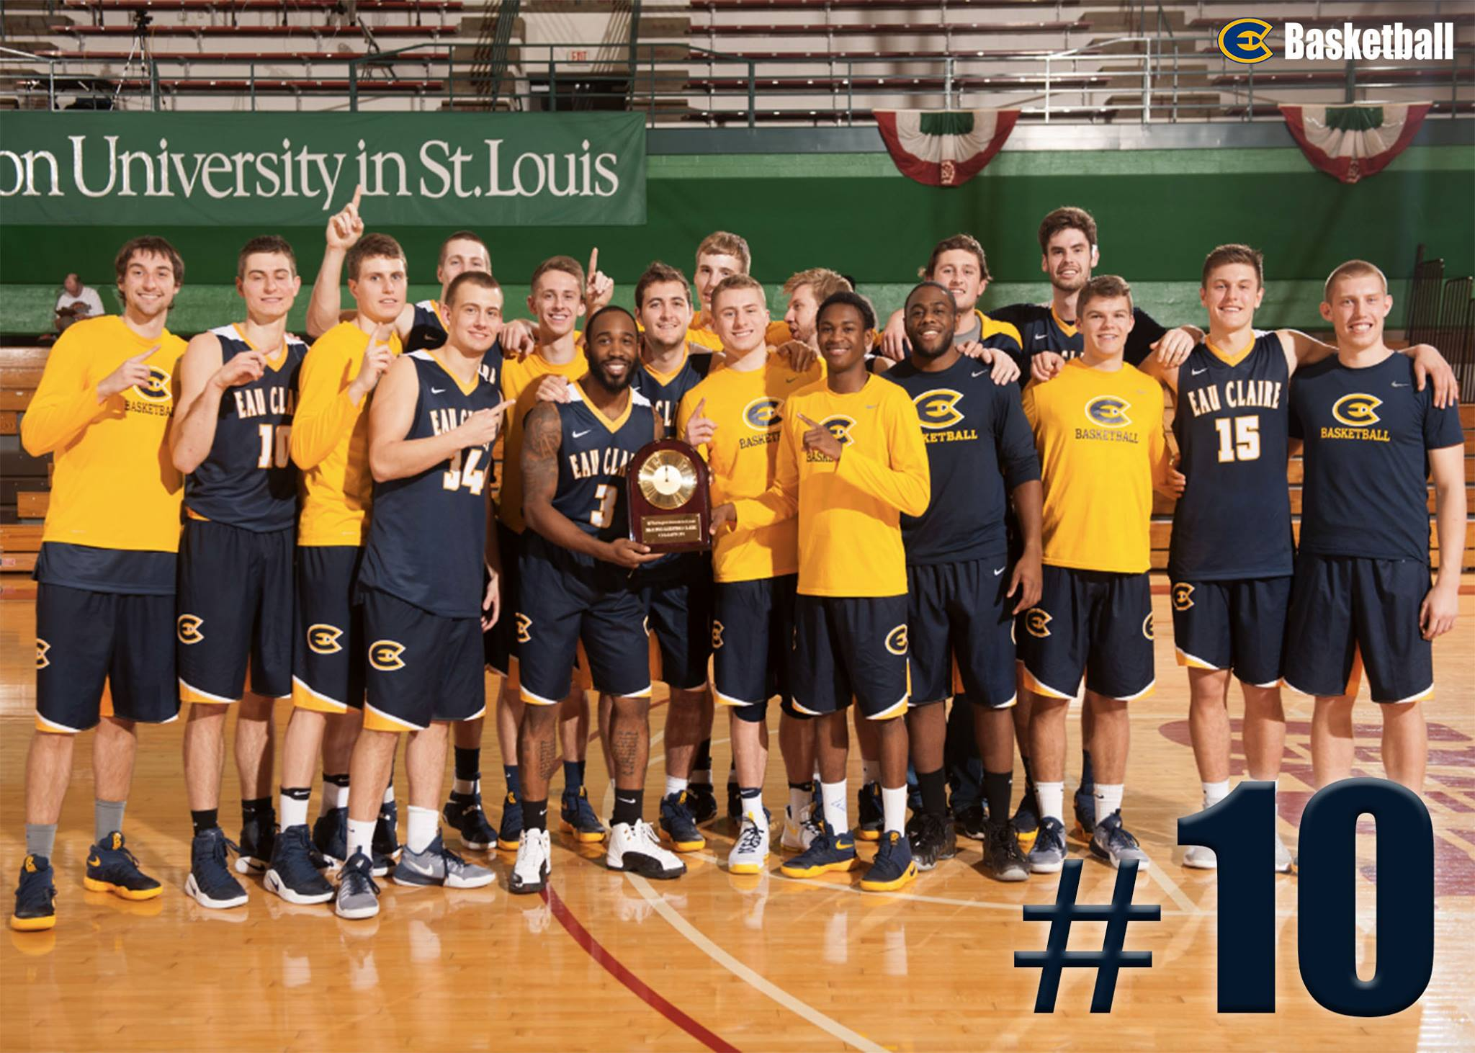
The Role of Group Status on Athlete Satisfaction and Team Cohesion
Assessing the Roles of the In-group & Out-group in Collegiate Sports
Michael Jablonsky, Jayke Meyers, Robert Smith & Nathan Ward | Communication
Research Question: Is an athlete's perception of personal team status associated with team cohesion and athlete satisfaction?
Introduction
Instruments
ABSTRACT
Athlete Satisfaction (Smith, 2011)
Includes:
23 items to measure athlete satisfaction with their teams using a 5-point Likert Scale from 1 (strongly disagree) to 5 (strongly agree)
A sample item is: “I am satisfied with the funding provided to my team.”
The scale was reliable, α=.71 , M=22.22, SD=5.74
Team Cohesion (Treadwell, Kumar, Lavertue, & Veeraraghavan, 2000)
Includes:
9 items to measure perceived Cohesion with their teams using a 5-point Likert Scale from 1 (strongly disagree) to 5 (strongly agree)
A sample item is: “I am satisfied with team members’ dedication to work together towards team goals.” The scale was reliable, α=.88, M=50.06, SD=9.83
Leader Member Exchange (Graen & Uhl-Bien, 1995)
Includes:
9 items to measure Leader Member Exchange with their teams using a 5-point Likert Scale from 1 (strongly disagree) to 5 (strongly agree)
A sample item is: “I have (had) a positive working relationship with my head coach.” The scale was reliable, α=.85, M=21.96, SD=8
Research shows that the quality of the employee-supervisor relationship is associated with the amount of interaction between the employee and the supervisor. In the athletic realm, the quality of athlete-coach relationship has shown to have a direct impact on the natural hierarchy and social dynamic of a sports team. Based on leader-member exchange theory (Graen, 1995), a central tenet of good leader-member relationships rests on the assumption that some members have an “in” with the leader, called an in-group, which inherently creates an out-group. This study examines potential associations between an athlete’s group status (in- or out- group) and levels of team cohesion and athlete satisfaction. Using a modified version of Spector’s (1994) Job Satisfaction Survey and Treadwell, Kumar, Lavertue, and Veeraraghavan’s (2000) Group Cohesion Scale, researchers surveyed athletes in a division 3 collegiate school in the Midwest to evaluate in- and out-group athlete satisfaction and perceived team cohesion. Results were used to help coaches understand the impact of their relationships with athletes on team cohesion and athlete satisfaction.
Bar graph and pie chart data found from the seven sample items from the LMX questions in our survey.
Discussion
Based on previous research, we expected that the In-group would have higher percentages of both athlete satisfaction and team cohesion. However, our findings didn’t support this. We interpret the data to mean the following:
Being a part of the in group does not automatically mean athletes are more satisfied. Factors like winning and funding may outweigh a coach’s personal favor
Findings suggest that LMX Theory has potential for adding insight into the study of leadership behavior in sport settings
Future studies should be conducted at Universities with sports teams that allocate scholarships to their athletes
Methods
A Qualtrics survey was sent out via email to male and female athletes at the university. We contacted the team captains and head coaches for each sport, having found their contact information through the university directory.
PARTICIPANTS
Research Questions and Results
59 Collegiate Athletes
18-24 years old
Non-Scholarship
Expectations:
Members of the out group have a weaker relationship with their head coach, which should result in a lower level of Athlete Satisfaction compared to those who are members of the in group.
RQ1: Is an athlete's perception of personal team status associated with athlete satisfaction?
We found that there was no correlation with being part of the in-group and having higher levels of athlete satisfaction.
RQ2: Is an athlete's perception of personal team status associated with team cohesion?
Results indicated a direct correlation between the in and out-group and team cohesion, r = .47, p<.001
Citations
Athlete Satisfaction (Smith, 2011)
Intrinsic Motivation: Relationships With Collegiate Atheltes’ gender, Leader Member Exchange (G.B.Graen & M.Uhl-Bien, 1995)
Scholarship, Status, and Perceptions of Their Coaches’ Behavior (Amorose, Horn, 2000)
Sport Support: Received Social Support as a Predictor of Athlete Satisfaction (Cranmer, Solitto, 2015)
Sports Teams as Organizations (Cranmer, Myers, Butterworth, Kassing, 2015)
Team Cohesion (Treadwell, Kumar, Lavertue, & Veeraraghavan, 2000)
The dynamics of group cohesion in sport (Carron, Chelladurai, 1981)
The Relationship Between Athletic Satisfaction and Intrateam Communication (Sullivan, Gee, 2007)
When do Bad Apples not spoil the barrel? Negative relationships in teams, team performance, and buffering mechanisms (Jong, Curseu, Leenders, 2014)
2013 National Champions
UWEC Men's Basketball
UWEC Women's Volleyball

