Slide 1


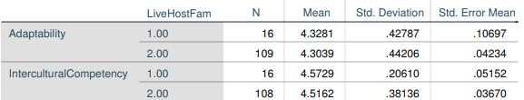
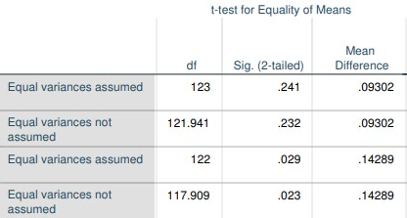
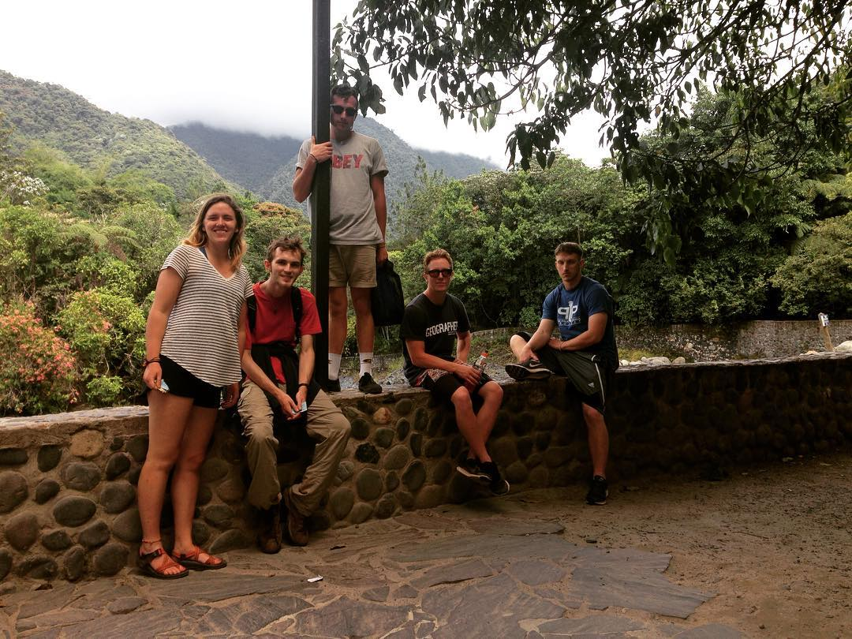
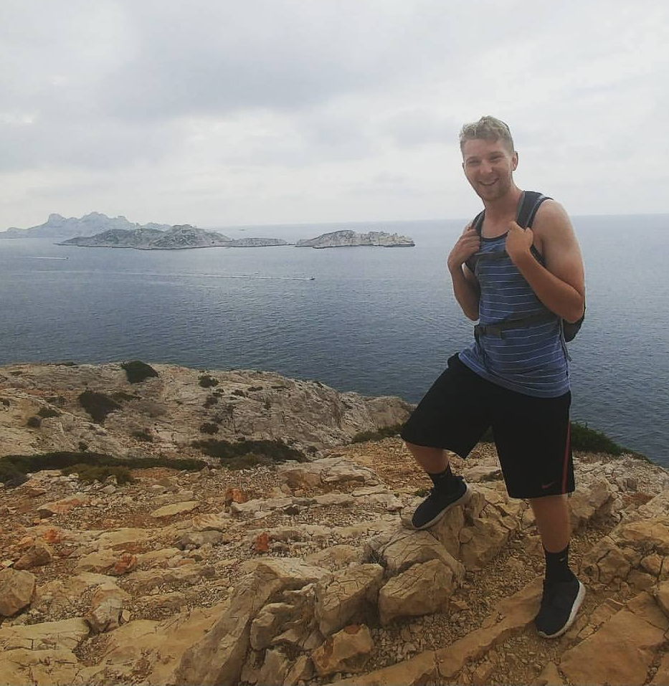
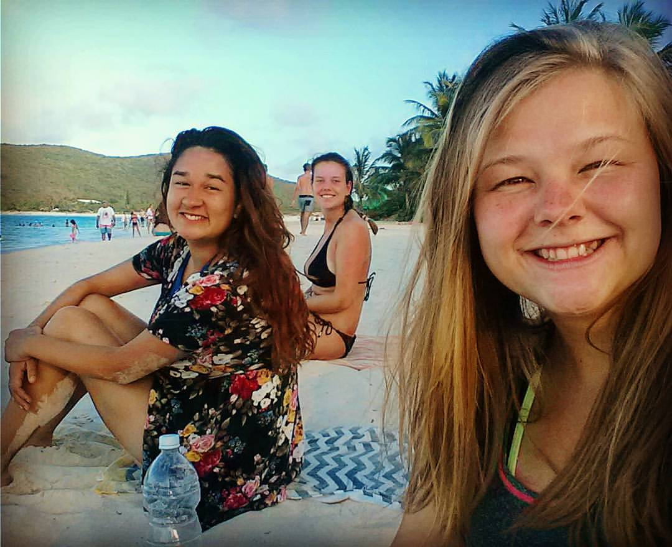
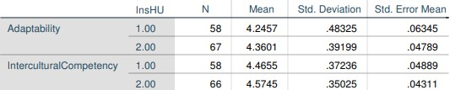
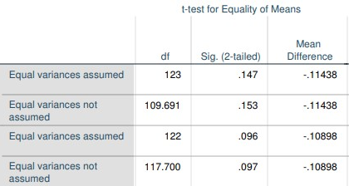
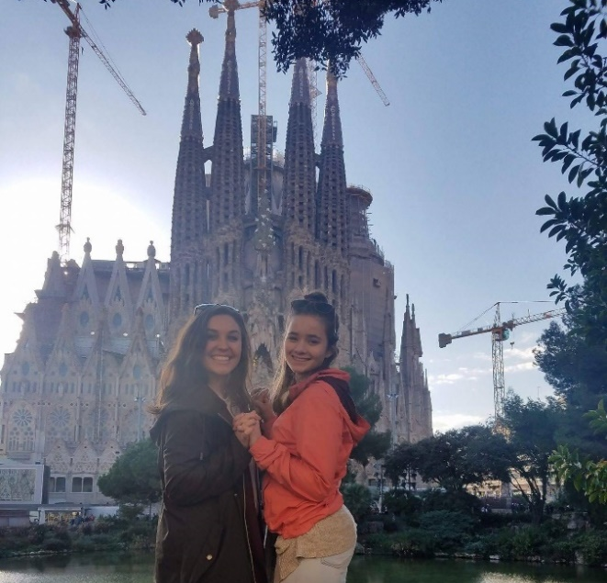
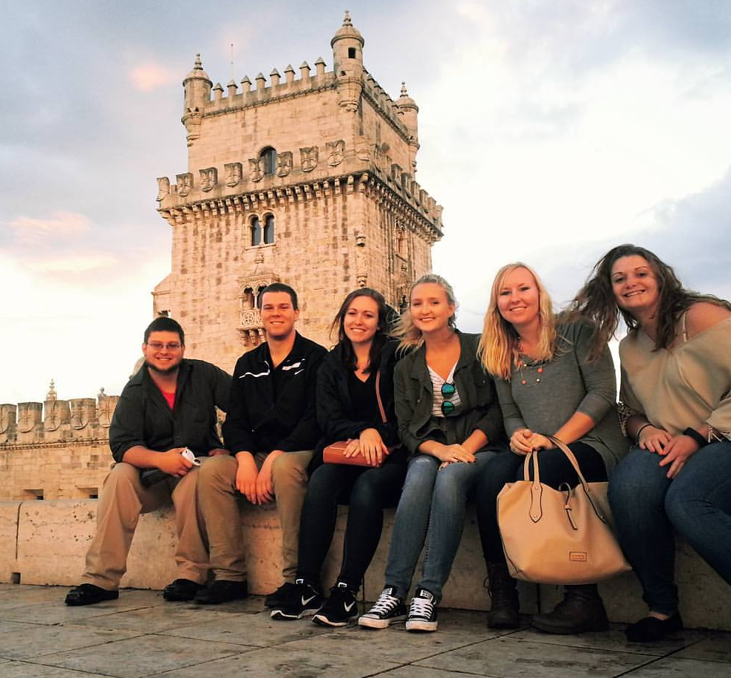


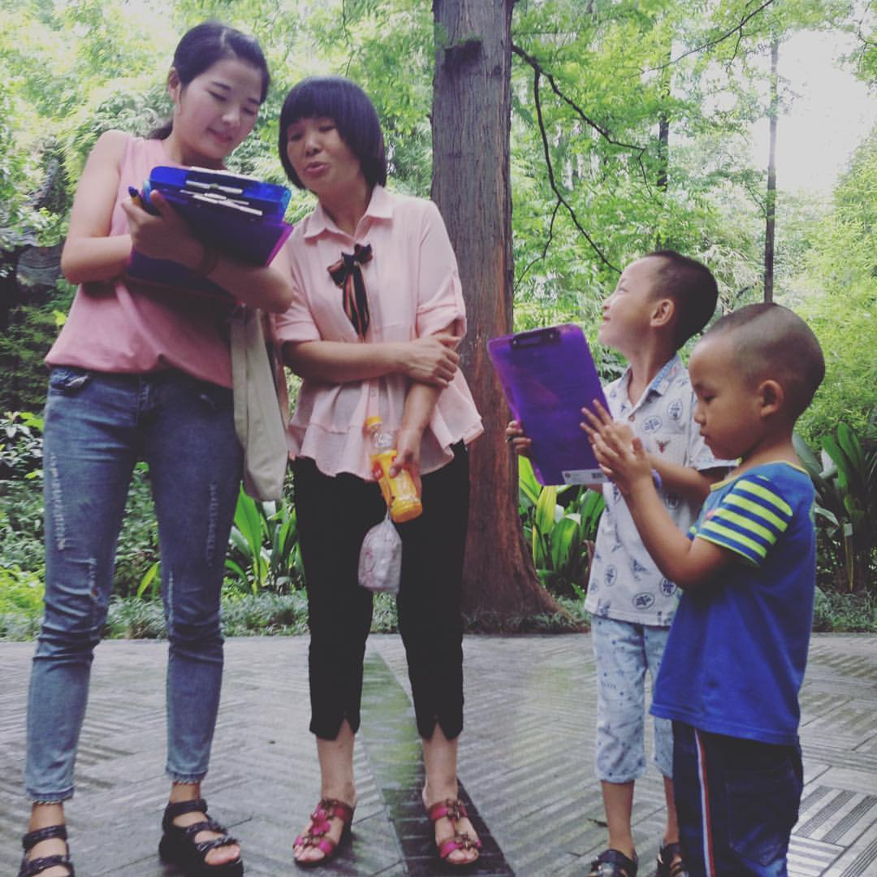
.
Returning to campus after study abroad: differences in intercultural competency and adaptability based on structure of study abroad program
Student researchers: Cora Cornett, Brett Hayden, Katie Forsha, Graham Rowe, and Danielle Wallace
Faculty mentor: Martha Fay, Ph.D.
Department of Communication & Journalism, University of Wisconsin-Eau Claire
Abstract
Social Judgment Theory
Discussion
Institutions of higher education face mounting pressures to stay on the cutting edge of opportunity availability as incoming students realize the demands of the increasingly globalized workforce of which they plan to enter. The availability and quality of a university’s study abroad/international immersion programs is at the forefront of many students’ minds when choosing an institution of higher education.
This study examines the potential associations between the structure of a study abroad/international immersion program and the sojourner outcomes of intercultural competency and adaptability as previous research suggests that the length of program alone does not correlate with these outcomes.
A Qualtrics survey was sent to students who have previously participated in any of the University of Wisconsin-Eau Claire’s study abroad/international immersion programs. Using adaptations of the Cross Cultural Adaptability Inventory Scale (Kelly & Meyers, 1995) and the Intercultural Competency Scale (Scally, 2015), we examine relationships between these outcomes and the structural features of programs in which the survey respondents have indicated they participated.
If associations are found between certain structural features and these outcomes, the University will have additional data for structurally enhancing and creating programs, marketing the benefits of its programs, and highlighting the importance of relevant funding and scholarships.
The Social Judgment theory examines how likely a person is to alter his/her opinions when necessary, his/her level of tolerance for differences in opinions from other people, and how people compare their opinions to those of others and how significantly the individual will accept the differing opinion as valid (Mallard, 2010).
Based on the theory, it is reasonable to think that individuals who have experiences abroad will be more willing to accept the different views of others because of their interactions with people different than themselves while abroad.
Social Judgment Theory suggests that people possess a range of acceptability of others’ views (Mallard, 2010). We believe that people who have spent time abroad would be more accepting of other perspectives because they have been more exposed to them. If this is correct, we would expect these individuals to have higher levels of intercultural competency, as well as adaptability because of their ability to understand other perspectives after exposure.
We found no correlation between the amount of variety within any of the five structural components of UWEC’s study abroad/ international immersion programs and intercultural competency or adaptability.
The study did yield a positive, statistically significant correlation between program participants having a host family and their intercultural competency. Due to the nature of the study, there is no way to tell if they lived with a host family for part or all of the program. Similarly, the correlation we found between intercultural competency and having at least some component of in-country coursework from an instructor from the participant’s host university refers to UWEC faculty or staff. Previous research (Yang, Orrego, Phillips, 2016) indicates that program-specific cultural mentoring is significantly and positively correlated with intercultural communication competence. We believe that a similar phenomenon is happening for UWEC students who have at least one UWEC professor with them while abroad as is the case with the University's Faculty-Led Intercultural Immersion Experiences and International Fellows Programs. Often times professors traveling abroad with students have a wealth of experiences abroad, often pertaining to the program’s specific host country(s) which allows the professor to act as a cultural liaison and mentor for students.
No other correlations were found using this same method between either outcome and any of the individual structural component options. This is most likely because some of the options were selected too infrequently by our survey respondents.
Future research could survey students both before and after completing their program in order to isolate changes in sojourner outcomes based on single program experiences as opposed to our study in which we had participants who had completed multiple programs in some cases.
Results
Introduction
RQ1: Is there an association between intercultural competency and the structure of study abroad program?
RQ2: Is there an association between adaptability and the structure of study abroad program?
Sample of multiple response question pertaining to intra-structural variety in program:
Please indicate the program-specific housing accommodations in the host country(s). Please check all that apply
Host family
Hostel/ hotel
University-sponsored housing (e.g. dormitory)
Other:
The five general structural components included in the survey:
Housing accommodations
Housemates
Classmates
Instructors
Learning environment
The number of options checked by respondent were then summed and ran in a Pearson correlation against both the adaptability and intercultural competency scales. This procedure was followed for each of the five intra-structural variety variables that we included in the survey. We found no correlations between any the degree of intra-structural variety variables with either sojourner outcome. In other words, in the case of the housing accommodations variable, for example, there was no correlation between a diverse program-specific housing accommodation experience and adaptability or intercultural competency.
We then used independent samples t-test to examine individual options against the sojourner outcomes. We did not control for respondents who had selected more than one option, so statistically significant correlations between any one option and an outcome did not inherently exclude the possibility of a respondent selecting any of other options in addition.
Housing Accommodations: The association between living with a host family and intercultural competency was statistically significant (p = .01), whereas there was no association between either outcome and living in university-sponsored housing (e.g. dormitories) or hostels/ hotels.
In-Country Course Leadership: We also found a correlation (p = .096) between having at least some component of course instruction from a home university instructor while in the host country and intercultural competency through an independent samples t-test. We make a case for this to be statistically significant (p = .05) through a one-tailed t-test in the discussion section.
Independent samples t-tests on all other structural variables and their individual options yielded no other relationships with either adaptability or intercultural competency.
Other Findings
We found no correlation between duration of program and either outcome. Previous research that examined similar study abroad outcomes has also concluded that there is no correlation between program duration alone and outcomes.
The number of programs completed and adaptability have a correlation of .30**
The number of programs completed and intercultural competency have a correlation of .18**
Unlike suggestions of previous research, we found no correlation between pre-, during-, or post- program mentoring and either sojourner outcome.
Adaptability is significantly and positively associated with how many experiences you have completed. Therefore, the more study abroad/ international immersion programs a student completes, the higher levels of adaptability they experience once they return to their home country.
Previous research suggests that there is little to no correlation between program length alone and student development of certain outcomes (Penington & Wildermuth, 2005), but rather that perhaps program type and course design are the main determinants of student outcomes after studying abroad. Additionally, previous studies have shown that more structured and hands-on programs are more beneficial for, and preferred by, students (Behnke, 2014). Our study adds to the discussion of the beneficial outcomes of studying outside of one’s home country. We specifically looked into the outcomes of adaptability and intercultural competence.
Adaptability is defined here as a the study abroad participants’ feeling of satisfaction and belonging in a new environment (Kristjansdottir, 2009).
Intercultural competence is defined by sets of skills individuals may possess, such as discovering and interacting with others, and valuing the differences in others’ values, beliefs, and behaviors (Scally, 2015), as well as abilities that are needed to perform effective and appropriate interactions with those who are of a different culture than one’s own (Taguchi, 2015).
References
Behnke, Seo, & Miller. (2014). Enhancing the study abroad experience: A longitudinal analysis of hospitality-oriented, study abroad program evaluations. Tourism Management, 42, 271-281.
Mallard, J. (2010). Engaging students in Social Judgment Theory. Communication Teacher, 24(4), 197-202.
Penington, B., & Wildermuth, S. (2005). Three Weeks There and Back Again: A Qualitative Investigation of the Impact of Short-term Travel/Study on the Development of Intercultural Communication Competency. Journal Of Intercultural Communication Research, 34(3/4), 166-183
Kristjansdottir, E. S. (2009). Invisibility Dreaded and Desired: Phenomenological Inquiry of Sojourners' Cross-Cultural Adaptation. Howard Journal Of Communications, 20(2), 129-146.
Scally, J. (2015). Intercultural Competence Development in Three Different Study Abroad Program Types. Intercultural Communication Studies, 24(2), 35-60.
Taguchi, N. (2015). Cross-cultural adaptability and development of speech act production in study abroad. International Journal Of Applied Linguistics, 25(3), 343-365.
Yang, Q., Orrego Dunleavy, V., & Phillips, J. R. (2016). Are You Satisfied? Exploring the Mediating Effects of Mentoring Communication Strategies in Predicting Chinese International Graduate Students’ Program Satisfaction. Communication Education, 65(2), 182-203.
Methods
Data was generated for this case study from a Qualtrics survey. Directors of the four types of programs (listed below) offered by the University of Wisconsin-Eau Claire (UWEC) emailed the survey to their respective program returnees. UWEC is a midsize Midwestern university of approximately 10,000 undergraduate students and approximately 600 graduate students.
These programs included:
Study Abroad
National Student Exchange (only those outside of the 50 United States)
Faculty-Led Immersion Experiences
International Fellowship Programs
Our survey included an adapted scale of the Cross Cultural Adaptability Inventory Scale of Kelley and Meyers (1995) and the Intercultural Competency Scale of Scally (2015). The structural variables we examined were length of program, living accommodations, coursework composition, classroom composition including classmates and instructors, and cultural mentoring that may have occurred before, during, and/or after the program.
Our survey sample:
N = 125
33 host countries represented
40 programs represented
6/7 continents represented
Adaptability Scale (5-point, 8 items)
The scale was reliable. α = .73, M = 4.31, SD = 3.47
I feel comfortable adjusting to unfamiliar situations to suit different conditions.
Strongly Disagree 1 2 3 4 5 Strongly Agree
Intercultural Competency Scale (5-point, 12 items)
The scale was reliable. α = .82, M = 4.51, SD = 4.26
I feel confident in my abilities to deal with diverse teams and cultures.
Strongly Disagree 1 2 3 4 5 Strongly Agree
Our Team’s Experiences Abroad
Among the five members of our team, we have completed the following study abroad/ international immersion programs offered by the University of Wisconsin-Eau Claire:
Study Abroad in Valladolid, Spain during Fall 2015
Study Abroad in Florence, Italy during Spring 2016
National Student Exchange in San Juan, Puerto Rico during Spring 2016
Faculty-Led Intercultural Immersion Experience in Harlaxton, England during Summer 2016
Study Abroad in Winchester, England during Fall 2016
International Fellows Program in Chengdu, China during Summer 2017
Study Abroad in Lyon, France during Fall 2017
Faculty-Led Intercultural Immersion Experience in Ecuador during Winterim 2018
Acknowledgements
We would like to extend our gratitude to the following people and services who made this project possible: our faculty mentor, Martha Fay, Ph.D. from the Department of Communication & Journalism; Shanti Freitas, Ed.M., the Intercultural Immersion Coordinator in Academic Affairs; Colleen Marchwick, M.A., the Interim Lead in the Center for International Education; and Learning and Technology Services for printing our poster.

