Slide 1
AN ECONOMICAL MODEL DEVELOPMENT FOR A HYBRID SYSTEM OF GRID CONNECTED, SOLAR PV AND ELECTRICAL STORAGE SYSTEM
Mohammad H Balali
Under the Supervision of Professor Hamid Seifoddini
Under the Supervision of Professor Adel Nasiri
University of Wisconsin Milwaukee, USA
December 2015

Slide 2
Overview
Problem Definition
Energy Sources
Literature Review
Non-Renewable/Renewable Energy Sources
Energy Storage
Energy Storage Systems
Methodology
Non-Linear/Linear Programming
Formulation and Discussion
Conclusion and Scope of Feature Research
Problem Formulating
Numerical Example
Result Conclusion

Slide 3
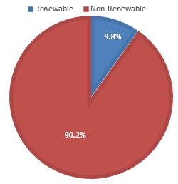
Energy Sources
Energy source management is important in domestic and international scale.
Availability
Energy Sources
Efficiency
Increasing world population leads to requiring increased availability of the energy and more effective ways of utilizing the available portion of the energy sources.
Finding a reliable and safe energy source is one of the most important concern in recent years.
Non-Renewable Energy Sources
Renewable Energy Sources
US energy sources contribution:
Notes:
All the announcements about the energy sources have certainly aware every one about energy sources limitation and restrictions.
In general, there are two types of energy sources, Renewable and Nonrenewable energy sources. Based on a report from DOE, 9.8% of US energy came from renewable energy sources in 2014.

Slide 4
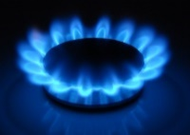
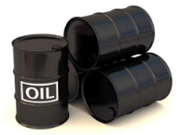


Non-Renewable Energy Resources
Non renewable energy sources cannot be replenished in a short period of time.
There are finite amount of these sources in the earth and one day they will run out.
Nonrenewable energy resources generally are energy from fossil fuels which made of Carbon.
Fossil fuels are a valuable source of energy and extracting process is inexpensive compared with other energy sources. They also can easily be stored and shipped to anywhere in the world.
Burning fossil fuels leads to several problems for environment like air pollution, water pollution and etc.
Natural gas, Petroleum, Coal, Uranium are some examples of nonrenewable energy sources.

Slide 5

Renewable Energy Sources
Renewable energy refers to energy from a source which is continuously replenished by natural processes.
Most of the renewable energy resources are not always available.
For instance, wind energy is variable and intermittent in nature. Therefore, the peak generation of wind farms and peak load demand typically do not occur at the same time. Therefore, using the Energy Storage Systems (ESSs) will increase the reliability and efficiency of the system.
Wind energy
Solar thermal energy
Photovoltaic energy
Biomass
Geothermal
Hydroelectric
Tidal or Wave Action
Fuel Cell

Slide 6
Advantages/Disadvantages of Renewable Resources
Advantages:
• Low or no fuel cost (except for some biomass)
• Shorter lead-times for planning and construction
• Utilize relatively small plant sizes
Significantly reduced environmental effects
Public support for use of renewable resources
Renewable resources are non-depletable resource base
Disadvantages:
• Public concern for land use, birds and animals and etc.
• Relatively high capital cost to construct a renewable facility
• Uneven geographic distribution of renewable resources
• Intermittent availability of some renewable resources

Slide 7
Energy Storage
Energy storage means absorbing energy, Storing for a period of time and then releasing the stored energy to the system.
Energy storage systems (ESSs) can be temporal time bridge or covering a geographical gap between energy supply and demand.
The main goal of storing energy is saving energy for future uses when the demands or the prices are higher or when the sources of energy are not available.
An energy bank deposit must be made at an earlier time for energy to be an available and usable form at the time of high peak demand.
Price of energy in high peak demand periods is higher than low peak demand periods. Therefore, efficient using of energy storage systems can have a great impact on the final price of electricity.

Slide 8
Energy Storage Systems (ESSs)
Reliability and Availability are one of the most important parameters in hybrid networks and electricity storage systems will increase the total reliability and efficiency of the network.
There are two major market needs for ESSs:
To utilize more renewable energy sources and less fossil fuel
Renewable energy output is undependable since it is relied on weather conditions.
The future of Smart Grid
ESSs installed in customer side substations can control power flow.
Energy storage applications are for the producers, for transmission system, for distribution networks , for retailers and for the consumers.

Slide 9
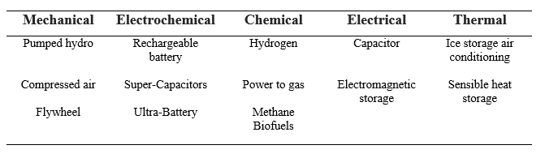
Classification of Electrical Storage Systems
Electrical Storage Systems has been classified to five different categories based on the form of energy used.
In this study, Compressed Air Energy Storage and Rechargeable Battery have been selected as energy storage systems in hybrid system.

Slide 10
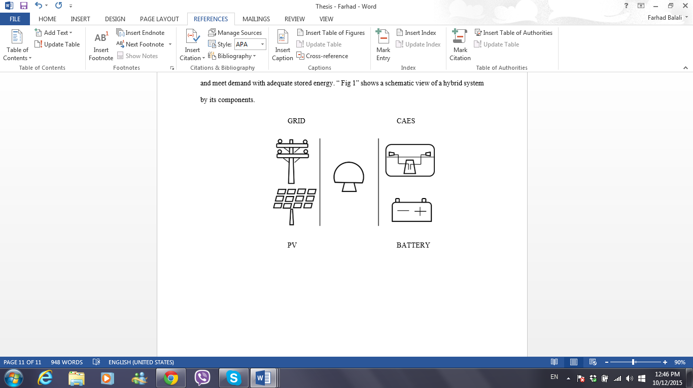
Hybrid Generation System
The model in this study combines Grid and PV panels with Compressed Air Energy Storage (CAES) and Battery storage for peak-shaving.
Using renewable energy sources coupled with storage systems help meet the demand more efficiently.
LOAD

Slide 11

Photovoltaic Panels
PV panels store solar energy by converting sunlight directly into electricity through the use of photovoltaic cells.
Photovoltaic panels can be used in small groups on rooftops or as part of a substantial system for producing large amounts of electrical power.
The amount of energy produced by a photovoltaic system depends upon the amount of sunlight available and the size of the system.
The intensity of sunlight varies by season of a year, time of a day and the degree of cloudiness.
The primary environmental impact of a large system is visual problem.
Final Price of electricity also decreases as the popularity of photovoltaic systems increases.

Slide 12
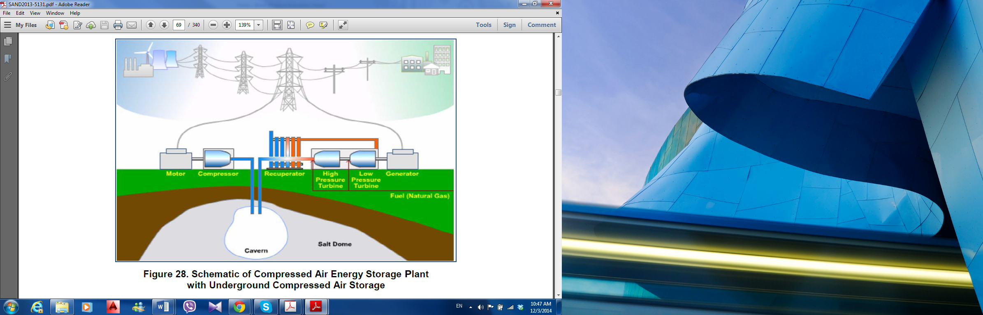
Compressed Air Energy Storage (CAES)
CAES systems use off-peak electricity to compress air and store it in a reservoir, either an underground cavern or aboveground pipes or vessels.
When electricity is needed, the compressed air is heated, expanded, and directed through an expander or conventional turbine-generator to produce electricity.
The compressed air is mixed with natural gas, burned and expanded in a modified gas turbine to increase the efficiency of the system.

Slide 13
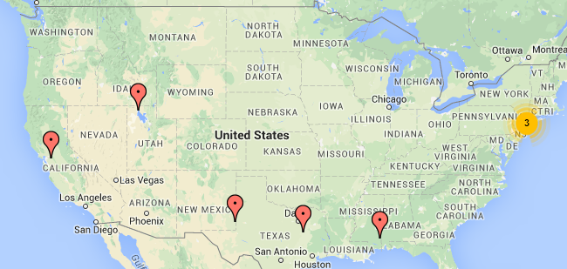
Compressed Air Energy Storage (CAES)
Advantages of CAES:
Large capacity.
Discharge time which is in tens of hours.
Store electricity for longer periods of time.
Final price of electricity
CAES can be coupled with lower capacity storage systems to increase the total efficiency.
The disadvantages are low efficiency and geographic limitation of locations.
Currently, there are 8 operational compressed air stations within the US which produce up to 780 Megawatts.

Slide 14
Rechargeable Battery
Battery is the simplest example of a storage system which comes to mind.
There are different types of rechargeable batteries and most of them are mature.
In this study, three kinds of batteries had been studied:
1) Lead Acid Battery
Lead acid batteries are the oldest form of rechargeable batteries.
Lead acid batteries can be used in both mobile and stationary application.
Typical applications of lead acid batteries are emergency power supply systems, stand-alone systems with PV and battery systems for mitigation of output fluctuations from wind power.
There are 40 operational lead acid battery projects in US which produce energy up to 132 Megawatts.

Slide 15
Rechargeable Battery
2) Lithium Ion Battery
Lithium ion batteries have become the most important storage technology in the areas of portable and mobile applications (e.g. laptop, cell phone, electric bicycle and electric car).
Lithium ion batteries generally have a very high efficiency compared with other batteries, typically in the range of 95 % - 98 %.
Discharge time can be from seconds to weeks which makes them a very flexible.
lithium ion batteries are still expensive and its technology is still developing.
There are 186 operational Lithium-Ion battery projects in US which produce energy up to 314 Megawatts.
3) Zink Bromine Battery
Zink Bromine battery is a kind of flow battery which Zink is solid during charging time and dissolved when discharged.
The approximate efficiency of Zink-Bromine batteries is 65 percent.
There are 18 operational Zink-Bromine battery projects in US which produce energy up to 32 Megawatts

Slide 16
Operation Research (OR)
OR is the discipline of applying advanced analytical methods to help make better decisions.
Operations Research is characterized by its broad applicability and interdisciplinary nature.
OR methods try to find the Optimize value for variables to satisfy the constraints and maximize or minimize an objective function from a set of alternative solutions.
“Formulation of the problem” and “constructing a mathematical model” are the first two phases of solving a problem by OR techniques.
Problem should be formulated in an appropriate model. The following information are needed for problem formulation:
Decision Makers
Objective Function
Variables
Constraints

Slide 17
Linear Programming/Non-Linear Programming
The term Linear Programming (LP) is the combination of the two terms. “Linear” means that all the relations in the problem are linear and “Programming” refers to the process determining particular program.
The linear programming method is a technique of choosing the best alternative from the set of feasible alternatives while objective functions and constraints can be expressed as linear mathematical function.
The main difference between nonlinear programming and linear programming is that nonlinear programming consist of at least one nonlinear function which could be the objective function, one or more constraints.
Most of the systems in real world are inherently nonlinear. The problem is that nonlinear models are much more difficult to optimize.

Slide 18
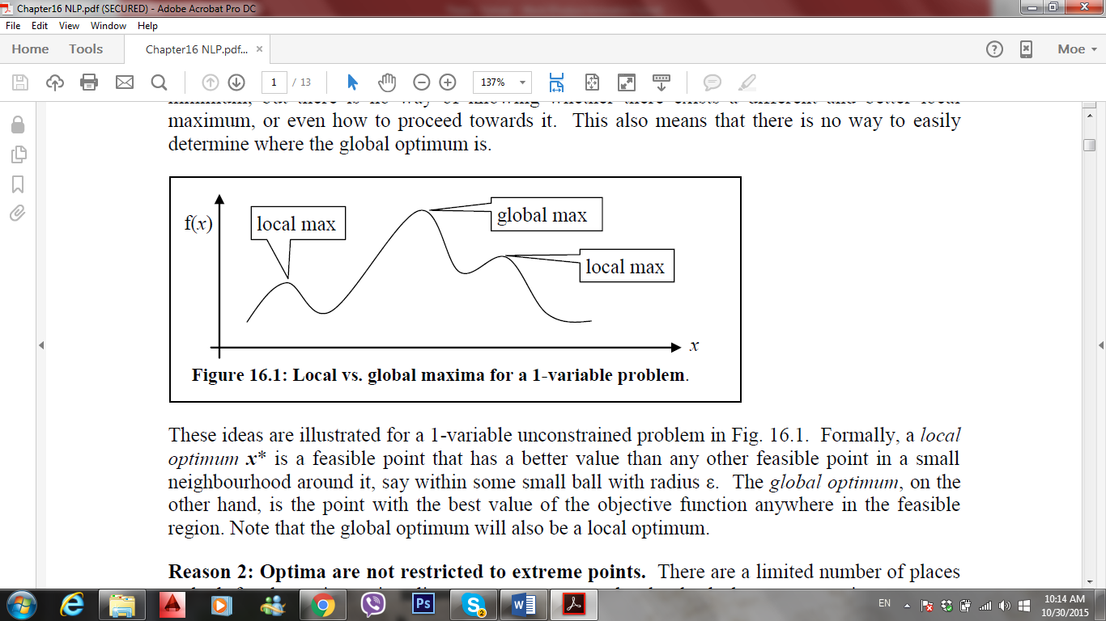
Linear Model / Non-Linear Model
Linear Programming:
It indicates how the available resources can be used in the best way to optimize the objective function.
It improves the quality of decisions.
It also reflects the drawbacks of the production process.
It helps in re-evaluation of a basic plan with changing conditions.
Non-Linear Programming:
There may be multiple disconnected feasible regions
It’s hard to distinguish a local optimum from a global optimum point
It may be difficult to find a feasible starting point
Different starting points may lead to different final solution
Different algorithms and solvers arrive at different solutions
Notes:
It shows the drawbacks and bottleneck of the production processes

Slide 19
Model Variables and Definitions
Variables:
∆ SC_{t}: Difference in stored energy level in CAES from period t to t + 1
∆ SB_{t}: Difference in stored energy level in Battery from period t to t + 1
X_{t}: The amount of energy in MWh generated during hour t from the Grid generation facility
Y_{t}: Part of the amount of energy in MWh generated during hour t from the PV that goes directly to meet the demand
B) Definitions
SC_{t}: The amount of potential stored electricity in CAES at the beginning of hour t
SB_{t}: The amount of potential stored electricity in Batteries at the beginning of hour t
V_{t}: The value of energy during hour t
Notes:
In this study, I focused to formulate the behavior of the hybrid system with its component which we already talk about. As we talk earlier, variables, definitions and parameters should exactly define.

Slide 20
Model parameters
C) Parameters
t_{i} : Hours of the day, t_{i} ∈ {1, 2,…..,24}
AC_{(t)}: Avoided cost of electricity per MWh which is the differences between the cost of energy on peak time and off peak time and it depends on finals price of generated electricity in period t.
AĆ _{(t):} Avoided cost of PV which is the deference between the cost of electricity from Grid and PV
RC_{Out}: Maximum CAES’s generator rate per hour
RC_{In}: Maximum CAES’s Compressor rate per hour
RB: Battery’s rate per hour
BC: Battery capacity at rated depth of discharge
PV_{t}: PV panels generation in period t
G: Grid capacity
C_{F}: Fuel cost
f: CAES conversion factor
e: Battery efficiency
D_{t}: Demand for load during hour t
I: The variable I is an indicator variable equal to one if the subscript condition is satisfied, and zero otherwise.
S: The amount of shortage
S_{max}: Maximum amount of shortage

Slide 21
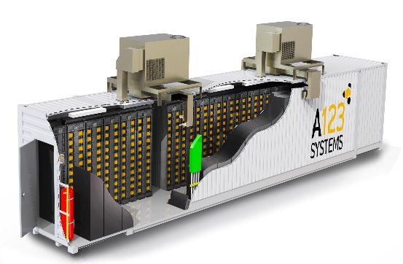
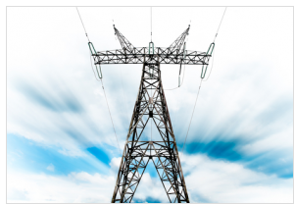

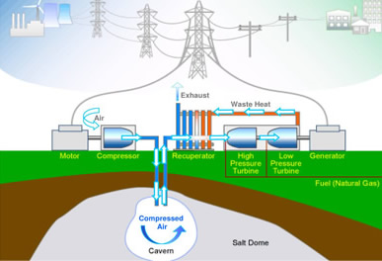
Model parameters
X_{t}
Generation Systems
Storage Systems
RB
G
RB
DEMAND
PV
RC_{In}
RC_{Out}
Y_{t}
Notes:
It’s a schematic view of the hybrid system and I just want to show some parameters on this figure.

Slide 22
Model Assumptions
Hourly time intervals have been used.
The level of stored energy at the beginning of first day have been assumed to be zero.
PV is the only source feeding ESSs.
All hybrid system’s components are already existed and there is no capital investment.
No storage system can be charged while, the other ESSs are discharging.
It has been assumed that one type of battery is being used in this system.
Demand is constant during each time interval.
Grid generation is always constant during a day for all intervals.
It has been assumed that energy loss is zero.

Slide 23
Non-Linear Model
Maximize V_{t} = I_{∆SC(t) ≥0, ∆SB(t) ≥0} [AC_{(t)}*(∆SC_{t} + ∆SB_{t} )] + I_{∆SC(t) ≤0, ∆SB(t) ≤0} { – [∆SB_{t} *(AC_{(t)} ) * e] – [∆SC_{t} ( AC_{(t)} – C_{F} ) * f ]} + (AĆ _{(t)} * Y_{t} )
S.t. (1) SC_{t+1} = SC_{t} + ∆ SC_{t}
(2) SB_{t+1} = SB_{t} + ∆ SB_{t}
(3) ∆ SC_{t} ≥ - min { SC_{t ,} RC_{Out} }
(4) ∆ SB_{t} ≥ - min { SB_{t ,} RB }
(5) ∆ SC_{t} ≤ min {PV_{t} -Y_{t} , RC_{In} }
(6) ∆ SB_{t} ≤ min {PV_{t} -Y_{t} , RB }
(7) Y_{t} + ∆ SC_{t} + ∆ SB_{t} < PV_{t}
(8) X_{t} + Y_{t} + SC_{t} + SB_{t} ≥ D_{t}
(9) Y_{t} ≤ D_{t}
(10) Y_{t} ≤ PV_{t}
(11) X_{t} < Grid
t_{i} ∈ {0,1, 2,…..,23}, I ∈ {0,1}, X_{t} , Y_{t} , ∆ SC_{t} , ∆ SB ≥ 0
Notes:
Here is the non-linear model of the hybrid system. I am going to talk about all the constraints and objective function in detail.

Slide 24
Non-Linear Model
V_{t} = I_{∆SC(t) ≥0, ∆SB(t) ≥0} [AC_{(t)}*(∆SC_{t} + ∆SB_{t} )] + I_{∆SC(t) ≤0, ∆SB(t) ≤0} { – [∆SB_{t} *(AC_{(t)} ) * e] – [∆SC_{t} ( AC_{(t)} – C_{F} ) * f ]} + (AĆ _{(t)} *Y_{t} )
V_{t} calculates the value of energy carried over a day.
It depends on the stored energy taken out or given into each energy storage system and PV generation.
There are two possible states for ∆SC_{t}, ∆SB_{t}. They are either both greater than or equal to zero or less than or equal to zero. It means that there is no situation when ∆SC_{t} ≥0 and ∆SB_{t} ≤0 or vice versa. The reason is when there is not enough generation to meet the demand, PV generation would be used to compensate the shortage and if it wasn’t enough either of the two storage systems will be used so, there is no more PV generation to feed the other one.
AC_{(t)} is added to the system to show the effect of different prices of electricity generation during a day.
AĆ _{(t)} is added to the system to show the different price of generated electricity from Grid and PV.

Slide 25
Non-Linear Model Description
(1) SC_{t+1} = SC_{t} + ∆ SC_{t}
(2) SB_{t+1} = SB_{t} + ∆ SB_{t}
levels of stored energy in storage systems at the beginning of next period is equal to levels of the stored energy at the beginning of current period plus the amount of energy which stored or given from the storage systems in the current period.
When ∆SC_{t} or ∆SB_{t} are negative, it means that energy is taken out from the storage system.
(3) ∆ SC_{t} ≥ - min { SC_{t ,} RC_{Out} }
(4) ∆ SB_{t} ≥ - min { SB_{t ,} RB }
Energy cannot be taken out faster than maximum CAES generator rate or battery rate and more than available amount of stored energy.

Slide 26
Non-Linear Model
(5) ∆ SC_{t} ≤ min {PV_{t} - Y_{t} , RC_{In} }
(6) ∆ SB_{t} ≤ min {PV_{t} - Y_{t} , RB }
Energy cannot be charged into the system faster than maximum compressor’s rate and battery’s rate. Also, the difference in energy level cannot exceed the part of PV generation which goes for feeding storage systems.
(7) Y_{t} + ∆ SC_{t} + ∆ SB_{t} < PV_{t}
Total amount of stored energy by all storage systems plus PV generation that goes directly to meet the demand during hour t cannot exceed the PV generation during that time since, PV generation is the only source for feeding all storage systems.

Slide 27
Non-Linear Model
X_{t} + Y_{t} + SC_{t} + SB_{t} ≥ D_{t}
Y_{t} ≤ D_{t}
Y_{t} ≤ PV_{t}
(11) X_{t} ≤ Grid
Inequality (8) can guarantee that shortage will not occur in this system.
Shortage can be added to this model but, maximum amount of shortage and the penalty for the shortage should be considered.
(8’) X_{t} + Y_{t} + SC_{t} + SB_{t} – S ≥ D_{t}
(12) S ≤ S_{max}
(9) and (10) shows that the part PV generation that goes for meeting the demand cannot exceed the demand and PV generation.
(10) is the capacity limitations of the grid generation.

Slide 28
Transforming Non-linear Model to Linear Model
Maximize V_{t} = I * [AC_{(t)}*(∆SC_{t} + ∆SB_{t} )] + (1-I) {– [∆SB_{t} (AC_{(t)} ) * e] – [∆SC_{t} ( AC_{(t)} – C_{F} ) * f ]} + (AĆ _{(t)} * Y_{t} )
S.t. (1) SC_{t+1} = SC_{t} + ∆ SC_{t}
(2) SB_{t+1} = SB_{t} + ∆ SB_{t}
(3) (-) ∆ SC_{t} ≤ SC_{t}
(4) (-) ∆ SC_{t} ≤ RC_{Out}
(5) (-) ∆ SB_{t} ≤ SB_{t}
(6) (-) ∆ SB_{t} ≤ RB
(7) ∆ SC_{t} ≤ PV_{t} - Y_{t}
(8) ∆ SC_{t} ≤ RC_{In}
(9) ∆ SB_{t} ≤ PV_{t} -Y_{t}
(10) ∆ SB_{t} ≤ RB
(11) Y_{t} + ∆ SC_{t} + ∆ SB_{t} < PV_{t}
(12) ∆SC_{t} > (1-I)*(-M)
(13) ∆SB_{t}> (1-I)*(-M)
(14) ∆SC_{t} < IM
(15) ∆SB_{t} < IM
X_{t} + Y_{t} + SC_{t} + SB_{t} ≥ D_{t}
Y_{t} ≤ D_{t}
Y_{t} ≤ PV_{t}
(19) X_{t} ≤ Grid
t_{i} ∈ {0, 1,…..,23}, I ∈ {0,1}, {X_{t} , Y_{t} , ∆ SC_{t} , ∆ SB } ≥ 0

Slide 29
Transforming Non-linear Model to Linear Model
The objective function was not a linear function and it has to transform to linear function.
V_{t} = I_{∆SC(t) ≥0, ∆SB(t) ≥0} [AC_{(t)}*(∆SC_{t} + ∆SB_{t} )] + I_{∆SC(t) ≤0, ∆SB(t) ≤0} { – [∆SB_{t} *(AC_{(t)} ) * e] – [∆SC_{t} ( AC_{(t)} – C_{F} ) * f ]} + (AĆ _{(t)} * Y_{t} )
V_{t} = I * [AC_{(t)}*(∆SC_{t} + ∆SB_{t} )] + (1-I) {– [∆SB_{t} (AC_{(t)} ) * e] – [∆SC_{t} ( AC_{(t)} – C_{F} ) * f ]} + (AĆ _{(t)} * Y_{t} )
∆SC_{t} > (1-I)*(-M)
∆SB_{t}> (1-I)*(-M)
∆SC_{t} < IM
∆SB_{t} < IM

Slide 30
Transforming Non-linear Model to Linear Model
Each of the inequalities of (3), (4), (5) and (6) have been transformed to two separate inequalities to eliminate Minimum function.
(-) ∆ SC_{t} ≤ SC_{t}
∆ SC_{t} ≥ - min { SC_{t ,} RC_{Out} } (-) ∆ SC_{t} ≤ RC_{Out}
(-) ∆ SB_{t} ≤ SB_{t}
(4) ∆ SB_{t} ≥ - min { SB_{t ,} RB } (-) ∆ SB_{t} ≤ RB
∆ SC_{t} ≤ PV_{t} - Y_{t}
(5) ∆ SC_{t} ≤ min {PV_{t} - Y_{t} , RC_{In} } ∆ SC_{t} ≤ RC_{In}
∆ SB_{t} ≤ PV_{t} - Y_{t}
(6) ∆ SB_{t} ≤ min {PV_{t} - Y_{t} , RB } ∆ SB_{t} ≤ RB

Slide 31
Numerical Example
RC_{In} : 600 MW per hour
RC_{Out} : 500 MW per hour
f = 1/0.75=1.33, 0.75 KWh of power used to store energy yields 1.0 kWh of energy while combined with 4300 BTU of natural gas.
AĆ _{(t)} is equal to $0.05.
As an example, Lead-Acid battery has been selected:
BC is 10,000 KW
e is 90 %
20 Battery exist in the system
C_{F} is $0.020 per MWh
PV capacity is 10000 MW
Grid capacity is 20000 MW

Slide 32
Numerical Example Inputs Data
t_{i} | D_{i} | PV_{i} | AC_{t} | t_{i} | D_{i} | PV_{i} | AC_{t}
0:00 | 850 | 0 | 0.013 | 12:00 | 4000 | 5500 | 0.007
1:00 | 750 | 0 | 0.013 | 13:00 | 3300 | 5200 | 0.008
2:00 | 750 | 0 | 0.013 | 14:00 | 3100 | 4800 | 0.009
3:00 | 750 | 0 | 0.013 | 15:00 | 3200 | 4200 | 0.008
4:00 | 2500 | 0 | 0.012 | 16:00 | 5100 | 2600 | 0.001
5:00 | 3900 | 0 | 0.01 | 17:00 | 8200 | 1000 | 0
6:00 | 4300 | 100 | 0.007 | 18:00 | 7800 | 500 | 0.002
7:00 | 3900 | 200 | 0.003 | 19:00 | 5300 | 0 | 0.004
8:00 | 3300 | 1500 | 0.004 | 20:00 | 3700 | 0 | 0.006
9:00 | 3500 | 3500 | 0.005 | 21:00 | 2300 | 0 | 0.009
10:00 | 3900 | 5000 | 0.006 | 22:00 | 1600 | 0 | 0.01
11:00 | 4200 | 5500 | 0.007 | 23:00 | 4000 | 0 | 0.007
Notes:
Here is the input data of the this example.

Slide 33
Numerical Results
t_{i} | X_{t} | Y_{t} | SC_{t} | ∆ SC_{t} | SB_{t} | ∆SB_{t} | V_{t}
0:00 | 850 | 0 | 0 | 0 | 0 | 0 | 0
1:00 | 750 | 0 | 0 | 0 | 0 | 0 | 0
2:00 | 750 | 0 | 0 | 0 | 0 | 0 | 0
3:00 | 750 | 0 | 0 | 0 | 0 | 0 | 0
4:00 | 2500 | 0 | 0 | 0 | 0 | 0 | 0
5:00 | 3900 | 0 | 0 | 0 | 0 | 0 | 0
6:00 | 4200 | 100 | 0 | 0 | 0 | 0 | 5
7:00 | 3700 | 200 | 0 | 0 | 0 | 0 | 10
8:00 | 1800 | 1500 | 0 | 0 | 0 | 0 | 75
9:00 | 0 | 3500 | 0 | 0 | 0 | 0 | 175
10:00 | 0 | 3900 | 0 | 600 | 0 | 200 | 199.8
11:00 | 0 | 4200 | 600 | 600 | 200 | 200 | 215.6
12:00 | 0 | 5400 | 1200 | 0 | 400 | 100 | 270.8
13:00 | 0 | 4000 | 1200 | 600 | 500 | 200 | 205.6
14:00 | 0 | 3300 | 1800 | 600 | 700 | 200 | 171.4
15:00 | 0 | 3100 | 2400 | 600 | 900 | 200 | 162.2
16:00 | 0 | 2600 | 3000 | -500 | 1100 | -100 | 125.2
17:00 | 3400 | 1000 | 2500 | -500 | 1000 | -200 | 50
18:00 | 7000 | 500 | 2000 | -500 | 800 | -200 | 25
19:00 | 7100 | 0 | 1500 | -500 | 600 | -200 | 0
20:00 | 4600 | 0 | 1000 | -500 | 400 | -200 | 0
21:00 | 3000 | 0 | 500 | -500 | 200 | -200 | 0
22:00 | 0 | 0 | 0 | 0 | 0 | 0 | 0
23:00 | 0 | 0 | 0 | 0 | 0 | 0 | 0
V is equal to $1690.6 for a day

Slide 34
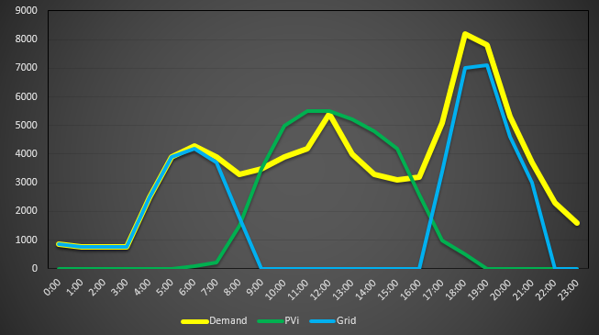
Graphical Results
MW
MW

Slide 35
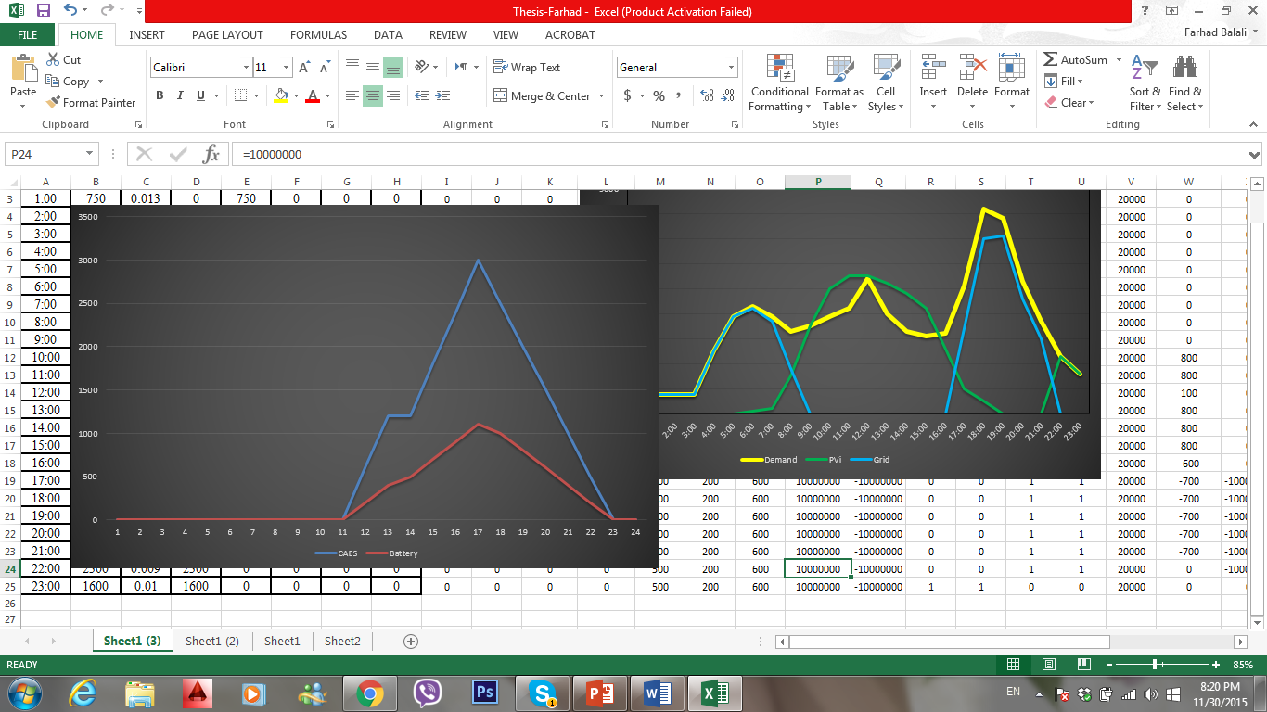
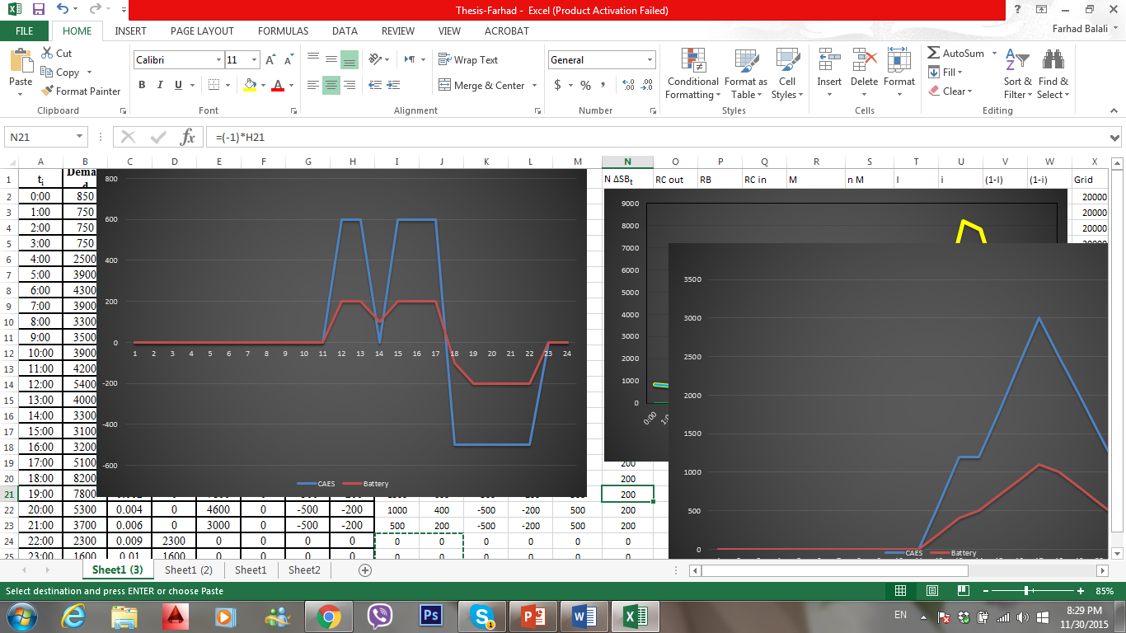
Graphical Results
MW

Slide 36
Sensitivity Analysis
By using this model, sensitivity analysis can be done for parameters and can answer to what-if questions.
1) AĆ = $0.05 AĆ = $0.06 Increased %20
V = $1690.6 V = $2023.6 Increased %19.5
2) Y_{(t)} 1.05 AC_{(t)} Increased %5
V = $1690.6 V = $1773.8 Increased %4.9

Slide 37
Conclusion
Efficient use of available portion of energy sources is one of the most important issue in recent years.
Renewable energy resources have been emerged to help traditional resources.
Renewable energy sources are not always available and it decreases the reliability of the system.
Adding energy storage systems can help the hybrid system to increase the reliability of the system.
Energy storage systems can charge whenever that the energy source is available or price of electricity is less than high peak demand. ESSs can be used as a backup for energy source.
Several types of energy storage systems had been studied in detail.
The topic is mainly focus on a hybrid system consist of grid generation, renewable energy sources and energy storage systems.

Slide 38
Conclusion
The main purpose of this research was formulating a hybrid system with respect to most important constraints.
The presented model was firstly nonlinear since, there were non-linear relation between some parameters. Using big M method could transferred the model to a linear one.
The linear model can be solved by Simplex method, Operation Research software like Math-lab or Simulation software like Simulink.
All the parameters should be defined to get an accurate result.
Based on the demand, this model can find best set of solution for variables to maximize the value of energy carried over and determine a schedule for charging and discharging the storage systems for each day.
The presented model is a theoretical model and in real world, some assumptions may be different.

Slide 39
Further Studies
For further studies, PV panels can be studied more accurately with respect to irradiance and reliability.
Different types of batteries or a mix of other energy storage systems can be added to the hybrid system.
To have more reliable system, wind turbines can be added to the system to smooth out the generation since, PV and Wind sources are complimentary during one day.

Slide 40

Acknowledgment and Question
Professor Hamid Seifoddini
Professor Adel Nasiri
Professor Wilkistar Otieno
Narjes Nouri
Thanks for your time and attention
Mohammad H Balali

Slide 41
Extras
C_{F} = $0.020 C_{F} = $0.040 Increase %100
V_{t}= $1690.6 V_{t} = $1684.4 Decrease %0.99
AC_{(t)} 1.1 AC_{(t)} Increase %20
V = $1690.6 V = $1697.8 Decrease %0.42

