Slide 1
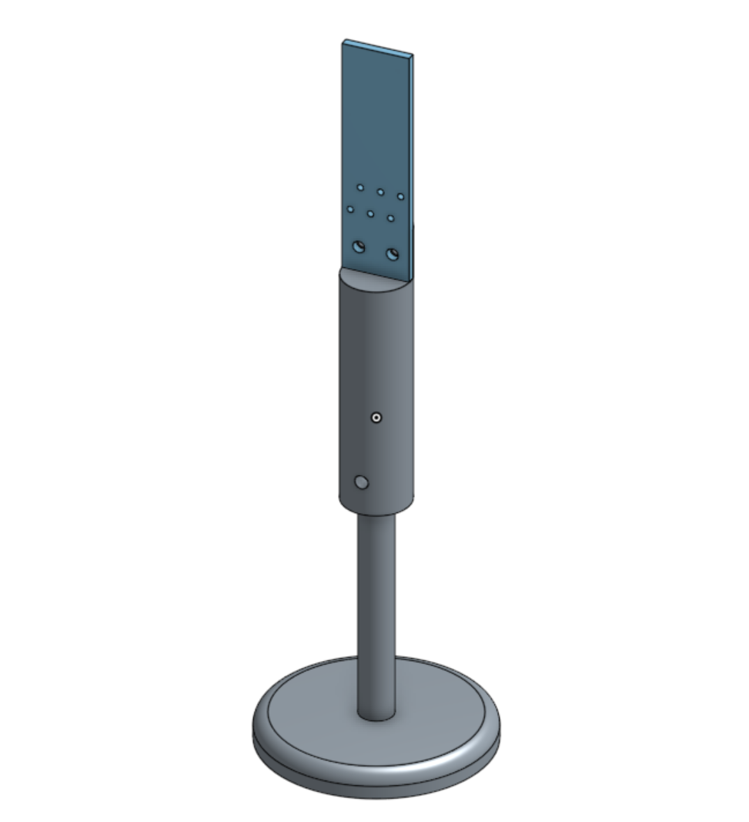
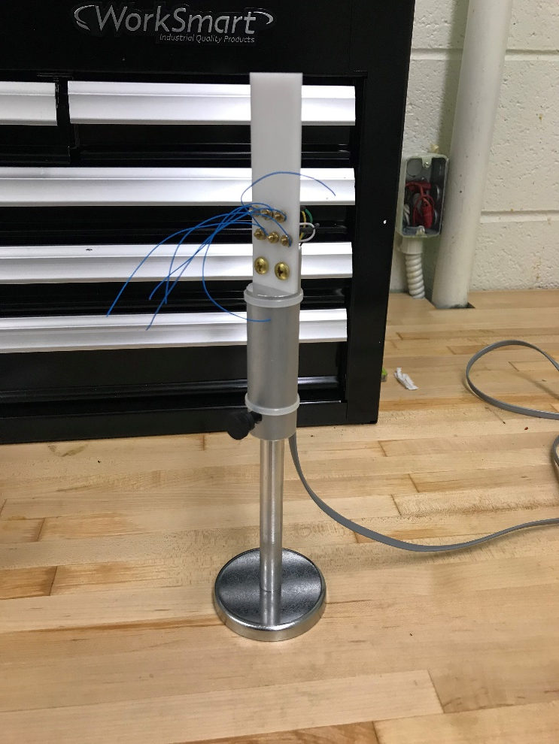
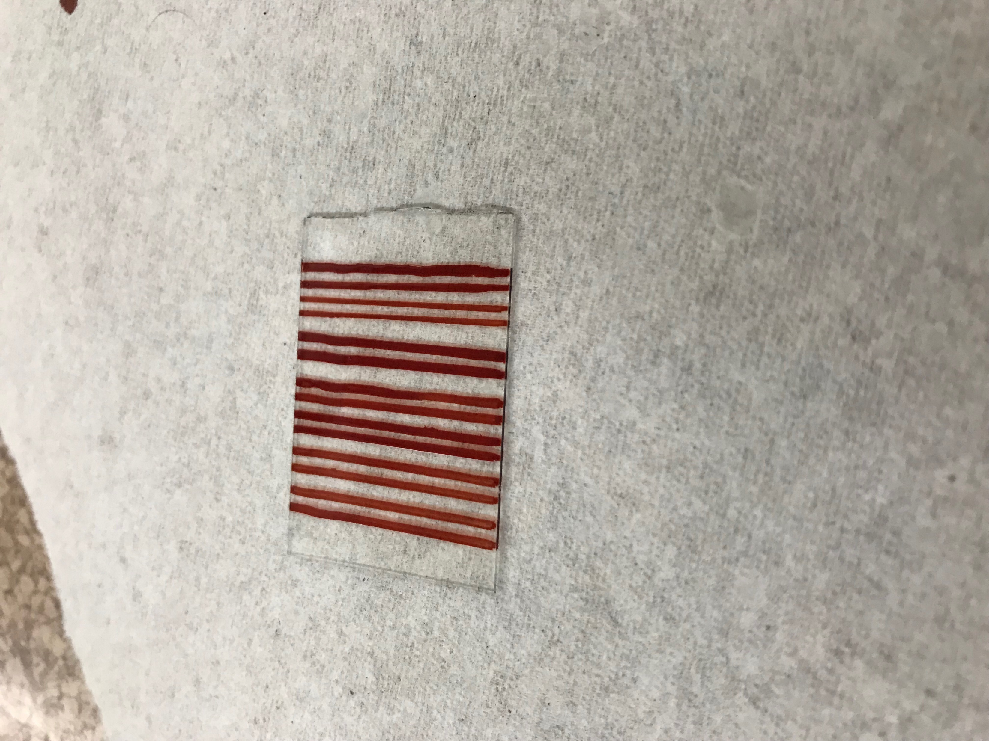
Organic Electronic Fabrication and Investigation of Organic Magnetoresistance
Aaron Kaufman, Connor Feltman, Faculty Mentor : Dr. James Rybicki | Physics and Astronomy
abstract
Data Acquisition and
Design complications
The field of organic electronics has advanced in recent years to create new devices for both display and memory-storage technology. Our research investigates organic magnetoresistance (OMAR) in organic semiconductors, specifically organic light emitting diodes (OLED). In the past we have carried out fabrication and measurement at the University of Iowa. To study OLEDs here at UW-Eau Claire requires the design and manufacturing of new equipment and for us to develop creative fabrication methods which take advantage of the facilities we have on campus. A specimen holder was designed using computer aided drafting and modeling and then fabricated using an automated mill and metal lathe. The OLEDs were designed using evaporative deposition techniques for the organic layer (Alq3), the Calcium cathode, and finally an Aluminum coating on an etched indium-tin-oxide coated glass slide. The geometry of the specimens is as such that numerous devises can be placed on a single slide. Lastly, to control our experiment and for data acquisition, a LabView program was utilized.
To acquire the minute resistance fluctuations in low magnetic fields, an ammeter, interfaced by a LabView program, will be used. The magnetic field strength is to be measured by a Hall Effect sensor. The magnetic field strength will be controlled by a precision voltage source generator, which will step through a specified voltage range, automated by the LabView program mentioned above.
The voltage source instrument does not currently allow for a scan from positive to negative voltages. This complicated our data due to the interesting magnetoresistance effects happens in magnetic fields with strengths near zero. To resolve this complication, with the current instruments, a cleaver circuit design will need to be designed to seamlessly sweep the magnetic field strength through zero.
Fabrication
OMAR Effect Graph from the University of Iowa Data
BASIC POSTER DESIGN GUIDELINES
Draw anti-etchant lines on ITO slides
Etch exposed ITO (Collector)
Cut the slides to appropriate device size
Clean with in a sonic cleaner
Soap and water
Water
Acetone
Isopropanol
Deposit Alq3 using a thermal evaporator
Deposit Calcium (Injector)
Deposit Aluminum (Protects the Ca layer)
Second Phase
The second semester of this research project will consist of following goals.
Continue manufacturing OLED devices on the UWEC campus
Refine the manufacturing processes to maximize production efficiency
Conduct magnetoresistance experiments on the UWEC campus
Investigate OMAR effects in our OLEDs
Device Holder Model
Device Holder and Stand
Introduction
The first phase of research consisted of experimental design, fixture manufacturing, and device fabrication. Experiments were previously conducted at the University of Iowa. The hope of the first phase of research was to move both the manufacturing and testing of organic light emitting diodes to the University of Wisconsin-Eau Claire.
Indium Tin Oxide
Acknowledgments and references
Alq₃ (30 nm)
Thank you to the University of Wisconsin-Eau Claire Physics and Astronomy department for the research grant.
Student and Faculty Collaboration:
Connor Feltman, Student
Dr. James Rybicki, Faculty Advisor
Turner Howard, Lab Specialist
Ca (60 nm)
Experimental design
Al (60 nm)
Specimen Mount
The design of the specimen mount needed to be as such, to hold the OLED devices within the uniform magnetic field created by a field generator. It consisted; of 3 parts, a non-conductive specimen plate for the devices to be mounted, a mount holder which allowed the operator the flexibility to adjust the position and orientation of the devices, and magnetic base and stem. The designs for these components were created in Solidworks and then manufactured using a manual and automated mill and a metal lathe.
Glass Slide
OLED Device Cross-section
ITO Line Etching

