Slide 1

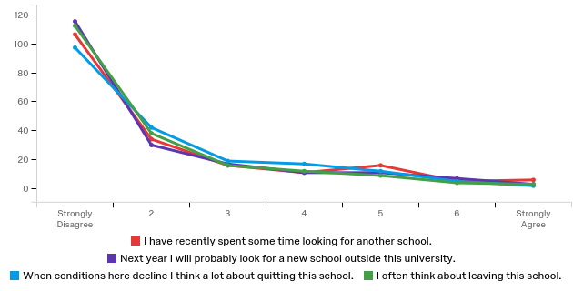
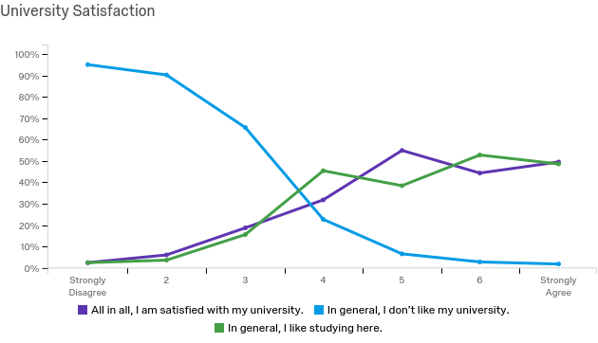
The Power of And: Which “Ands” Matter Most
Adriana Oakland & Rebecca Wyland, Ph.D.
Department of Management & Marketing
Abstract
Results
Results
The primary purpose of this study is to examine whether involvement in and congruency between life domain activities increases university commitment, university loyalty, and university satisfaction. Previous studies have examined multiple-role facilitation, but few studies have focused on school-life relationships. A Qualtrics research survey was conducted and analyzed using correlation analysis. Results suggest that congruency between school and outside activities positively correlates to university satisfaction, university loyalty, and university identity. Furthermore, results suggest that students who experience congruency between school and outside activities are less likely to exit the university.
Correlations
 | School-Activity Congruency | University Related Stress | University Satisfaction | University Loyalty | University Commitment | Organizational Identity | Intent to Exit
School-Activity Congruency | 1 | -0.154* | 0.339** | 0.334** | 0.384** | 0.243** | -0.183*
University Related Stress | -0.154* | 1 | -0.301** | -0.269** | -0.206** | -0.267** | 0.137
P ≤ 0.05* P ≤ 0.01**
Students who work 1-10 hours per week for paid employment reported that they are less likely to want to exit the university on average than those who work 11-31 hours.
Students who engage in 16-30 hours of service per semester report more loyalty and report being less likely to leave the university on average than those who do not participate in service learning.
Students in leadership positions reported more loyalty and reported being less likely to exit the university on average than those not in leadership positions.
Only 8.25% of students involved in activities reported that they have not made strong interpersonal connections within those activities.
Our results suggest the university might want to increase school-activity congruency because it is correlated to higher levels of satisfaction, loyalty, commitment, organizational identity, and lower intentions of exiting the university.
Intent to Exit the University
Number of Responses
University Satisfaction
Background
  People commonly manage multiple life domains at once (Wyland, Lester, Ehrhardt, & Standifer, 2016).
  The quality of life domains may be improved from involvement in additional life domains (Marks, 1977; Sieber, 1974).
  Multiple-role facilitation was originally developed and applied to work-family research, but now scholars have begun to study it within the context of the school domain (Butler, 2007).
References & Acknowledgments
Butler, A. B. (2007). Job characteristics and college performance and attitudes: A model of work-school conflict and facilitation. Journal of Applied Psychology, 92, 500-510. doi:10.1037/0021-9010.92.2.500.
Marks, S. R., (1977). Multiple roles and role strain: Some notes on human energy, time and commitment. American Sociological Review, 42, 921-936.
Sieber, S. D. (1974). Toward a theory of role accumulation. American Sociological Review, 39, 567-578.
Wyland, R., Lester, S. W., Ehrhardt, K., & Standifer, R. (2016). An examination of the relationship between the work-school interface, job satisfaction, and job performance. Journal of Business and Psychology, 31 (2), 187-203.
Special thanks to participants, UW-Eau Claire Office of Research and Sponsored Programs, and Learning & Technology Services.
Methods
Most Common Student Activities
  195 participants from various majors at UW-Eau Claire completed a Qualtrics survey.
  All items were measured from established scales (valid and reliable) in existing literature.

