Slide 1



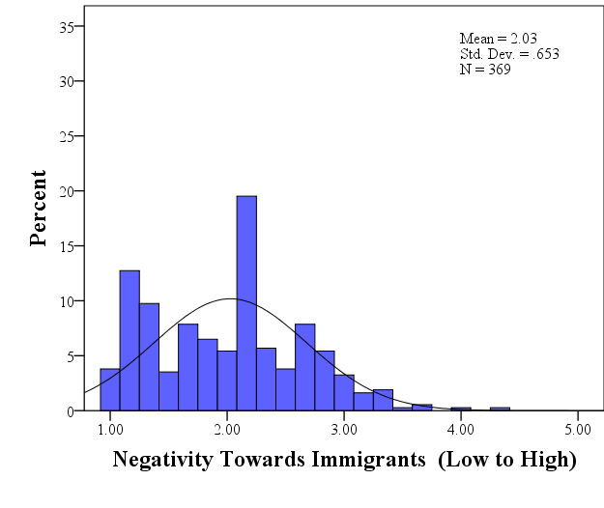
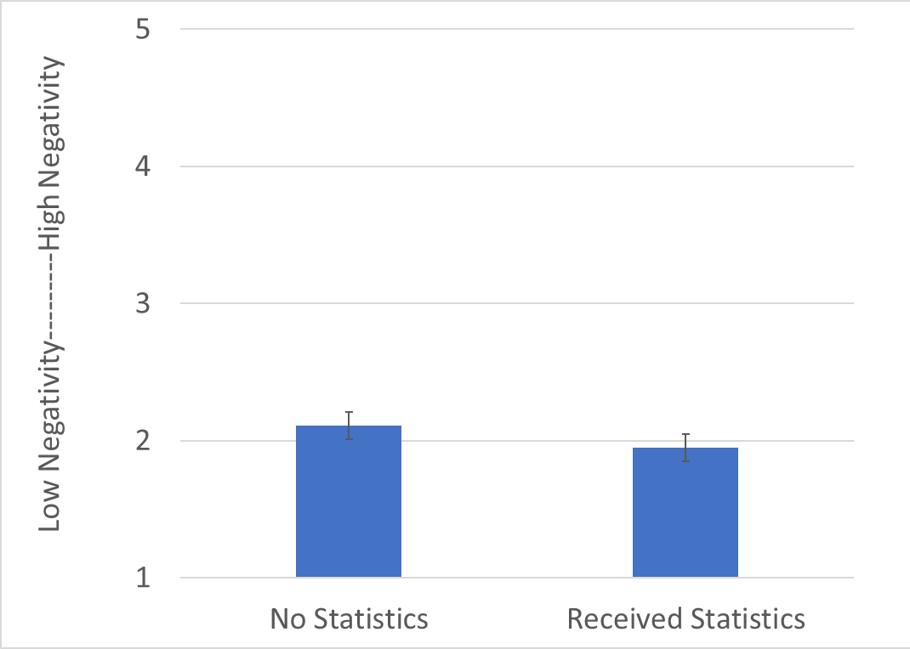
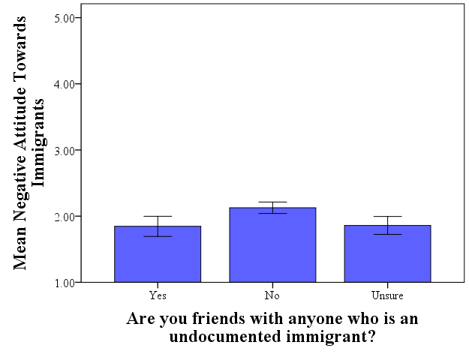
Attitudes on Immigrants – Stories vs. Statistics
Student Researcher: Emmanuel Castellanos, Psychology Faculty: Dr. April Bleske-Rechek, Psychology
Abstract
Participants
Results
The topic of immigration is a politically polarizing issue despite the U.S.A.’s characterization as a post-racial nation-state. In the current research, we tested the hypothesis that people’s attitudes about immigration are influenced more by exposure to vivid, emotional stories about an immigrant than by exposure to non-partisan statistics about immigrants. Participants were 369 undergraduate students enrolled at a public, Midwestern university in the U.S.A. In the study, some participants were exposed to a positive story about an undocumented immigrant, some to a negative story, and some to no story at all. In addition, half of the participants in each story condition were exposed to national statistics about immigration through a “Did you know?” quiz, while the other half in each story condition were not exposed to the statistics. Then, all participants reported their attitudes toward immigrants. Data analysis revealed that attitudes towards immigrants were moderate-to-positive regardless of condition, and exposure to the non-partisan statistics had a small, positive effect on attitudes. The current findings suggest that statistics can sway attitudes; however, we question whether the findings will replicate in a sample drawn from a more politically and educationally diverse population.
A total of 387 participants were gathered from undergraduate courses at the University of Wisconsin-Eau Claire. Student participation was voluntary. After data were entered, researchers omitted participants who failed the manipulation check and participants with incomplete data (final N = 369).
Finding 1:
In the sample as a whole, attitudes towards immigrants were skewed (N=369, M=2.03, SD=0.65), with the vast majority of responses below the midpoint. The histogram to the left shows participants’ composite scores on the Negative Attitude Towards Immigrant Scale (NATIS). The NATIS showed high internal reliability (α=.92). On the NATIS, lower scores imply less negative attitudes towards immigrants. Our hypothesis that the overall mean attitude towards immigrants would be negative was not confirmed. There were only a few participants whose score reflected negative attitudes towards immigrants.
Finding 2:
Our second hypothesis was that exposure to true statistics about immigrants would not affect people’s attitudes towards immigrants. In fact, providing statistics had a small negative effect on negativity towards immigrants, F(1,363)=5.55, p=.019, η²=.02. As displayed at left, those who received statistics had less negative attitudes (M=1.95, SD=0.62) in comparison to those who did not receive statistics (M=2.11, SD=0.68). This finding suggests that being presented nonpartisan statistics about immigration may have a small but favorable effect on people’s views towards immigrants.
Finding 3:
Although there was no overall systematic interaction between valence of story and exposure to statistics (F(2,363)=0.85, p=.426, η²=.00), participants who received statistics in addition to the positive story reported less negative attitudes (M=1.88, SD=0.69) than those who received only the positive story (M=2.14, SD=0.69). This comparison suggests that being exposed to nonpartisan statistics may have reinforced the positive elements of the positive testimonial and thereby influenced participants’ attitudes about immigrants. Also as displayed in this graph, the negative testimonial did not have a negative effect on attitudes as we predicted it would, and the positive testimonial did not have an overall positive effect on attitudes towards immigrants.
Finding 4:
Participants who reported that they did not have an undocumented friend reported more negative attitudes towards immigrants (M=2.13, SD=0.67) than did those who did (M=1.85, SD=0.62) or who were unsure (M=1.86, SD=0.58), F(2,365)=7.89, p<.001, η²=.04. Interestingly, participants who were unsure held similar attitudes to those who did have friends who were undocumented immigrants.
*All error bars 95% CI
Materials & Method
Data was analyzed using IBM SPSS Statistics 24. Frequency tests, reliability analyses, and ANOVAs were completed to obtain the data presented.
Participants were randomly assigned to one of six research conditions. These conditions were created by the combination of two independent variables. The first independent variable, story, had three levels: Positive Story, Negative Story, and No Story. The second IV, statistics, had two levels: Statistics and No Statistics. All participants reported their demographics and completed an assessment of their attitudes toward immigrants (dependent variable).
Condition 1 | Condition 2 | Condition 3 | Condition 4 | Condition 5 | Condition 6
Positive Story | Positive Story | Negative Story | Negative Story | No Story | No Story
Statistics | No Statistics | Statistics | No Statistics | Statistics | No Statistics
DV | DV | DV | DV | DV | DV
Positive Story
Gerardo came to the United States of America, undocumented, when he was 18. Upon arriving to the USA, he enrolled in classes and earned his General Equivalency Diploma (GED). He immediately looked for landscaping work and other manual labor to pay for necessities. Within a couple of years, he established himself as an active member of his local community, where he attended weekly meetings about how to improve the neighborhoods and plan community festivals. After a few years in the USA, Gerardo got married and, with his wife, established a network of community friends who help incoming immigrants assimilate to the local culture. He is now 55 years old and has been working with the same construction company for twelve years. His two children are in high school, and although he has not applied for residency, he has instead saved a good chunk of money to help his children pay for college. Gerardo’s English has improved with time and, because of his bilingual skill, he now helps with retention coordination at his construction company.
Negative Story
Gerardo came to the United States of America, undocumented, when he was 18. Upon arriving to the USA, he was encouraged to attend classes that would help him earn his General Equivalency Diploma (GED), but he decided not to. He initially relied on selling marijuana to pay for necessities. Within a couple of months, he obtained part-time service jobs, but because of his poor English could not communicate well with others and was forced to work alongside other undocumented Spanish-speaking immigrants. Regardless, he was fired from those positions because of his unreliable work ethic and so continued to sell drugs. The majority of his clients are students from the local high school who he sees walking home after classes. Now, at 21 years old, Gerardo has fathered two children; he is not an active part of either of their lives and is moving from state to state to avoid paying child support to their mother. He asks for government assistance to afford food and shelter, and each month he sends any extra money he makes back to Mexico.
Select Statistics (of 10 provided)
Did you know that 3 out of 4 immigrants are lawful immigrants?
Did you know that 1 million immigrants receive lawful permanent resident status in the U.S.A. each year?
Did you know that undocumented immigrants cannot legally receive welfare or Medicare?
DV: Select NATIS Questions (out of 12)
The NATIS is assessed on a five point scale from (Completely disagree to Completely Agree).
Immigrants should be given the same rights as native citizens. (rev)
Immigrants do not have valid reasons for leaving their native country.
Immigrants are a threat to national security.
Background
Despite scientists’ wishes, presenting people with data about an issue does not generally sway people’s attitudes if they have a vivid story (or testimonial) that contradicts the data (Hamill 1980). In the research completed by Hamill and colleagues, even when participants were told that the person in the vivid testimonial was atypical, they continued to generalize about others based on their vivid testimonial and NOT based on the (more accurate) statistical information presented to them.
In the current study, we investigated the influence of personal stories (vivid testimonials) versus statistical information on people’s attitudes towards immigrants. We assessed participants’ attitudes via the Negative Attitude Toward Immigrants Scale (NATIS; Varela et al., 2013).
On the basis of the literature reviewed, we hypothesized that (1) people’s attitudes towards immigrants are polarized and mostly negative; (2) participants’ attitudes towards immigrants would not be influenced by non-partisan, accurate statistics about immigrants; and (3) participants’ attitudes towards immigrants would be negatively affected by a negative story and positively affected by a positive story.
Conclusion
Our data suggest that attitudes towards immigrants - at least as indicated by our sample - are not as negative as they are portrayed in the media. In fact, very few students in our sample reported negative attitudes. Thus, one take-away message is that people’s attitudes towards immigrants on college campuses is not as negative as people might assume based on what they hear on the news about attitude polarization in the U.S.A.
Contrary to expectation, participants’ attitudes were not swayed by reading a vivid testimonial about an individual immigrant. However, we did document data that suggest that having friendships with people who are undocumented immigrants may be either a cause or consequence of positive attitudes towards immigrants. A key take-away, therefore, is to bridge the gap between others and aim to have friends of varying experiences that may be different from your own. While this may be difficult for some, the ability to make connections beyond our in-group is far easier when we realize we are complex human beings that cannot be categorized in the simplicity of black and white categories.
Acknowledgements
This research is supported by the Office of Research and Sponsored Programs at UWEC.
We thank our colleagues in psychology and in the IDEP lab for helpful discussions of this topic, and we thank LTS for printing this poster.
We would like to thank our funding sources: Our ORSP SREU grant and the McNair Program.
References
Borgida, E., & Nisbett, R. E. (1977). The differential impact of abstract vs. concrete information on decisions. Journal of Applied Social Psychology, 7(3), 258-271.
http://dx.doi.org/10.1111/j.1559-1816.1977.tb00750.x
Hamill, R., Wilson, T. D., & Nisbett, R. E. (1980). Insensitivity to sample bias: Generalizing from atypical cases. Journal of Personality and Social Psychology, 39(4), 578-589.
http://dx.doi.org/10.1037/0022-3514.39.4.578
Henderson-King, E. I., & Nisbett, R. E. (1996). Anti-Black prejudice as a function of exposure to the negative behavior of a single Black person. Journal of Personality and Social Psychology, 71(4), 654-664.
http://dx.doi.org/10.1037/0022-3514.71.4.654
Nisbett, R. E., & Borgida, E. (1975). Attribution and the psychology of prediction. Journal of Personality and Social Psychology, 32(5), 932-943.
http://dx.doi.org/10.1037/0022-3514.32.5.932
Pettigrew, T. F. (1979). The ultimate attribution error: Extending Allport's cognitive analysis of prejudice. Personality and Social Psychology Bulletin, 5(4), 461-476.
http://dx.doi.org/10.1177/014616727900500407
Varela, J. G., Gonzalez, E., Jr., Clark, J. W., Cramer, R. J., & Crosby, J. W. (2013). Development and preliminary validation of the Negative Attitude Toward Immigrants Scale. Journal of Latina/o Psychology, 1(3), 155-170.
http://dx.doi.org/10.1037/a0033707

