Slide 1



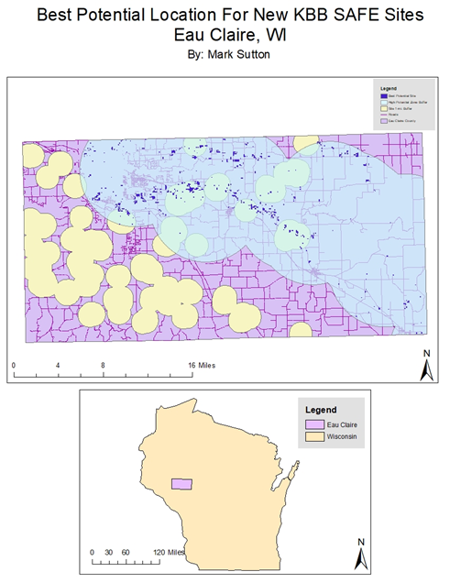
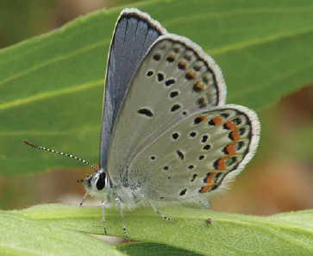
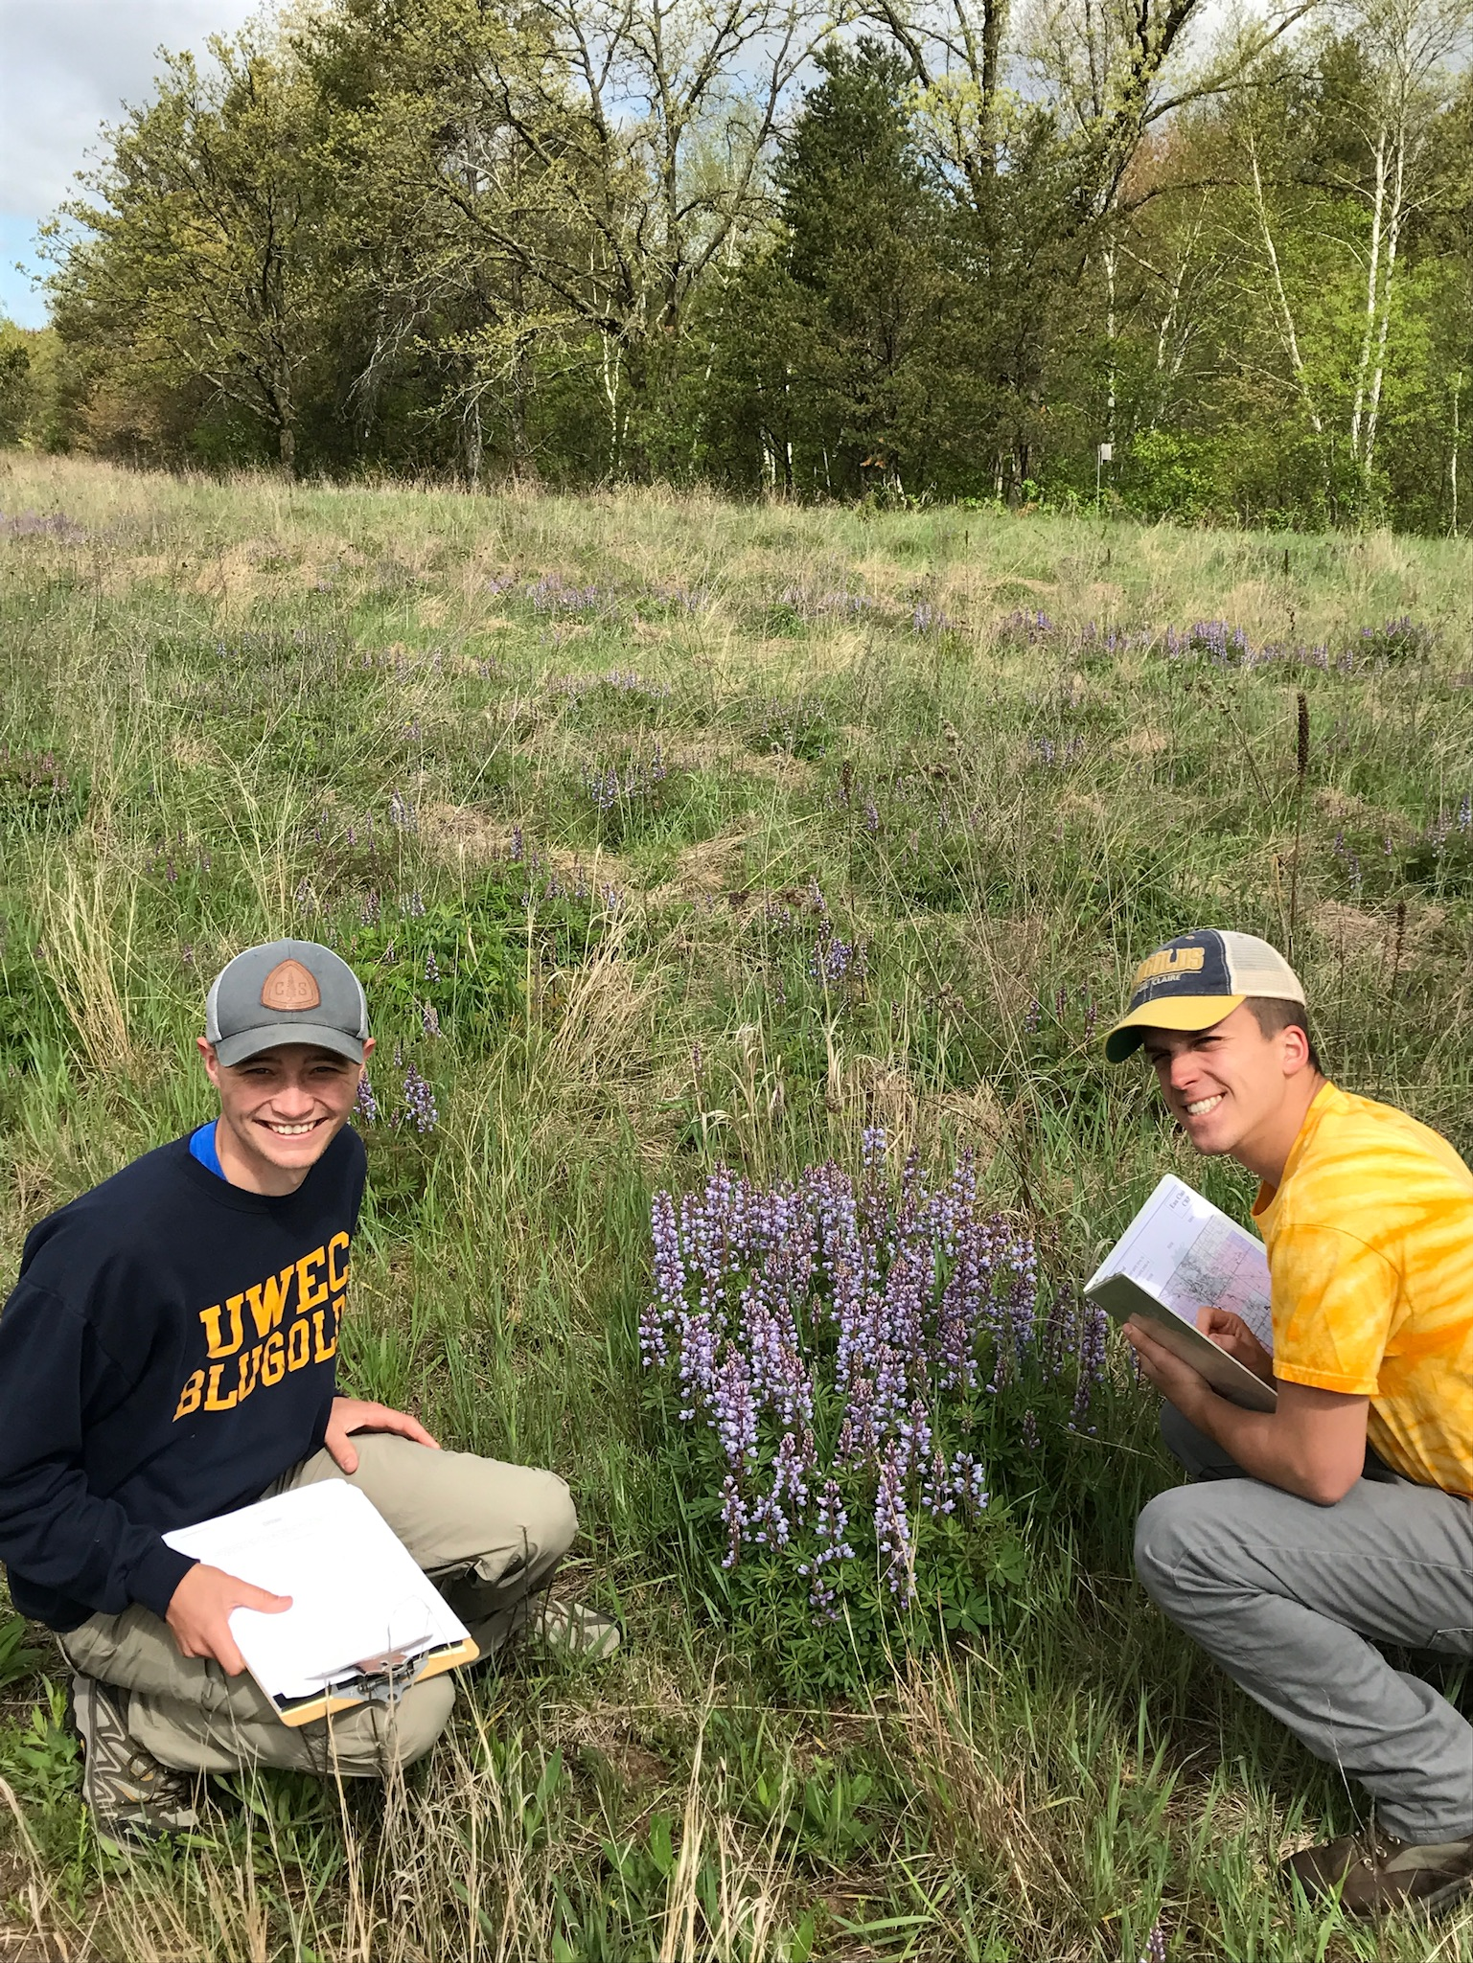
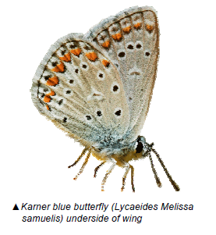
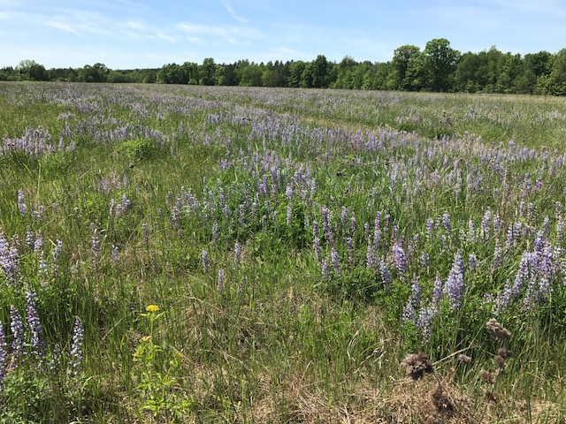
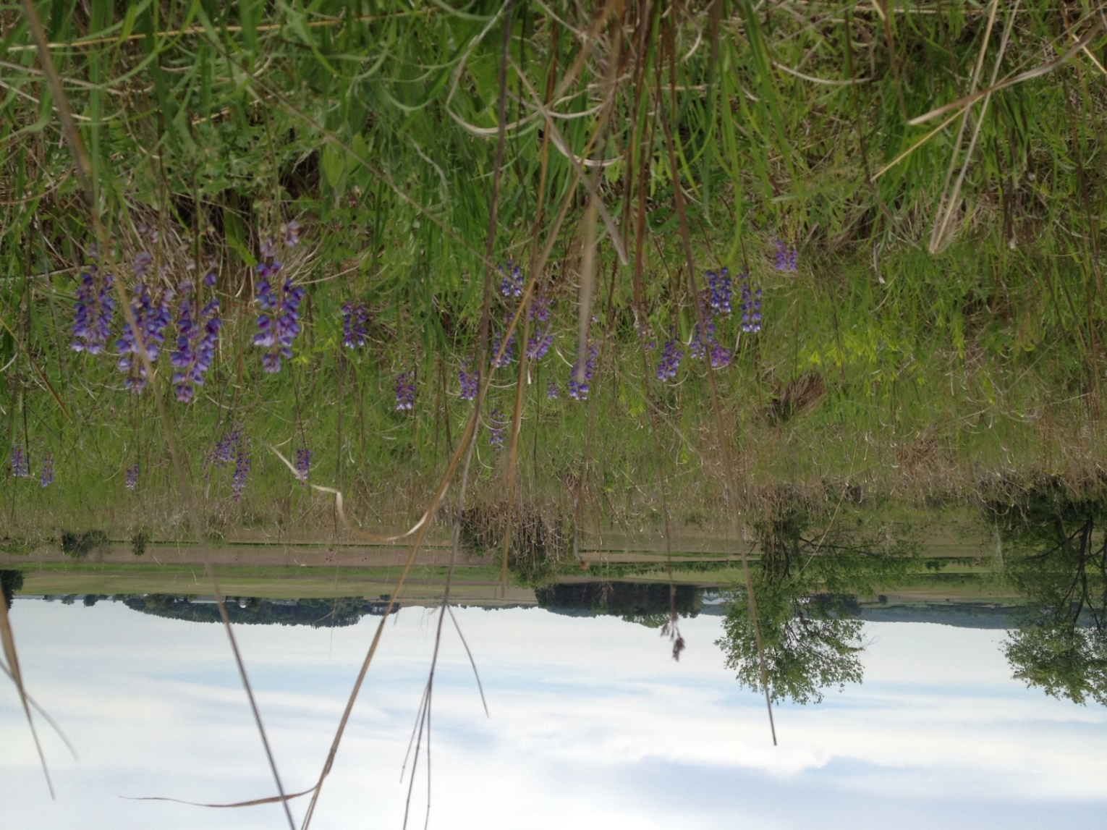
A geospatial view of farmland for the Karner Blue
Author: Mark Sutton, Biology Dept.
Contributor: Chase Stoffel, Biology Dept.
Faculty Mentor: Dr. Paula Kleintjes Neff, Biology Dept.
BACKGROUND
methods
results
In 2017, we conducted our project on farmlands enrolled in the USDA-NRCS State Acres for Wildlife Enhancement (SAFE) program for the Karner Blue Butterfly (Lycaeides melissa samuelis). In Eau Claire County, SAFE sites were developed to provide favorable habitat for the federally endangered butterfly. The sites were planted in 2009-2015 with a native seed mix (3.78 lbs./acre) of grasses and pollinator nectar plants, including wild lupine (Lupinus perennis) (3.0 oz./acre). Larvae of the Karner are dependent on wild lupine, and sites with the densest and most abundant patches of the flowering plant are most likely to attract, host and maintain Karner populations.
The goal of our project was to first, monitor lupine abundance on all 60 farms enrolled in the project and second, do a GIS analysis of the data to answer the following questions:
Which environmental features are most conducive to lupine growth?
Where would be the most favorable location for future sites?
We used CRP SAFE site maps provided by the USDA-Natural Resources Conservation Service-Altoona Office.
CRP SAFE sites (n=51/60) were thoroughly walked with equally adjusted time and effort and presence of wild lupine was recorded (Figs. 3 & 4)
Field success was ranked on a relative scale used by the WDNR
0=lupine absent
1=lupine uncommon, infrequently encountered
2=lupine not as common, but encountered
3=lupine common and abundant (Fig.6)
Using ArcGIS by ESRI, the quantitative success value was added as a field to a polygon layer of the CRP sites.
Using various ArcMap tools, the following variables were analyzed: soil type, average slope, site success, and historic land use, and location within the High Potential Zone (HPZ).
Based on research, zonal statistics, and professional guidance, favorable variable traits were selected.
When favorable traits were combined, the GIS would illustrate farms that possessed all, most or none of the variables.
We created a final map that assists in predicting sites most suitable for planting and successfully establishing lupine.
On the map, tan buffers surround SAFE farm locations. Farms are blurred to maintain confidentiality.
The light blue semi-transparent layer is a five-mile buffer of the High Potential Zone for lupine and Karner habitat.
The dark purple indicates best site locations, based on results of input variables (soil type, slope, land use, and location within the HPZ for KBB)
Conditions that were met by the locations identified in Figure 7 are as follows:
Soil type – Sandy Loam, or loamy sand
Average slope less than 3 degrees
Previous agricultural land use
Located within high potential range (HPZ)
of KBB
results
Fig. 1: Male Karner Blue butterfly
Figure 7: Best locations for future Karner SAFE sites in Eau Claire County.
Approx. 77% of farms in 2017 had lupine present, but realistically, <20% had lupine dense enough to support Karners*
*Two of 60 farms have been colonized by Karners, 7-years post planting
Although, 77% of assessed farms had lupine, few were found to be highly suitable to support dense enough quantities to attract and support populations of Karners. Lupine is a disturbance-dependent plant, and a limitation to our study was that we lacked data on the variability of disturbance among sites. Additionally, the fields were observed June-August. Lupine blooms in early summer so it becomes increasingly difficult to identify as other grasses and forbs matured.
In the future, dependant on both farm bill funding for SAFE CRP contracts and site availability, there are regions of farmland that could be added to the program for the Karner Blue Butterfly to increase adequate habitat within the high potential range and adjacent to native habitat, i.e. EC County Forest, known to support robust populations of lupine and Karner blue butterflies.
(Kleintjes Neff, Locke & Lee-Mäder 2017. J Insect Conserv.)
Figure 5: Relative abundance of lupine
(n=51 farms, 2017)
Figure 2: Historic and current habitat and range of the Karner Blue Butterfly
ReFEreNCES/Acknowledgements
We thank FSA and NRCS-Altoona Staff, especially Jen Roetter, District Conservationist for their assistance; LTS and UWEC Printing Services for poster printing; Dept. of Geography and Anthropology for Geospatial training and software; and the Prairie Biotic Inc. Grant to PK Neff, UWEC DT and the UWEC Office of Research and Sponsored Projects for SREU funding.
In: SoilWeb. https://casoilresource.lawr.ucdavis.edu/soil_web/ssurgo.php?action=list_mapunits&areasymbol=wi035.
Majka, D., Beier, P., Jenness, J., 2007. CorridorDesigner ArcGIS Toolbox Tutorial. Environmental Research, Development and Education for the New Economy (ERDENE), 1-25.
Neff, P. K., Locke, C., & Lee-Mӓder, E. (2017). Assessing a farmland set-aside conservation program for an endangered butterfly: USDA State Acres for Wildlife Enhancement (SAFE) for the Karner blue butterfly. Journal of Insect Conservation, 21(5-6), 929-941. doi:10.1007/s10841-017-0032-x
Pl KBBenzler, M.A., Michaels, H.J., 2015. Seedling Recruitment and Establishment of Lupinus perennis in a Mixed-Management Landscape. Natural Areas Journal 35, 224-234.
Smallidge, P.J., Leopold, D.J., 1997. Vegetation management for the maintenance and conservation of butterfly habitats in temperate human-dominated landscapes. Landscape and Urban Planning 38, 259-280.
Walsh, R.P., 2017. Microclimate and biotic interactions affect Karner blue butterfly occupancy and persistence in managed oak savanna habitats. Journal of Insect Conservation 21, 219-230.
Figures 3: EC County SAFE farm with lupine
Figure 4: Mark and Chase collecting lupine data
Photos: PK.Neff all field sites, D. Taron male KBB
Figure 6: Farm with abundant lupine

