Slide 1
Sakyadhita: The Daughters of Buddha
Elaine Yarger
Carroll University

Slide 2

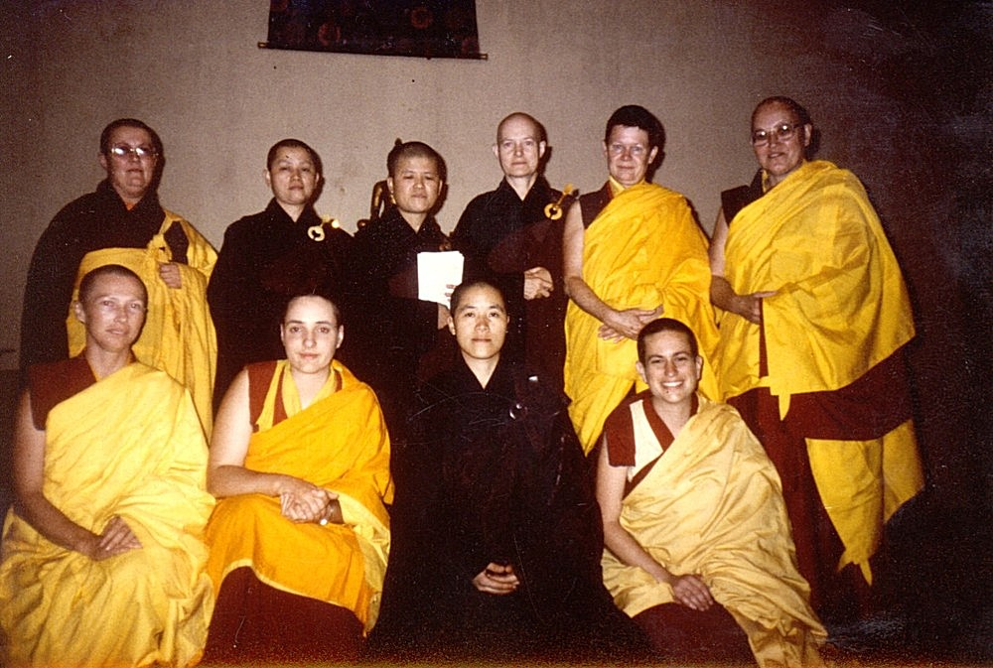
The founding members of Sakyadhita
https://sakyadhita.org/home/ourhistory.html

