Slide 1
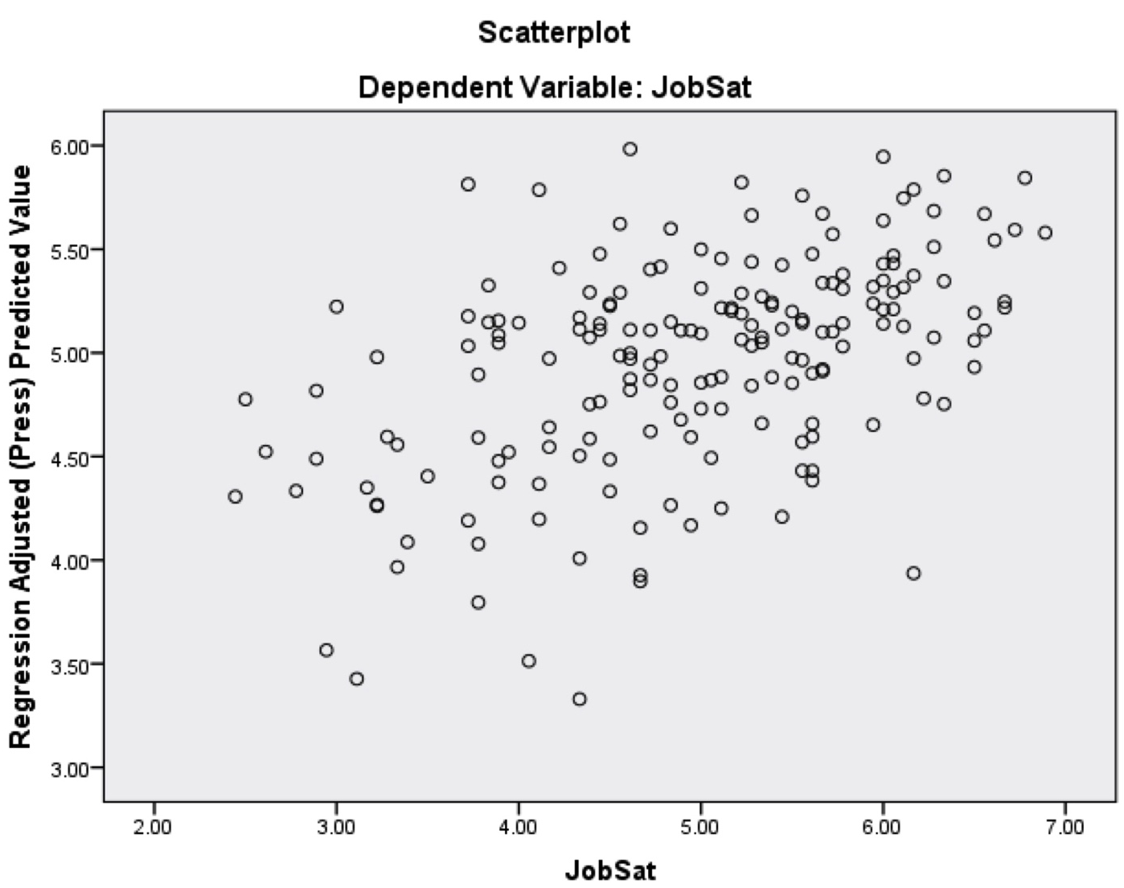
Supervisor and Employee Perceptions
Employees’ perceptions of their supervisors’ thoughts on them
Samantha Poeske, Saffron O’Brien, Hannah Shaw, Sarah Dies, Jessica Werner | Faculty Advisor: Dr. Martha Fay
Department of Communication & Journalism | University of Wisconsin-Eau Claire
Abstract
Methods
Previous research has linked quality of the supervisor-employee relationship with job satisfaction. However, what employees perceive their supervisor thinks of them has not been examined. Quality of supervisor-employee relationships has also been associated with life satisfaction, but the role life satisfaction may play when considering all of these associations is unclear. Using a Qualtrics survey with Spector’s (1994) Job Satisfaction scale, Rubin’s (1970) Liking Scale, Diener, Emmons, Larsen, and Griffin’s (1985) Life Satisfaction scale, and Weimann’s (1977) Communication Competence scale, this study looked for potential relationships between employee perceptions of supervisor liking and job satisfaction and tested whether life satisfaction moderated the relationship between the two. This study tests the self-fulfilling prophecy theory (Merton, 1948) to examine whether employees’ perceptions of relational realities are associated with outcomes important to individuals and organizations, thereby opening a potential avenue for improving the supervisor/employee relationship.
Participants
186 participants with a majority being between the ages 18-25 and 46-54.
70% of participants were female.
Measures
81 question survey distributed via email and social media to individuals who have had a job or currently have a job.
Survey included four scales that related to liking, job satisfaction, life satisfaction, and communication competence.
Job Satisfaction Scale (Spector, 1994)
One 12-question scale measuring Job Satisfaction with responses ranging from “definitely false” to “definitely true.”
Sample Item: I feel I am being paid a fair amount for the work that I do.
Scale was reliable, α = .90, M = 89.58, SD = 17.88
Liking Scale (Rubin, 1970)
One 18-question scale measuring Employee-Supervisor liking (Rubin, 1970) with responses ranging from “strongly disagree” to “strongly agree.”
Sample Item: I believe my supervisor thinks that most people would react positively to an encounter with me.
Scale was reliable, α= .92, M = 81.73, SD = 12.96
Results/Research Questions
Literature Review
RQ₁: Are employees’ beliefs about their supervisors’ perceptions of them associated with employee job satisfaction?
A Pearson correlation analysis showed a significant relationship between job satisfaction and employees’ beliefs of their supervisors’ perceptions of them, r = .47, p < .001.
RQ₃: Is supervisor communication satisfaction associated with job satisfaction?
Pearson correlation analysis showed a strong relationship between supervisor communication satisfaction and job satisfaction, r= .65, p < .001
A multiple linear regression was calculated to predict job satisfaction based on perceived supervisor liking, life satisfaction and supervisor communication satisfaction. A significant regression equation was found F((178,2) = 65.37, p<.001), with an R² of .46. These variables accounted for 46% of the variance in job satisfaction.
Self-Fulfilling Prophecy Theory suggests that by making a prediction it will directly or indirectly cause it to become true.
Job satisfaction and work-life balance were related in a telework context (Hill, Miller, Weiner & Colihan, 2006).
Differences exist between supervisors and employees about their perception and satisfaction with communication (Schnake, Dumler, Cochran, & Barnett, 1990).
There is little literature that addresses a potential association between employees’ perceptions of their supervisors’ opinions and job satisfaction.
Previous research has shown that there is a positive relationship between job and life satisfaction by using the spillover model (Heller, Judge, & Watson, 2002).
Satisfaction with Life (Diener, Emmons, Larsen, and Griffin’s, 1985)
One 5-question scale measuring life satisfaction with responses ranging from “strongly disagree” to “strongly agree.”
Sample Item: In most ways my life is close to my ideal.
Scale was reliable, α = .86, M = 25.31, SD = 5.79
RQ₂: Does life satisfaction moderate the relationship between employee beliefs about their supervisors’ perception of them and job satisfaction?
Using a regression analysis there was no evidence of moderation
A regression model showed life satisfaction and liking predict 26% of the variance in job satisfaction.
Liking significantly predicts job satisfaction scores, β = .36, t(184) = 5.11, p < .001. Life satisfaction significantly predicts job satisfaction scores, β = .24, t(184) = 3.45, p < .001.
Communication Competence Scale (Weimann, 1977)
One 36-question scale measuring communication competence with responses ranging from “strongly disagree” to “strongly agree.”
Sample Item: My supervisor finds it easy to get along with others.
Scale was reliable with α= .98, M = 198.56, SD = 43.34.
Discussion/Implications
Further Research
Previous research on how employees view their supervisors but not how employees think their supervisors view them.
Employees’ beliefs about supervisors’ perceptions of them job satisfaction.
Supervisors could use information from this study to build positive relationships with their employees and increase harmony in the workplace.
Other studies have shown how job satisfaction impacts life satisfaction, however this study suggests how life satisfaction impacts job satisfaction.
Further research should be conducted on life satisfaction impacting job satisfaction, because the results from this study suggest life satisfaction had no moderation on perception and job satisfaction.
Further research could be done to focus on the effects of gender, race, and culture to observe how perceptions differ to more or less satisfied with the communication competence.
Supervisor communication competence and satisfaction is another area that needs further research and could be influential in this field of study.

