Slide 1


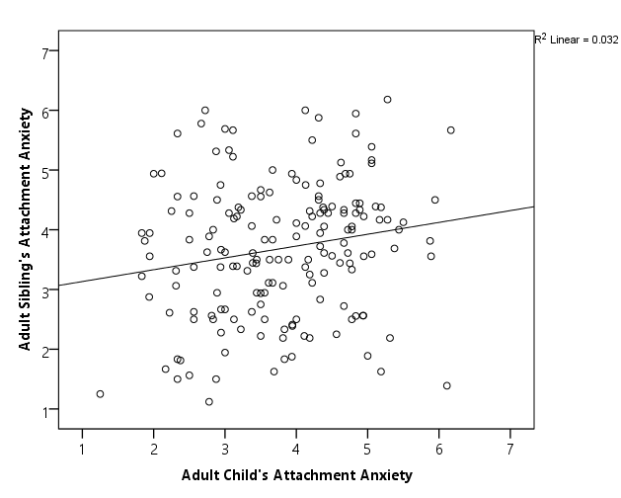
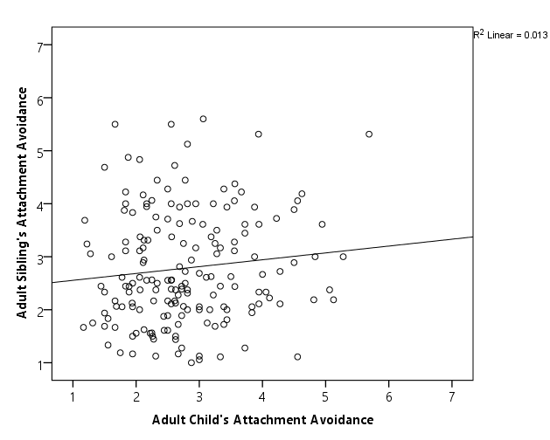
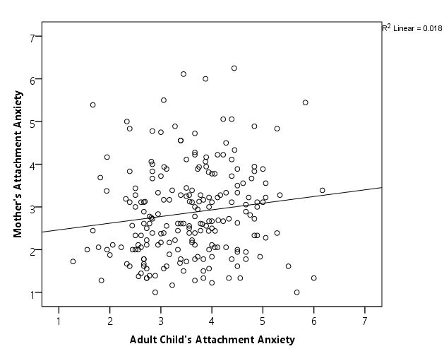
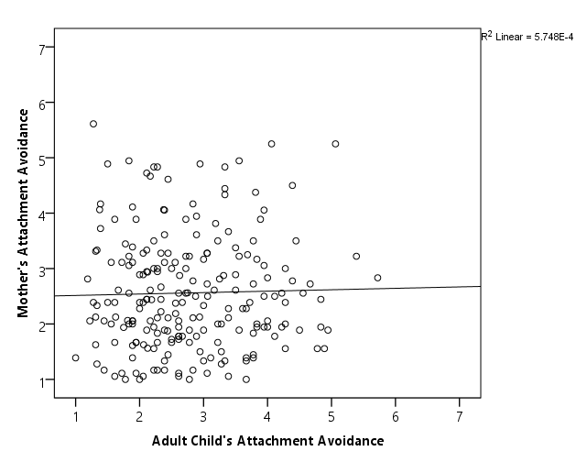
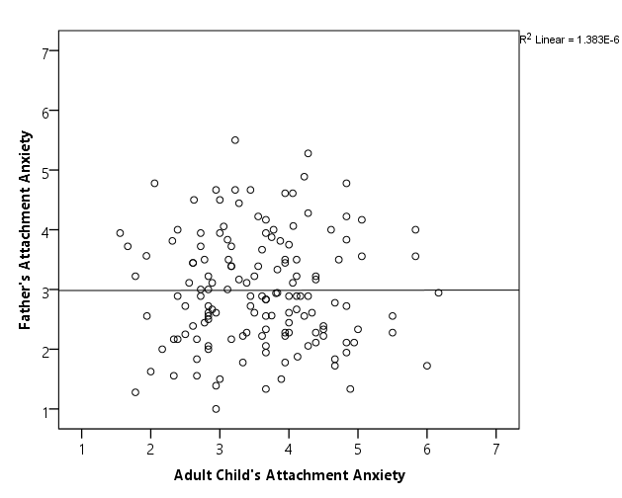
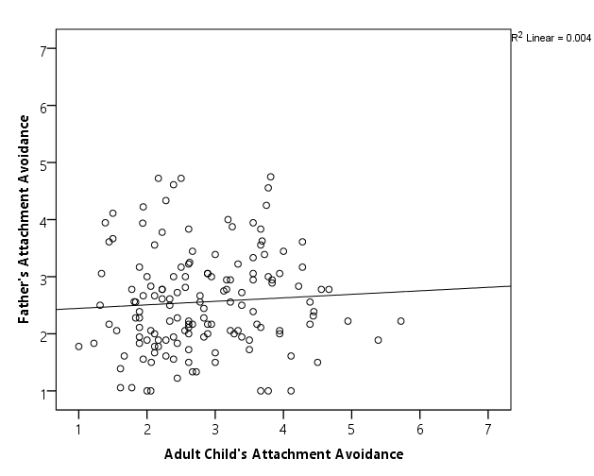
Exploring Familial Resemblance In Romantic Attachment:
Shared Genes And Shared Rearing Environment Do Not Equal Shared Attachment
Grace E. Nuck, Michaela M. Gunseor, and Eleni Seyoum
Faculty Mentor: April Bleske-Rechek
Department of Psychology  University of Wisconsin-Eau Claire
Introduction
Attachment research began when John Bowlby recognized the importance of the emotional bonds, or “attachments,” formed between infants and their caregivers.
In the late 1980s, psychologists extended Bowlby’s research into the domain of adult romantic relationships by proposing that romantic love can be conceptualized as a process of becoming attached (Hazan & Shaver, 1987).
Individuals differ in two primary attachment dimensions: avoidance, or the extent to which they are uncomfortable with closeness, and anxiety, the extent to which individuals worry about abandonment in their relationships (Feeney, Noller, & Callan, 1994).
Since Hazan and Shaver’s (1987) initial conceptualization of romantic love as an attachment process, researchers have documented links between individuals’ romantic attachment scores and their memories of their relationships with their parents during childhood, their parents’ relationship status (e.g., divorced), and their own current and past romantic relationship experiences.
Research has not, however, utilized genetically informed designs to explore the degree to which genetic factors, shared environmental factors, and nonshared environmental factors explain individual differences in romantic attachment style.
We conducted a series of studies to explore the possibility that romantic attachment style is transmitted via the family, either through shared genes or shared rearing environment. Family members should be similar in attachment style if it is transmitted familially. To test this idea, we obtained romantic attachment scores from various within-family pairings.
Method
Data were collected at four different time points. At each time point, we recruited our original participants from lower level psychology courses at UWEC; after students completed their questionnaires, we mailed a blank copy of the questionnaire to each family member that students gave us permission to contact.
Not all family members sent back questionnaires, and response rates varied (e.g., in Sample 1, which involved parents, 45% of the fathers and 65% of the mothers returned their questionnaires; in Sample 3, which involved only siblings, the response rate was 85%).
For the analyses reported here, we have compiled the four samples. Analyses include only family members who are (or are very likely to be) biologically related based on the demographic information we have.
Sample 1 was collected in 2006 (183 original participants, plus mothers and fathers).
Sample 2 was collected in 2007 (169 original participants, plus mothers, fathers, and siblings).
Sample 3 was collected in 2013 (92 original participants, plus siblings).
Sample 4 was collected in 2017 (521 original participants, plus mothers, fathers, and siblings).
Participants in Samples 1, 2, and 3 completed the 36-item Experiences in Close Relationships (ECR) inventory, which provides scores on continuous dimensions of anxiety and avoidance (Brennan, Clark, & Shaver, 1998). Sample items include “I worry about being abandoned by my romantic partners” (anxiety) and “I try to avoid getting close to my romantic partners” (avoidance). Participants responded using a seven-point rating scale (strongly disagree to strongly agree). Participants in Sample 4 completed a 40-item adaptation of the ECR called the Trent Relationship Scales Questionnaire (RSQ). In past studies, ECR and RSQ scores correlate highly. In our samples, internal reliabilities were high (α ≥ .85).
Results
Discussion
Individual differences in romantic attachment scores – discomfort with closeness (avoidance) and fear of abandonment or rejection (anxiety) – are tied to people’s psychological adjustment and behavior in their romantic relationships (Hazan & Shaver, 1987). But what are the root causes of individual differences in romantic attachment attitudes?
Attachment theorists and psychologists are fond of attributing individual differences in romantic attachment attitudes to rearing environments, implying that individuals’ parents and their parents’ romantic relationship provide a model of attachment behavior and attitudes (e.g., see Gottman, 2001, pp. 138, 162; Lamanna, 2014, pp. 33, 43). If shared rearing environment is important, then college students should resemble their parents in romantic attachment scores; and to the extent that siblings live together for years and witness the same parental relationship role models (or serve as models for each other), siblings should resemble each other in romantic attachment styles, as well. In addition, if romantic attachment is under genetic influence, family members should be similar because of shared genes. When genetically related family members who have been raised together do not resemble each other, then the only broad factor remaining to explain the variance is non-shared environmental factors.
When we compiled the data from four different samples of family members, the findings were consistent: family members showed negligible to weak, and not statistically reliable, resemblance in their romantic attachment scores. These findings imply that sharing genes and being raised together do not create similar attitudes toward romantic relationships, and that a substantial proportion of individual differences in romantic attachment styles are explained, instead, by differences in non-shared environmental influences. Non-shared environmental influences are those that are not shared by members of the same family, such as idiosyncratic life events and people’s unique romantic relationship histories.
The lack of resemblance we found does not appear to be a fluke or due to methodological error, because our samples functioned much like previous samples in several ways: (1) the parents in our samples scored lower in anxiety and avoidance than the young adults did, (2) the young men in our samples scored lower in attachment anxiety than the young women did; and (3) individuals who scored higher in attachment anxiety also scored higher in the personality trait of neuroticism.
Select References
Brennan, K. A., Clark, C. L., & Shaver, P. R. (1998). Self-report measurement of adult attachment: An integrative overview. In J. A. Simpson and W. S. Rholes (Eds.), Attachment theory and close relationships (pp. 46-76). New York, NY: Guilford Press.
Hazan, C., & Shaver, P. R. (1987). Romantic love conceptualized as an attachment process. Journal of Personality and Social Psychology, 52, 511-524.
Fraley, R. C. (2000). Adult romantic attachment: Theoretical developments, emerging controversies, and unanswered questions. Review of General Psychology, 4, 132-154.
Acknowledgements
We thank all the participants who generously permitted us to invite their family members to participate and those who encouraged their family members to complete the questionnaires. We also thank faculty who allowed us into their classrooms over the years to recruit original participants.
This research has been supported by student-faculty collaboration grants from the Office of Research and Sponsored Programs at UWEC.
We thank Learning and Technology Services at UWEC for printing this poster.
Participant-Sibling Resemblance
The scatter plot to the left shows that participants and their siblings were slightly similar in attachment anxiety.
The scatter plot to the right shows that they were slightly similar in attachment avoidance.
Comparison of the two scatter plots reveals that participants and their siblings scored lower in attachment avoidance than in attachment anxiety.
Participant-Mother Resemblance
The scatter plot to the left shows that participants were slightly similar to their mothers in attachment anxiety.
The scatter plot to the right shows that participants did not resemble their mothers at all in attachment avoidance.
Participant-Father Resemblance
The scatter plot to the left shows that participants did not resemble their fathers at all in attachment anxiety.
The scatter plot to the right shows that participants did not resemble their fathers in attachment avoidance, either.
*The seven-point scales on each scatterplot represent low (1) to high (7) scores.
Familial Resemblance, by Specific Family Pairings
This table shows the results of correlational analyses on different pairs of family members. The top row of each set (shaded in grey) provides the values from the pairings displayed in the scatter plots above. Overall, familial resemblance in self-reported romantic attachment attitudes is weak.
 |  | ATTACHMENT ANXIETY |  |  | ATTACHMENT AVOIDANCE
FAMILY PAIRING | n | Pearson’s r | p |  | Pearson’s r | p
participant-sibling (overall) | 174 | .18 | .018 |  | .11 | .140
sister-sister | 83 | .28 | .012 |  | .12 | .281
brother-brother | 17 | -.20 | .446 |  | -.25 | .328
brother-sister | 74 | .15 | .189 |  | .19 | .102
participant-mother (overall) | 210/217 | .13 | .052 |  | .02 | .725
daughter-mother | 156/163 | .09 | .258 |  | .01 | .928
son-mother | 53 | .31 | .026 |  | .12 | .375
participant-father (overall) | 147 | .00 | .989 |  | .07 | .436
daughter-father | 105/106 | -.06 | .563 |  | .06 | .529
son-father | 41/42 | .08 | .635 |  | .13 | .408
Note. Because of the multiple analyses we ran (20), a Bonferroni correction is in place; p values less than .0025 are required to be interpreted as statistically significant. With the Bonferroni correction in place, none of the correlation coefficients are statistically significant.

