Slide 1
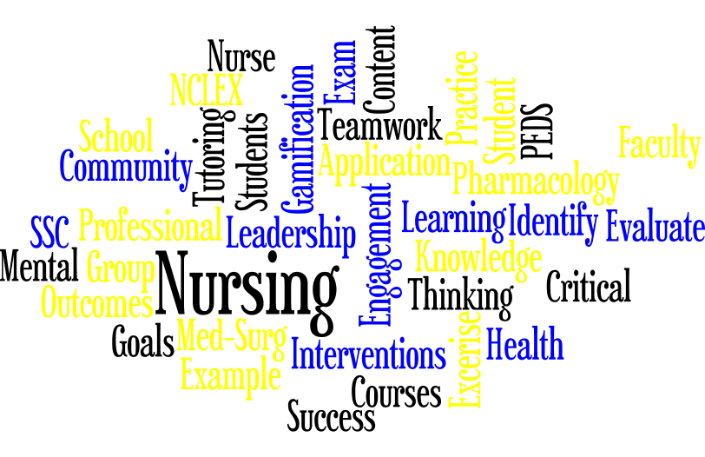

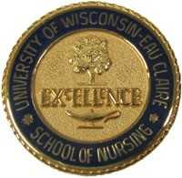
Utilization of Literature-Based Strategies to Promote Nursing Student Success
Kimberly Ziolkowski, Sabrina Mitchell, Andrew Studinski | BSN Nursing Students
Rachael L. Haupt-Harrington, DNP, RN, WHNP-BC | Faculty Advisor
University of Wisconsin Eau Claire - College of Nursing and Health Sciences
Abstract
Learning Interventions
Student Feedback
Nursing’s Student Success Center (SSC) is available to support nursing students academically throughout their time in the program; students self-refer or are guided by their academic advisor to access the SSC for assistance with study strategies or tutoring. An integrative literature review (Pitt, Powis, Levett-Jones, and Hunter, 2012) describes the significant impact of factors such as prerequisite course performance, hours of part-time employment, first semester GPA, and English as second language, on nursing students’ performance and attrition. A Case Management Model (CMM) has been utilized to proactively identify factors related to nursing student performance and attrition (Elder, Jacobs, and Fast, 2015). Application of this and other literature-based success strategies will be piloted and evaluated at the Marshfield-site SSC. Desired long and short-term student outcomes include improved first-time NCLEX pass rate, decreased attrition, access to resources, and student satisfaction. Strategies supporting positive student outcomes will be considered for long-term inclusion.
Traditional Tutoring- The traditional tutoring model is currently available, and is based on the student’s self and/or faculty referral. The student contacts the SSC Faculty who assesses needs and recommends appropriate resources. The SSC Faculty connects the student with an available, topic-proficient SSC Peer Tutor, who schedules the Peer Tutoring sessions per student request and needs. SSC Tutoring incorporates basic study strategies along with student-requested nursing topics.
Gamification- The process of incorporating game elements into the SSC’s student success sessions is a newly piloted intervention. This component was implemented first with the Sophomore II’s Pharmacology content. Student success sessions review Cardiovascular, Respiratory, GI, and GU medications, along with content recall techniques and tips, such as mnemonics. Content is presented in game-show format which promotes student involvement through active learning, teamwork, and problem-solving, along with friendly competition, all within a safe and supportive learning environment.
SSC Proactive Campus Engagement-
SSC Faculty and Peer Tutors attend new student orientation sessions to increase the visibility and awareness about the SSC, to promote a proactive approach to nursing student success, and to help minimize negative connotations around seeking SSC support and/or tutoring.
Weekly NCLEX questions are posted by the Peer Tutors in the SSC to encourage active participation, learning, and discussion among students.
Planned, Pending Events- These activities are under development and are anticipated to occur as part of the ongoing development of the SSC.
“Speed-Dating Your APA Book”- An event where students would better familiarize themselves with APA Formatting and their APA Reference. This will be an interactive event toward a better understanding and improved utilization of APA.
Study and Test Strategies Workshop- An event where students would learn different ways to study for nursing school courses, and improve test-taking strategies, to help promote nursing student success in the UWEC-nursing program.
Marshfield-Site “Scavenger Hunt”- Peer Tutors will provide information about resources on campus. Students will locate these resources from the provided clues. The purpose of this is to increase the incoming students’ knowledge and familiarity with available resources.
Student Success NCLEX “Lock-In”: This event is planned to be piloted on the Marshfield Campus. The “Lock-In” will occur over several hours, similar to a trivia-style event. Student teams will be exposed to NCLEX-style questions to assess their knowledge on various nursing topics.
Student satisfaction with the game-style student success review session was informally assessed. Of the total 17 Marshfield students in the course, 11 attended the session and completed the assessment. Both ratings and student comments were in strong support of the provided session. All students ranked the session 7 or greater, with an average combined score of 9.1.
Student responses to “What did you like most about the session?” follow:
“Got me thinking about possible exam questions.”
“Good review/example test questions.”
“I like how the students leading the session took the time to explain the answers to each question.”
“I enjoyed studying through practice questions.”
“We were able to test our current knowledge.”
“All the questions and why we chose the answer; the explanation of why something was the right answer.”
Background
Nursing’s Student Success Center (SSC) traditionally was available to support nursing students academically throughout their time in the nursing program. Identified peer tutors availed themselves to nursing students on an as needed basis. Students would self-refer to the SSC, or be recommended by their advisor to seek SSC support; peer tutors would work with these students using a traditional tutoring model. The Marshfield-site SSC Peer Tutors and Faculty recognized the need, and sought the opportunity, to further develop and make available additional resources to promote nursing student success.
Discussion and Implications
Traditional tutoring remains a valuable student success intervention that helps to promote content mastery, as well as improved student self-confidence.
The innovative teaching-learning strategy of Gamification is an active, engaging approach that helps to reinforce content, improve recall, and make learning enjoyable for both students and faculty.
CMM has helped to proactively identify students who may benefit from additional resources, helping to foster overall nursing student success.
Engagement and active learning strategies are essential components for nursing student success.
References
Methods
Carini, R. M., Kuh, G. D., & Klein, S. P. (2006). Student engagement and student learning: Testing the linkages. Research in higher education, 47(1), 1-32.
Day-Black, C., Merrill, E. B., Konzelman, L., Williams, T. T., & Hart, N. (2015). Gamification: An innovative teaching-learning strategy for the digital nursing students in an community health nursing course. ABNF Journal, 26(4), 90-94.
Elder, B. L., Jacobs, P., & Fast, Y. J. (2015). Identification and support of at-risk students using a case management model. Journal of Professional Nursing, 31(3),247-253.
Gamification. (n.d.) Retrieved April 23, 2018, from https://www. Merriam-webster.com/dictionary/gamification.
Pitt, V., Powis, D., Levett-Jones, T., & Hunter, S. (2012). Factors influencing nursing students academic and clinical performance and attrition: An integrative review. Nurse Education Today, 32, 903-913.
Royse, M. A. & Newton, S. E. (2007). How gaming is used as an innovative strategy for nursing education. Nursing Education Perspectives, 28(5), 263-267.
Sweet, M., & Michaelsen, L. K. (2012). Team-based learning in the social sciences and humanities: Group work that works to generate critical thinking and engagement. Stylus Publishing, LLC.
Zhao, C. M., & Kuh, G. D. (2004). Adding value: Learning communities and student engagement. Research in higher education, 45(2), 115-138.
Marshfield-site Peer Tutors and Faculty completed a literature review to identify potential interventions that support nursing student success.
A Case Management Model (CMM) was applied to nursing student success (Elder, Jacobs, and Fast, 2015). The CMM proactively identifies factors related to student performance and attrition. After identification, at-risk students work with an advisor to identify an individualized success plan and access appropriate resources.
Gamification, adding games or game-like elements to engage participation (Merriam-Webster, 2018), increases student interest and motivation, encourages students’ retention of knowledge, and cultivates the development of problem-solving skills (Day-Black, Merrill, Konzelman, Williams, and Hart, 2015; Royse and Newton, 2007).
Benefits associated with student engagement include learning content on a deeper level, improved information recall, and the development of teamwork and communication skills (Carini, Kuh, and Klein, 2006; Sweet and Michaelson, 2012; Zhao and Kuh, 2004). Further, the Peer Tutors own experiential learning influenced their desire to employ active and engaging strategies in their success sessions with students.
Case Management Model
CMM (Elder, Jacobs, and Fast, 2015) was assessed for its potential use, and possible benefits, at the Marshfield-site. The CMM would work to proactively identify students in need, though all students will have access/be eligible for CMM services. Students can self-refer, or be recommended by an instructor or advisor to seek CMM services. A possible assessment and intake process for the pilot have been identified. Necessary tools have been created and anecdotally utilized this semester where applicable. Pilot implementation is planned for Fall 2018.
Acknowledgments
University of Wisconsin Eau Claire-Office of Research and Sponsored Programs
The Mary and Fred Bliss Fund for Nursing Faculty Professional Development
Celebration of Excellence in Research and Creative Activity (CERCA)

