Slide 1
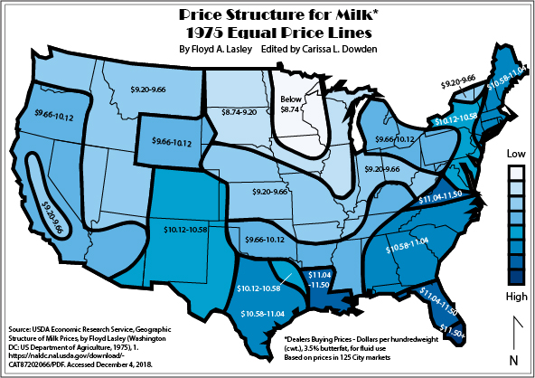
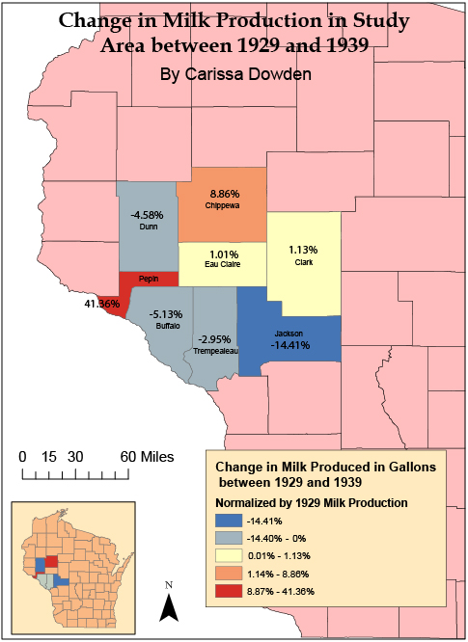
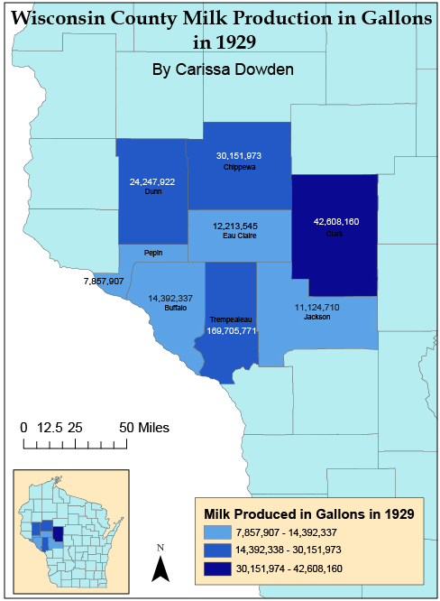
Queen Cow and the Eau Claire Rule
Eau Claire as the new Deal Base Point for the Federal Milk Marketing Order
Carissa Dowden, Dr. James Oberly, and Dr. Ezra Zeitler | Department of History
Introduction
Historiography
USDA Publication Analysis
There has not been any formal research done on this topic. Any sources that do concern this very topic are brief and vague, so this paper seeks to fill the void of knowledge. As such, secondary sources found for this paper primarily concern subsets of the topic: agricultural history of Wisconsin, agricultural economics, Depression Era history, geographic perspectives and economic policy history. Many scholars have written on early state agricultural history in Wisconsin. Edward Janus and Norman K. Risjord’s works on Wisconsin history as America’s Dairyland were consulted for this paper. To better understand the nuances of agricultural policy in the 1930s and on, scholars with works in agricultural economic history also had to be consulted, including Laurie Winn Carlson’s 2005 book William J. Spillman and the Birth of Agricultural Economics on the history of agricultural economics post-World War One and during the Great Depression. Eric M. Erba and Andrew M. Novakovic mention some aspects of this in their 1995 paper, but offer a dairy-based history of agricultural economics, in addition to explaining federal government intervention during crisis. Geographers primarily explore the topic of agriculture through quantitative change over time and cartographic analyses of geographic distributions of phenomena. John A. Cross from UW: Oshkosh explores the impact of dairy farming on the landscape of Wisconsin through cartography though many of his publications. He and other scholars, like Loyal Durand Jr., also explore patterns of spatial distribution on the landscape, like the regionality of milk and manufactured dairy products in Wisconsin (e.g. Dodge County cheese). Durand examines locational factors in Wisconsin source regions of dairy products in order to better understand the causes of geographic shift in markets in his 1947 paper, “Recent Market Orientations of the American Dairy Region.” This type of analysis is even found in R. H. Whitbeck’s paper from 1912, “Industries of Wisconsin and their Geographic Basis,” which is a comprehensive geographic and cartographic analysis of Wisconsin’s industries.
This paper primarily analyzed the data from the Yearbooks of Agriculture between the years of 1930 and 1935 and utilized data from other governmental sources, such as USDA’s Census of Agriculture Historical Archive. Looking at the Agricultural Census of the United States in 1940, Eau Claire’s milk production can be directly compared to other counties in Wisconsin. The counties contiguous to Eau Claire County are Buffalo, Chippewa, Clark, Dunn, Jackson, Pepin, and Trempealeau. If Eau Claire is at the heart of dairy surplus in the Upper Midwest, then theoretically, the counties will have like or slightly less production counts. Specifically using the 1940 Census of Agriculture document on dairy outputs between 1929 and 1939, I have created two basic maps showing the area in question’s milk production in 1929, and the change between 1929 and 1939. As seen in the two maps below, while a high producer, Eau Claire county was not the largest producer of the surveyed counties, and the northern contiguous counties “won” this survey. While the city of Eau Claire itself was closer to the highest producing counties of Chippewa, Clark, and Dunn, Buffalo county pulled the high values slightly southwest. In the change map, both Eau Claire and Clark county experienced small increases of milk production within the region, while Chippewa and Pepin experienced significant growth, which may relate to the regional surplus in Eastern Minnesota as well. If one were to look further north and west, county milk production and sales most likely continued to increase, also showcasing the historical Upper Midwest surplus of milk. As such, while there was no specific federal proclamation as the city as a base point for the FMMO, Eau Claire can be most likely be understood as a contemporary general geographic mean center of milk production in both the upper Midwest and the United States as a whole.
Source: USDA, “Cows milked, and milk produced in 1929 and 1939; Dairy products sold and butter churned, 1939; and cows kept for milk on April 1, 1940; by number of cows milked, by counties.” Census of Agriculture Historical Archive. Accessed December 5, 2018. http://usda.mannlib.cornell.edu/usda/AgCensusImages/1940/04/03/1329/Table-19.pdf.
Equal Price Lines of Milk in 1975. USDA Economic Research Service, Geographic Structure of Milk Prices, by Floyd Lasley (Washington DC: US Department of Agriculture, 1975), 1. https://naldc.nal.usda.gov/download/CAT87202066/PDF.
The Federal Milking Marketing Order (“FMMO”), established as a part of President Roosevelt’s New Deal in 1937, supposedly established Eau Claire as the national base point, or the site from which minimum fluid milk prices are set. The colloquially-known “Eau Claire Rule” sets Class 1 (beverage) milk prices as a function of distance from Eau Claire, Wisconsin (Mahon 2004). That is, the farther that one travels from Eau Claire, Wisconsin, the more that Class 1 milk prices increase, which is shown in the 1975 Price Structure for Milk map by Floyd Lasley. One can see that prices generally increased as one got farther in distance from the tri-state area of Minnesota, western Wisconsin, and northeastern Iowa. Farmers suffered the immediate economic consequences of the drought of 1930, as it resulted in reduced public demand for agricultural products. This forced farmers to increase production in order to cover business costs, despite rapidly plummeting prices from the continually deepening nadir of economic despair. With this story in mind, this research seeks to illuminate the reasons why, of all places, the federal government assigned Eau Claire as the base point of minimum milk prices.
History of Agricultural Problems in Wisconsin
For those coming to Wisconsin in the late 1840s, it was not milk that reigned king, but wheat. Called the “wheat error” by Edward Janus, the newly colonized land of Wisconsin was virgin and fertile, and “wheat miner” farmers were taking advantage of the new cash crop (Janus 2011, 6). However, wheat destroyed the fertility of Wisconsin’s soils, and multiple blights upon farmer’s crops drove many West in search of productive land (Apps 2009, 49). In looking for “salvation” for their soil, farmers turned to livestock to provide nutrients for their land. While sheep were an original favorite for farmers, as they are quickly profitable animals, cattle slowly but surely became a mainstay of the farm. Soil exhaustion and declining wheat yields in southeastern Wisconsin by the 1860s invited many dairy advocates, mainly from New York, where they had replaced wheat agriculture with dairy two decades previous (Risjord 2018, 43). Yankee emigrants brought English milk cows to Wisconsin territory, and it became more common for farmers to keep a cow or two to produce milk seasonally for their family.
In 1870, Wisconsin had ninety cheese factories (Apps, 49). By 1905, that number had increased to 1518, and in 1922, to 2807. William Dempster, the editor of Hoard's Dairyman, aptly said "Queen Cow dethroned King Wheat” (Apps, 50). By the early 1920s, Wisconsin was America’s Dairyland; "In a mere sixty years Wisconsin had risen from a state of economic and moral depletion to become a national icon of wholesomeness and rural rectitude.” (Janus, 47). After WWI, farm prices slumped, leading to producer struggles during the 1920s. During the decade, farm journals and organizations had been advising farmers to control their production. Advocates were calling for government intervention throughout the 1920s, but no steps were taken, even when farm prices fell more than fifty percent between 1929 and 1932 at the beginning of the Depression. Farm Commodity Programs, a result of FDR’s administration, were created to combat the price nadir, but production in agriculture does not easily or quickly adjust to changes in the market, dairy even moreso (USDA 1932, 10). Despite many federal support programs, as said by the Henry A. Wallace, Secretary of Agriculture in 1934, “the depression robbed farmers of their independence, formerly the chief attraction of country life, and thereby weakened the foundations of our whole economic system” (USDA 1934, 2).
Conclusion
Upon going through every bit of language concerning the Federal Milk Marketing Order, there is not one mention of Eau Claire, Wisconsin, or the base point. Statistically speaking, however, the upper Midwest was and remains a bastion of dairy production in the United States. The Eau Claire Rule has become a part of Wisconsin culture as well as a myth of dairy farming in America. “We have urban myths, and we have rural myths,” said Mark Stephenson for On Wisconsin Magazine,“Eau Claire is a rural myth,” started in the 1920s and rolled out in the 1930s (Allen 2013). While Eau Claire may be in a part of the United States with a tendency to produce dairy products over local demand, there are other parts of the country with the same propensities (e.g. New York). However, agricultural production costs in the upper Midwest tend to be lower than in other parts of the country, contributing to this continuation of myth (Lasley 1975, 1). Well after FDR’s America, the power of that base point is be weakening today, with the California FMMO as an example (USDA 2018). However, the silent power of a mid-sized community in the west-central part of Wisconsin has held the both the milk prices in the state and the rest of the country captive for almost a century. Therefore, the Eau Claire rule can be associated with a paradigm shift in agricultural policy and the interaction between the federal government and citizens during times of crisis.
Bibliography
Primary Sources
Allen, John. “Milk Matters.” On Wisconsin (Madison, WI), Winter 2013. Accessed December 5, 2018, https://onwisconsin.uwalumni.com/features/milk-matters/.
Committee on Agriculture and Forestry, To Regulate Commerce in Agricultural Products. HRG-1939-AFS-0004 (Washington DC, February 1-3, 7-8, 10-11, 17, 1939). ProQuest: Congressional. Accessed December 5, 2018. https://congressional-proquest-com.proxy.uwec.edu/congressional/docview/t29.d30.hrg-1939-afs-0004?accountid=14790.
Library of Congress, Congressional Research Service, Farm Commodity Legislation: Chronology, 1933-2002, 2002, CRS-1.
Library of Congress, Congressional Research Service, Federal Milk Marketing Orders: An Overview, 2017, 6.
US Library of Congress, Congressional Research Service, Farm Commodity Legislation: Chronology, 1933-2002, 2002, CRS-1.
US Library of Congress, Congressional Research Service. Federal Milk Marketing Orders: An Overview, 2017, 6.
USDA Agricultural Marketing Service. “Advanced Announcement of Class Prices and Related Data for December 2018.” Accessed online December 15, 2018. http://www.fmma30.com/ClassPrice/2018/AdvancePrice--12-18.pdf.
USDA Agricultural Marketing Service. “Federal Milk Marketing Orders.”https://www.ams.usda.gov/rules-regulations/moa/dairy (accessed November 11, 2018).
USDA Economic Research Service, Geographic Structure of Milk Prices, by Floyd Lasley. (Washington DC: US Department of Agriculture, 1975), 1. Accessed December 4, 2018. https://naldc.nal.usda.gov/download/CAT87202066/PDF.
USDA Economic Research Service. History of Agricultural Price-Support and Adjustment. Programs, 1933-1984. (Washington DC: US Department of Agriculture, 1985), 1.
USDA. “Cows milked and milk produced in 1929 and 1939; Dairy products sold and butter churned, 1939; and cows kept for milk on April 1, 1940; by number of cows milked, by counties.” Census of Agriculture Historical Archive. http://usda.mannlib.cornell.edu/usda/AgCensusImages/1940/04/03/1329/Table-19.pdf. Accessed December 5, 2018.
USDA, Large-scale organization in the dairy industry, Rudolph K. Froker, Colebank, A. W., and Hoffman, A. C. (Washington D.C.: US Department of Agriculture, 1939), 19.
USDA. “PART 1030--MILK IN THE UPPER MIDWEST MARKETING AREA.” (Washington DC, Electronic Code of Federal Regulations, 2018). 1-20. https://www.ecfr.gov/cgi-bin/textidx?SID=a709893419f11845a46bb42e7d66b531&mc=true&node=pt7.9.1030&rgn=div5. Accessed December 5, 2018.
USDA. Yearbook of Agriculture: 1930. (Washington DC, US Department of Agriculture, 1930).
USDA. Yearbook of Agriculture: 1931. (Washington DC, US Department of Agriculture, 1931).
USDA. Yearbook of Agriculture: 1932. (Washington DC, US Department of Agriculture, 1932).
USDA. Yearbook of Agriculture: 1933. (Washington DC, US Department of Agriculture, 1933).
USDA. Yearbook of Agriculture: 1934. (Washington DC, US Department of Agriculture, 1934).
USDA. Yearbook of Agriculture: 1938. (Washington DC: US Department of Agriculture).
US. Congress, Senate, Committee on Agriculture and Forestry, To Regulate Commerce in
Agricultural Products. 76th Cong., 1st sess., 1939, 1-427. ProQuest: Congressional. Accessed December 5, 2018. https://congressional-proquest-com.proxy.uwec.edu/congressional/docview/t29.d30.hrg-1939-afs-0004?accountid=14790.
USDA. “PART 1030--MILK IN THE UPPER MIDWEST MARKETING AREA.” (Washington DC, Electronic Code of Federal Regulations, 2018). 1-20. Accessed December 5, 2018. https://www.ecfr.gov/cgi-bin/text-idx?SID=a709893419f11845a46bb42e7d66b531&mc=true&node=pt7.9.1030&rgn=div5.
Secondary Sources
American Dairy Products Institute. “Milk Pricing 101.” https://www.adpi.org/Portals/0/Academy/Milk%20Pricing%20101.pdf (Accessed December 2, 2018).
Apps, Jerry. “Dethroning King Wheat.” Voyageur: Historical Review of Brown County and Northeast Wisconsin 26, no. 1 (2009): 49.
Carlson, Laurie Winn. William J. Spillman and the Birth of Agricultural Economics. Columbia: University of Missouri Press, 2005. Accessed December 5, 2018. ProQuest Ebook Central. https://ebookcentral.proquest.com/lib/uwec/reader.action?ppg=1&docID=3570852&tm=1544227708912.
Cross, John A. “Change in America’s Dairyland.” Geographical Review, 91, no. 4 (October 2001), 702-714.
Durand, Loyal Jr. “Cheese Region of Southeastern Wisconsin.” Economic Geography, 15, no 3 (July 1939) 283-292. Accessed December 6, 2018. Taylor & Francis, Ltd. https://www.jstor.org/stable/141547?seq=1#metadata_info_tab_contents
Durand, Loyal Jr. “Recent Market Orientations of the American Dairy Region.” Economic Geography, 23, no. 1 (January 1947), 32-40. Accessed December 6, 2018. Taylor & Francis, Ltd. https://www.jstor.org/stable/141652?seq=1#metadata_info_tab_contents.
Erba, Eric M. and Novakovic, Andrew M. “The Evolution of Milk Pricing and Government Intervention in Dairy Markets.” Ithaca, NY: Cornell Program on Dairy Markets and Policy, 1995.
Janus, Edward. Creating Dairyland: How Caring for Cows Saved Our Soil, Created Our Landscape, Brought Prosperity to Our State, and Still Shapes Our Way of Life in Wisconsin. Madison, Wis.: Wisconsin Historical Society Press, 2011.
Risjord, Norman K. "From the Plow to the Cow: William D. Hoard and America's Dairyland." The Wisconsin Magazine of History 88, no. 3 (2005): 40-49. http://www.jstor.org.proxy.uwec.edu/stable/4637137.
Victory Horticultural Group. “Department of Agriculture Yearbooks.” http://www.saveseeds.org/library/holdings/yoa.html (Accessed December 2, 2018).
Whitbeck, R. H. “Industries of Wisconsin and Their Geographic Basis.” Annals of the Association of American Geographers, 2 (1912), 55-64. Accessed December 5, 2018. Taylor & Francis, Ltd. https://www.jstor.org/stable/2560641?seq=1#metadata_info_tab_contents.

