Slide 1
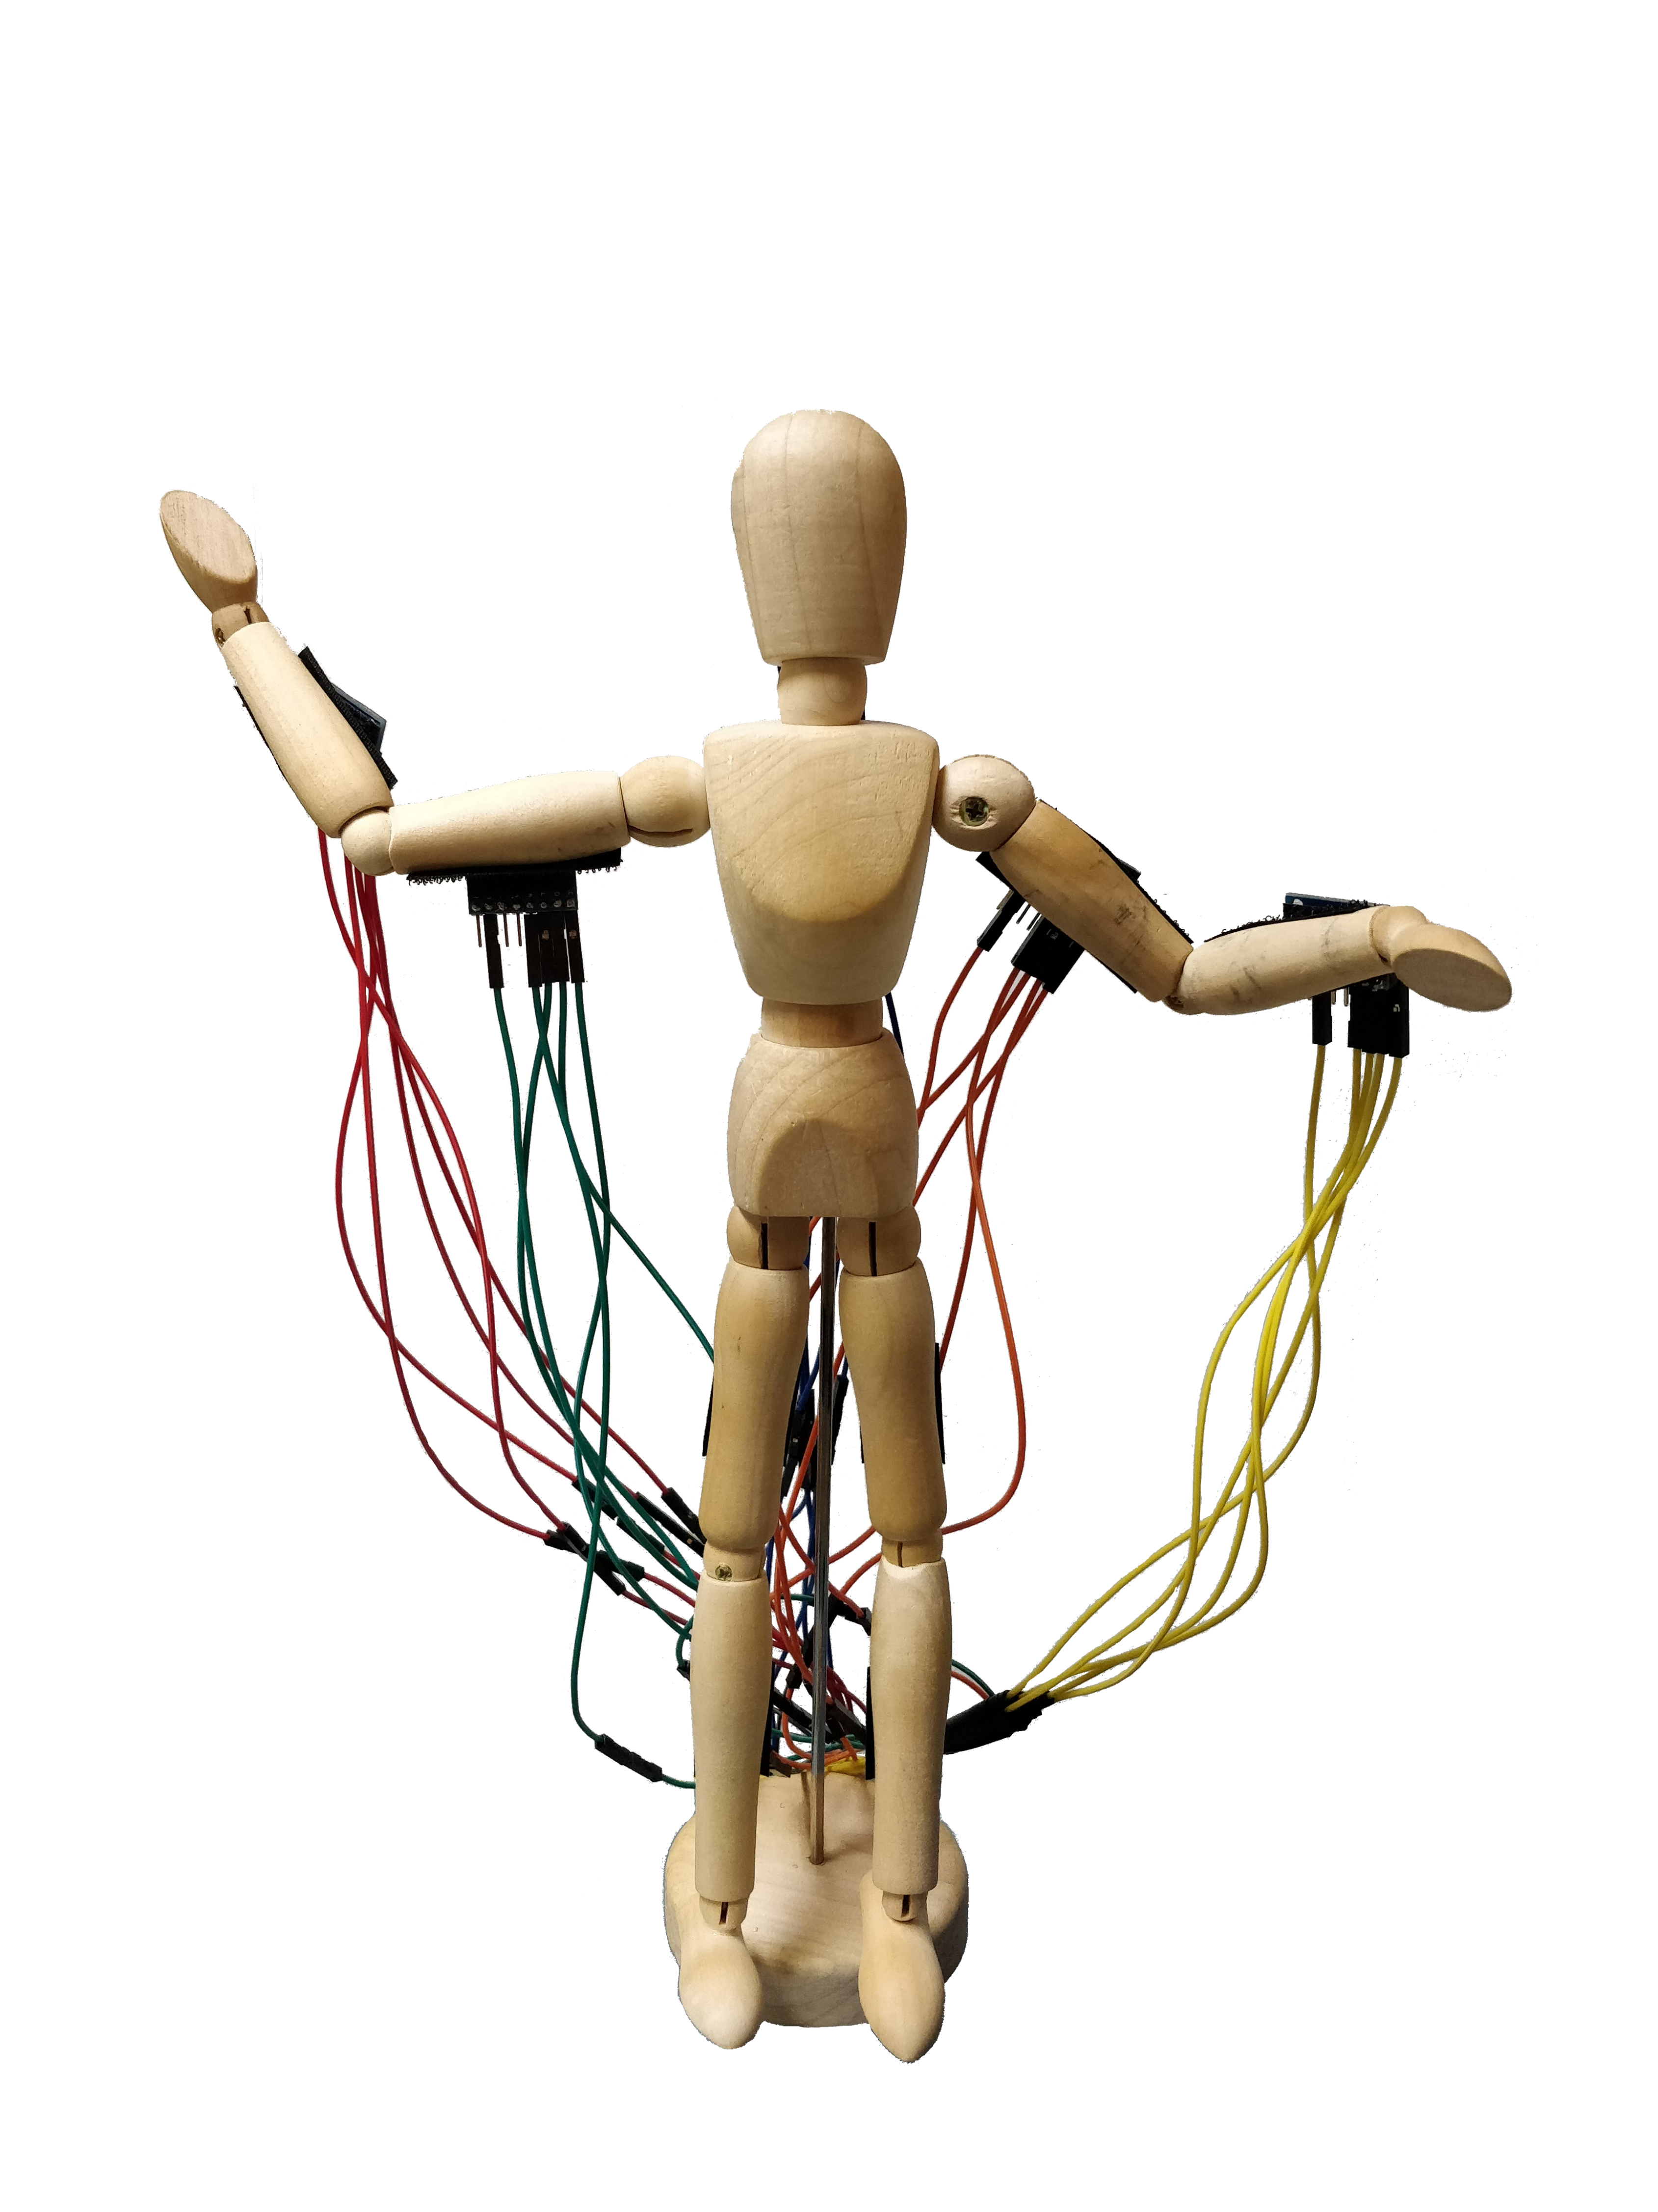
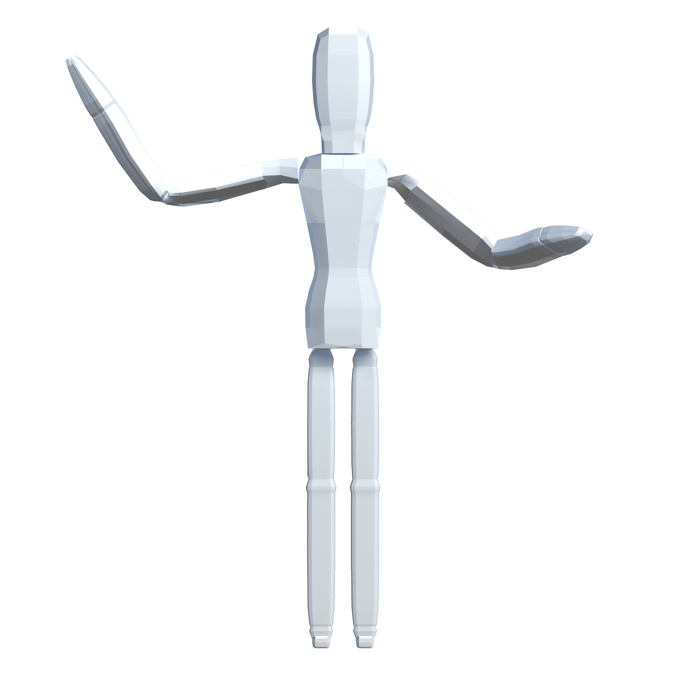
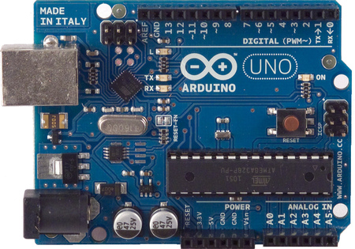
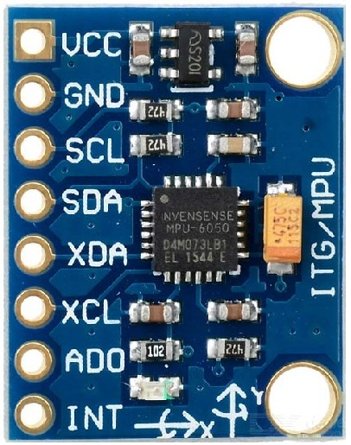
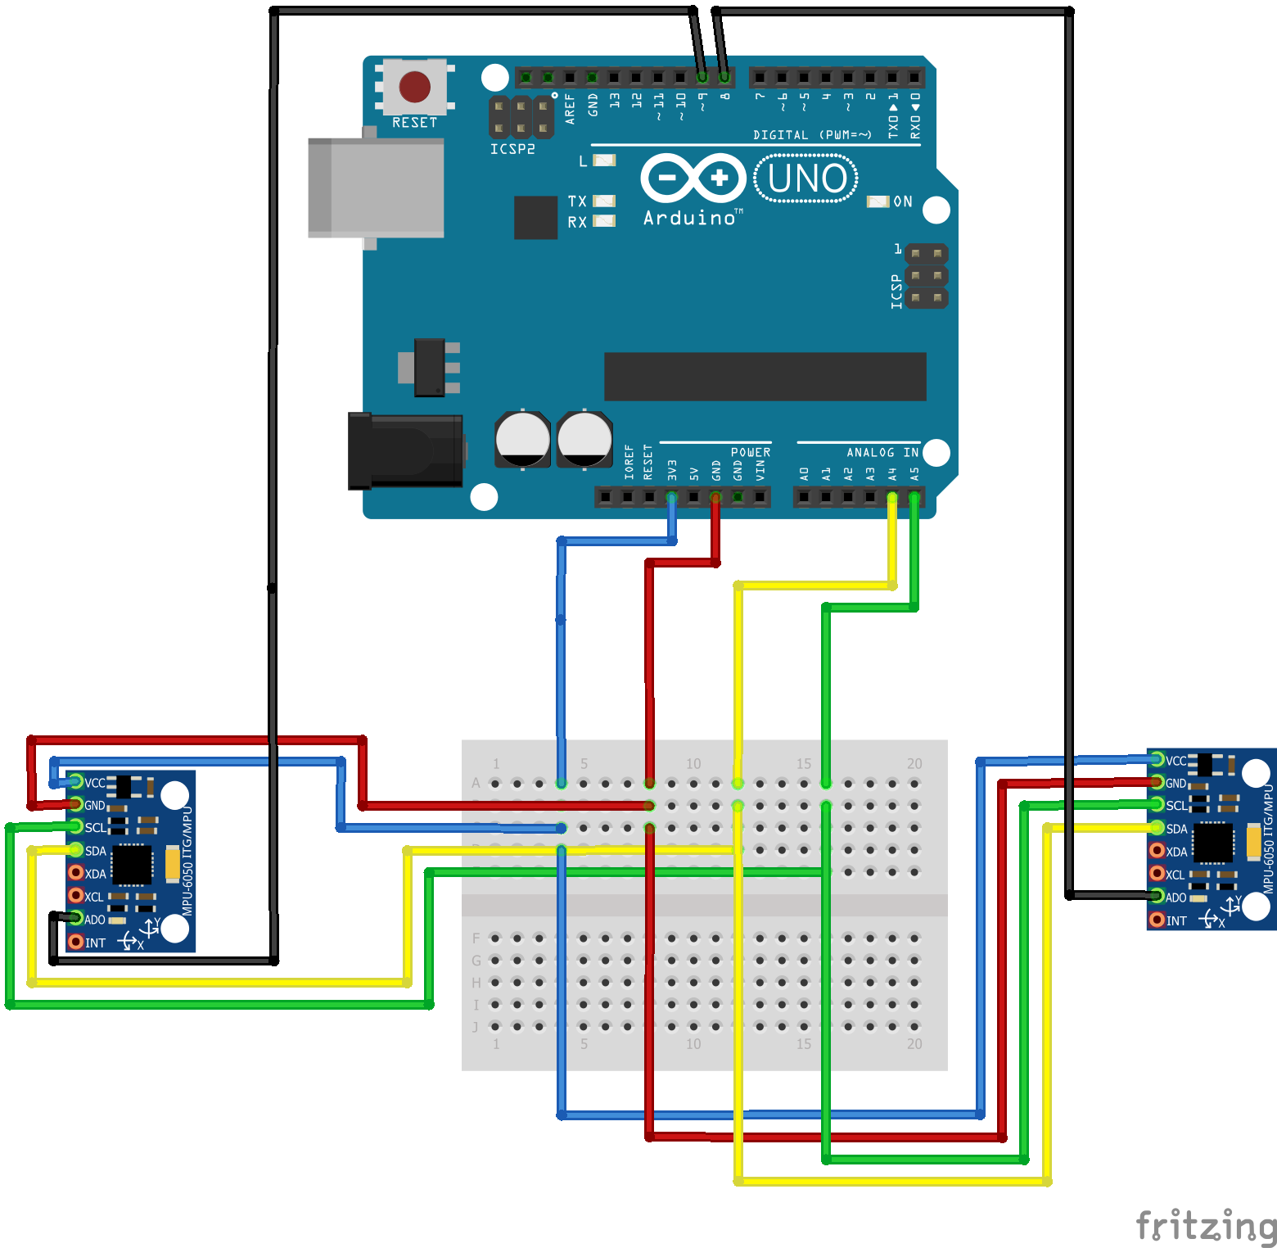
Mannequino – Bridging the Gap to the Virtual World
Designing a full-body motion input device with an Arduino microcontroller
Patrick Balfanz and Dr. Chris Johnson | Computer Science
Introduction
From the sensors
to the board
This research focuses on creating a new input device using accelerometers wired to a wooden mannequin to manipulate virtual objects within the Unity game engine. By moving the physical arm of the mannequin, the arm of a character will bend the same way in the game world. We hope that the finished product could even be used in conjunction with virtual reality.
Board setup and addresses
Because the I2C bus from the accelerometers to the Arduino board only has two possible addresses to work with, we constructed a process to send the sensor data over the serial port, mapping the active sensor to be read to the first address and the inactive sensors mapped to the second.
Every time a sensor needs to be read, we can switch it to the active address and send the required orientation data in the form of a quaternion (x, y, z, w) to the computer. This way we could bypass the two-sensor limit and have any number of them attached to the board as long as we have the space for it. Theoretically, we can have up to fourteen sensors per board, one for each digital pin.
Hardware and software
Arduino Uno Microcontroller
Up to fourteen MPU-6050s, A Gyro and Accelerometer by InvenSense
Unity Game Engine – Code in C#
Arduino IDE
Arduino communication software derived from Jeff Rowberg’s I2Cdev library
Virtual Mannequin Model
Fanning out the signal
The motion of the physical model is translated to the virtual 3D model
In order to successfully connect multiple sensors to an Arduino board, each connection except for the ADO pin, which is used by each sensor to tell it what individual address it has been assigned, can be shared. Four total pins are fanned out to every MPU connected to the Arduino:
The Physical Mannequin Model
The Arduino Uno Board
3.3V to each VCC - This connection provides power
GND to each GND - This connection is the ground which completes the circuit
Analog 4 to each SDA - The I2C bus data line for information transfer
Analog 5 to each SCL - The I2C bus clock line for synchronization
From the board
to unity
Data through the serial port
Calibration
Applications
All data is sent to the computer through the serial port, a communication interface which information transfers in or out one bit at a time. Captured data from each sensor is assigned an id which is sent across the serial port along with its rotation values to be read by our script within Unity.
In its raw form, the given quaternion values are difficult to work with because they are not oriented in the correct position needed to track on the mannequin. After each sensor is activated for the first time, calibration is needed.
To calibrate each rotation given by a sensor, the inverse of the quaternion generated is calculated. By multiplying this inverse by each sequential rotation, we can offset the model mannequin limb back to its default location to correctly track the sensor’s movement.
We envision that this software could be used as an aid for skeletal animation or as an input device specifically for video game development.
Future variations this project could include easy adaptation for different models, wireless sensor connection, or upgrading the components to integrate more accelerometers into the system.
A MPU-6050 Accelerometer
Basic procedure
Id x y z w
[0 -0.57452 0.29175 0.27881 0.61859]
[1 0.97705 0.38397 1.22919 -0.38239]
[2 1.90729 1.35913 1.48285 -1.89764]
[3 -0.75726 1.87604 0.23627 -0.84680]
[4 0.48267 1.04260 0.68219 -0.76996]
Gyroscopes are attached to different limbs on the mannequin model assigned to each sensor
Data from the sensors is sent to the board via the I2C bus protocol, a common standard of peripherals information transfer
Data is then sent over the serial port to a desktop computer to calculate the individual rotation of each sensor and make calibration adjustments
Motion of each sensor is translated to a similar mannequin 3D model running on the Unity game engine
References
Raw quaternion values given directly by a sample of five sensors
Rowberg, Jeff. i2cdevlib, 2018, GitHub, https://github.com/jrowberg/i2cdevlib
This data is then read from the serial port and parsed through on the Unity side to be dumped into a quaternion object and the rotation is applied to a selected limb. Other adjustments to compensate for differences in the default position of the physical sensors on the mannequin are then applied.
At startup:
Quaternion q = ReadRotation(serialLine);
offset[i] = Quaternion.Inverse(q);
Where q is the rotation read in and offset is an array of calibration offsets
For each new quaternion q read:
limbs[i].rotation = offset[i] * q;
Where limbs is an array of limbs on the mannequin model to be rotated
Acknowledgements
This project was funded by the Blugold Fellowship program.
Our physical board setup with two MPU-6050s

