Slide 1

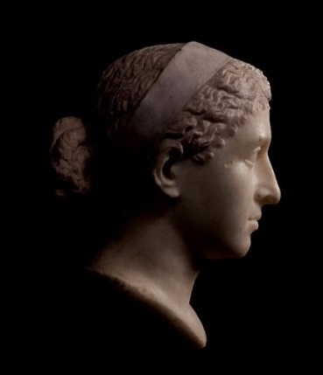
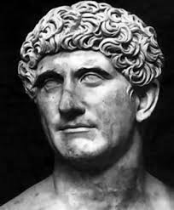
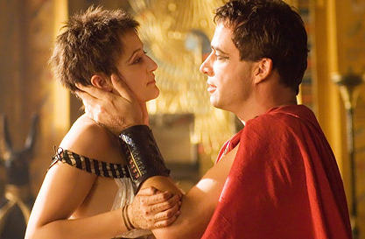

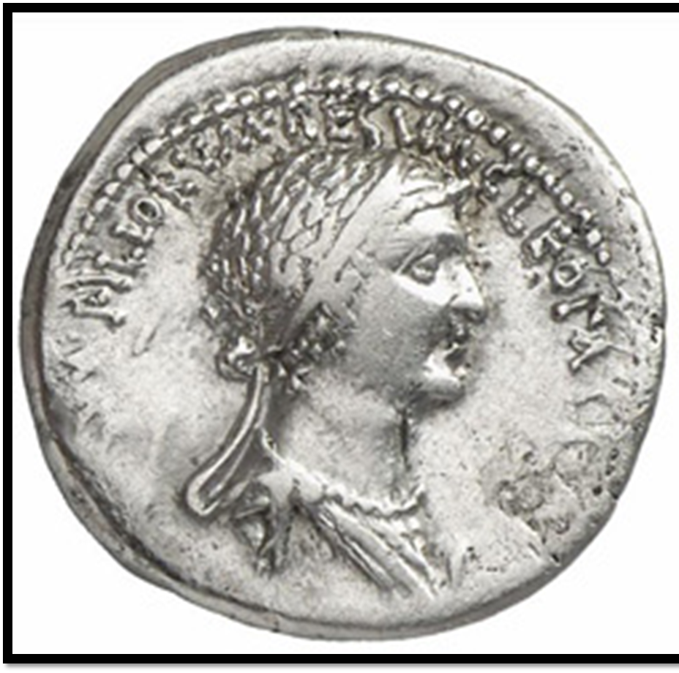
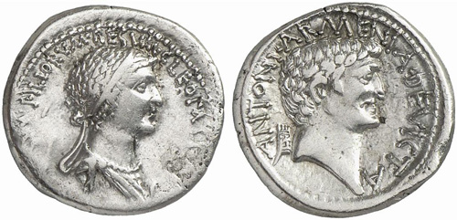
Vice and Virtue: The Dichotomy of Fact and Fiction in the Romance of Antony and Cleopatra
Brianne Ackley
Faculty Mentor: Dr. Matt Waters
Ancient Studies
University of Wisconsin-Eau Claire
Introduction:
One of the most intriguing romance stories in Rome 1st century BC, Marcus Antonius and Cleopatra VII have prompted the question of whether their romance was based more in the political or in the personal realm. Plutarch (c. 100 CE) is our main source. Based on literary choices, the question is explored through the lens of idiom (personal self) and koinon (communal self).
  55 BCE Cleopatra casually meets Antony as he visits Egypt
  43 BCE Cleopatra supports the second triumvirate (Antony, Octavian, Lepidus) in fight against Cassius and Brutus
  41 BCE Cleopatra meets Antony in Tarsus to aid in his campaign against the Parthanians
  40 BCE Cleopatra gave birth to Antony’s twins, Helios and Selene
  36 BCE Cleopatra and Antony “marry” (against Roman law since he is married to Octavia). Cleopatra gave birth to Antony’s third son, Ptolemy Philadelphos
  34 BCE Antony wills Helios and Selene his claim of Roman empire, and Octavian exposes this to Rome
  32 BCE Antony divorces Octavia (Octavian declares war on Cleopatra, but NOT Antony “bellum iustum”- a just war)
  31 BCE Antony and Cleopatra flee after the Battle of Actium
  30 BCE Antony and Cleopatra commit suicide in Egypt before Octavian can capture them
Vice and Virtue: Xenophon (early 4th c BCE)
Antony linked to Heracles (in Xenophon’s Memorabilia Hercules must make a choice between virtue and vice)
The choices Antony and Cleopatra made were not all explainable through political gain (virtue) which points to a path of personal gain (vice)
The idiom as vice and the koinon as virtue
In the Memorabilia, Socrates tells a story by the Sophist Prodicus about Hercules, and the choice we must make between “Virtue”, a difficult but rewarding path, and “Vice”, a simple but unfulfilling path
“Friends call me ‘Happiness’…but those that hate me call me ‘Vice’” (Xenophon, Memorabilia, 1.26)
Conclusion and Future Research:
While some debate that the relationship between Antony and Cleopatra was settled in the koinon (via Plutarch and other primary evidence like the coins), there are literary elements that point to an impracticality of the relationship for political gain, including the rhetorical portrayal of Cleopatra, and the personal choices of Antony and Cleopatra (i.e.. the divorce with Octavia), and Plutarch’s linking of Antony to Hercules,. This leads to the conclusion that it was predominantly centered in the idiom. Future research to expand on this topic would include a more in-depth reading on typical Egyptian relationships as well as further Roman propaganda techniques.
Plutarch:
“It is not histories I am writing, but lives; and in the most glorious deeds there is not always an indication of virtue of vice, indeed a small thing like a phrase or a jest often makes a greater revelation of a character than battles where thousands die.”- (Plutarch, Life of Alexander, 1.2 ~75 A.D.E)
Rhetorical choice of Cleopatra’s “charm”/bewitching Antony (Life of Antony 36.1) [political motive]
Focus on a romantic relationship, just like the Greek parallel life Demetrius/Lamia
Antony and Cleopatra, in Alexandria; [HBO’s Rome, 2005]
Fig. 1: Tetradrachm coin, Art Institute of Chicago, Greco-Roman, minted in Eastern Mediterranean (possibly Antioch)
Selected Bibliography:
Arendt, Hannah . Biopolitics: A Reader, edited by Campbell and Sitze. The Human Condition. 2013. New York. Print
*Acknowledgment due to Office of Research and Sponsored Programs at the University of Wisconsin-Eau Claire, Dr. Waters for his mentorship through this research, and LTS for printing the poster.
Vice and Virtue: Idiom and Koinon
Koinon- the political or “public self”
Idiom-the private self of “personal self”
Political self on the depiction of Antony and Cleopatra on coins [Cleopatra made to mirror Antony on Tetradrachm(coin)- issued in 37/33 BCE: koinon
Personal self linked with Octavia divorce/living will to Cleopatra’s children/double suicide to: idiom

