Slide 1
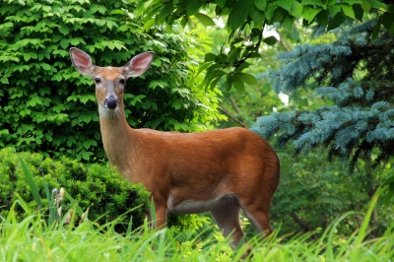
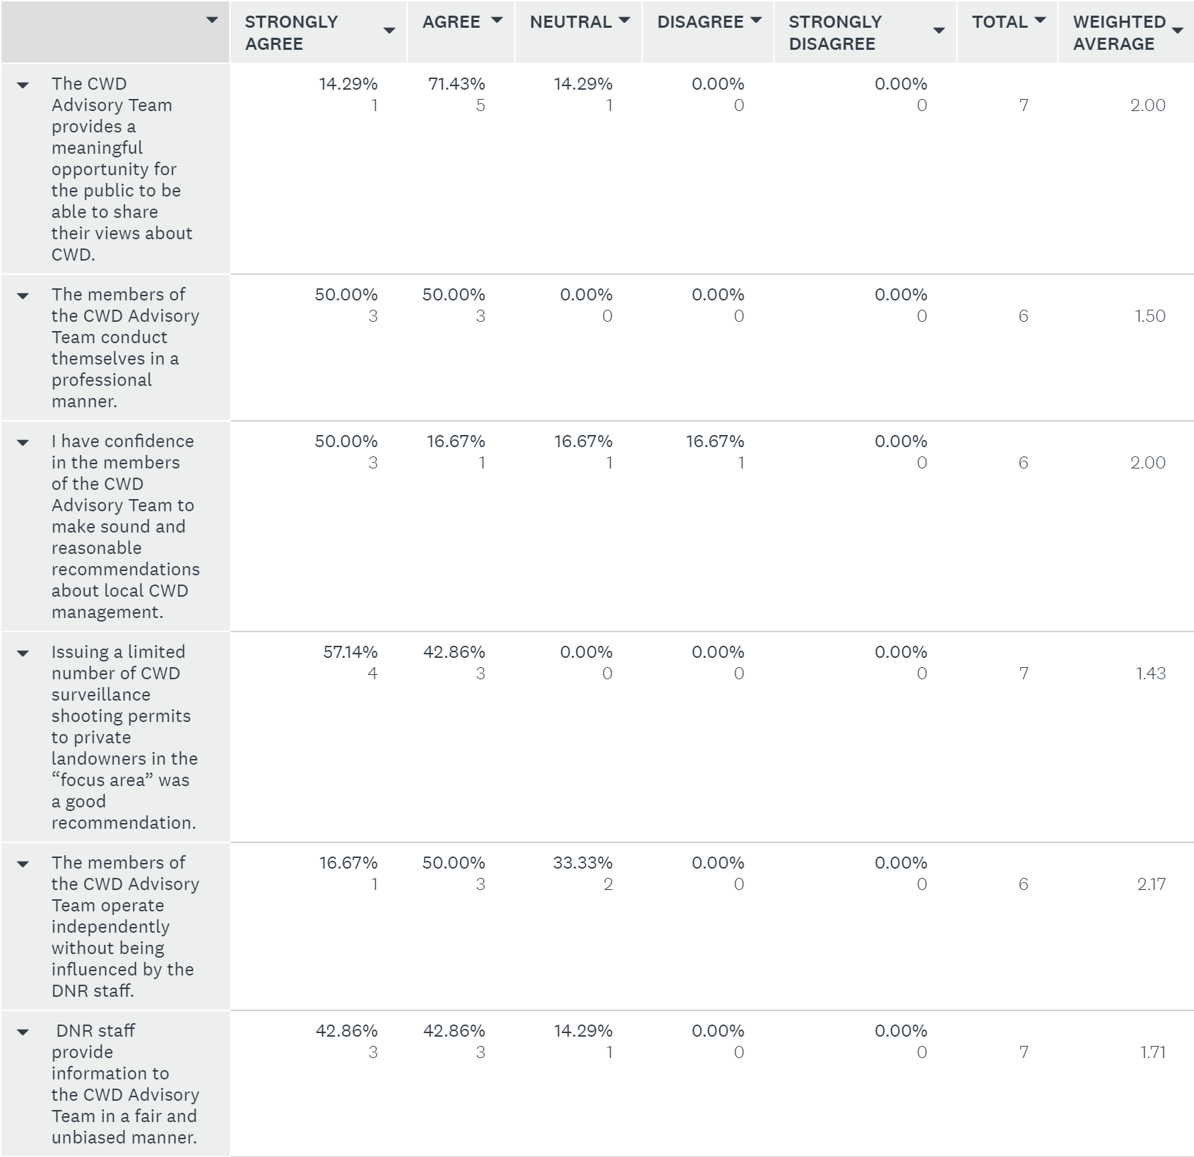
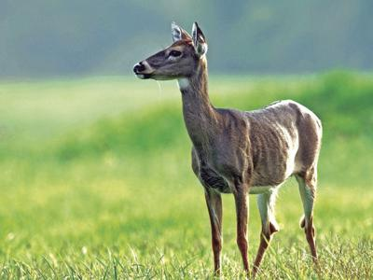
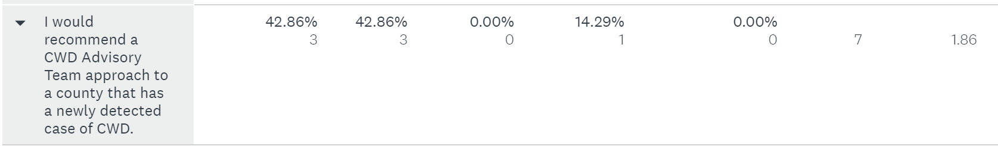
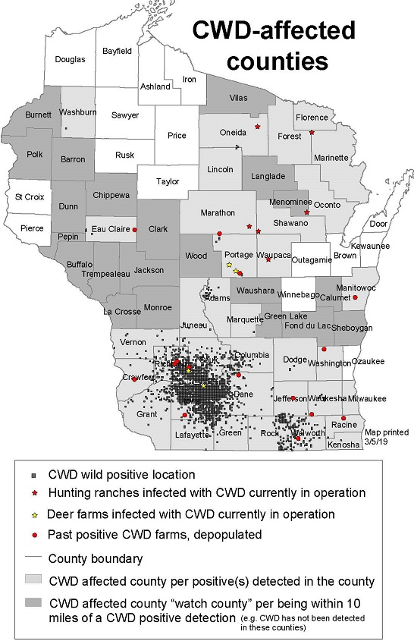
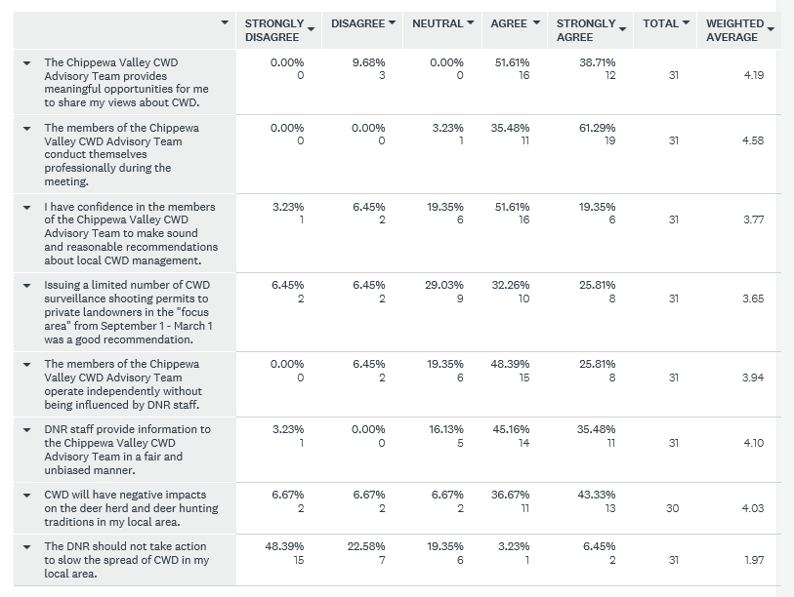
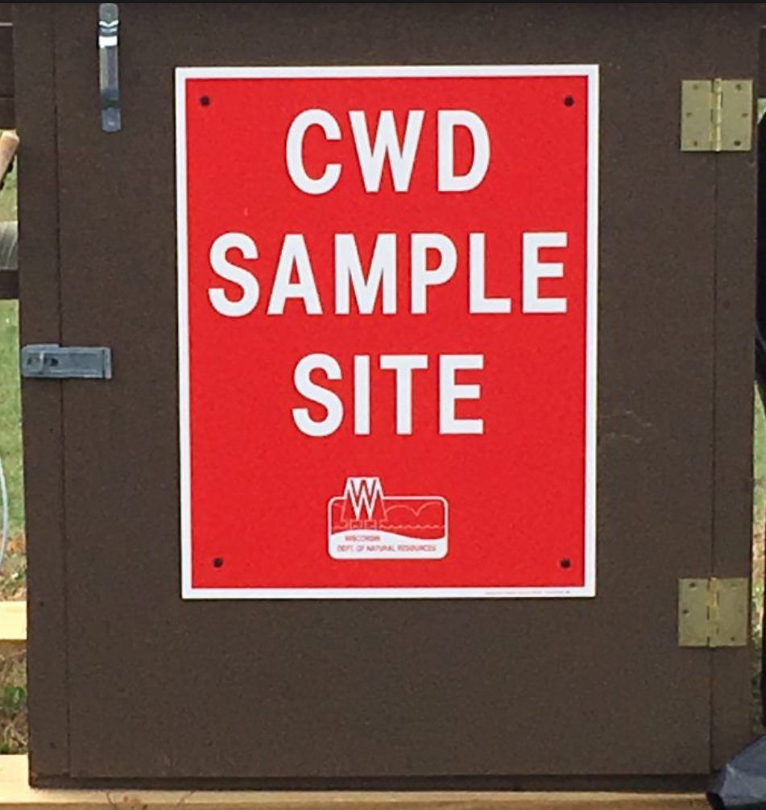
Human Dimensions of
Chronic Wasting Disease in Wisconsin
Samantha Edwards | Biology Department
Faculty mentor | Dr. Paula Kleintjes Neff
WDNR Staff Survey Results and Discussion
abstract
According to most of the WDNR staff surveyed they find the CVCAT useful and doing the job that was intended for them to do. This suggests that the WDNR has a level of trust in the CVCAT to be a forum for the public discourse. The only slight disagreement was whether or not the CVCAT should be used to make sound recommendations and whether they should operate independently. I interpret this as the WDNR staff feeling as though the CVCAT does not have the full understanding or background to understand the best choice for deer management. The WDNR however, does understand the importance of giving the public a voice and most would recommend a CWD Advisory Team to other counties.
CWD is a disease caused by prions (an infectious protein particle similar to a virus). CWD can affect deer, elk, moose and reindeer. The first case of CWD in Wisconsin was discovered in 2002 and in Eau Claire County in 2018. Its arrival initiated the creation of the Chippewa Valley CWD Advisory Team (CVCAT). The CVCAT is made up of 7 members of the public that have prior knowledge of deer herd management and hunting practices. The goal of CVCAT is to provide the WDNR recommendations regarding local surveillance areas and methods, and management options for white-tailed deer potentially exposed to CWD. The objective of this study is to qualitatively assess the effectiveness of the CVCAT , i.e., assessing what the public thinks it wants and what the WDNR would like to see happen. The assessment includes interviewing and surveying four focal groups who have a stake in either deer hunting, and/or deer population management (CVCAT members; members of public who attend CVCAT meetings; WDNR employees working directly with CWD; and students/deer hunters in the UWEC Rod and Gun Club). Survey results will be summarized and analyzed to gauge local perceptions of CWD and the effectiveness of the CVAT. The data will then be potentially used by the WDNR as they face the challenge of working with the public to manage deer and this emerging infectious disease.
Healthy appearing White-tailed Deer
Figure 1. All individuals surveyed are WDNR employees working specifically with CWD. All WI counties included in the survey were: Buffalo, Trempealeau, Eau Claire, Vernon, Taylor, Rusk and Milwaukee.
White-tailed deer infected with CWD
Tools used
Public Survey Results and Discussion
Interviews with the CVCAT were done over the phone individually. Eight questions were designed for open answers from the interviewees. The interviews took between 30-60 minutes.
Surveys of the DNR staff and the public that attends the CVCAT meetings were designed using survey monkey. Both surveys had questions that used a strongly agree to strongly disagree scale. The surveys each had eight questions and took roughly 5-10 minutes to complete. The analysis of the surveys was done using survey monkey which created an average chart.
Figure 2. All individuals surveyed attended the CVCAT meeting in March 2019. T total of 42% of participants lived within the “surveillance area”(500+ square miles from an infection site), 45% within the “focus area”(25.5 square miles from an infection site) and 13% lived in neither.
Range of CWD in Wisconsin
CVCAT Interview Results and Discussion
All members of the CVCAT agreed that they work well within themselves at understanding and working through disagreements. This suggests that the WDNR chose individuals that are able to communicate and compromise when needed. The CVCAT appeared open to public opinion at any point in time during the meetings. Having a group that is willing to listen, even if their opinion does not match the individuals, is an important aspect of their advisory role. CVCAT members want to make informed recommendation that address public concerns. Levels of action that different CVCAT members would like to take included mandatory CWD testing, longer shooting periods, and sharp shooting to cull infected animals. However, since some of these actions may be considered extreme ideas for managing CWD, all members understood they may not be publicly acceptable. Survey results suggest that the CVCAT provides a safe platform for the public to be able to share their opinions and they would recommend a CWD Advisory Team approach to any county with a newly found CWD case.
For the most part, the opinions and concerns of the public were similar. Many of them agreed that the CVCAT is a safe place for them to share their thoughts and ask questions about things they did not understand. This is great because at least the public feels as though they are being heard and that they can easily receive new information. The red flag that pops up when looking at the results is that they do not feel the CVCAT is getting unbiased information from the WDNR or that they are running independently. This may be due to WDNR staff being present at the meetings. However, they need to be there to get input and directly hear from the public. Lastly most of the public acknowledges that that if CWD continues to spread rapidly it will affect our hunting culture and deer population.
CWD Sample drop-off site
THANK YOU
I thank the following people for whom without them this study would not have been possible. First is William Hogseth (Wildlife Biologist, Eau Claire WDNR) who took a chance on me and brought me on as an intern working with CWD. He was a great inspiration for creating this project and helped guide me in the right directions throughout. Shala Brehm and Steve Pence who are also employees at the WDNR helped me in understanding more about CWD and collecting data. Dr. Paula Kleintjes Neff (UW Eau Claire Biology department Chair) who is my mentor in this project. She was able to give me input along the way as to how I could better conduct and analyze parts of my project.

