Slide 1


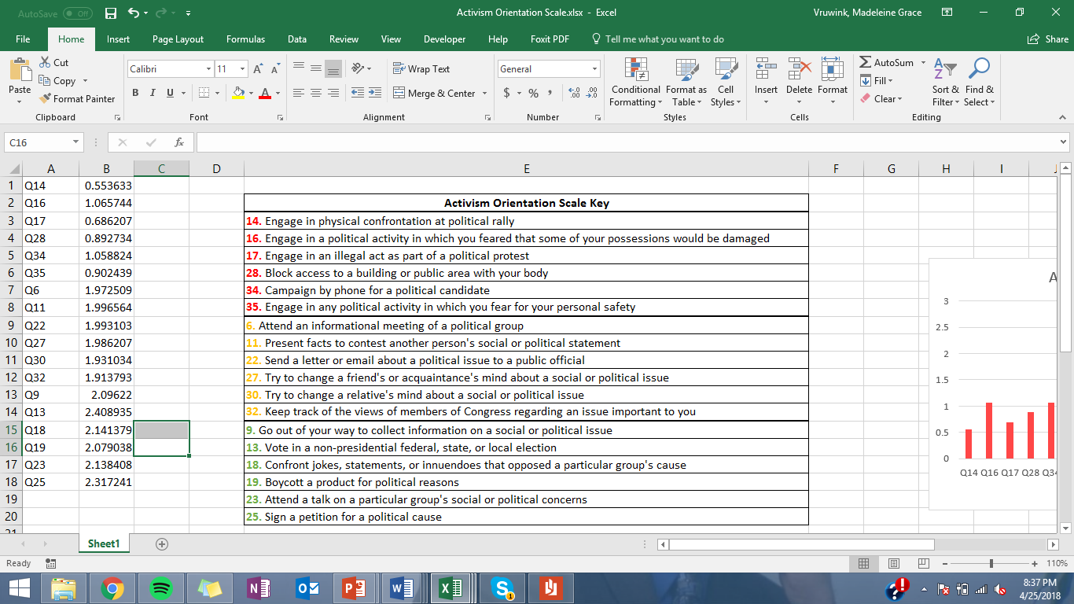
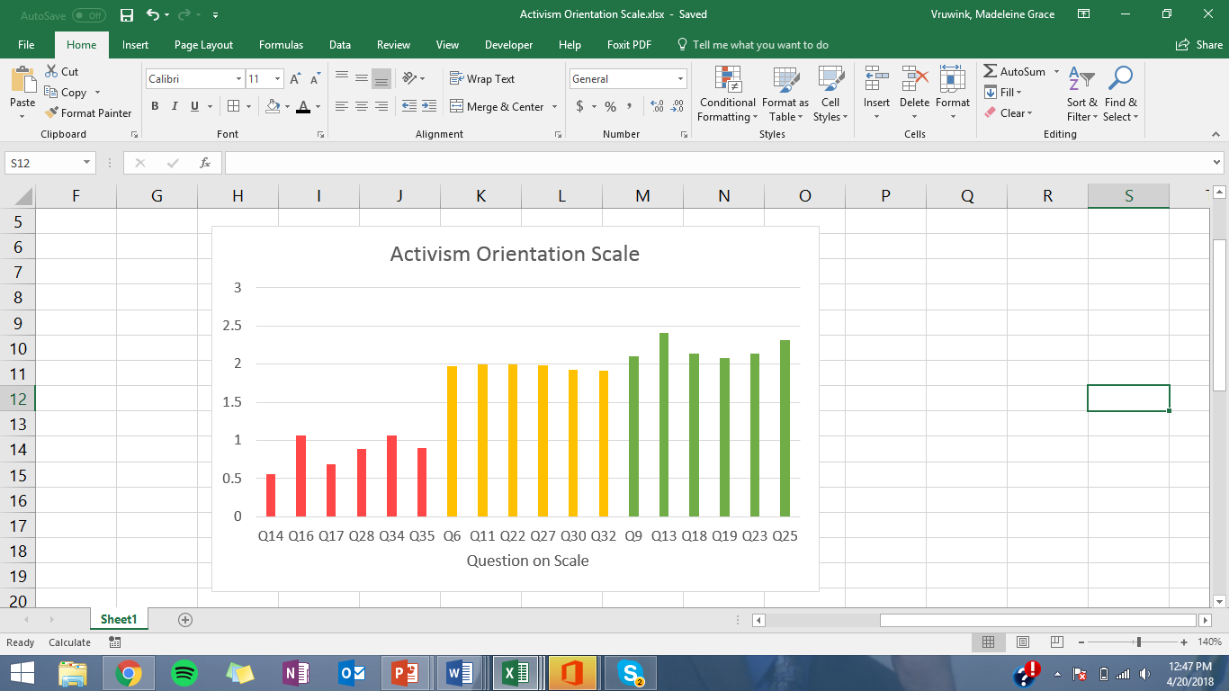
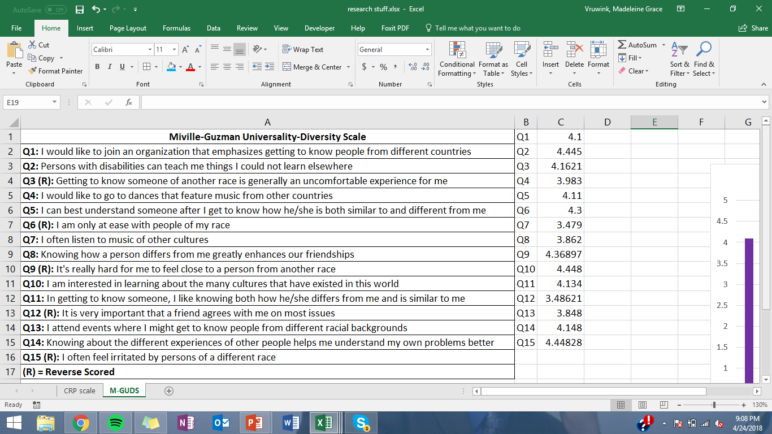
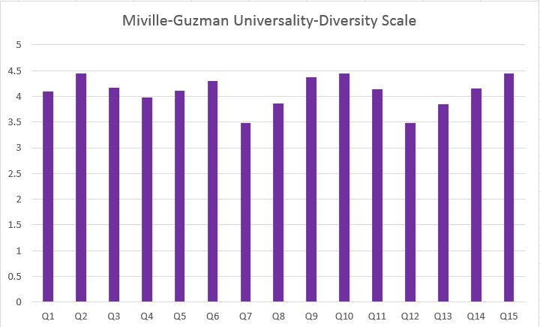
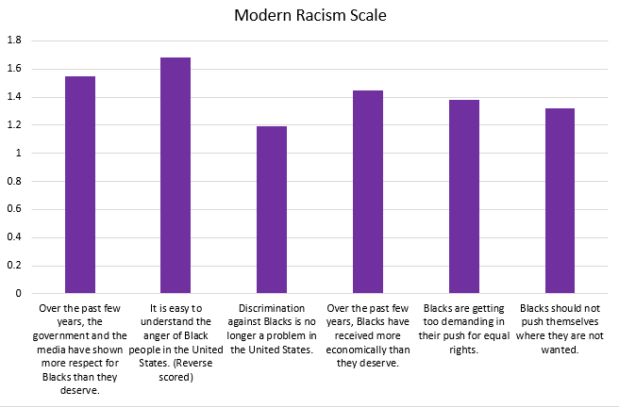
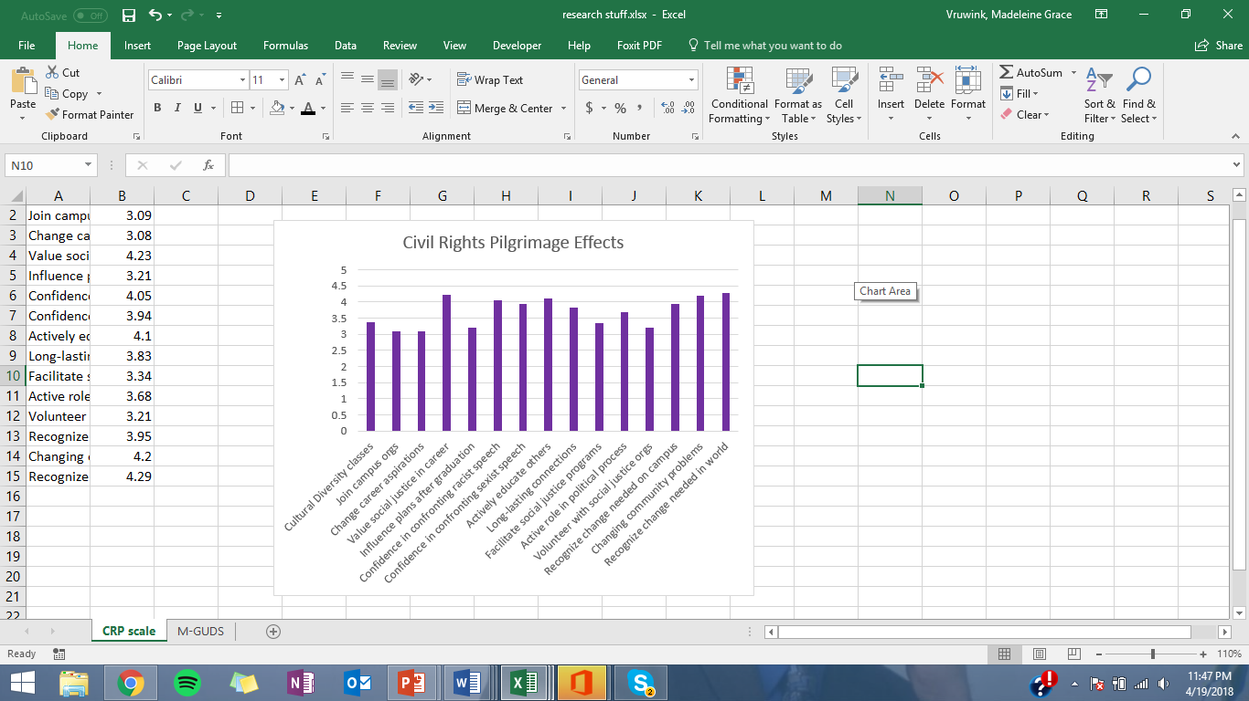

Long-Term Effects of the University of Wisconsin-Eau Claire Civil Rights Pilgrimage
Kelly Anthony, David Edwardson, Jacie Jones, Cecelia Lewis (Lead), Madeleine Vruwink (Lead), Nicholas Walkowiak,
and Faculty Advisor Jodi Thesing-Ritter
University of Wisconsin-Eau Claire
IRB Number: WALKOWNJ7536117162018
Background
v
Discussion
Results
Discussion
Of the participants who responded to our survey, 77.5% were women, 21.9% were men, and 0.6% other; 74.4% were white and 25.6% were students of color.
We divided the Activism Orientation Scale into two subscales to match Corning and Myers’ research. The subscales were divided by the content of the total question, high risk (7) and conventional (28). Five of the six lowest scored responses were a part of the high risk subscale, which is expected because the high risk subscale involves a form of violence and the CRP had a focus on non-violence. The six highest scored responses were all a part of the conventional subscale. This shows that the participants on the CRP are more likely to engage in conventional methods of political activism than engage in high risk methods. Race comparisons had a statistically significant difference between white individuals and people of color for five of the conventional activism subscale items. White individuals were more likely to keep track of Congress member views on a social issue of importance (p̂ =.004), use facts to contest social or political statement (p̂ = .002), confront speech that opposed a group’s cause (p̂ =.001), attend a political group’s meeting (p̂ =.000), and attend a regularly planned political organization’s meeting (p̂ .003). We predicted these outcomes because the Civil Rights Pilgrimage was originally created for white individuals to confront their privilege.
Five out of the fifteen questions in the Miville-Guzman Universality-Diversity Scale were reverse scored (3, 6, 9, 12, and 15). Our top five scores were as follows: Question 15, when reverse scored, had an average score of 4.45. Question 10 also had a 4.45. Question 2, which was also reverse scored, had an average score of 4.44. Question 9, also reverse scored, averaged to 4.27. Question 3, also reverse scored, averaged to 4.16. These results are possibly due to social desirability bias, since four out of the five questions were reverse scored. This is a possible limitation of the scale.
Results show that participants of the CRP demonstrate an overall low score on the Modern Racism Scale, with means ranging from 1.19 to 1.68. These scores show that the CRP has a lasting positive effect on racist attitudes of participants in that the low means translate to low levels of racism. Question two, "It is easy to understand the anger of Black people in the United States", is reverse scored.
All fifteen questions in regards to the Civil Rights Pilgrimage were rated a three or above on a five-point scale. The highest ratings resulted from three questions regarding value of social justice in career, recognition that change is needed in the world, and changing community problems. Our results were as hypothesized, and the means we found are all over 3.
For further analysis, we intend to compare past student coordinator outcomes to participant outcomes. We also would like to compare Spring vs. inter trip outcomes, as well as outcomes of participants who went on the trip in the first couple of years and those who went on the trip in the later years. We also will be comparing the original post trip surveys taken by the participants with this longitudinal survey to better match participants to see how their outcomes have changed over the years.
The Civil Rights Pilgrimage (CRP) is an immersion experience that has been offered 20 times with 1206 total participants available for study. Participants go on a ten-day pilgrimage, visiting key historical locations of the civil rights movement, touring museums, and speaking with influential foot soldiers. Anecdotally, many participants report a life-changing experience, bringing what they learned back to the University of Wisconsin-Eau Claire and into their own lives. In order to understand the CRP’s impact, we will investigate how or if the CRP has changed participants’ lives one to ten years after the experience by acquiring descriptive research.
This research supports the claim that cultural immersion experiences have a positive and lasting impact (https://www.aacu.org). Immersion experiences help participants gain abstract understanding skills like thinking outside the box, called higher order thinking (Prawat, 1991).
Political Engagement Scale
Activist programs with a focus on social justice educate participants on how to apply learning through civic engagement (Astin, 1993). The political engagement scale measures participants’ attitudes and willingness to support social justice oriented causes, and how campus experiences affect activism (Dolittle & Faul, 2013). We predicted that the CRP’s long-term effects would also emulate themes of social action and civic engagement.
Modern Racism Scale
The Modern Racism Scale (MRS) is perhaps the most widely-used measure of modern racism (McConahay, 1986). The MRS was developed to measure subtle forms of racism that are prevalent in the United States today, and includes questions that indirectly relate to racial attitudes (Kim, 2006). We predicted that the CRP would encourage anti-racist behavior and attitudes.
Miville-Guzman Universality-Diversity Scale
The Miville-Guzman Universality-Diversity Scale (M-GUDS) measures social attitudes regarding cognitive, affective, and behavioral aspects of Universality-Diversity Orientation (UDO) (Fuertes et al., 2000). The scale examines empathy and connectedness through shared experiences with others (Ponterotto, 2010). Research regarding diversity using the M-GUDS shows higher scores among those in inclusive settings (May, 2012). Our research utilizes the M-GUDS scale to evaluate respondents’ perceptions on racial identity, prejudice, and diversity.
The above graph illustrates participants likelihood of being politically engaged after the immersion experience of the Civil Rights Pilgrimage. The green bars show the highest mean scores, the yellow bars show the second highest mean scores, and the red bars show the lowest mean scores on the Activism Orientation Scale.
Astin, A. (1993). Diversity and Multiculturalism on the Campus. Change: The Magazine of Higher Learning, 25(2), 44-49. doi: 10.1080/00091383.1993.9940617
Bowen, L. (2005). Engaging Diversity on the Homogeneous Campus: The Power of Immersion Experiences. Diversity Digest, 8(3).
Corning, A. F., Myers, D. J., Individual Orientation toward Engagement in Social Action. Political Psychology, 23(4), 703-729. Retrieved from http://www.jstor.org/stable/3792364
Doolittle A. & Faul A. (2013). Civic Engagement Scale; A Validation Study. Sage Journals. 1-7. doi: 10.1177/2158244013495542
Fuertes, J. N., Miville, M. L., Mohr, J. J., Sedlacek, W. E., & Gretchen, D. (2000). Factor Structure and Short Form of the Miville-Guzman Universality-Diversity Scale. Measurement and Evaluation in Counseling and Development, 33(3), 157-69.
Kim, K. (2006). Measures of racial prejudice: modern racism scale. In Y. Jackson (Ed.), Encyclopedia of multicultural psychology (pp. 295-295). Thousand Oaks, CA: SAGE Publications Ltd. doi: 10.4135/9781412952668.n146
Kottke, J. (2011). Additional Evidence for the Short Form of the Universality-Diversity Scale. Personality and Individual Differences, 50(4), 464-469. doi: 10.1016/j.paid.2010.11.008
May, Cynthia. (2012). An Investigation of Attitude Change in Inclusive College Classes Including Young Adults with an Intellectual Disability. Journal of Policy and Practice in Intellectual Disabilities, 9(4), 240-246. Retrieved from https://cpb-us-w2.wpmucdn.com/blogs.cofc.edu/dist/6/250/files/2007/07/JIPPD_pdf1.pdf
McConahay, J. B. (1986). Modern racism, ambivalence, and the Modern Racism Scale. In J. F. Dovidio & S. L. Gaertner (Eds.), Prejudice, discrimination, and racism (pp. 91-125). San Diego, CA, US: Academic Press.
Miville, Marie L., Gelso, Charles J., Pannu, Raji, Liu, Will, Touradji, Pegah, Holloway, Pauline, & Fuertes, Jairo. (1999). Appreciating similarities and valuing differences: The Miville-Guzman Universality-Diversity Scale. Journal of Counseling Psychology, 46(3), 291-307. Retrieved from https://search-proquest-com.proxy.uwec.edu/docview/57708201?rfr_id=info%3Axri%2Fsid%3Aprimo
Ponterotto, J. (2010). Multicultural Personality: An Evolving Theory of Optimal Functioning in Culturally Heterogeneous Societies. The Counseling Psychologist, 38(5), 714-758. doi: 10.1177/0011000009359203
Prawat, R.S. (1991). The Value of Ideas: The Immersion Approach to the Development of Thinking. Educational Researcher, 20(2), 3-10+30. doi: 10.2307/1176828
References
The above graph shows the results from the Miville-Guzman Universality-Diversity Scale (M-GUDS). The scale measures social attitudes by using a 5 point Likert scale.
Method
This research project assessed CRP participants 3 months to 10 years after they went on the trip. Participants completed the Political Engagement Scale, the Modern Racism Scale, the Miville-Guzman Universality-Diversity Scale, and qualitative questions on how they believe the trip impacted their lives. Researchers distributed the survey through an email list, and past Civil Rights Pilgrimage Facebook groups. We did descriptive statistics and frequencies on all data, independent sample t-tests on all data, one way ANOVA’s for the activism orientation scale and M-GUDS data, and reliability analysis on all data to determine validity.
_{Acknowledgements}
We would like to thank the Division of Equity, Diversity, and Inclusion and the UW-Eau Claire Foundation. We are also thankful for the Blugold Commitment Differential Tuition Grant as well as the University of Wisconsin-Eau Claire and the Office of Research and Sponsored Programs. We are also thankful for all of the participants we had on the Civil Rights Pilgrimage. We are grateful that we are able to share the experience of the pilgrimage with others. We would also like to thank Diane Bilderback and Cheri Snobl for their dedicated support. Lastly, we would like to thank Learning and Technology Services for the printing of this poster.
The above graph shows the mean scores of participant's endorsement of items on the modern racism scale. A lower score indicates lower endorsement of racist ideologies.
The above graph shows the results from researcher generated questions to see the effects of taking the Civil Rights Pilgrimage. It is scored from 0 to 5, 0 being extremely unlikely and 5 being extremely likely.

