Slide 1

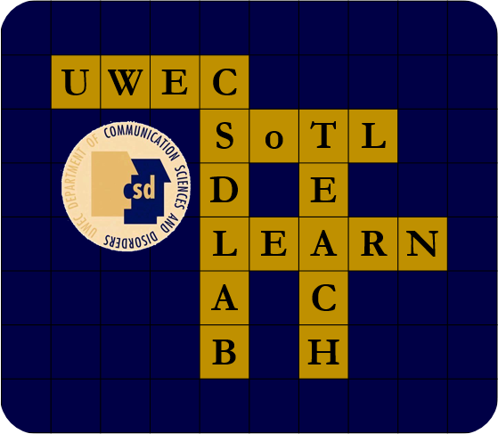
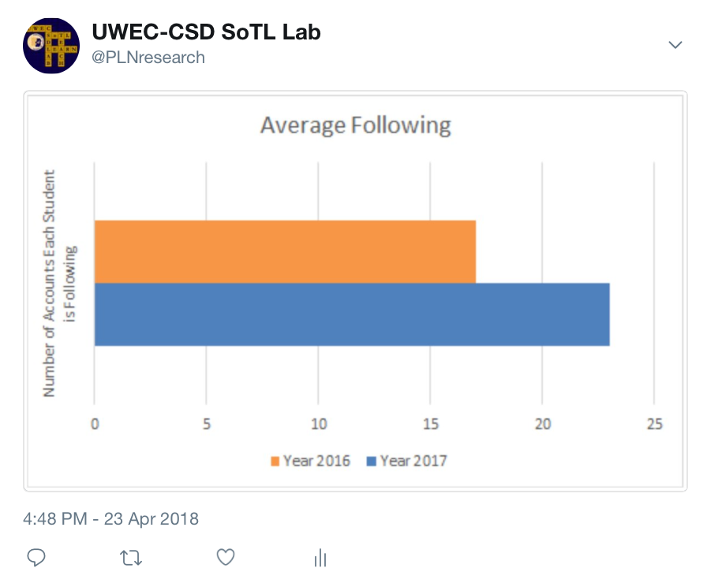
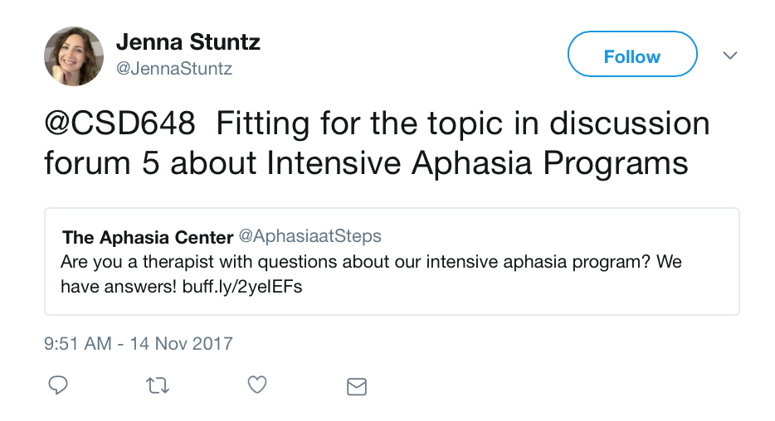
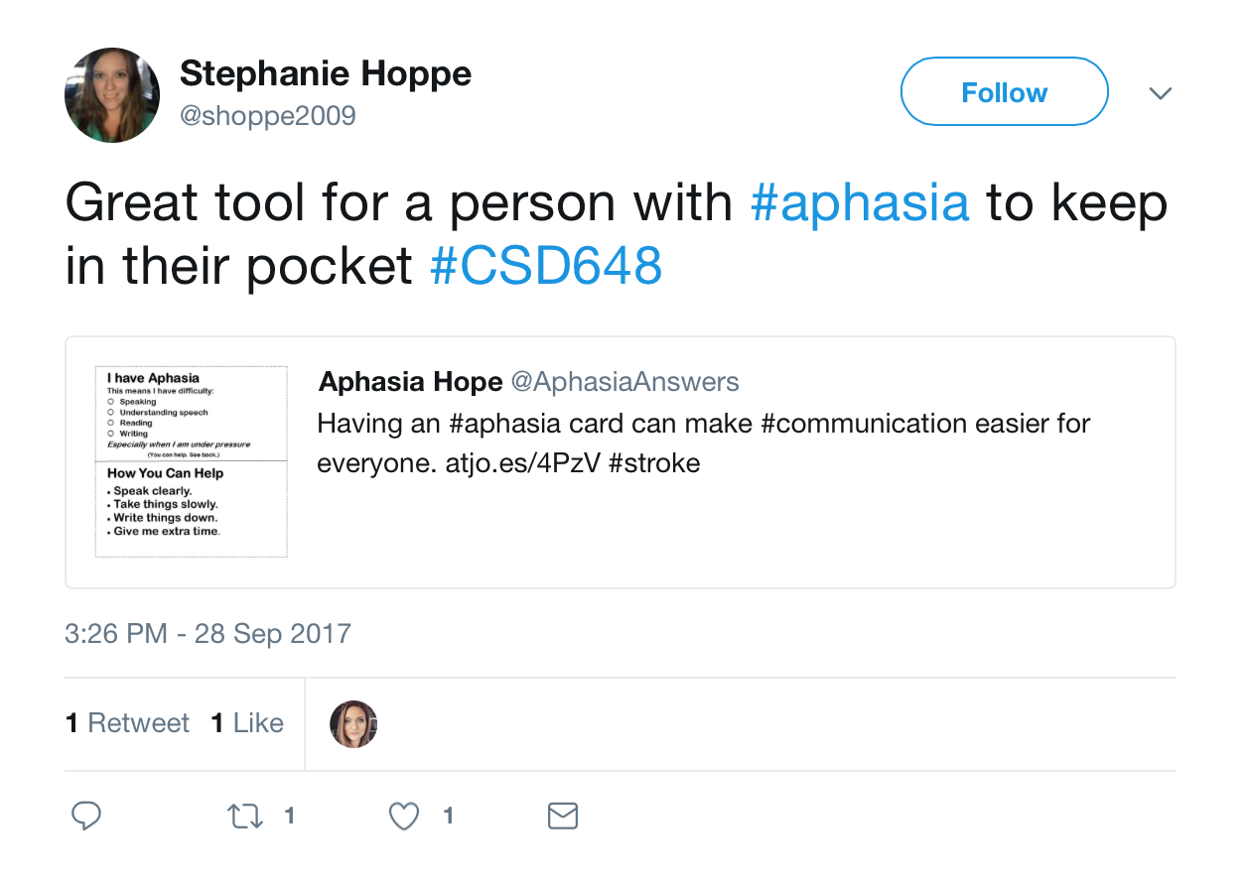
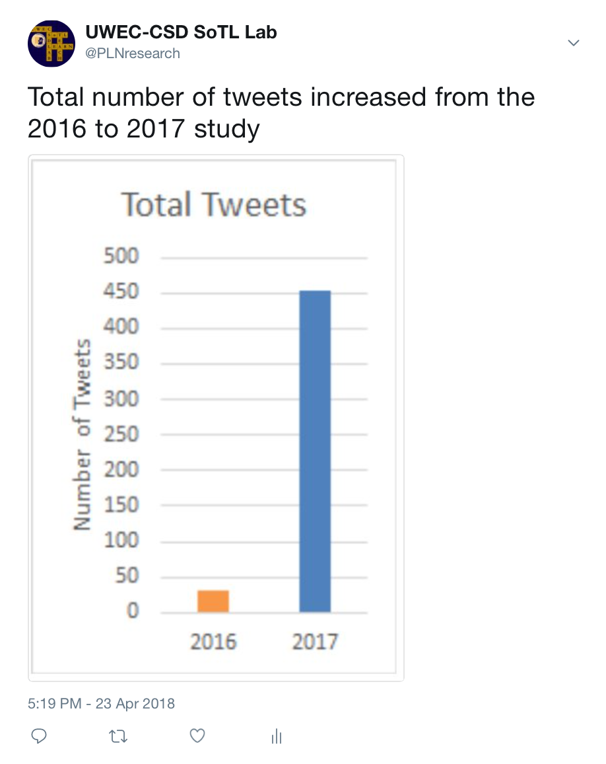
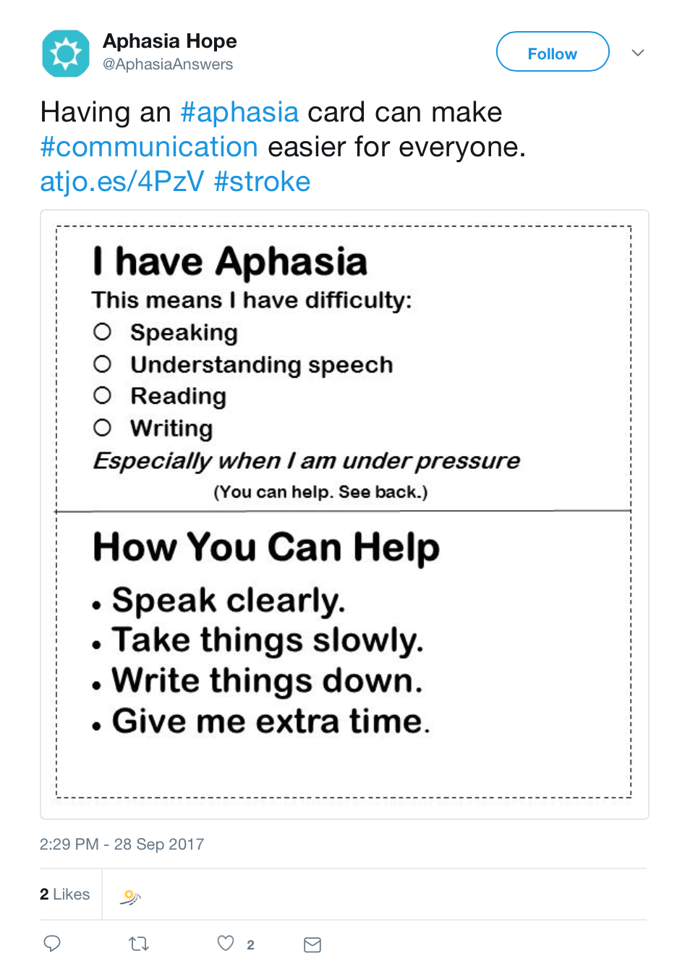

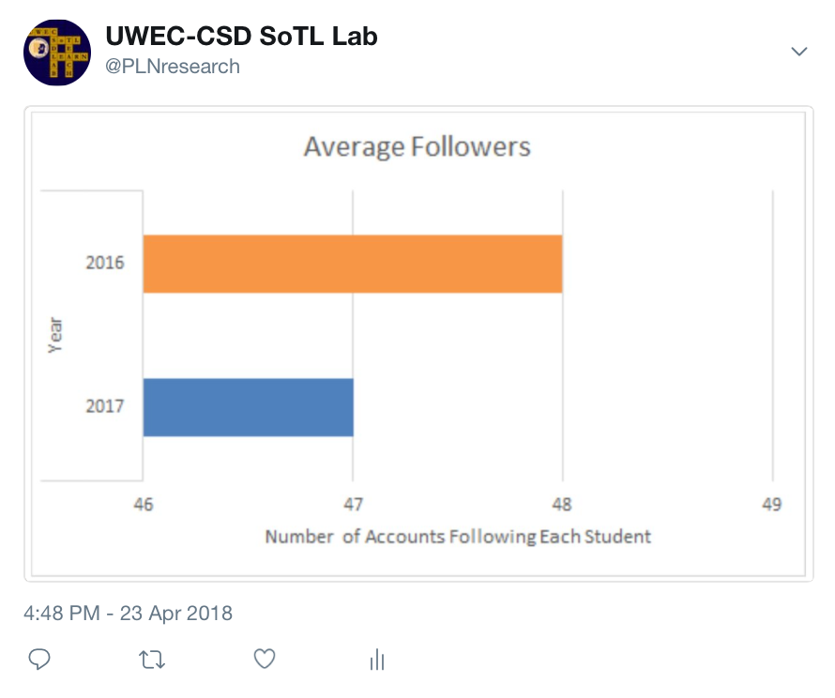
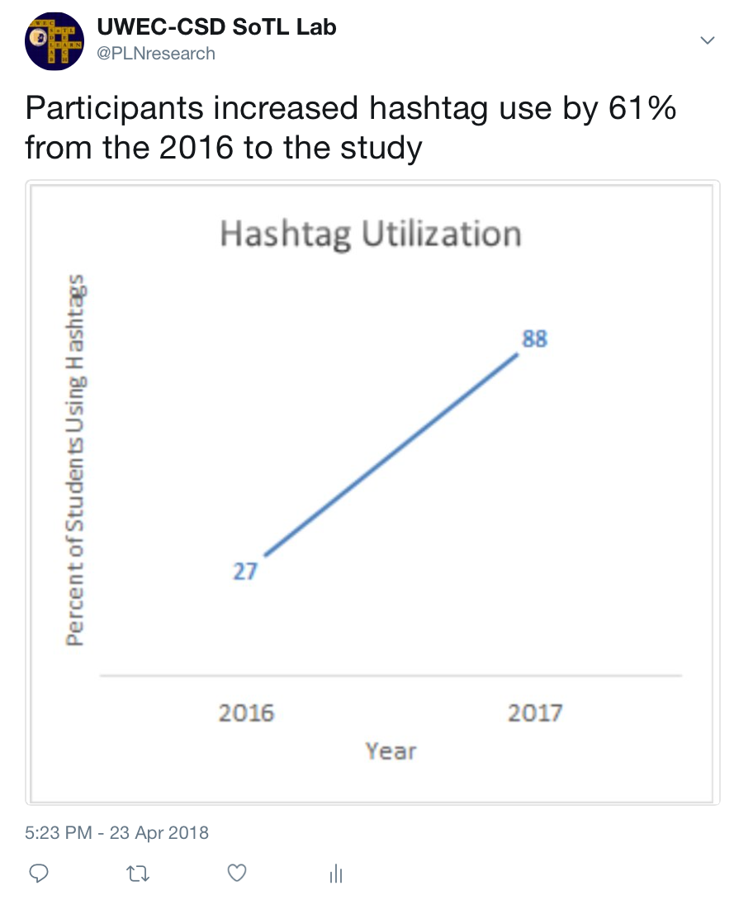

The Implications of Required Twitter Engagement in #HigherEd
Lian Arzbecker¹ @lianarz24; Lindsey Deans¹ @lindsbetty7; Dr. Tom Sather¹, PhD/CCC-SLP @TomSatherSLP
¹University of Wisconsin – Eau Claire Department of Communication Sciences and Disorders
2016
Minimal interaction with the preexisting #aphasia
Twitter use required for full credit on assignments
Twitter use completely optional in assignments
Twitter use incentivized with extra credit on assignments
Curating a week-long international #WeSpeechies discussion
Mandatory weekly discussion forum posting of Twitter relics
2017
Background
Twitter emerged as a microblogging platform in 2006; despite more than a decade of free accessibility, there is a paucity of research regarding Twitter use in the field of Communication Sciences and Disorders and online coursework.
Twitter employs a hashtag system, denoted by an octothorpe (#), to categorize and link topics on their site. For instance, the “aphasia” hashtag connects users to relevant tweets composed by clinicians, researchers, and individuals with aphasia. Additionally, there are multiple world-renowned aphasiologists who maintain active Twitter profiles.
This investigation sought to analyze Twitter implementation in higher education; specifically, the attitudes and behaviors of 21 online CSD graduate students were examined, coded, and compared to pilot study data to determine best practices – if any – for Twitter as an adjunct to existing pedagogical tools.
Year-To-Year Comparison
Barriers
Requirements
“The required “relics” I posted were not as thoughtful as I wish they were.”
Steep Learning Curve
“Even though I have used Twitter for several years, it is one of the more confusing social media platforms.”
Faulty Twitter Design
“I’m not the biggest fan of the layout of Twitter nor am I the biggest fan of the way it operates.”
Facilitators
Pedagogical Benefits
“Using Twitter over the course of the semester was an unexpected way to gain knowledge about aphasia, the people affected by it and the growing research.”
Professional Networking
“I was intrigued though to learn that there was a whole other side to Twitter, a professional and clinically applicable side, that I wasn't aware of before.”
Awareness of Groups in the Field
“I am glad I found them [specific Twitter account], as I will reference back to them in my career when looking for ways to earn ASHA CEU’s.”
Future Directions for the Fall 2018 Cohort
• Require Twitter utilization biweekly for entire semester
• Continue involvement with rotating curator discussions (e.g. @wespeechies)
• Provide additional structured platforms, similar to curated discussions
Skepticism
Twitter Layout
Time
Midterm
38%
Final
14%
Midterm
26%
Final
5%
Midterm
29%
Final
9%
Pedagogical Benefits
PLN
Future Use
Midterm 52%
Final 33%
Midterm 43%
Final 48%
Midterm 33%
Final 24%
Implications
• Positive adjunct to online course
• Excessive requirements may led to reduced student engagement
• Coded barriers will inform future usage
We thank the Office of Research and Sponsored Programs for supporting this research, and Learning & Technology Services for printing this poster.
Notes:
Don’t make font smaller than 28 point

