Slide 1
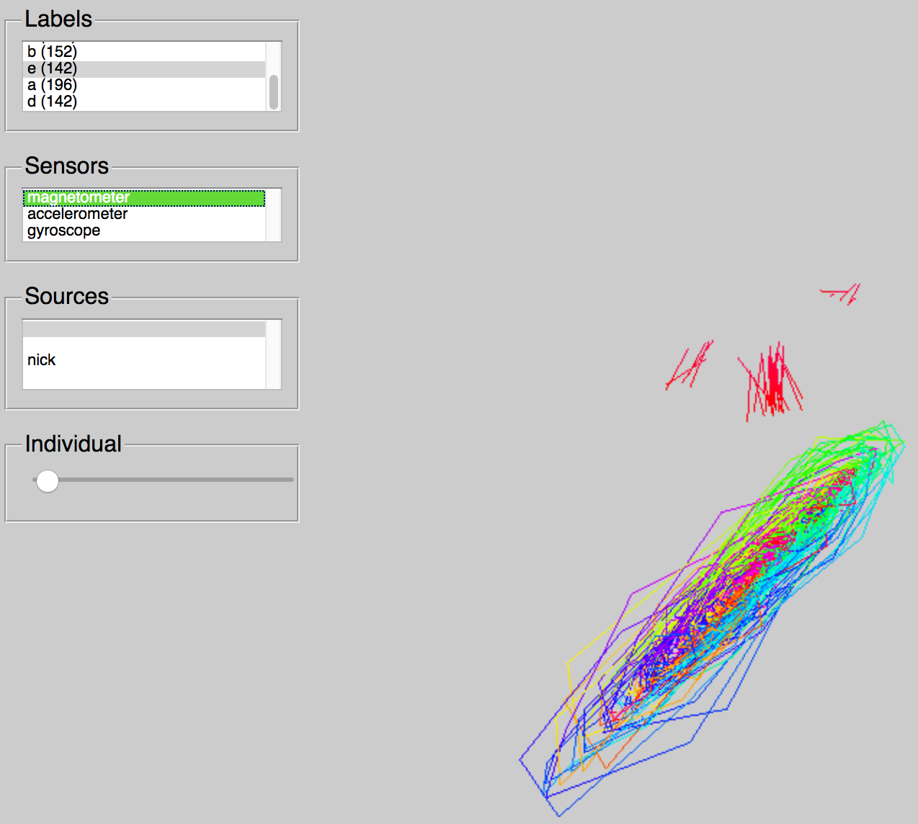
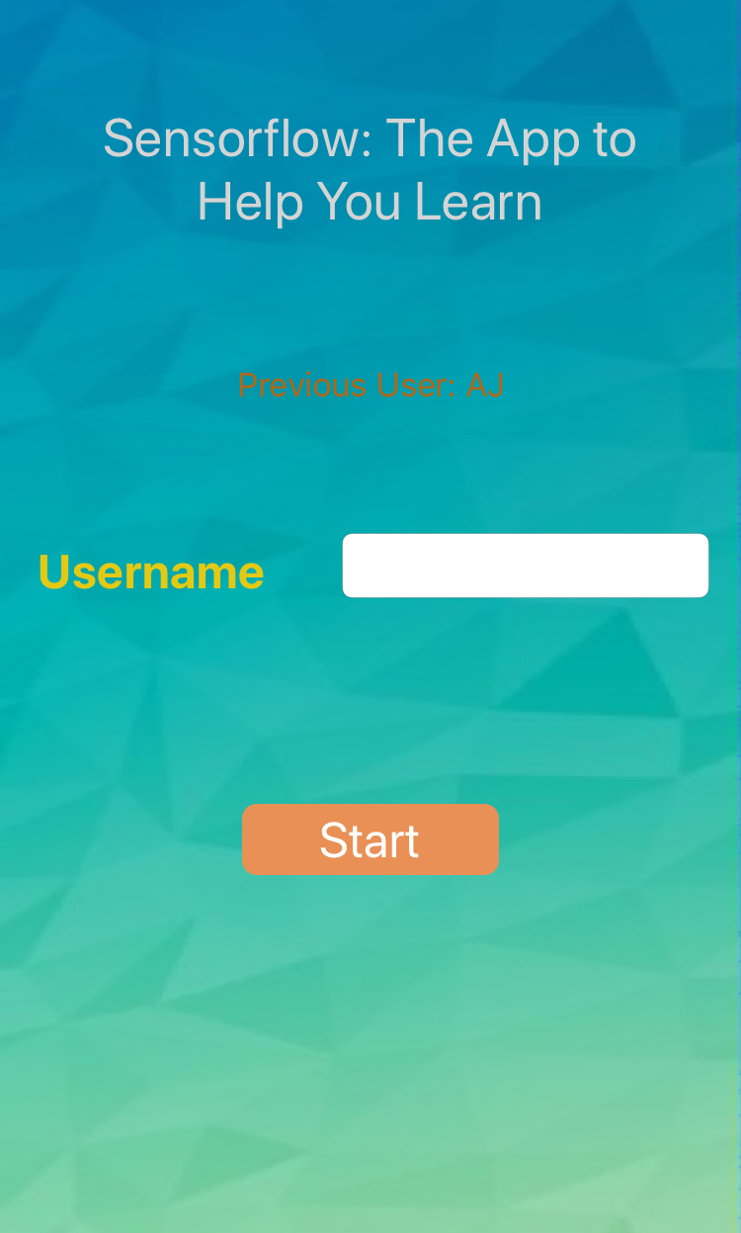
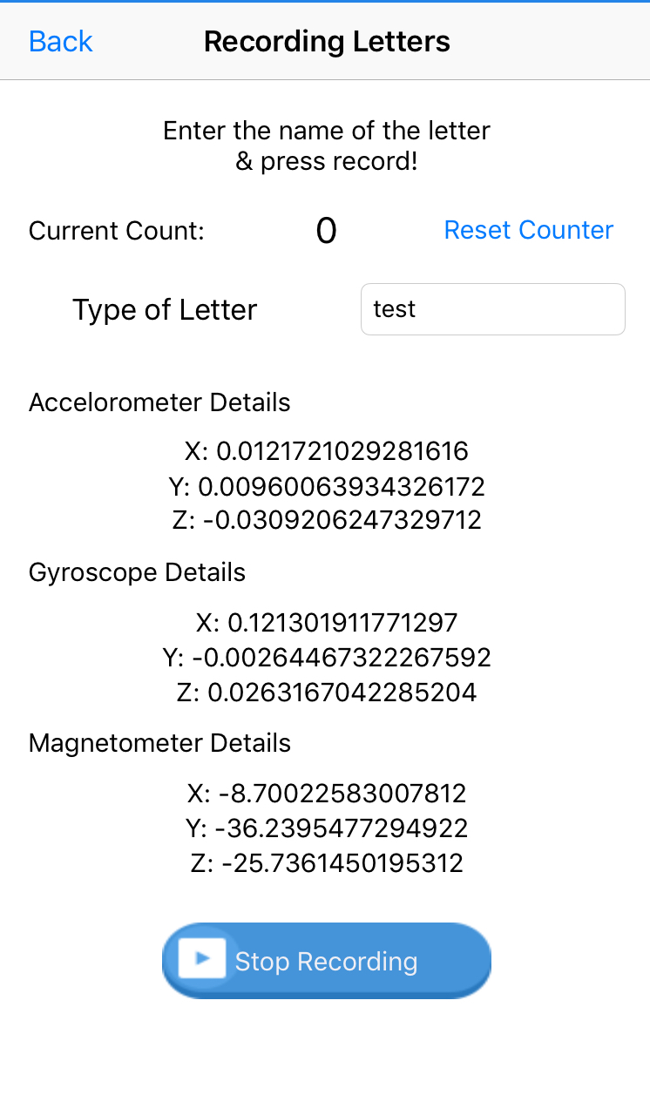
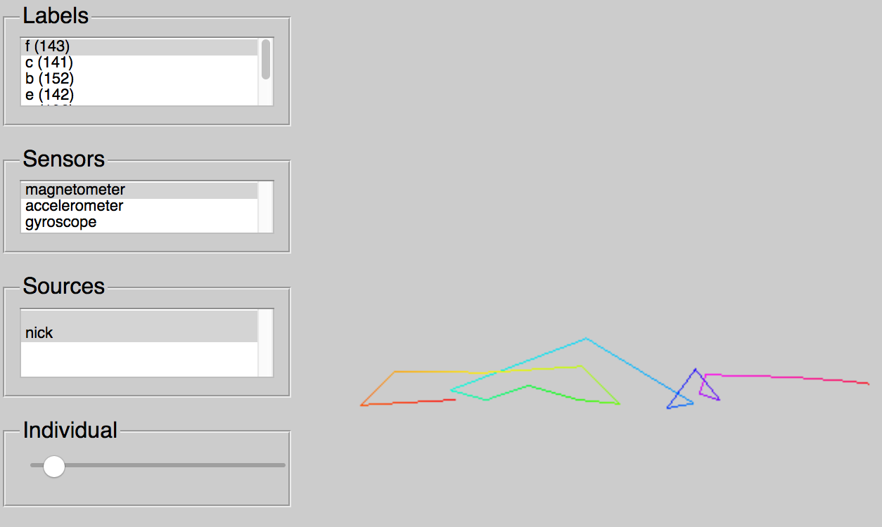
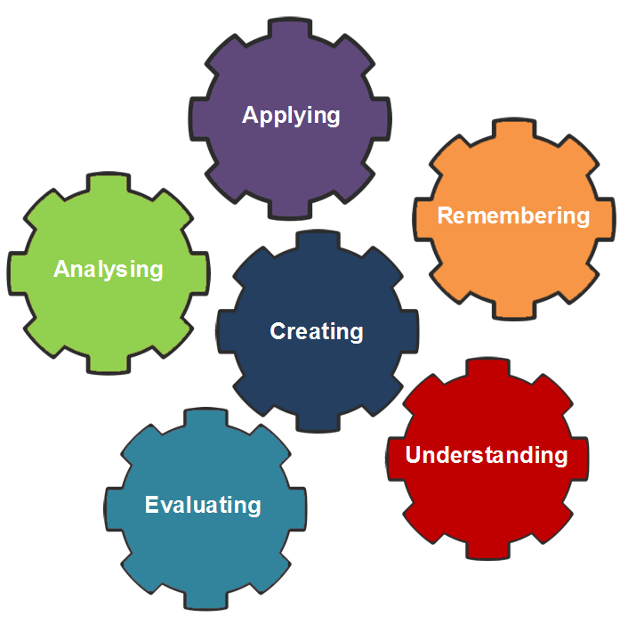
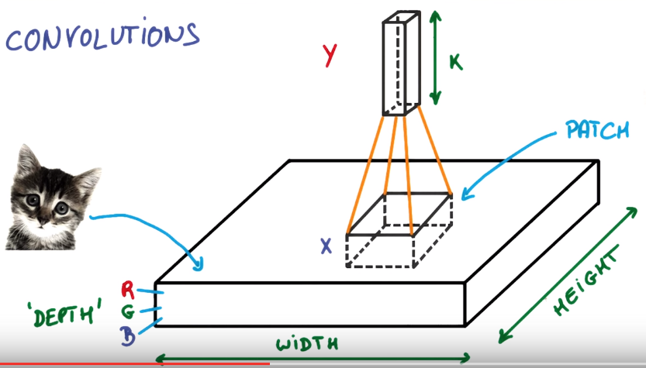
Sensorflow: Learning Through Motion
Dr. Johnson, Adrian Abundez-Arce, and Nick Ziebel | Computer Science
Introduction
We want to enable the user to use internet-connected (IoT) devices in order to learn any alphabet outside the typical classroom setting in an engaging way. Machine learning facilitates classifying any type of images by learning through patterns in the data its given while making the program reusable for any type of similar datasets. Using this knowledge, this project is an app that will be able to discern different types of alphabets it knows using a Machine Learning model called Convolutional Neural Network.
Image C
The image on the left showcases the data and its correlation with data of the same label. In this case, the user (blank in this example) selected the magnetometer sensor of letter “e”. This visual program displays all of the data that was made from the same user with the label they decided to look at. On the lower part of the image, it shows a single drawing of a letter and the path it took when the user “wrote” the letter using their mobile device. The colors demonstrate start (red) to finish (magenta) of an individual sensor.
Sensorflow: a mobile application
The pictures on the bottom showcase the application made for collecting data. The final product which will only classify the letter drawn onto it will look very similar, but it will have the option to run new letters drawn in a model that classifies the pictures.
Image A
The image on the right displays what the user would see with the mobile application where it saves a username to remember the style of writing for each individual.
Image B
The image on the right is an example of when the application is recording. Each x, y, and z corresponds to the sensor described above them and is the X, Y, and Z axis of the letter defined in each sensor.
background
Present Progress
Machine Learning
Currently, as shown above, we are at the end of the data generation phase of the project. With Machine Learning, a plethora of data is needed in order to abstract patterns that are not easily seen with the human eye. As more data is fed into the network, the network solidifies its confidence levels of what character someone draws is, making it more reliable. The data we provide the network are many “drawings” of a letter generalized into three main sensors—Accelerometer, Gyroscope, and Magnetometer. Currently, the stores the letters by using a phone—an internet-connected device—and having a user wave it in the air following the letter’s path to simulate writing it on a piece of paper. In the future, there is a possibility of changing the device to a pencil which have the same sensors in order to write a letter instead of waving it in the air with a mobile device.
This is a subset of AI (Artificial Intelligence) which allows systems and models to learn and improve from the data given to it without having to explicitly program it for a particular dataset. In other words, given a generalized problem—as easy as something like classification to as hard as self-driving–and enough data, the system can simulate learning from experience and extract patterns in the data that is hard or impossible for the human eye to see. There’s research that use it for finding out if blood samples contains cancer to allowing a system to autonomously drive a car in a safe way.
Concepts that are included in Machine Learning
Future Goals
Convolutional neural network
In the future, the goals for the project are the following
Pre-process (clean) the data given to the network
Create the network to accommodate using sensors for a Convolutional Neural Network
Modify the mobile application in order to be suitable for the network to classify letters
Give the application to real students who are learning and see the progress they make
All of these goals are to hopefully have students be more engaged in classes that allows them to learn inside and outside the classroom as well as scholars who are autodidacts and learn at home. With research like this, we can provide more innovation in classrooms to enhance the learning experience of students and create novel ways to using technology in the classroom.
There are different types of ways that Machine Learning goes through absorbing the patterns in a dataset, and one that this project uses is a Convolutional Neural Network. This network is a system that uses neurons, a machine learning unit algorithm, to analyze data. These perceptrons learn the best values in order to heighten how confident the network is with classifying a certain object.
A quick example of a neuron

