Slide 1
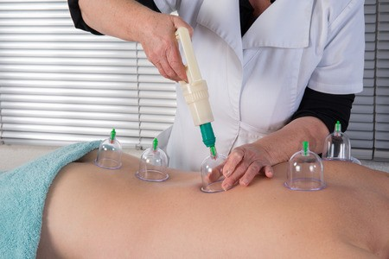
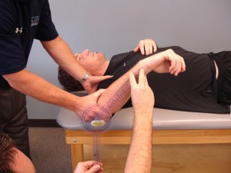
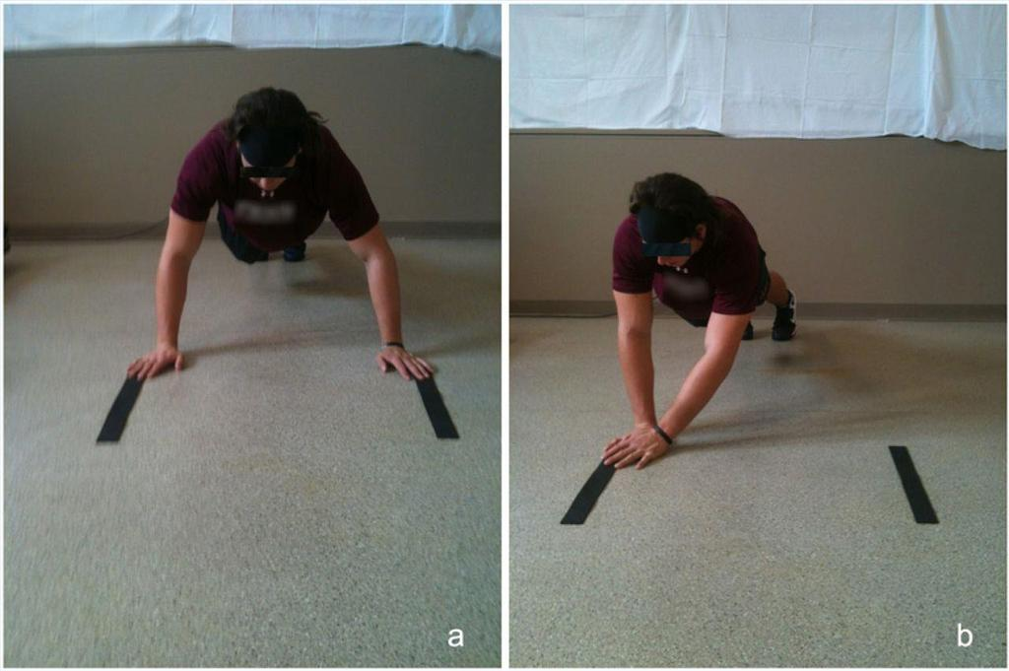
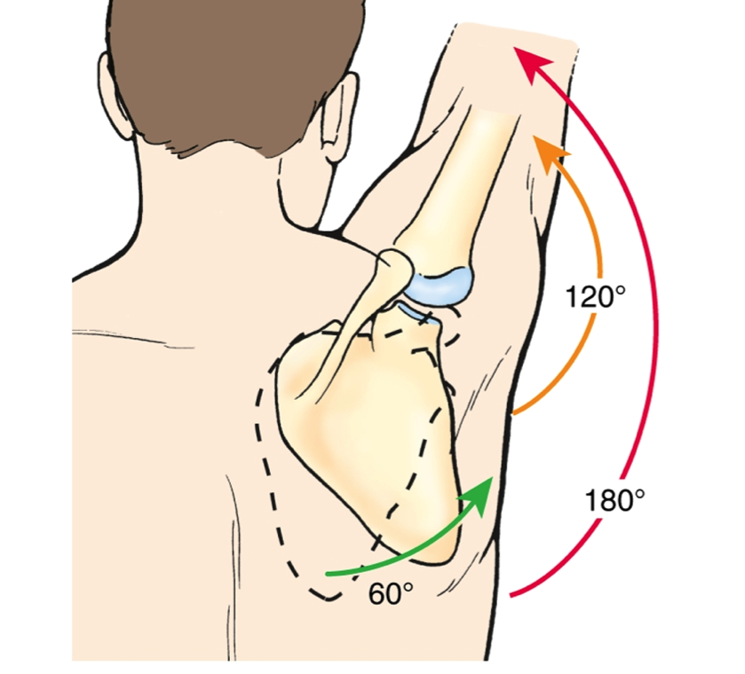
Effectiveness of Muscle Energy Technique vs. Dry Cupping on Scapulohumeral Rhythm and Shoulder Stability in Overhead Athletes
Jessica Heffel, Emma Lehman, Ryley Freiberg, Hannah Wendel & Zachary Williamson | Department of Kinesiology
Abstract
Methods and Materials
Dysfunction in scapular movement can lead to tissue damage, chronic pain and pathology of the shoulder as well as tissue restrictions and limitations in nearby joints. The purpose of this study is to determine an effective treatment for scapulohumeral rhythm in either cupping therapy or muscle energy technique. Two randomized groups in gymnasts and swimmers were recruited, a total of 12 participants. Each participant was randomly assigned cupping therapy or muscle energy technique intervention. This study aims to provide valuable insight on effective treatments for scapular dyskinesis, as well as how to increase glenohumeral stability and range of motion.
Dry Cupping
Dry cupping is a type of therapy that involves placing cups on the skin in order to create suction. Cupping increases blood circulation to the area where the suction is applied. This may relieve muscle tension, which promotes overall blood flow as well as cell repair. The cups were placed on the internal rotators of the glenohumeral joint as well as the latissimus dorsi. The cups stayed on the participants for six minutes with a two minute rest period following the treatment.
Dry cupping therapy applied to the musculature of the back
Muscle Energy Technique
Introduction
Muscle energy technique (MET) is a manual therapy intervention that uses the muscle’s own energy in the form of gentle isometric contractions to relax and lengthen muscles and normalize joint motion. The participants placed in the MET group were treated with MET techniques for the upper trapezius as well as the internal and external rotators of the glenohumeral joint. The technique positions were held for three sets of ten seconds each with three seconds of rest between each set.
Repetitive overhead motion predisposes the athlete to common biomechanical adaptations such as glenohumeral instability, deficits in range of motion, muscle imbalances with a lack of scapular retraction and resulting scapular dyskinesis. These adaptations may result in tissue breakdown and injury. Once underlying biomechanical deficits have been identified, treatment should focus on rehabilitation protocol that emphasizes correcting these deficits, preventing further injury and returning to play. The purpose of this study is to evaluate two different types of treatment; muscle energy technique and dry cupping therapy and their effect on scapular dyskinesis and shoulder stability in collegiate overhead athletes. The researchers hypothesize that there will be greater internal and external shoulder range of motion after muscle energy technique than dry cupping therapy in overhead athletes, and that overhead athletes will have improved scapulohumeral rhythm and test higher on the Closed Kinetic Chain Upper Extremity Stability (CKCUES) test after muscle energy technique compared to cupping therapy.
Goniometry
A goniometer is an instrument used to measure the range of motion available at the joint. The goniometer has a stationary arm, a movement arm, and an axis. The stationary and movement arm are aligned with their respective anatomical landmarks, while the axis is centered on the joint of which the range of motion is being assessed. In this study, a goniometer was used to assess the range of motion at the glenohumeral joint during internal and external rotation of the humerus. The axis of the goniometer was placed over the olecranon process of the elbow while in 90 degrees of flexion. The stationary arm was aligned perpendicular to the trunk of the participant while lying supine. The movement arm followed the styloid process of the ulna while the participant moved their shoulder into both internal and external rotation. Measurements were taken before and after treatment was administered.
Goniometry measurement of internal rotation of the glenohumeral joint
Inclinometry
An inclinometer is an instrument used to measure angles of slope, elevation or depression of an object with respect to gravity's direction. Inclinometry was used in this study to measure the angle of the scapula during shoulder abduction in order to measure scapulohumeral rhythm. The inclinometer was placed on the medial border of the scapula. The angle of the scapula was measured while the shoulder was at rest and the measurement was repeated as the humerus moved into 30, 60, 90, 120 and 180 degrees of shoulder abduction. Measurements were taken before and after treatment was adminstered
Demonstration of the Closed Kinetic Chain Upper Extremity Stability test
Closed Kinetic Chain Upper Extremity Stability Test
The Closed Kinetic Chain Upper Extremity Stability Test (CKCUES Test) is used to assess the stability of the shoulder joint in rehabilitation. The test consists of counting how many times, in 15 seconds, the participant assuming a push-up position is able to touch the lateral side of their supporting hand with their swinging hand. The participants assumed a push-up position (a modified push-up position was offered for those unable to hold the standard position during the test) with their arms placed 36 inches apart. One tester timed the test, telling the participant when to begin and when to stop. Another tester counted the number of touches during the 15 second timespan. The number of touches was recorded and the participant was given a 45 second break between each of 3 trials.
Scapulohumeral Rhythm
What is it?
References
Scapulohumeral rhythm is the kinematic interaction between the scapula and the humerus. It can be defined as the ratio of glenohumeral movement to scapulothoracic movement during arm elevation. Between 0 and 30 degrees of elevation, shoulder abduction occurs primarily at the glenohumeral joint. After 30 degrees and up to 90 degrees of elevation, the ratio of movement between the humerus and the scapula is 2:1. The ratio of movement changes to 1:1 after 90 degrees of shoulder abduction. This interaction ensures the quality of movement at the shoulder joint. The disruption of this rhythm is termed "scapular dyskinesis."
Forthomme, B., Crielaard, J., & Crosier, J. (2008). Scapular positioning in athlete’s shoulder. Journal of Sports Medicine, 38(5), 369-386.
Kennedy, D. J., Visco, C. J., & Press, J. (2009). Current concepts for shoulder training in the overhead athlete. American College of Sports Medicine, 8(3), 154-160.
Musumeci, G. (2016). Could cupping therapy be used to improve sports performance? Journal of Functional Morphology and Kinesiology, 1(4), 373-377.
The scapula and humerus move in a 1:2 ratio. When the arm is abducted to 180 degrees, 60 degrees occurs by rotation of the scapula and 120 degrees by rotation of the humerus at the glenohumeral joint.

