Slide 1
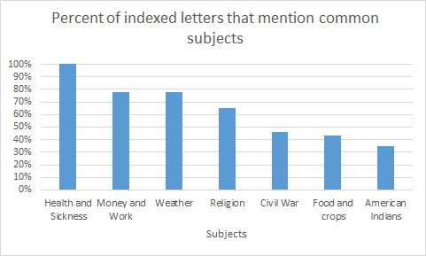
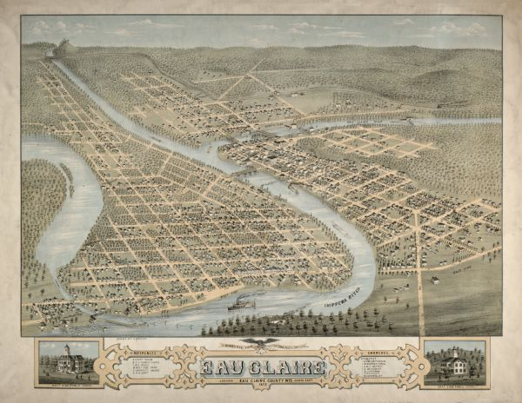
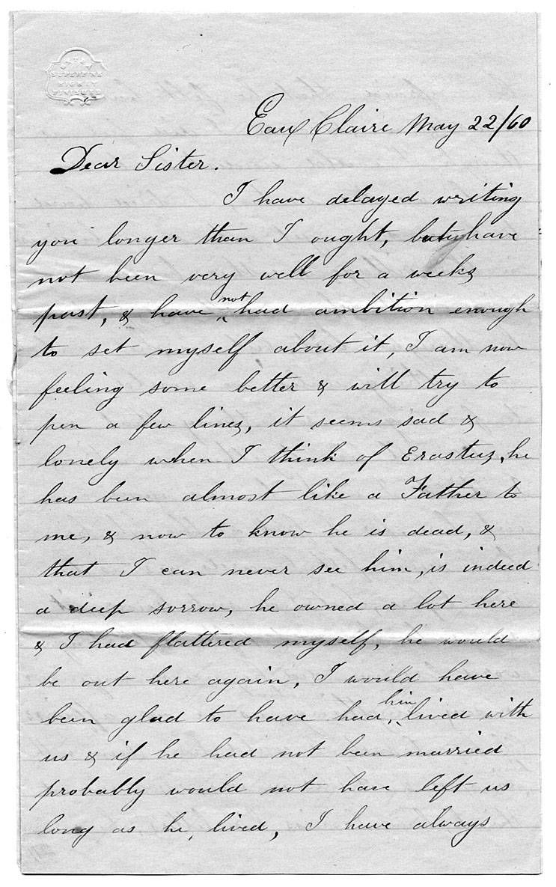
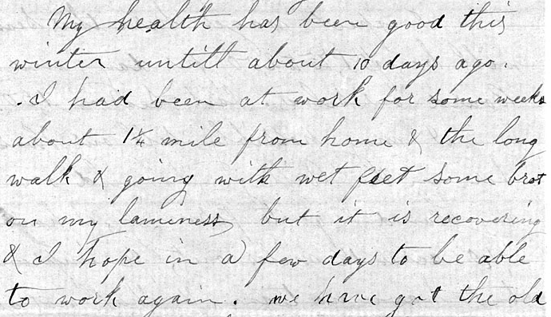
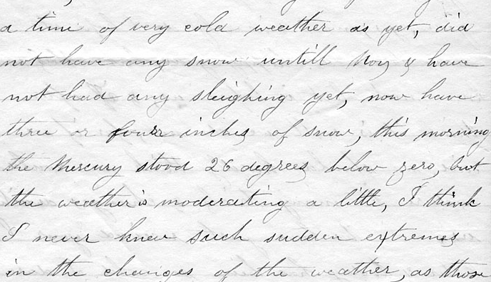
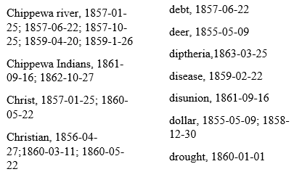
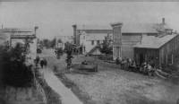
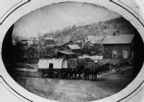


Making the Lucy Hastings Letters Digital: Crowd-Sourcing, Indexing Texts, and Timeline-Building
Project Overview
Cade Lambrecht, Michael William Carini, Connor James La Favor, Maddie Post, Logan Seymour, Elizabeth Peterson, Samuel Peterson, Department of History
With assistance from Robin Miller, Greg Kocken, James W. Oberly | McIntyre Library and Department of History
Introduction
Finding and Significance
Lucy Hastings came to Wisconsin from Massachusetts in the mid 1850s. She and her husband, David Smead Hastings, worked the land in Eau Claire County. Her letters give us valuable insight into the circumstances of Eau Claire area settlers. When the Hastings settled in Eau Claire, the village had barely 100 inhabitants, yet by 1856 the village was marked as the seat of the newly-founded Eau Claire county. As population increased, large numbers of Yankees such as the Hastings family, as well as German and Norwegian immigrants settled the area, and contributed to the growing lumber industry so much that Eau Claire became known as the “Sawdust City”.
The terms “digitize” and “digital” are ubiquitous in today’s tech world. History and the humanities are part of that world. The term “digitize” in the humanities means simply to reproduce in electronic form a document or set of documents. One of the most valuable manuscript collections in the Area Research Center is the Lucy Hastings Collection of letters. Lucy Hastings migrated to Eau Claire in the 1850s and wrote letters to her family in Massachusetts. The letters have been transcribed and scanned for easier access, but no other computer enhancement has been added. The term “digital,” when used in history scholarship, means to make use of computers and software to allow for a deeper understanding of a digitized text. This faculty-student research collaboration uses computers and software to allow scholars a deeper understanding of the Lucy Hastings Letters. Students in History 288 have constructed an index to the 23 transcribed and digitized letters for subjects discussed and for proper names mentioned. They have also built a digital timeline to identify change over time in the correspondents listed in the letters and some of the most important topics discussed.
Source: Lucy Hastings Digital Index, History 288
Lucy Hasting enjoyed sending, reading and writing letters to and from her family and friends back home. She sometimes mentioned national events like slavery, secession and the Civil War, or the Dakota War in nearby Minnesota. However, health and sickness, and the weather were the primary concerns expressed by the Hastings.
David Smead Hastings discussing his “lameness” that he believed he contracted by getting his feet wet
https://www.wisconsinhistory.org/Records/Image/IM12330
The Lucy Hastings manuscript collection is a series of 62 letters from Lucy A. Hastings and her husband David Smead Hastings to family members in Massachusetts and Michigan. Volunteers in 1985 transcribed 23 letters as part of “Women’s History Week “ The Wisconsin Historical Society scanned the transcripts and posted them to the UW Digital Collections site.
Sample index entries
http://digicoll.library.wisc.edu/cgi-bin/WI/WI-idx?type=header&id=WI.Hastings1k&isize=M
Lucy Hastings discussing a harsh winter in Eau Claire
http://digicoll.library.wisc.edu/cgi-bin/WI/WI-idx?type=header&id=WI.Hastings1k&isize=M
http://digicoll.library.wisc.edu/cgi-bin/WI/WI-idx?type=header&id=WI.Hastings1k&isize=M
Acknowledgements
We thank the Wisconsin Historical Society for making the Lucy Hastings Collection available online. We also thank our classmates in History 288 for their contribution to the index. History 288 students have expanded the digitized collection by transcribing 15 additional letters
https://www.ecpubliclibrary.info/chippewa-valley-history
https://www.ecpubliclibrary.info/chippewa-valley-history

