Slide 1

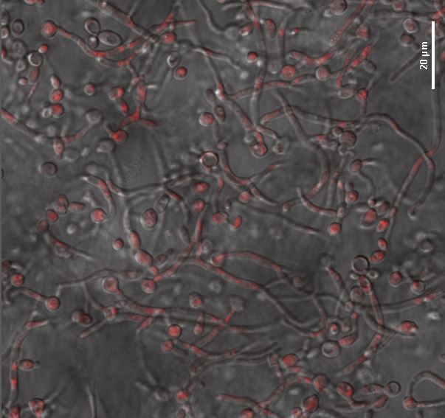
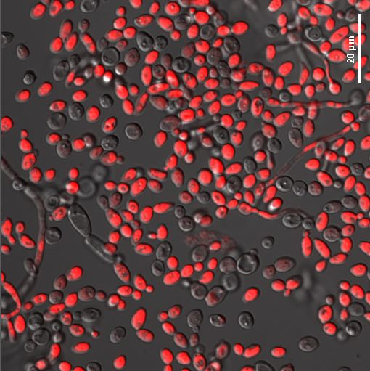
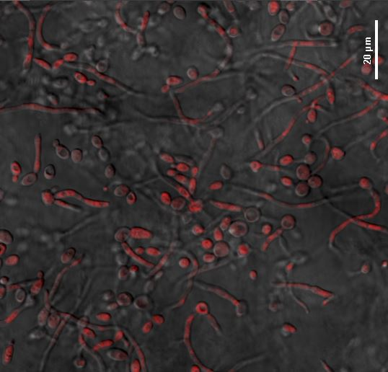
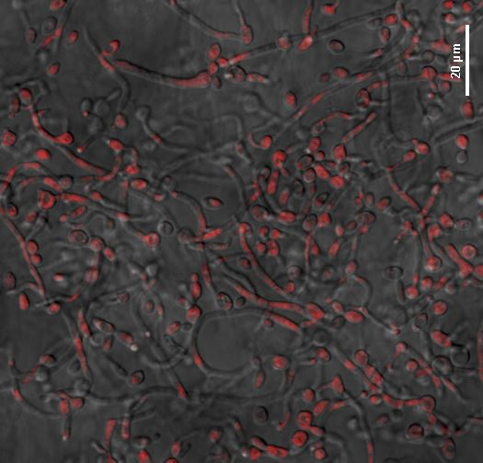
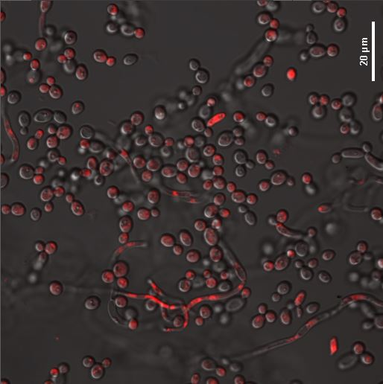
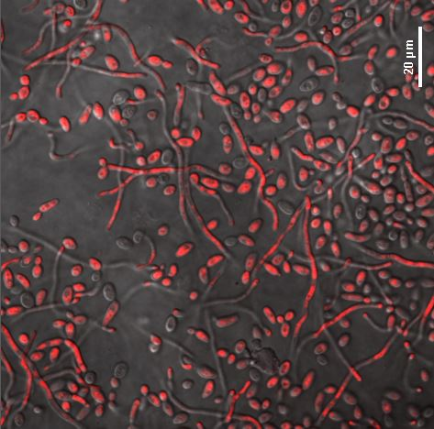
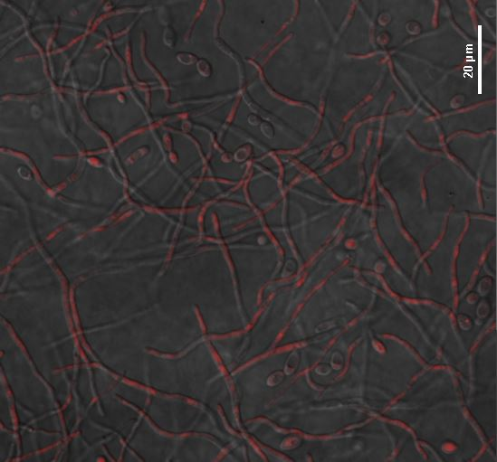
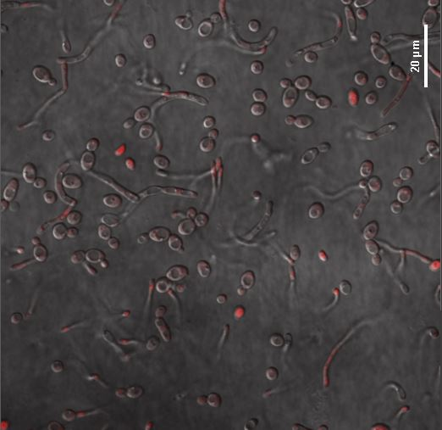
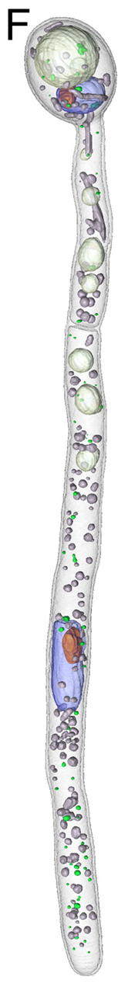
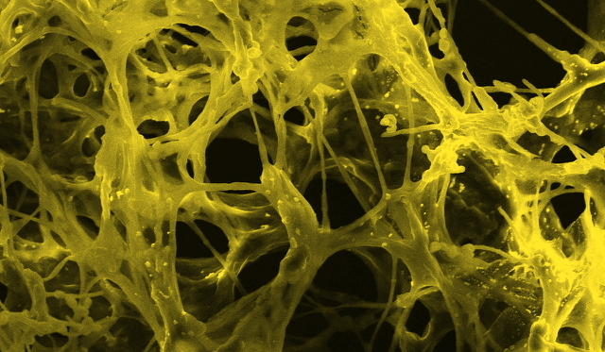

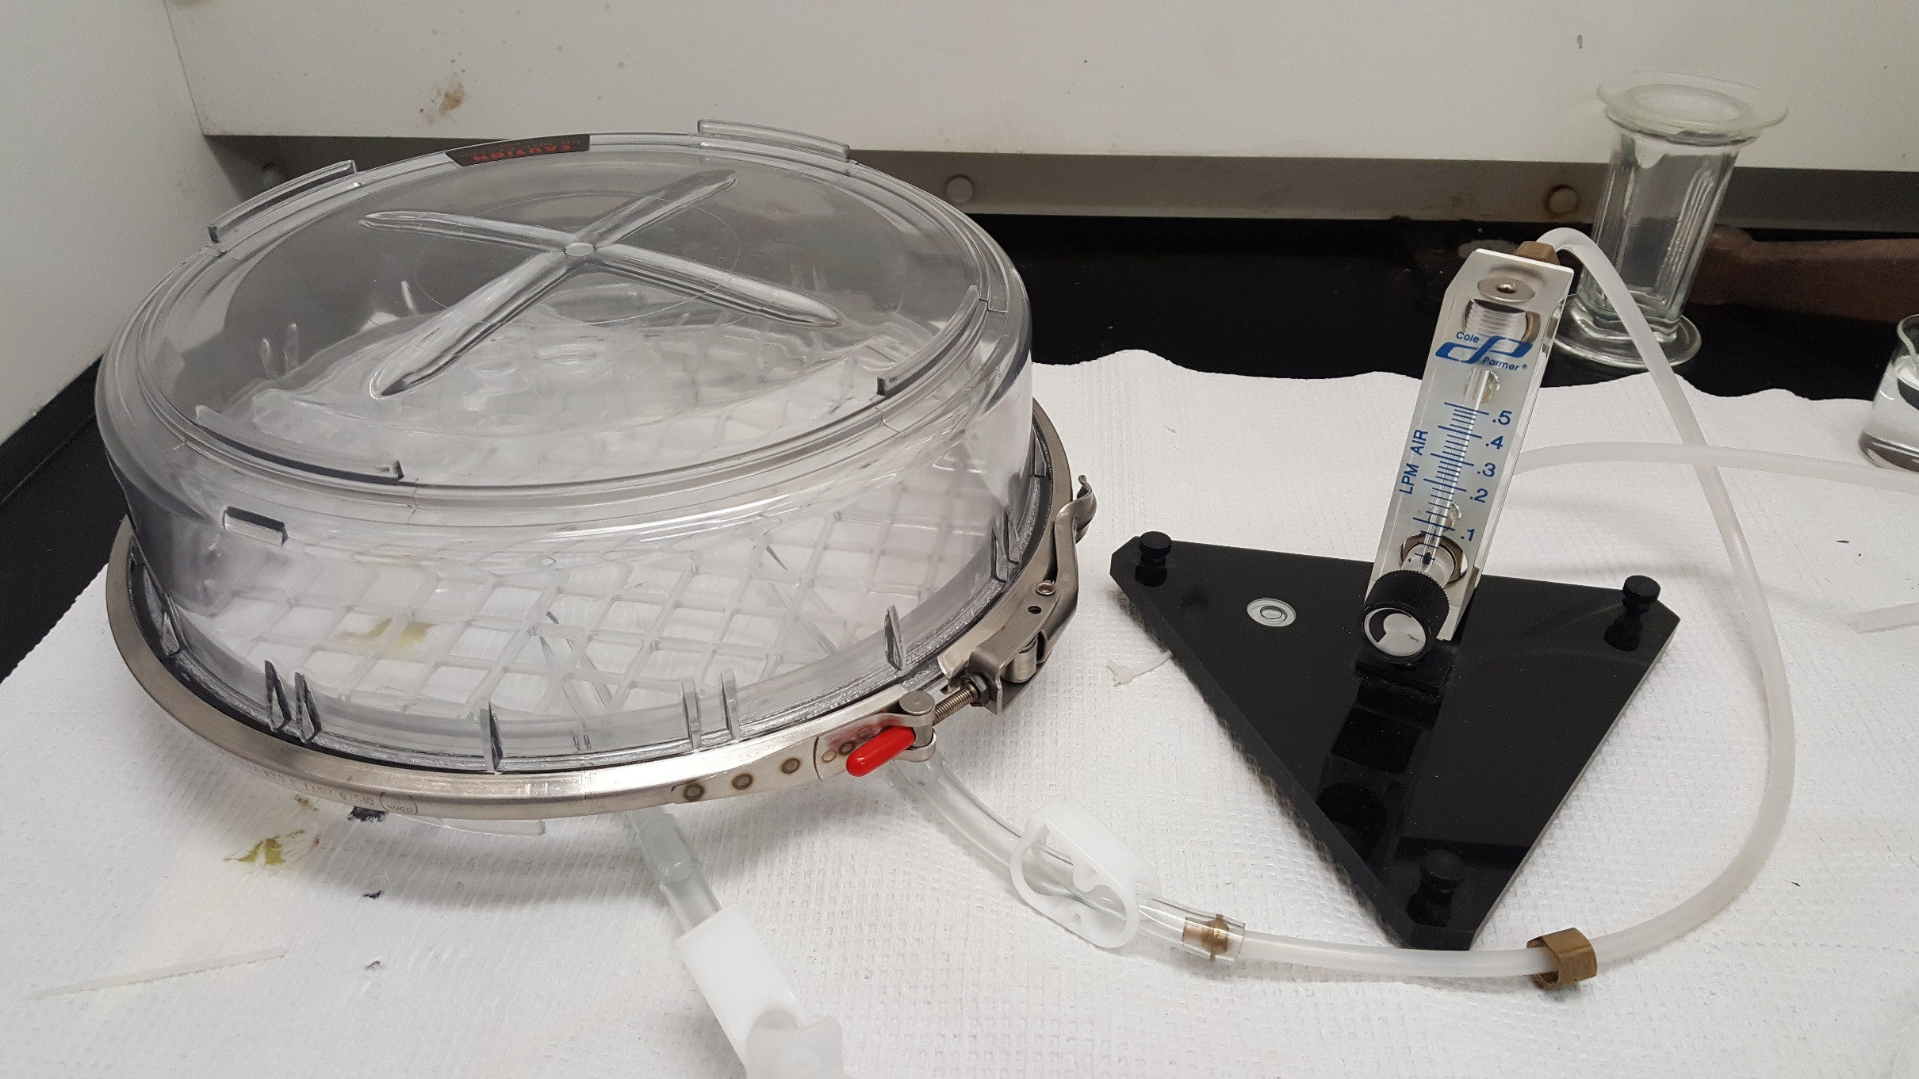
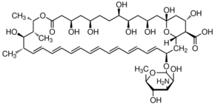
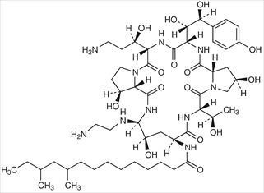
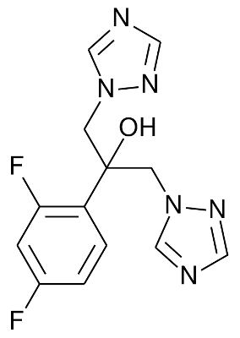
Antifungal Susceptibility of Candida albicans Biofilms under Hyperbaric Conditions
Claudia Tourville, Gabrielle Rigden, and Dr. Scott Bailey-Hartsel
❖ Chemistry Department  University of Wisconsin-Eau Claire
Abstract
Response to Atmospheric and Hyperbaric Conditions
Candia albicans is a fungus notorious for infection of indwelling medical devices and inflamed tissues in immunocompromised patients. Its unique ability to form biofilms, or scaffold-like networks, makes it increasingly resistant towards treatment. Multiple classes of antifungal drugs have been developed for treatment, but each demonstrates its own threat towards patient recovery and future quality of life. Despite extensive research focused on Candida species, few have thoroughly investigated the influence of oxygen availability on biofilm formation and drug resistance. Hypoxia, or oxygen depletion, is common at sites of infection and has been identified as a potential stimulant of extracellular matrix (ECM) production. ECM material assists formation of the biofilm while providing a protective coat to block antifungals from accessing the fungal cellular membrane. In this research, we explore the effects of high-pressure oxygen (hyperbaric) conditions on the development of biofilms and susceptibility towards polyene, triazole, and echinocandin antifungals. Advanced confocal microscopy techniques have allowed us to assess the viability and morphology of biofilms in response to drug treatment simultaneously. With approximately 46,000 cases of Candida infections annually in the US, this simple approach towards improved outcomes has the potential to be both far-reaching and easily accessible to many in need.
Control
Amphotericin B (2µg/mL)
Fluconazole (1µg/mL)
Caspofungin (0.02µg/mL)
Atmospheric Culturing Conditions
Candida albicans Biofilms
Hyperbaric Culturing Conditions
Candida albicans is distinct from other fungal species in its ability to form biofilms. This process differentiates planktonic cells into hyphae that form three dimensional scaffolds, making the fungus highly resistant towards antifungal treatments by employing a variety of defense mechanisms. Unfortunately, this species is becoming increasingly common in clinical settings. Patients with indwelling medical devices and those receiving immunosuppressive treatments are particularly susceptible to infection. Immunodeficiency and indwelling devices allow Candida albicans to anchor to host tissues or indwelling plastics and proliferate within hours.
Evaluating Candida albicans using the Biotium Yeast Vitality Staining Kit via confocal microscopy provides information on both morphology and viability of each culture. The viability assay is displayed in the red overlay on the bright field micrographs. Intense red fluorescence identifies dead cells while low-level red fluorescence indicates that a cell is metabolically inactive or unhealthy.
Fluconazole and caspofungin were administered to the treatment dishes at 1µg/mL and 0.02µg/mL, respectively. These concentrations are slightly below the minimum inhibitory concentrations (MICs) for these drugs in vitro. This reveals the subtle effects that the antifungals may have within a biological system before an infection is eliminated.
When comparing the atmospheric and hyperbaric control cultures, it is apparent that the proportion of hyphal cells is much lower in the hyperbaric control. A similar effect is seen between the caspofungin treatments. This suggests a suppressive effect on the planktonic to hyphal morphological transition that normally occurs when Candida albicans is cultured at 37°C.
Conversely, nearly all cells in the hyperbaric fluconazole treatment dish transitioned to the hyphal morphology. This suggests a defensive response from the fungal culture to the threatening, but not fungicidal, effects of fluconazole administration at this dose.
Candida albicans biofilm SEM
Uchida M, McDermott G, Wetzler M, Le Gros MA,
Myllys M, Knoechel C, Barron AE, Larabell CA (2009)
Hyperbaric Oxygen Culturing
Conclusions
Common Antifungals for Candidiasis
Hyperbaric oxygen therapy is a non-invasive method used to treat a variety of clinical conditions by improving the ability of the blood to carry oxygen to tissues throughout the body. The process involves the patient lying in a full-body chamber filled with pure oxygen gas for up to 2 hours.
Hypoxia, or oxygen depletion, has been demonstrated to trigger mitochondrial stress in Candida albicans and facilitate the planktonic to hyphal morphological transition during biofilm formation. For this reason, many research groups have proposed the potential benefit of oxygen therapy in treating Candidiasis, though there are few published conclusions.
For the purposes of this research, hyperbaric oxygen therapy was simulated in vitro using a hyperbaric chamber. Culturing Candida albicans in this system provides a preliminary look into the combinatorial effects of hyperbaric oxygen therapy and antifungal administration.
Hyperbaric culturing of Candida albicans at 37°C plays a suppressive role on the transition from the planktonic to hyphal cell morphology.
Antifungal administration of fluconazole and caspofungin below their respective minimum inhibitory concentrations (MICs) results in widespread cell damage despite expected low levels of cell death.
Low-dose fluconazole administration stimulates a significant planktonic to hyphal morphology transition under hyperbaric conditions as compared to the largely planktonic hyperbaric control culture.
Further experimentation is necessary to determine the dose-dependent relationship each antifungal has with the simultaneous hyperbaric oxygen treatment.
Amphotericin B (AmB) has been a common choice of antifungal drug for widespread fungal infections since the 1960’s. AmB exhibits its fungicidal effect by selectively binding the ergosterol found in fungal cell membranes and creating a pore to leak vital cell components, ultimately leading to fungal cell death. The original formulation, Fungizone, is a micellar form of AmB. Unfortunately, Fungizone has demonstrated numerous adverse side effects, the greatest being nephrotoxicity. Despite more modern antifungals with reduced toxicity, AmB is still used clinically for fungi that have developed resistance to other drugs.
Fluconazole first emerged in the 1990’s and has quickly become a first-choice drug for Candidiasis. It demonstrates a greatly reduced toxicity compared to AmB while maintaining a similar fungicidal effect. In a fungal cell, Fungizone acts as an inhibitor towards the enzyme responsible for the biosynthesis of ergosterol, 14-α demethylase. When the cell is unable to produce this vital membrane component, they are unable to proliferate and eventually cannot be sustained.
Caspofungin emerged in the early 2000’s and is often used today against Candida infections, but can be limited by its narrow range of activity against Aspergillus and Candida species. It exhibits its fungicidal effect by inhibiting the synthesis of ß-1,3-D-glucan, an essential component of the fungal cell wall. Since mammalian cells do not have a cell wall, this drug has little effect on the healthy maintenance and growth of human cells.
References
Uchida, M., McDermott, G., Wetzler, M., Le Gros, M. A., Myllys, M., Knoechel, C., Barron, A. E., and Larabell, C. A. (2009) Soft X-ray tomography of phenotypic switching and the cellular response to antifungal peptoids in Candida albicans, Proceedings of the National Academy of Sciences of the United States of America 106, 19375-19380.
Caspofungin
Amphotericin B
Methods
Acknowledgements
.
Candida albicans were grown in RPMI medium at 37°C on polylysine coated glass-bottomed dishes for 48 hours. Hyperbaric conditions were obtained by pumping a sealed hyperbaric chamber full of O₂ at 0.4 L/min prior to incubation. Antifungals were added to treatment dishes and then incubated for an additional 17 hours under atmospheric or hyperbaric conditions at 37°C. Viability assays were performed with the Biotium Yeast Vitality Staining Kit according to the outlined protocol. Confocal microscopy was done on a Nikon A1R confocal microscope using a 561nm laser to detect Calcofluor White and a 405nm laser to detect ViaVac Red/Green.
University of Wisconsin – Eau Claire Office of Research and Sponsored Programs (ORSP)
University of Wisconsin – Eau Claire Chemistry Department
University of Wisconsin – Eau Claire Learning and Technology Services (LTS)
This study was supported by the UW-Eau Claire Blugold Fellowship Program which is jointly funded by Differential Tuition and The Foundation
This study was supported by the National Science Foundation- Research Experience for Undergraduates (NSF-REU) stipend via the University of Wisconsin - Eau Claire
Fluconazole

