Slide 1
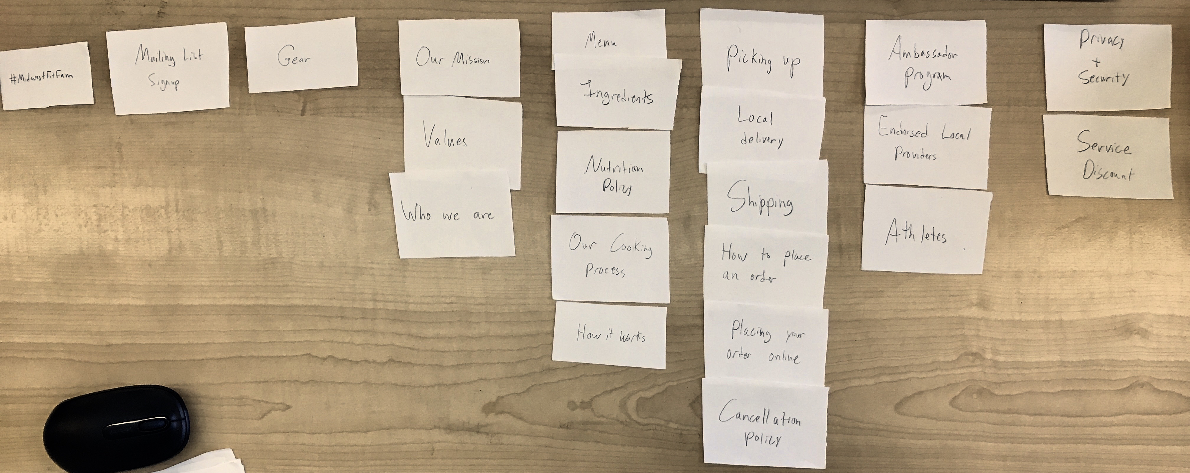

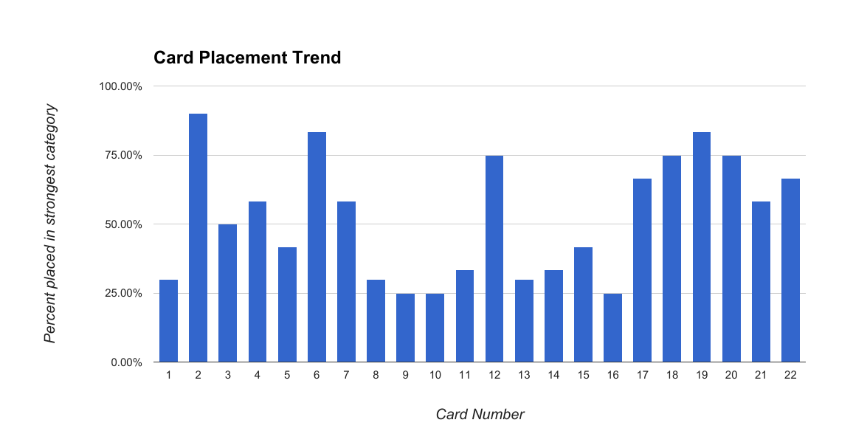
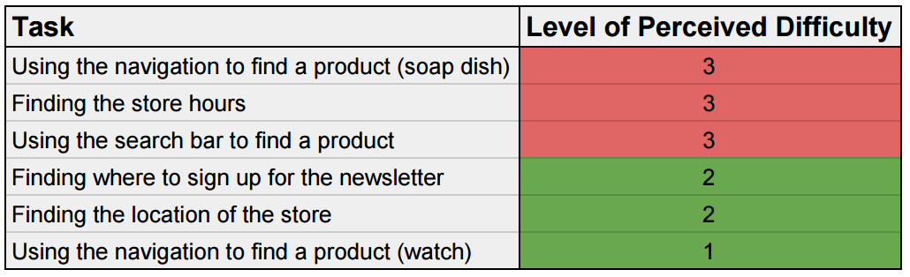

UX Research & Design
For Midwest Meals and Red’s Mercantile
Jacob Techmeier, Mary Laura Samples & Dr. Jean Pratt | Information Systems
Introduction
Deliverables
The goal of this creative project was to identify—from both a student and faculty perspective—the challenges and rewards associated with integrating industry-targeted, online courses into a community- based client project as part of a University independent-study course. The project resulted from an identified gap among industry need, existing information systems (IS) curriculum, and faculty resources related to User Experience (UX) Design.
After the clients’ websites were analyzed and appropriate research methods were developed, research subjects were found and asked to perform the various necessary tasks. For each test, quantitative and qualitative analysis was conducted. Then, written recommendations and visual design mockups were provided to the client in order to demonstrate execution of the recommendations. Below are the aggregated and analyzed results of this research.
Clients
MIDWEST MEALS
MIDWEST MEALS
For this site, the card sorting test proved to provide the most obvious differences between the current content structure and that which would be preferred by the user. When the data was aggregated, 17 distinct conceptual content categories arose. Nine of these were consistent 30% or more of the time. These categories informed the overwhelming majority of the content reorganization.
In addition, four main tasks that users were asked to perform were shown to be common “friction points,” and were largely consistent with changes made in the content reorganization due to card sorting data.
Midwest Meals seeks to provide a local meal-prep solution focused on health and nutrition. They aim to provide balanced diets to aid fitness and health goal-setting through their premade meals.
Research Methods
Findings
CARD SORTING
The two student researchers made similar observations that the organization and/or presentation of their clients’ websites often suffered. Though both retail, their clients had very different existing websites structurally and aesthetically. Thus, different research methods were relevant in conducting an analysis of the user experiences of these websites.
To learn how people perceive a website’s content structurally and nominally, cards with labels for each content area on the website can be defined, allowing each research subject to sort the cards (pictured above). This grouping data can then be aggregated based on the most common pairings as well as common names to suggest changes to the website’s navigation and structure.
RED’S MERCANTILE
TASK TEST
Herein, the task test provided more useful and actionable data, mostly by way of the accompanying qualitative data. This consisted of comments made by users while conducting routine tasks on the site. Much of the quantitative data collected, such as time taken to complete a given task and perceived difficulty, were unusable. The task success rates were also used to show that most of the chosen routine tasks fell below average (78%).
Mostly design changes were proposed, in addition to a few minor content addition suggestions. Some language was clarified, and many pages were made to fit a standard browser screen.
RED’S MERCANTILE
In order to gather data about how difficult it may be for end users to complete common tasks on the client’s website, we chose a few specific tasks and asked research subjects to attempt them. It was recorded whether the user failed or succeeded to complete the task, and simultaneously timed. Results were averaged to find problem tasks which helped indicate potential areas of change.
Red's is a modern home goods + accessories shop based in Eau Claire, WI., selling only Made in America goods to support makers + regional economies. Red’s is also a gathering place for women in the Chippewa Valley, hosting poetry readings, workshops, yoga, rallies + more, working to connect women in authentic ways.
Strength of card sorting categorization
Initial analysis showed that Midwest Meals’ moderate level of text content was grouped into many small pages and, therefore, had a high number of navigation options. In order to accurately stratify a considerable amount of information, high-level and conceptual analyses. For this reason, the card sorting test was by far the most useful and informative test.
The same analysis of Red’s showed much less content, but few navigation options. Most of the content focused on the retail outcome, which meant very few high-level structural changes were needed. Rather, specific task tests showed common difficulties that were able to be analyzed further.
Conclusions
An example of Task Test Difficulty Rating results
User Experience research and design involves a very intense understanding of the website being analyzed. That said, the same basic tests, when tailored to the client, can provide very valuable insight into user assumptions and trends. However, the data is never the answer—much analysis of the data is required in order to recommend useful and effective changes to the current content and/or structure.
SUBJECTIVE INTERVIEW
Each research participant was asked to provide basic information about them and their relationship with the company. This was intended to allow the researchers to apply demographics to the results.

