Slide 1


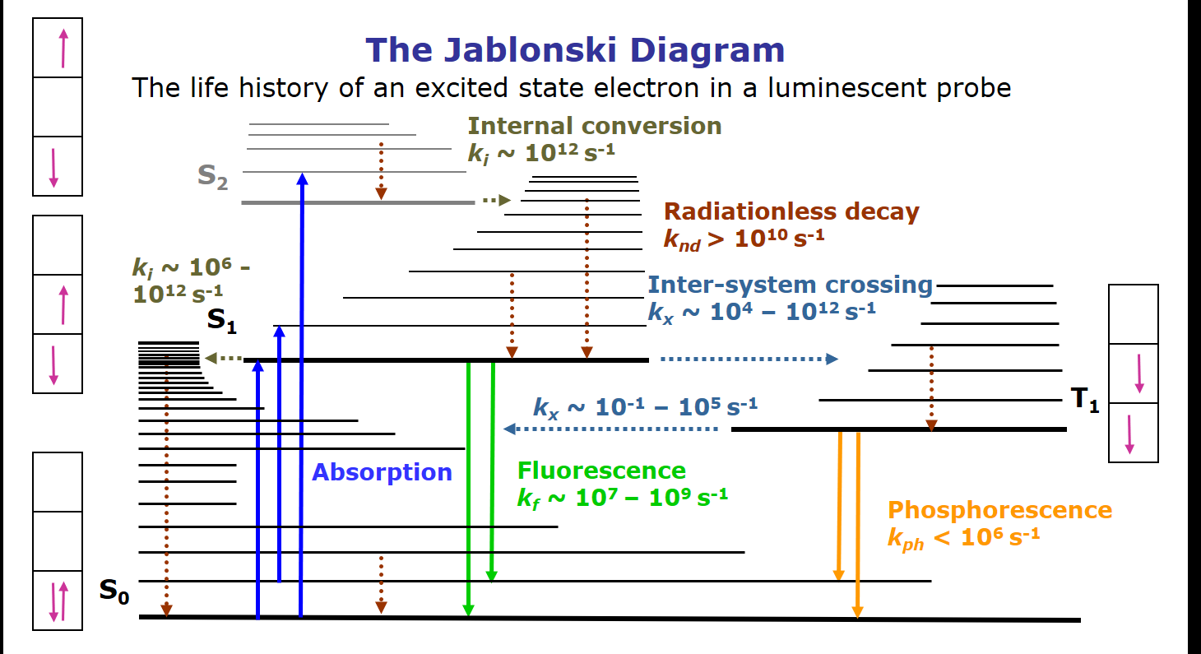
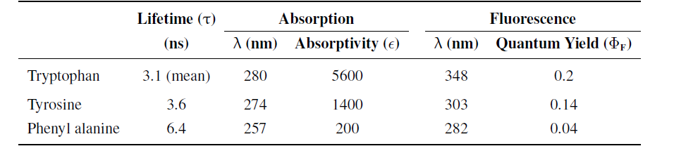
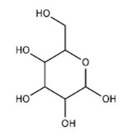
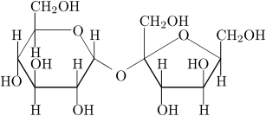
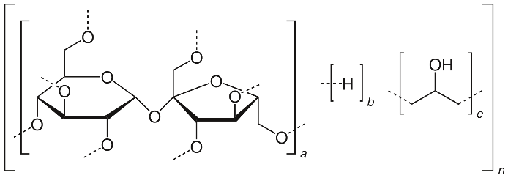
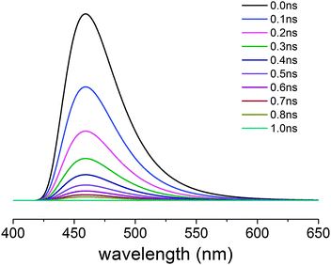
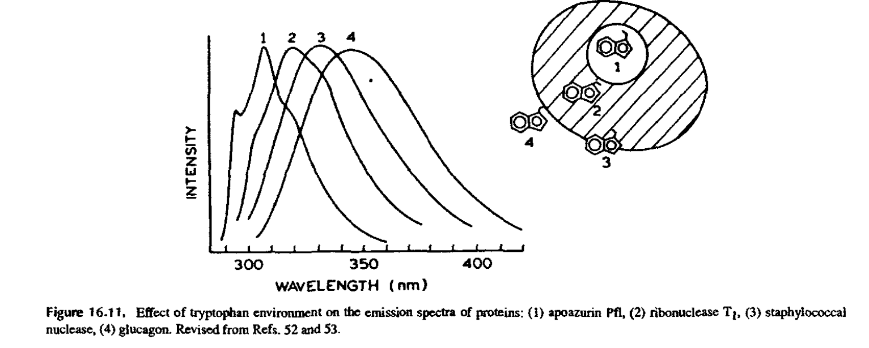
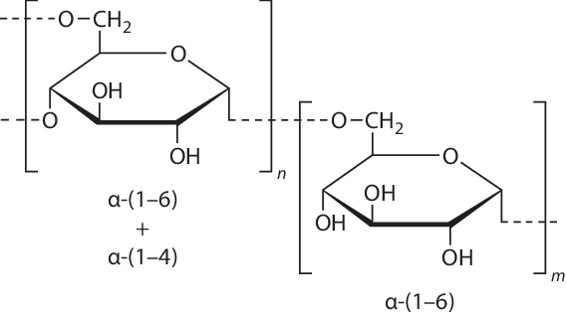
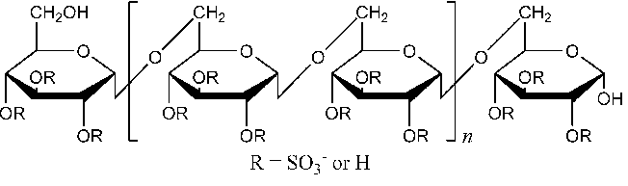
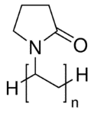

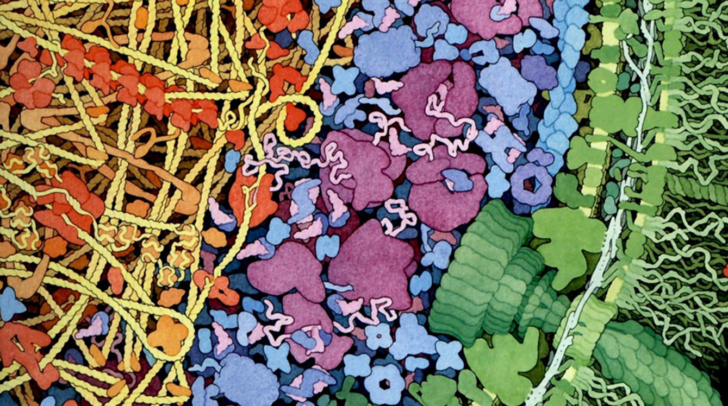
Studying the Interactions between Monosaccharide/Polysaccharide with Tryptophan
Using Fluorescence Spectroscopy
Benjamin Johnson, Sudeep Bhattacharyya, and Sanchita Hati
Department of Chemistry, University of Wisconsin-Eau Claire, WI 54702
Abstract
Fluorescence Spectroscopy
Results
Fluorescence spectroscopy has become a pivotal tool in biochemical research by virtue of its robustness and high sensitivity. In particular, intrinsic protein fluorescence, that originates mainly from the aromatic amino acid tryptophan, have been extensively explored to study protein dynamics and conformational changes. Tryptophan has the strongest fluorescence quantum yield of all the amino acids found in proteins and its fluorescence is highly dependent on the surrounding environment. Therefore, properties including absorption and fluorescence maxima (λ_{max}), florescence intensity, and quantum yield have been used to probe conformational changes in a protein due to the change in external environment. Intrinsic tryptophan fluorescence spectroscopy is routinely used to study the impact of common metabolites and metal ions on proteins conformations and functions. However, the impact of some of these metabolites, specifically monosaccharides and polysaccharides, on free tryptophan has remained unknown. In our lab, we are performing a thorough investigation of the impact of monosaccharides and polysaccharides on free tryptophan using fluorescence spectroscopy. The preliminary results of our study are presented here.
Tryptophan fluorescence parameters in the presence of crowding agents
Fluorescence properties of aromatic amino acids in water at neutral pH [4]
Crowding agents | Structure | R_{h} (Å) | Conc. (mg/ml) | % decrease in intensity | Δλ_{bcm} _{(nm)*}
Dextrose |  | 4.2⁵ | 300 | 5.11 ± 0.7 | -0.047 ± 0.072
Sucrose |  | 5.2⁶ | 300 | 28.58 ± 1.20 | 1.75 ± 0.041
Ficoll 70 |  | 40⁷ | 300 | 48.23 ± 1.26 | 0.061 ± 0.245
Dextran-40,000 |  | 4.78 ⁸ | 300 | 52.26 ± 2.60 | 0.902 ± 0.915
Dextran sulfate-40,000 |  | 4.78 ⁸ | 300 | 84.45 ± 0.44 | 52.044 ± 12.000
Polyvinyl- pyrrolidone-10, 000 |  | 2.16⁸ | 100 | 83.20 ± 0.39 | 0.039 ± 0.132
Polyethylene glycol-8000 |  | 27.5⁶ | 300 | 5.91 ± 1.14 | -3.21 ± 0.307
Intensity ∝ 1/ [quencher]
Background
Intensity
Most in vitro and in silico studies are performed in dilute conditions
The intercellular environment is crowded with an assortment of macromolecules [1]
This crowding can have an impact on the structure and function of proteins
One way to analyze the effects of crowding on protein structure is through intrinsic tryptophan spectroscopy
Fluorescent spectroscopy works through exciting electrons to a higher orbital, followed by a reemission at a different wavelength
Tryptophan is one of three fluorescent amino acids. It has the best quantum yield, and occurs infrequently enough to be used as a marker [2]
The fluorescent emissions of tryptophan are highly dependent on its surrounding, making it ideal for use when investigating the effects of macromolecular crowding [2]
This study focuses on the effects of crowders on the fluorescence of free tryptophan, which will be valuable information when extended to the study of protein fluorescence
Two quenching processes:
Dynamic (collisional) quenching
Static (complex formation ) quenching
Effect of Tryptophan Environment on the emission spectra of protein [2]. Exposure polar solvent leads to red-shift
Objective
* Red-shift and blue-shift in barycentric wavelength is shown in red and blue color, respectively. Measurements are performed in triplicate.
To study the impact of synthetic crowding agents on tryptophan’s florescence properties.
Methods
All samples were run using a Cary Eclipse Fluorescence Spectrophotometer
The sample was excited at 280 nm, and emissions collected from 250-450 nm
The concentration of tryptophan was 10 μM
Change in intensity was measured by subtracting the maximum intensity of Tryptophan in a 300mg/ml crowder solution from the 0 mg/ml solution
The blank contained no tryptophan to account for manipulation of the light from sources other than tryptophan
Phosphate buffer (0.03 M, pH 8) and NaCl (0.1 M) were also added to the solution to control the pH and salinity
A linear Stern-Volmer plot indicates purely dynamic or static quenching
A Stern-Volmer plot with a quadratic form indicates both dynamic and static quenching
Dynamic and static quenching
Dynamic or static quenching
Conclusions
The presence of macromolecular crowders decreases the fluorescence intensity of free tryptophan
The decrease in fluorescence intensity is proportional to the concentration of the crowder
Impact of crowding on florescence intensity is independent of crowder’s size [hydrodynamic radium (R_{h})]
Dextran sulfate has maximum impact on barycentric mean wavelength (λ_{bcm})
Stern-Volmer plots revealed that quenching in presence of dextran sulfate is due to steric and dynamic quenching
Future Directions
References-
The effect of varying concentrations of crowders will be extended to the other crowders
Temperature variation studies will be performed to examine the molecular mechanism of quenching
A cross section showing a portion of an Escherichia coli bacterium, including all macromolecules. Small molecules like ATP, glucose, and water are omitted for clarity The coloring scheme is designed to highlight the functional compartments of the cell, with the cell wall and flagellar motor in green, soluble enzymes and other proteins in turquoise, ribosomes and tRNA in magenta, DNA in yellow, and proteins in the nucleoid in orange[3].
Acknowledgements:
-National Institute of Health (Grant number GM085779)
Office of Research & Sponsored Programs at UWEC
Department of Chemistry
Zimmerman and Trach. J. Mol. Biol. (1991) 222, 599-620
Lakowicz JR. Protein Fluorescence (2006) 529-575.
Goodsell. Bioessays. (2012) 34, 718–720.
Ghisaidoobe and Chung. Int J Mol Sci. (2014) 15,22518–22538.
Schultz and Solomon J. Gen. Physiol. (1961) 44, 1189-99.
Ling, Jiang, and Zhang Nanoscale Res. Lett. (2013) 8, 20.
Kuznetsova, Turoverov, and Uversky Int. J. Mol. Sci. (2014) 15, 23090-23140.
Armstrong, Wenby, Meiselman, and Fisher Biophys. J. (2004) 87, 4259-70.

