Slide 1

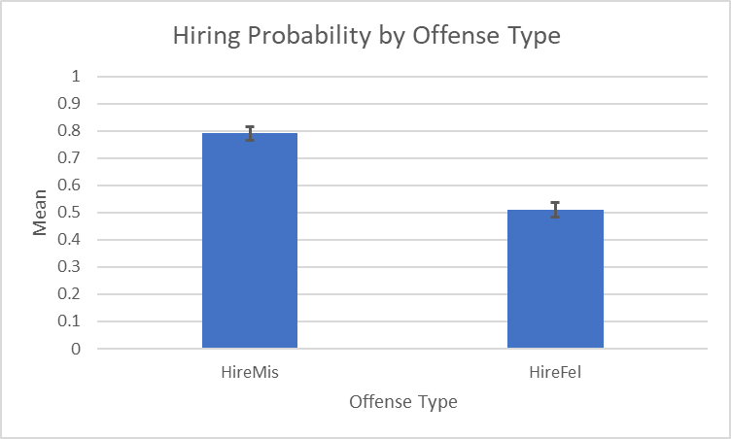
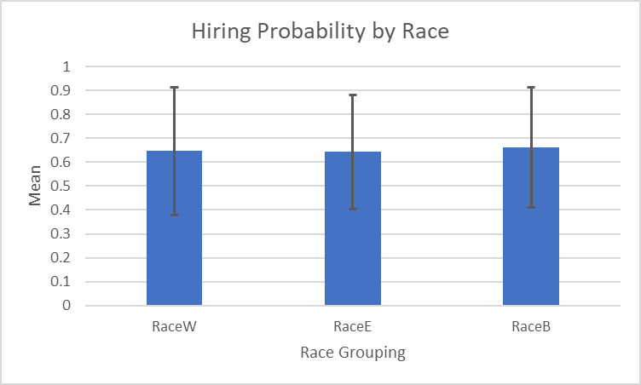
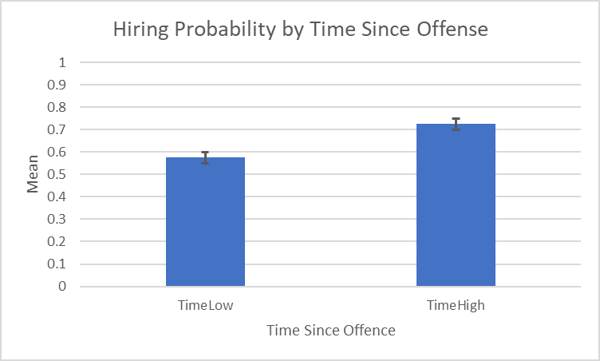
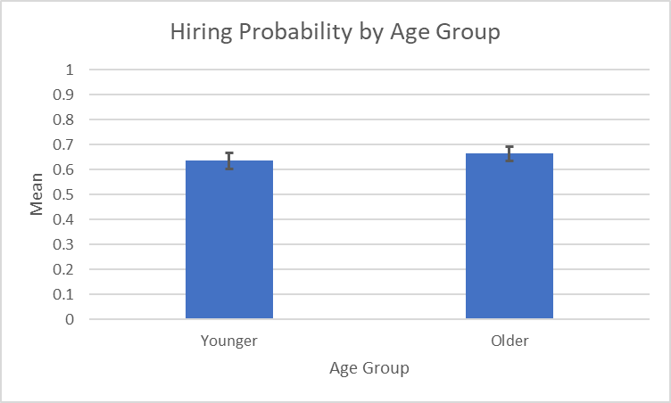
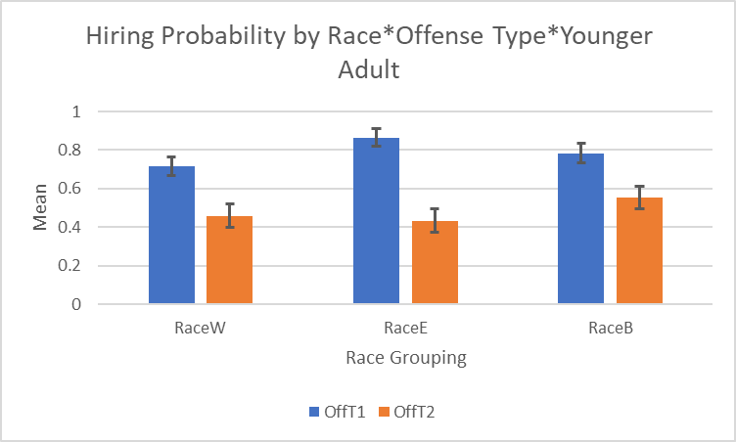
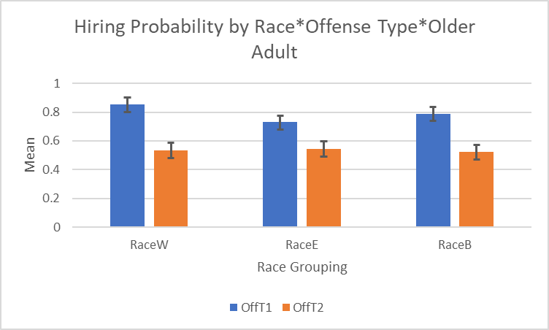
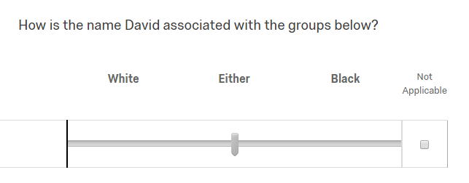
Impact of Race and Criminality upon Employment
Austin Van Cleave, Karin Knapp, and Jena Wagner | Research Mentor: Jarrod Hines | Psychology
Background
Study 2 – Demographics and Results
This study examined the role of applicants’ race, past criminality, and time since criminal conviction on participants’ evaluations of the fitness of fictional job candidates. Participants were told that they were acting as hiring agents at a job-placement firm and would review a pool of applicants from a local community college. Their goal was be to rate the fitness of each applicant and determine whether they would be allowed into the hiring agency’s applicant pool, which would allow these individuals to be considered for available employment opportunities. The participants only screened applicants to determine their fitness for placement into the agency’s pool of applicants—not whether they were a good fit for a specific job. The applicants had a similar educational background, and researcher-constructed applications also included information like their names, type of crime committed, and the time since the offense (along with other typical job application information). Race was not be mentioned explicitly; instead, a preliminary study was done to find names that are strongly associated with Black or Caucasian individuals. These names were then used for the current study.
 | % Female | Age | % Hispanic | % Race
 |  |  |  | American Indian / Alaska Native | Asian | Black | White | Other
Younger Adults | 75.70 | 19.50 | 2.70 | 0.00 | 5.40 | 0.00 | 89.20 | 2.70
Older Adults | 50.00 | 63.60 | 2.20 | 2.20 | 0.00 | 2.20 | 95.70 | 0.00
Hypothesis
Our factorial ANOVA results were expected to indicate an age difference such that older participants would rate the fitness of Black applicants as worse than Caucasian applicants. Younger adults’ ratings were expected to be more similar across levels of offense and time from offense than those made by older adults, who were expected to be less forgiving or more likely to stereotype applicants.
Micah falsely reported his income on their yearly taxes. The IRS conducted a tax audit and found proof of fraudulent activity. The authorities were contacted immediately, and Micah admitted to underreporting his income on his tax documents. Consequently, Micah was charged with a felony for tax evasion.
Years since offense: 12
Corey had been practicing new graffiti art styles on his neighbor's house. When the neighbor arrived home, they contacted the police about the graffiti. Corey later admitted to practicing graffiti on their neighbor’s house. Consequently, Corey was charged with a misdemeanor for the vandalism of private property.
Years since offense: 5
Study 1 – Categorize Names
Positive Comment: Taking liberties with one’s tax return is common and would not be a reason to eliminate this candidate.
Negative Comment: This was not a mistake, it was a calculated move. Xavier intentionally broke the law, which hurts his chances of being hired.
Positive Comment: I like the way a lot of graffiti looks and graffiti has made a lot of people famous so I don’t think it should stop anyone from getting a job.
Negative Comment: He lacks respect for others and their properties. He appears to have problems with impulse control. I would fear that his lack of respect would continue.
The names for our study were chosen by a pilot study, in which participants were asked to determine which racial category the name best fit.
Study 2 – Method
Discussion and Future Directions
Using Qualtrics software, we designed a survey in which we asked questions targeting participants’ attitudes towards felony and misdemeanor convictions. We used 12 names from study 1; four were classified as being White, four as Black, and four as racially indiscriminate. Participants were given 12 scenarios in which a person was charged with either a felony or misdemeanor, along with how long it had been since the offense occurred. Participants were then asked if they would put the person from the scenario into a pool of applicants from an employment agency, and to explain their reasoning.
The results from this study has brought us to the conclusion that a follow up study can be done to analyze generational differences in naming convention. Generational differences in naming convention could possibly explain the lack of main effects found within our study. Repeating our first study with older adults could give our research more insight into possible generational differences seen in naming convention. We believe that finding these generational differences with naming should be our main future focus for research given the results we found. Additionally, we could use measure the confidence that participants have that the applicants would succeed in getting a job after being placed into the pool.
References
Bertrand, M., & Mullainathan, S. (2003). Are Emily and Greg More Employable than Lakisha and Jamal? A Field Experiment on L abor Market Discrimination. The National Bureau for Economic Research.
Ravenzwaaij, D. V., Van Der Maas, H. L., & Wagenmakers, E.
(2011). Does the Name-Race Implicit Association Test Measure Racial Prejudice? Experimental Psychology, 58(4), 271-277.

