Slide 1
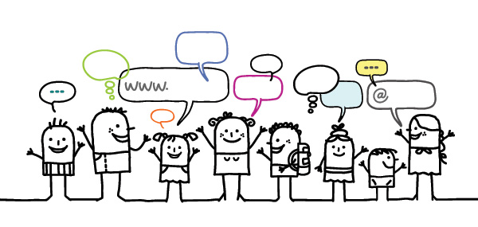

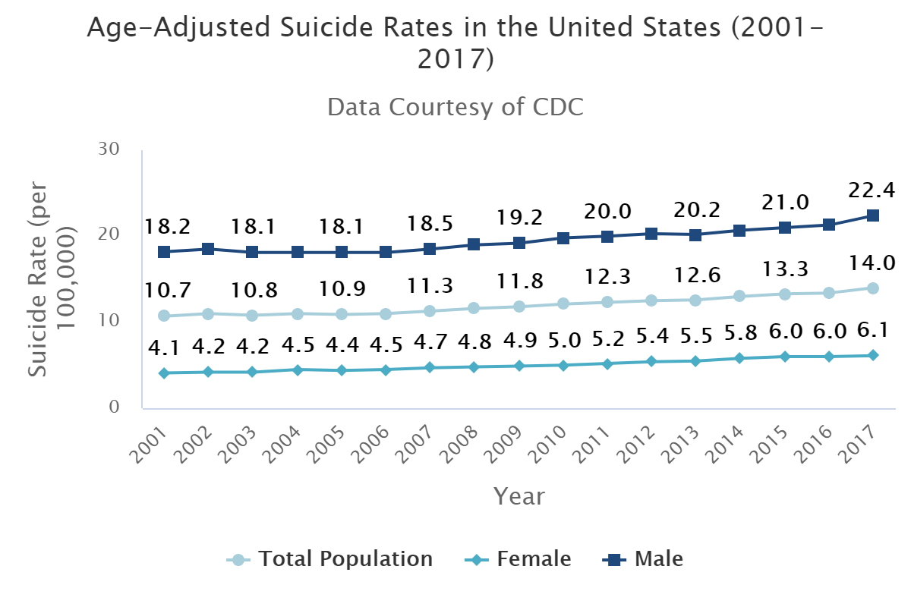
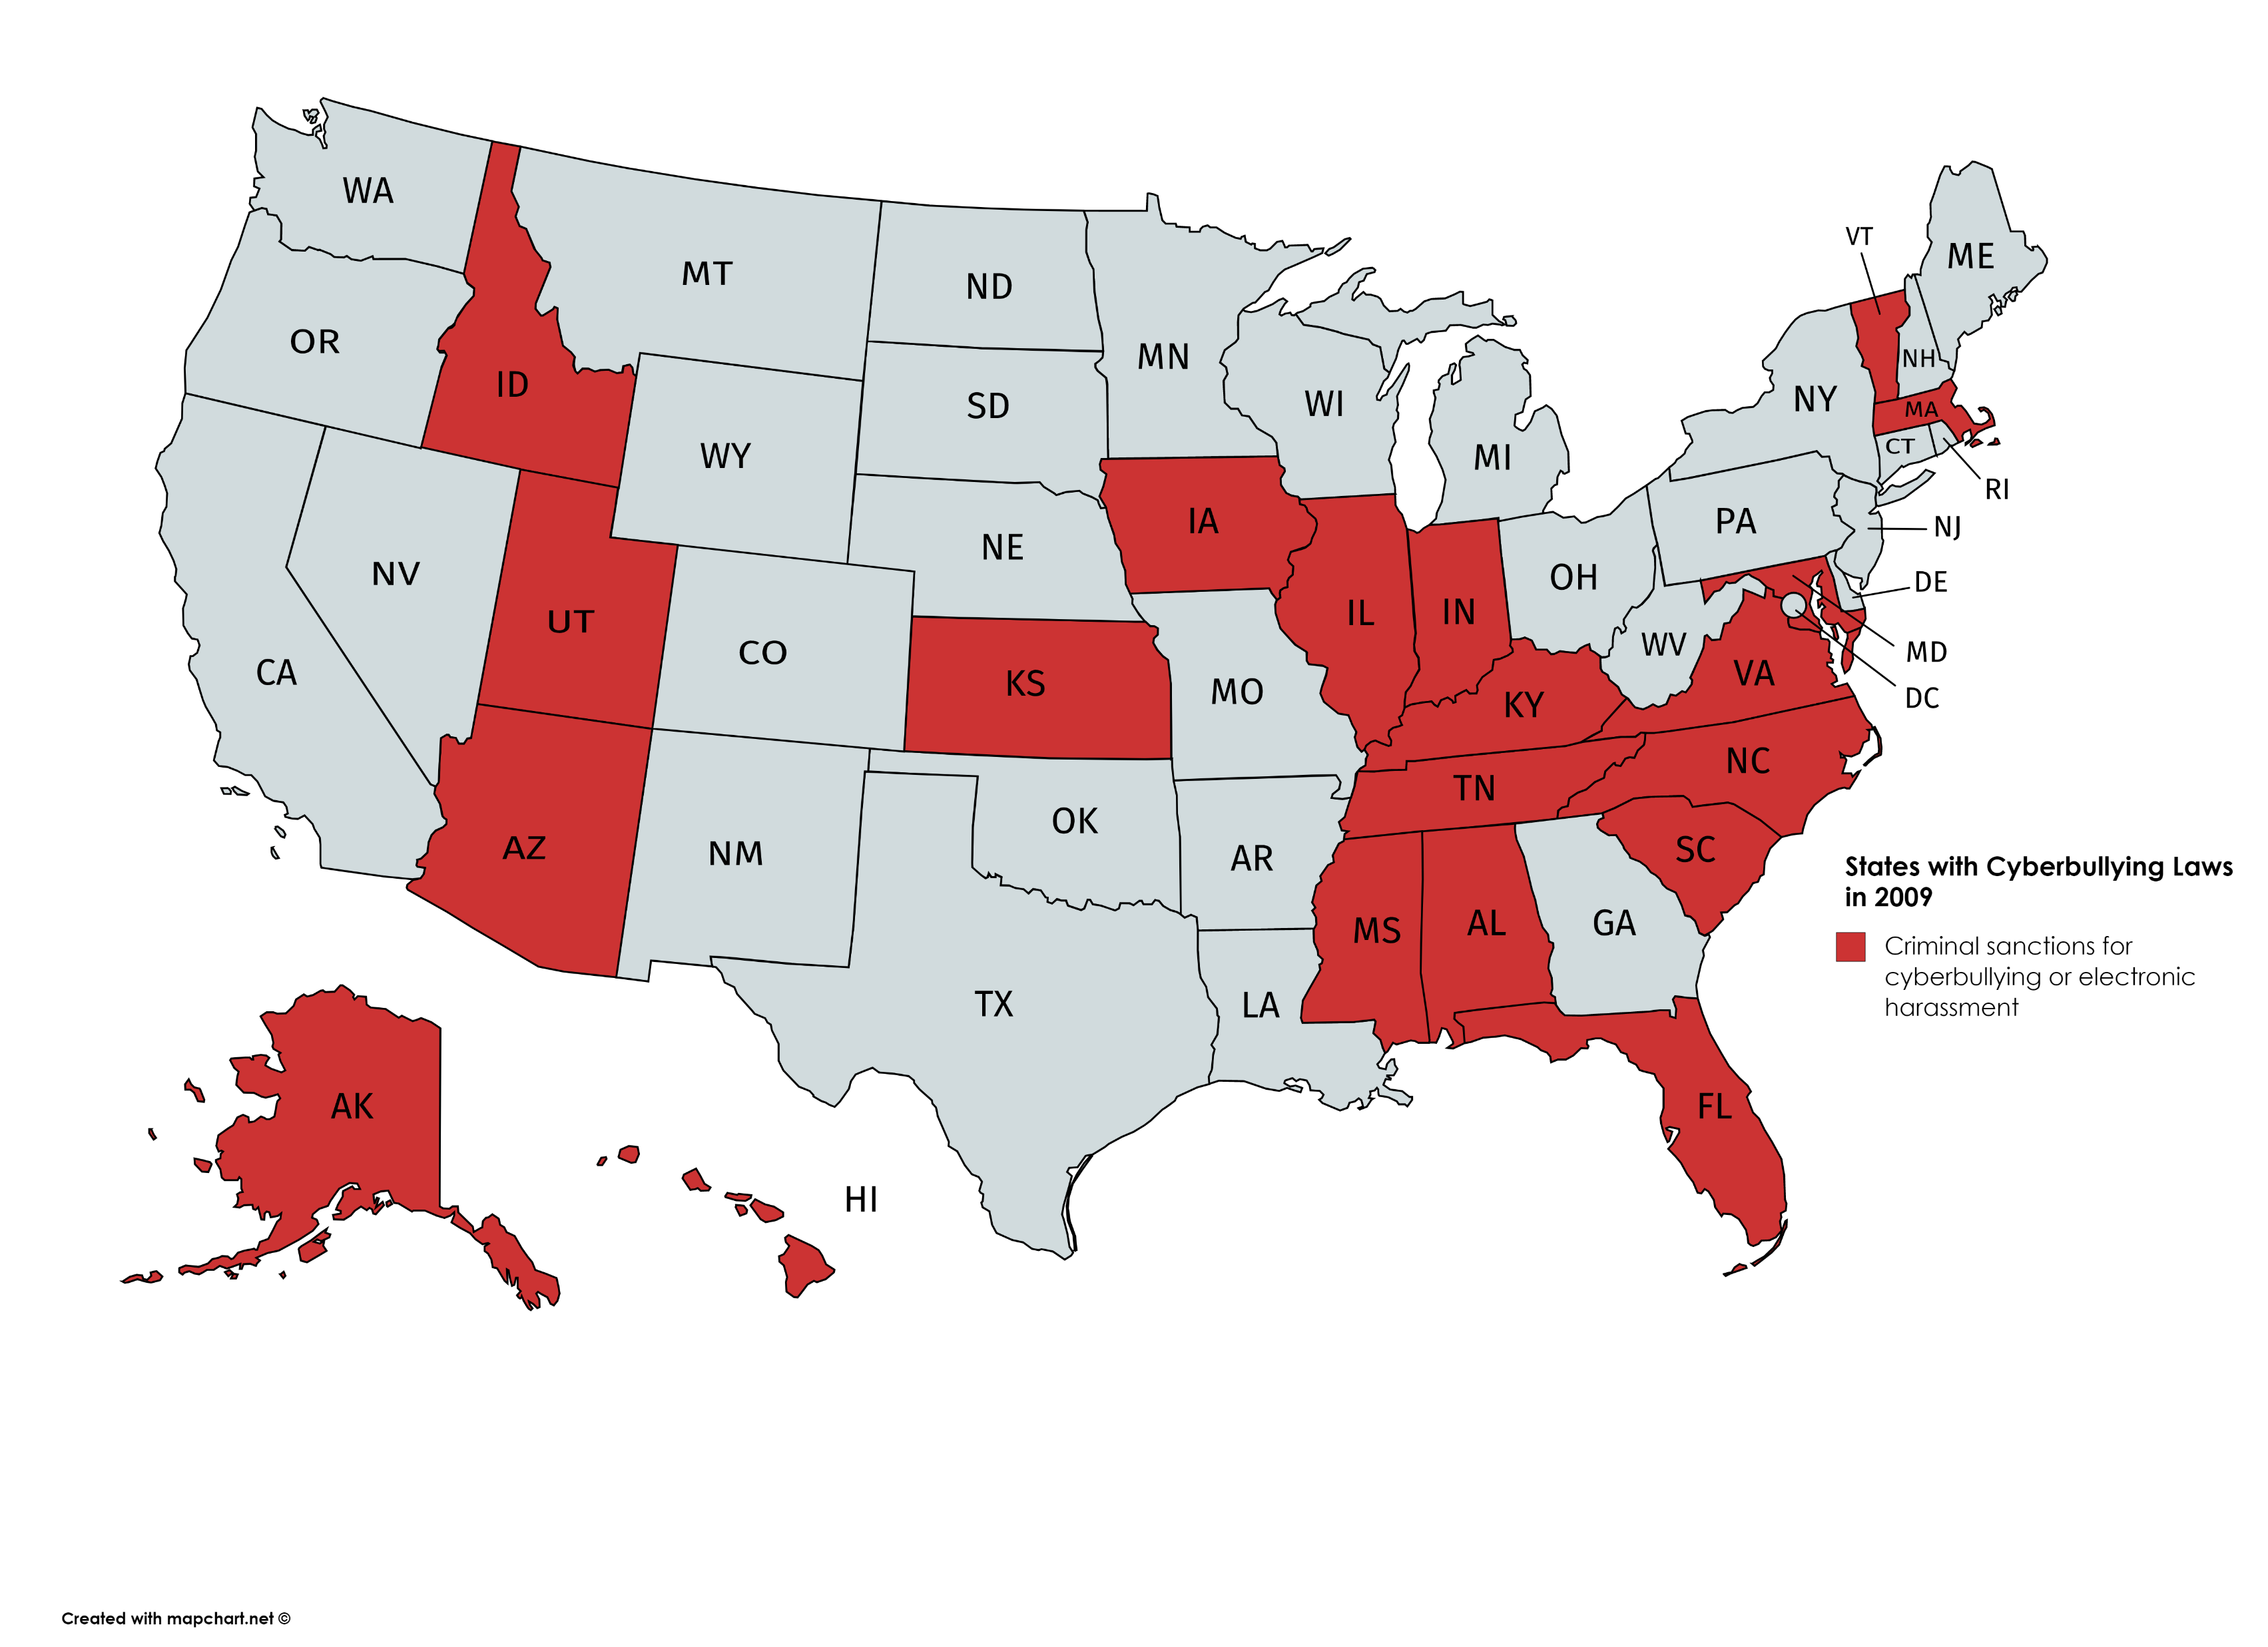
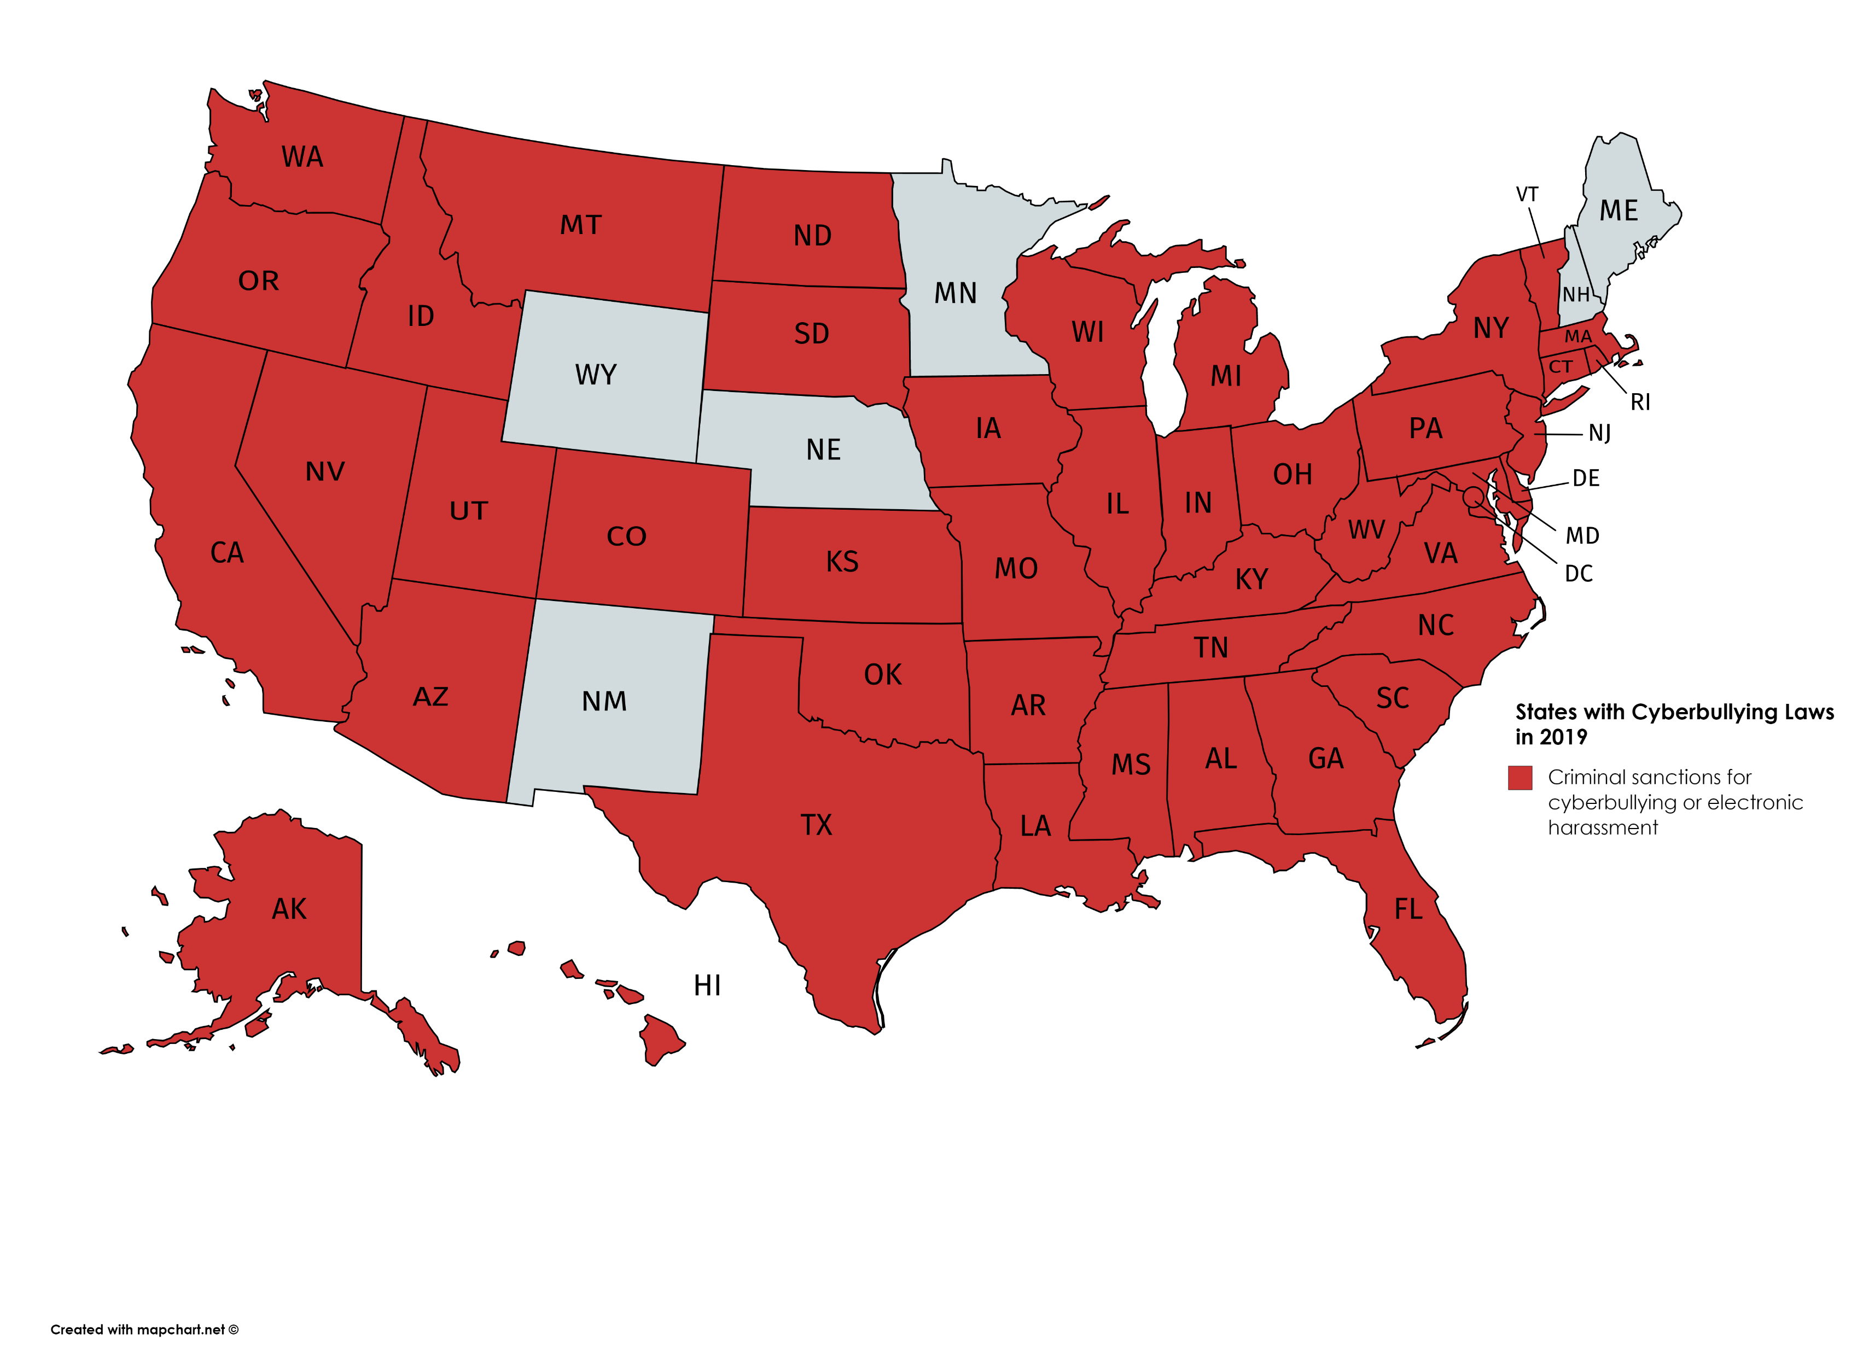
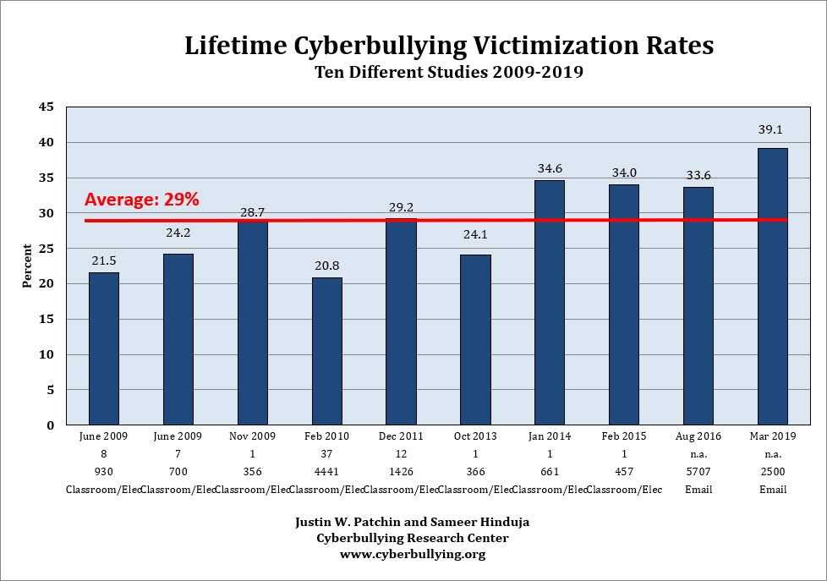
Our Online World:
An Overview of Cyberbullying Issues from 2009-2019
Elli Becker ● beckerej7866@uwec.edu
Faculty Mentor: Justin W. Patchin ● patchinj@uwec.edu
Criminal Justice Program ● Department of Political Science
University of Wisconsin – Eau Claire
Abstract
From the creation of the world wide web, our society has quickly woven the internet into our everyday lives. While it provides countless resources, the internet has also become a tool for those who seek to put others down. "Cyberbullying" emerged as a real issue that has finally begun to be addressed in the past years. We studied many aspects of cyberbullying and the effects it has on individuals. As its prevalence grew, cyberbullying became illegal in many states. Seeking to truly find if the internet has "destroyed the minds of a generation" and if cyberbullying has gotten worse, we looked at the changes in apps, laws, and effects (depression and suicide rates) over the span of a decade. Our analysis shows that cyberbullying is an issue, but that it is no more prevalent than bullying itself, and the internet should not take the brunt of the blame. We aim to educate on cyberbullying with facts and provide an empirically backed explanation for the trends of the time.
Is cyberbullying illegal?
Over the past decade, many states enacted legislation concerning cyberbullying, in order to address this new issue. The following maps illustrate the differences in 2009 to 2019.
Overall, we see a large increase in the number of states with criminal sanctions for cyberbullying.
Other Findings
In extreme cases, individuals who are cyberbullied are at an increased risk for suicide attempts.
Suicide Rates Over Time:
2009
What is cyberbullying?
“Willful and repeated harm inflicted through the use of computers, cell phones, and other electronic devices.”
(Hinduja & Patchin, 2008)
Expanding Upon Previous Knowledge
The following literature provides additional information on bullying, cyberbullying, and how they relate to factors such as suicide.
Bullying, Cyberbullying, and Suicide – 2010 (Hinduja & Patchin)
Connecting Adolescent Suicide to the Severity of Bullying and Cyberbullying – 2018 (Hinduja & Patchin)
Timeline of Popular Social Media Platforms
Cyberbullying can occur in different forms through any of these apps.
Skype, Facebook, YouTube, Twitter, and Tumblr all launched before 2009.
KiK – Launched 2009
Omegle – Launched 2009
Ask.fm – Launched 2010
Instagram – Launched 2010
Pinterest – Launched 2010
Snapchat – Launched 2011
Vine – Launched 2013
Yik Yak – Launched 2013 (Shut down in 2017)
Musical.ly – Launched 2014
Sarahah – Launched 2016 (Removed from Google and Apple app stores in 2018)
2019
Thoughts for the Future
As our society becomes more interwoven with technology, many of our everyday tasks could not be done without it. Overall, the trends in the prevalence of cyberbullying are varied with increases some years and decreases others. More research must be conducted over time with consistent methods to gather sound information. (There have not been many studies on prevalence.) The internet has not ruined a generation any more than any other new form of living. For the future, we want to promote education of safe internet use and the spread of more positivity, while also advocating for additional research on the topic. Cyberbullying and regular bullying trace their roots to different aspects of a person’s life that may drive them to that behavior. Traditional bullying is still more prevalent than cyberbullying, so it is up to us as human beings to improve our conduct towards others.
Overall Cyberbullying Trends
Prevalence for cyberbullying has varied over the past decade. This year, there may be the slightest increase, but overall about 29% of adolescents say they have been cyberbullied.
(Patchin & Hinduja, 2019)
Visit cyberbullying.org for more information on how you can help make a difference!
Acknowledgments: This project was funded through UW-Eau Claire Center of Excellence for Faculty and Undergraduate Student Research Collaboration

