Slide 1
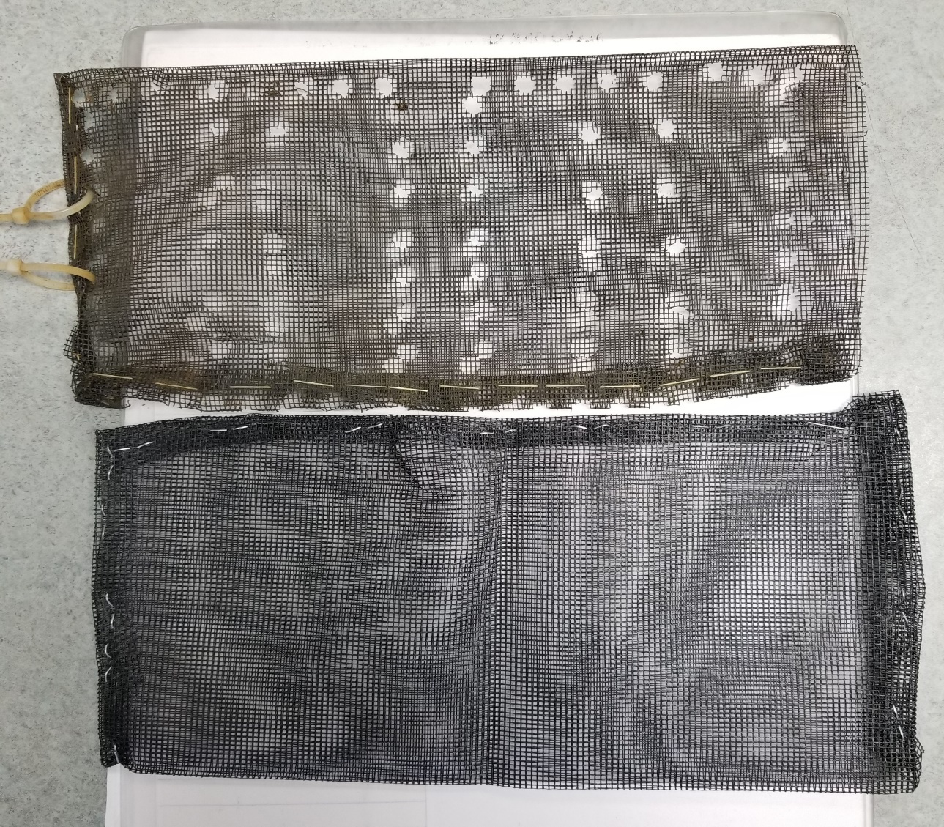
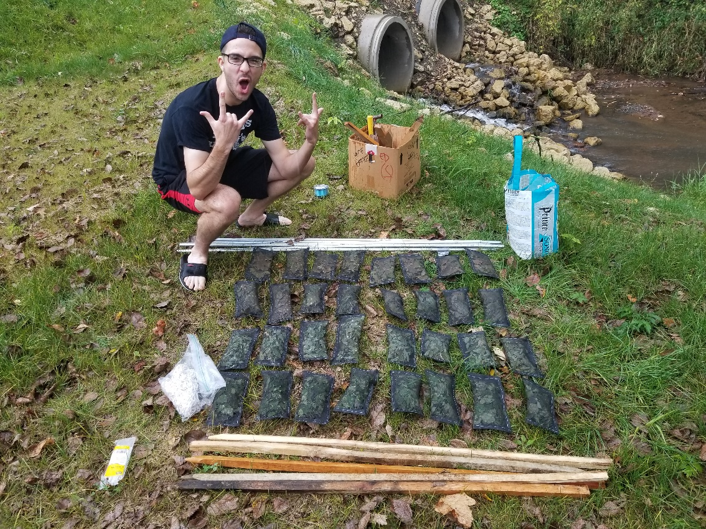
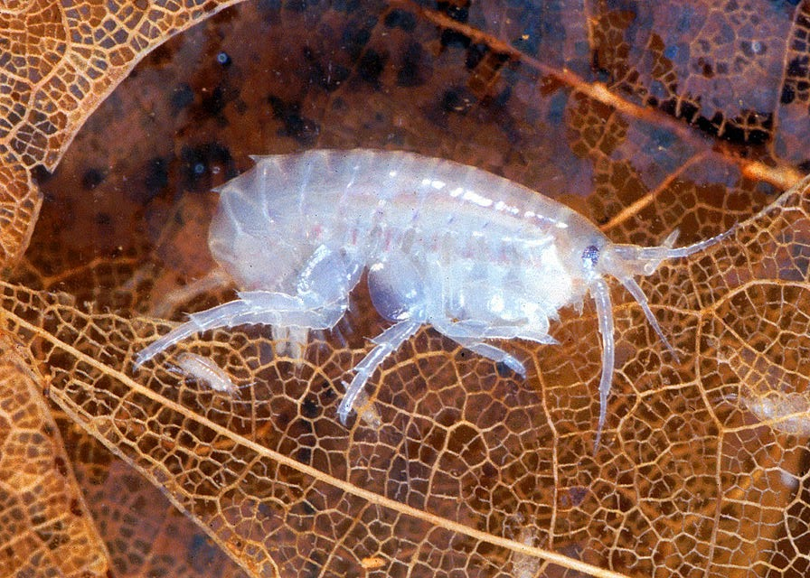
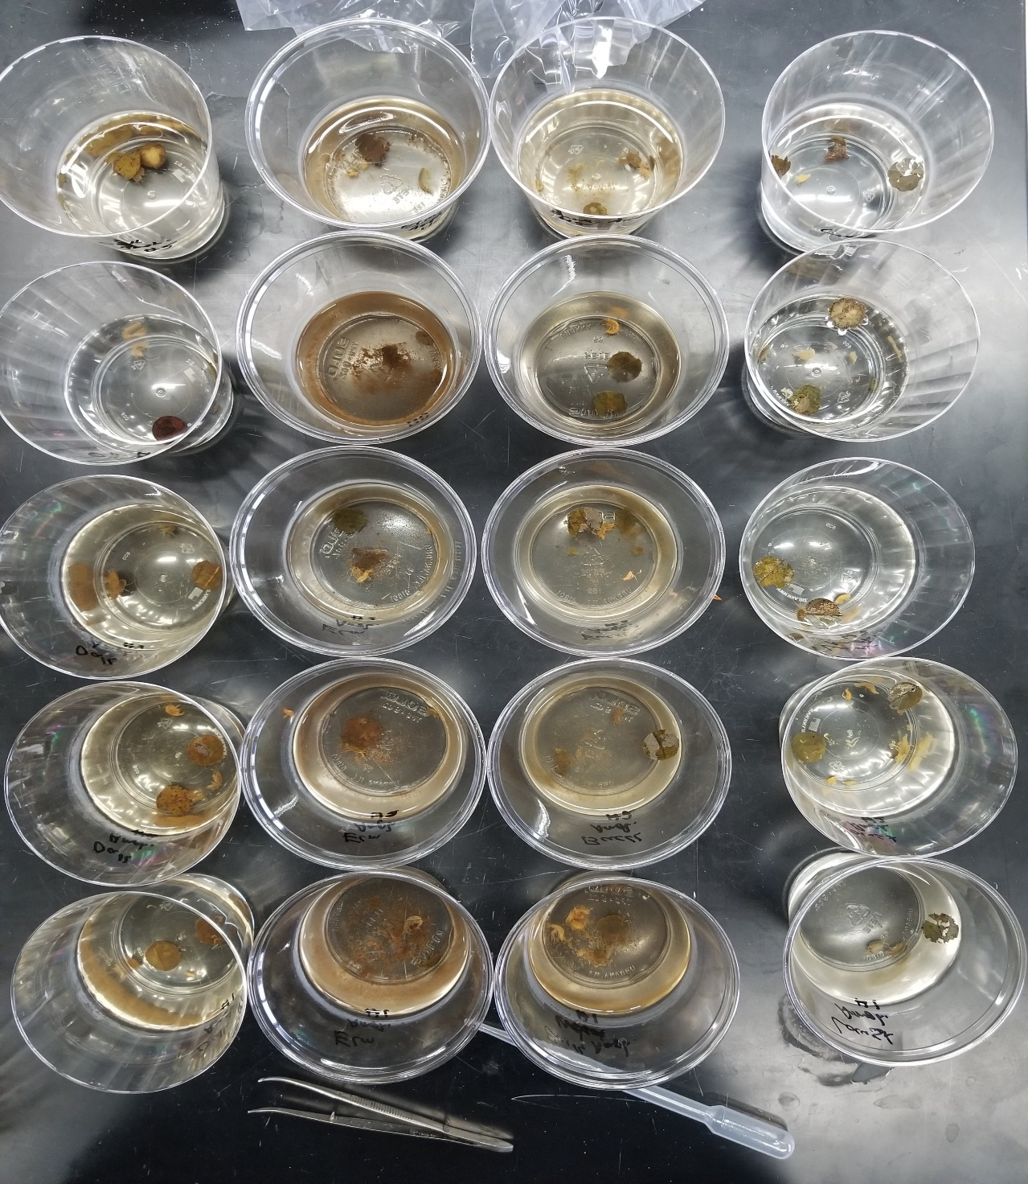

Effects of Invertebrate Shredders and Leaf Type on Leaf Breakdown in Streams
Kevin Kasza, Dana Lind and Lawton Menard | Biology
Mentor: Todd Wellnitz
Introduction
Methods
Results
Leaf litter is a vital source of nutrients for stream-dwelling organisms and the rate at which these nutrients are released by decomposition is important to the overall functioning of the stream¹.
Both microorganisms and aquatic “shedders” (invertebrates that feed on leaves) are important for breaking down leaves that fall into streams, but their relative contributions to leaf breakdown may vary among tree species.
We hypothesized 1) that leaves from native trees of oak and maple would decompose more slowly in streams compared to non-native species of buckthorn and black locust², and 2) amphipod shedders (Fig. 1) would consume more native than non-native leaf biomass because they are adapted to consuming native leaves.
To test these hypotheses, we conducted a field and a laboratory experiment. In the field study, leaf bags of nylon mesh (Figs. 2 & 3) that either excluded or allowed amphipod access, and contained either oak, maple, buckthorn or black locust leaves, were put into Taylor Creek for 4 weeks and then removed and weighed. In the laboratory experiment (Fig. 4) we examined the` consumption rates of the four leaf types in the presence of absence to amphipods.
Figure 2. Two of the 32 mesh bags used in the field experiment. Each measured 15 x 10 cm and was made from nylon screening folded over and stapled. Half the bags (16) had holes to allow amphipod shredders access to the leaves.
Figure 3. Using a 4 x 2 factorial design, mesh bags were separated into 8-bag blocks (4 leaf species x 2 shredder treatments) and attached to poles that held them in place in the stream. After 4 weeks the leaves were removed, dried and weighed.
Field Experiment. Mean (± SEM) percent of initial leaf weight lost after being in Taylor Creek for 1 month. Columns having the same letters are not different (Tukey’s p > 0.05).
Figure 1. The amphipod shown here is a common shredder found in many Wisconsin streams.
Figure 4. Photo of the 36 plastic cups used in the laboratory experiment. Each cup had two, pre-weighed leaf disks and half had amphipods in 4 x 2 (leaf types x amphipod treatments) factorial design. The experiment ran 1 week, after which leaves were removed, dried and weighed.
http://dailyparasite.blogspot.com/2014/11/leptorhynchoides-thecatus.html
Laboratory Study. Mean (± SEM) dry weight of leaf discs as a percent of initial mass after decomposing in water plastic cups with or without amphipods. Columns having the same letters are not different (Tukey’s p > 0.05).
Literature Cited
Discussion
Conclusion
Webster JR, Benfield EF. 1986. Vascular plant breakdown in freshwater ecosystems. Annual Review of Ecology and Systematics 17(1):567–594.
Kennedy KTM, El-Sabaawi RW. 2017. A global meta-analysis of exotic versus native leaf decay in stream ecosystems. Freshwater Biology 62(6):977–989.
Freund G. et al. 2013. Rapid in-stream decomposition of leaves of common buckthorn (Rhamnus cathartica), an invasive tree species. Journal of Freshwater Ecology 28(3):355–363.
Our results support findings by Freund et al.³ who found that native species do not necessarily decay at different rates than invasive species. Rather, as Kennedy & El-Sabaawi² suggested, leaf composition may have a more significant effect on leaf decay, and may also influence the effect of leaf mass lost due to invertebrates. Amphipod stream shredder presence was much more significant in stagnant water versus in stream water with mesh bags to exclude shredders.
The results show that leaves of buckthorn (invasive), and elm (native), consistently break down faster than the other leaf types. This suggests that individual leaf qualities, rather than nativity, determine breakdown rate. In addition, the presence of stream shredders in the lab experiment caused the difference in breakdown rate due to individual leaf characteristics to be more evident.

