Slide 1



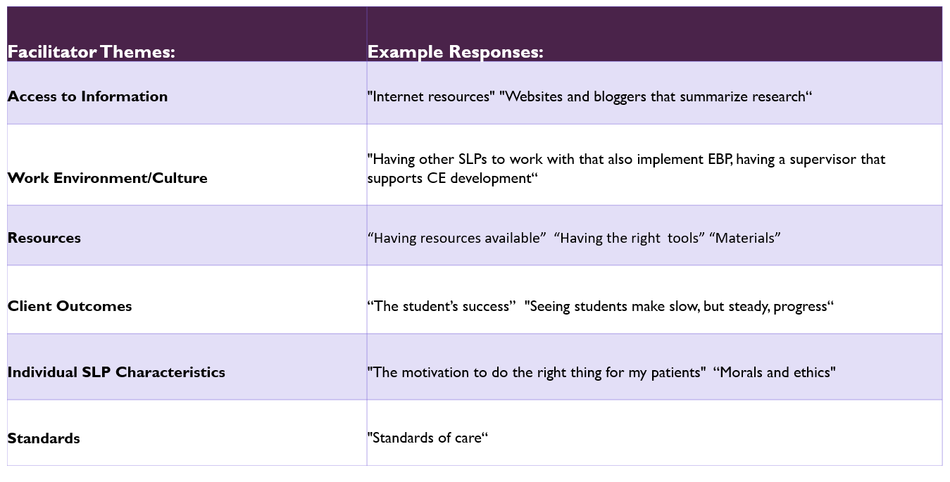
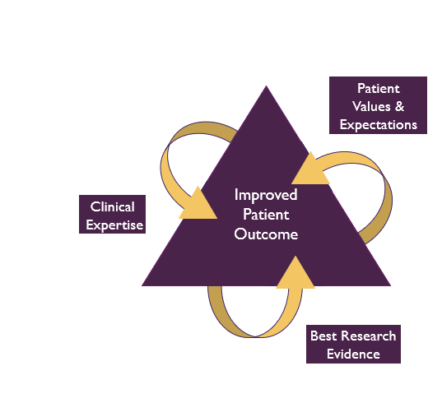
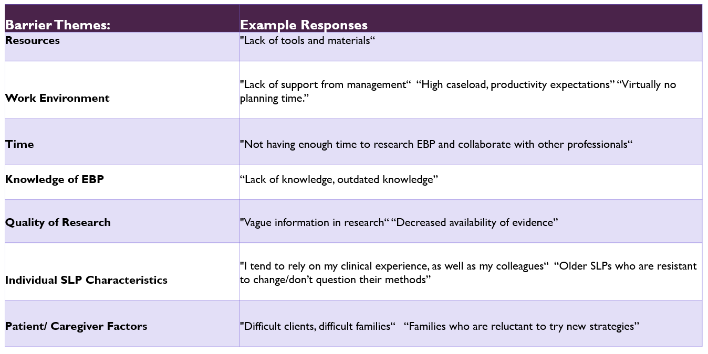
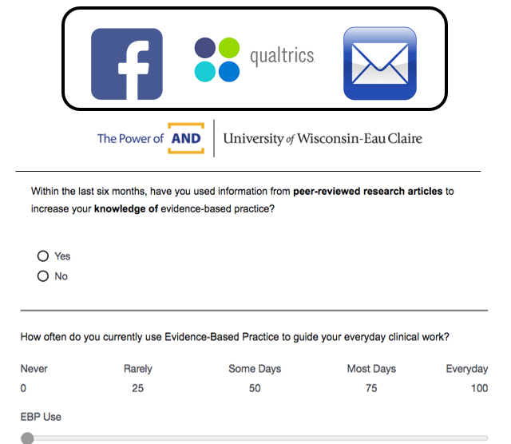
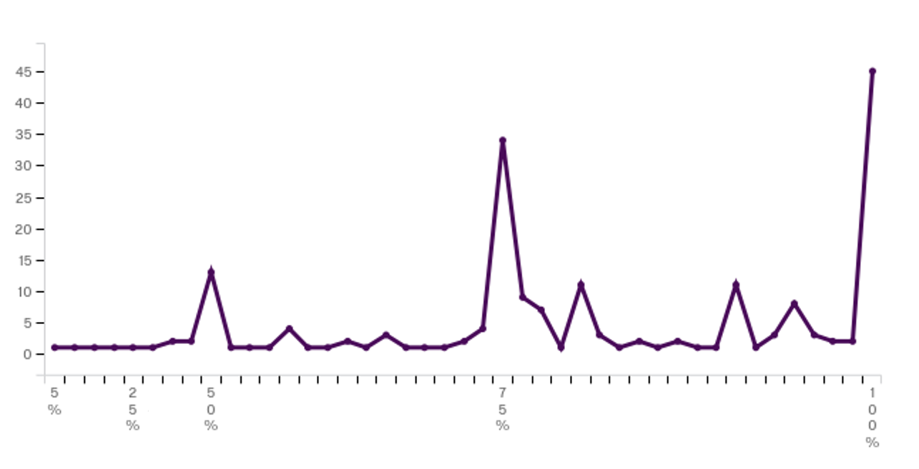
Research into Evidence-Based Practice Among
Practicing Speech-Language Pathologists
Josie Zimmel, Kaitlyn Bruggenthies | Communication Sciences and Disorders Undergraduate Student Researcher
Rebecca Jarzynski, M.S., CCC-SLP Jerry Hoepner, Ph.D., SLP Abby Hemmerich, Ph.D., SLP | Communication Sciences and Disorders Faculty
Introduction
Evidence-Based Practice
Investigated the gap between evidence-based practice (EBP) and the clinical methods used by practicing speech-language pathologists (SLPs)
A survey was developed and distributed to practicing SLPs to:
Identify how often SLPs consult research
Identify barriers and facilitators of information access to EBP
Identify barrier and facilitators of implementation of EBP
Results will be used to identify potential methods for increasing access to and use of EBP across clinical settings
Background
SLPs and other healthcare professionals consistently reported difficulty accessing and implementing research-backed information (Nail-Chitwetalu & Berstein-Ratner, 2007; Zipoli & Kennedy, 2005).
Nursing disciplines reported information availability, understanding, and value as key barriers (Nail-Chiwetalu & Berstein-Ratner 2007)
79% of occupational therapists reported consulting colleagues to be the primary way that they accessed EBP (Powell & Case-Smith, 2003).
Lack of time has been identified as the largest barrier (Coumou & Meijman, 2006).
Survey completed by SLPS in 2005 (Zipoli & Kennedy 2005)
50% of respondents ‘‘disagreed’’ or ‘‘strongly disagreed’’ that they had the professional time to participate in EBP
17.7% of SLPs drew upon research studies within the last six months
More experienced SLPs reported that they were less inclined to access research, relying more on personal experience.
Less experienced SLPs held better attitudes toward the use of EBP
Methods
205 practicing SLPs
Mean of 12.53 years of experience
Daily Use of EBP as Reported by SLPs
Implications/Future Directions
SLPs are accessing peer-reviewed research more frequently
A gap between EBP and the clinical methods used by SLPs continues to exist
SLPs continue to rely heavily on colleagues to increase their knowledge of EBP
Barriers and facilitators of EBP extend beyond knowledge of and access to EBP information
Further qualitative and quantitative analyses will be conducted to analyze:
Variables that impact SLP use of EBP
Barriers and facilitators of EBP access and use
Graduate schools’ areas of strength and areas of challenge in preparing clinicians to use EBP
Potential methods of graduate school’s support of the use of EBP among practicing clinicians after graduation
References
Coumou, H. C., & Meijman, F. J. (2006). How do primary care physicians seek answers to clinical questions? A literature review IRP. Journal of the Medical Library Association, 94(1), 55.
Council for Clinical Certification in Audiology and Speech-Language Pathology of the American Speech-Language-Hearing Association. (2013). 2014 Standards for the Certificate of Clinical Competence in Speech-Language Pathology. Retrieved March 27, 2018
Nail-Chiwetalu, B., & Ratner, N. B. (2007). An assessment of the information-seeking abilities and needs of practicing speech-language pathologists. Journal of the Medical Library Association, 95(2), 182.
Powell, C. A., & Case-Smith, J. (2003). Information literacy skills of occupational therapy graduates: a survey of learning outcomes. Journal of the Medical Library Association.
Zipoli, R. P., & Kennedy, M. (2005). Evidence-based practice among speech-language pathologists: Attitudes, utilization, and barriers. American Journal of Speech-Language Pathology, 14(3), 208-220.
Notes:
What is the purpose of your poster? What message do you want viewers to glean from it? Scientific posters generally follow the same progression of topics:
background
Methods
Results
Discussion
References
Acknowledgements

