Slide 1

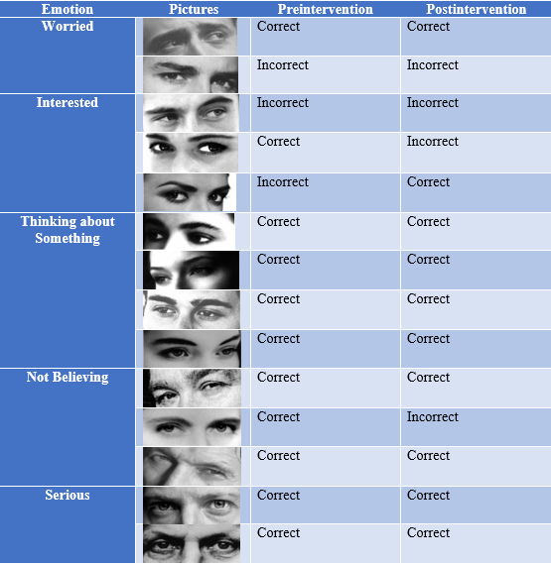
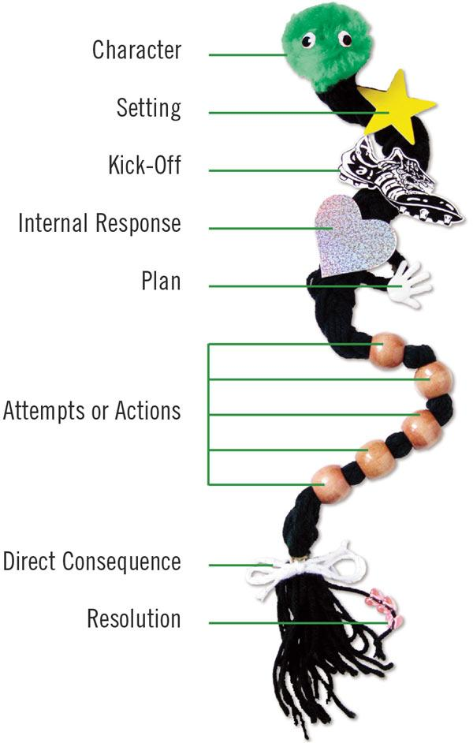
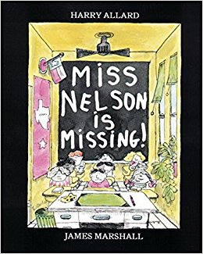

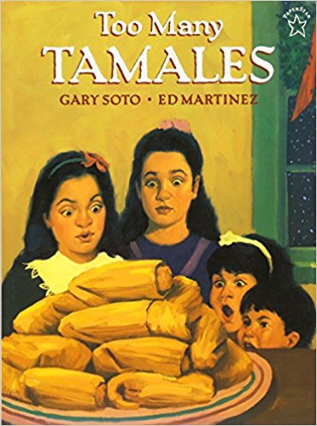

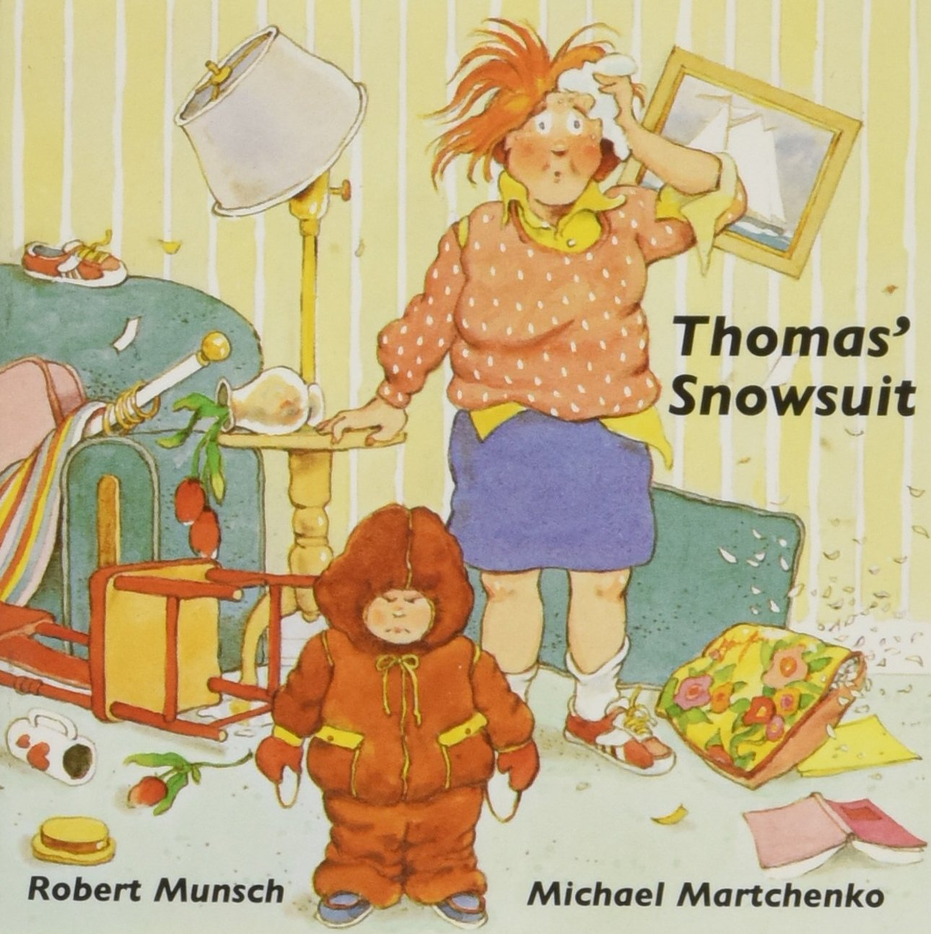
Narrative Intervention to Teach Emotion Recognition in Children During the Middle Childhood Years
Kayley Eslinger
Faculty Mentor: Deborah Elledge, Ph.D., CCC-SLP
University of Wisconsin – Eau Claire
Department of Communication Sciences and Disorders
Background
Assessment Measures:
Child’s version of “Reading the Mind in the Eyes” test (Baron-Cohen, Wheelwright, Spong, Scahill, and Lawson, 2001)
Interpersonal Reactivity Index (IRI) (Garton and Gringart, 2005)
Story retell activity, using the book, Harry the Dirty Dog by Gene Zion [1956]
Story Retell:
Importance of emotion recognition:
Instrumental to successful relationships at school with teachers and peers (Voltmer & von Salisch, 2017)
Use of narratives:
Narratives require an individual to apply mental states to characters and make sense of their actions to understand the perception and intentions of others (Dodd, Ocampo, & Kennedy, 2011)
Research Question
Do measures of emotion recognition increase with a narrative intervention approach for children during the middle childhood years?
Preintervention and Postintervention Perspective-Taking Score and Psychological Terms
Preintervention |  | Postintervention
Harry’s Perspective | Children’s Perspective | Harry’s Perspective | Children’s Perspective
2 | 2 | 3 | 3
Terms Used
Hate | Saw; Believed | Realize; Look; Hate | Think; Look; Hate
Results
Emotions represented by multiple pictures on the child’s version of “Reading the Mind in the Eyes” test :
Methods
Participant:
Typically developing 7;4-year-old female
Procedure:
The study was an ABA single-case design. The intervention sessions were thirty minutes each, three times/week for six weeks.
Conclusions
Perspective--Taking
Emotion
Recognition
Limitations:
Single-subject design limits generalizability
Variable testing conditions
Interpersonal Reactivity Index (IRI) Differences:
Future Directions:
Item | Preintervention | Postintervention
“I think people can have different opinions about the same thing.” | Not Like Me at All | Fairly Like Me
Investigate the effect of intervention on emotional recognition skills in other populations:
Children with autism spectrum disorder
Children with language impairments
The books and intervention protocol followed the procedure used by Dodd, Ocampo, & Kennedy (2011) that targeted perspective taking through narratives for children with ASD.
The sequence of data collection was:
Preintervention data collected
Intervention of 180 minutes conducted over a 2-week period; Miss Nelson Is Missing by Harry Allard [1977]
Intervention of 180 minutes conducted over a 2-week period; Too Many Tamales by Gary Soto [1996]
Intervention of 180 minutes conducted over a 2-week period; Thomas’s Snowsuit by Robert Munsch [1989]
Postintervention data collected
references
http://blog.earlymoments.com/6-favorite-first-grade-books-from-my-childhood/
Story Retell Differences in Story Endings:
Aldrich, N. J., Tenenbaum, H. R., Brooks, P. J., Harrison, K., & Sines, J. (2011). Perspective taking in children's narratives about jealousy. British Journal of Developmental Psychology, 29(1), 86-109.
Allard, H. (1977). Miss Nelson is missing. New York, NY: Houghton Mifflin
Baron-Cohen, S. Wheelwright, S. Scahill, V. Lawson, J. and Spong, A. (2001). Are intuitive physics and intuitive psychology independent? A test with children with Asperger Syndrome. Journal of Developmental and Learning Disorders 5:47-78
Dodd, J. L., Ocampo, A., & Kennedy, K. S. (2011). Perspective Taking through Narratives: An Intervention for Students with ASD. Communication Disorders Quarterly, 33(1), 23-33.
Garton, A., & Gringart, E., (2005). The development of a scale to measure empathy in 8- and 9-year old children. Australian Journal of Education and Developmental Psychology, 5, 17-25.
Munsch, R. (1989). Thomas’ snowsuit. Toronto, Canada: Annick Press.
Soto, G. (1996). Too many tamales. New York, NY: Putnam.
Voltmer, K., & von Salisch, M. (2017). Three meta-analyses of children's emotion knowledge and their school success. Learning & Individual Differences, 59107-118. doi:10.1016/j.lindif.2017.08.006
Harry’s Perspective:
Pre-intervention: “And then he had a happy ending”
Post-intervention: “The moral of the story don’t run away from your home”
Children’s Perspective:
Pre-intervention: “And we gave him a bath and found out it was Harry.”
Post-intervention: “Moral of the story don’t judge things by their looks.”

