Slide 1


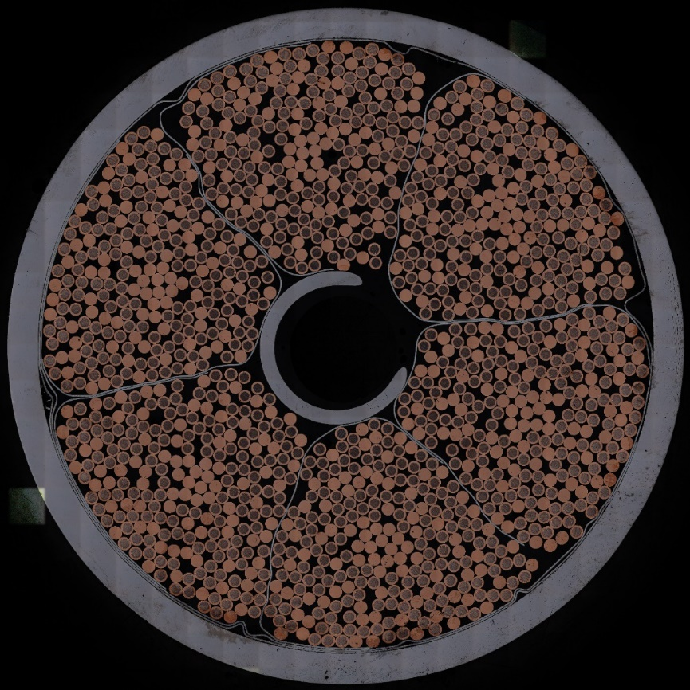
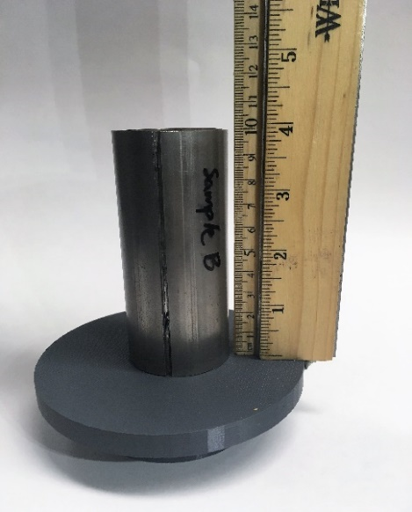
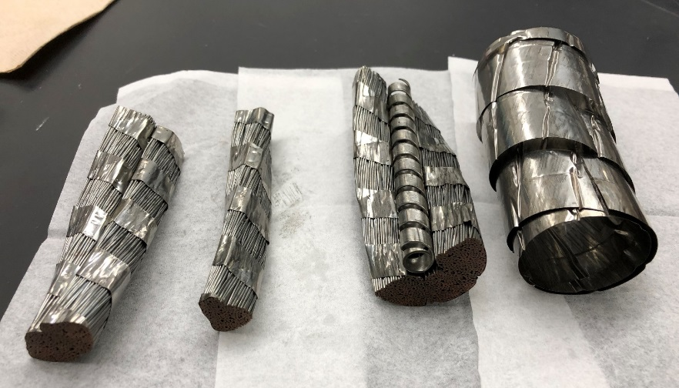
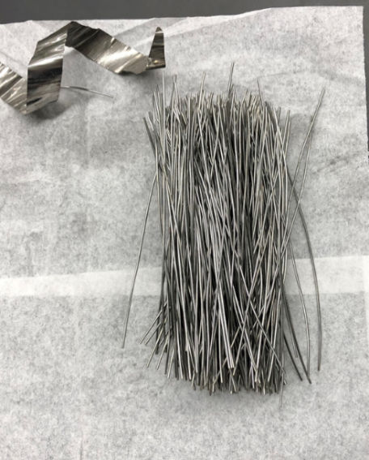
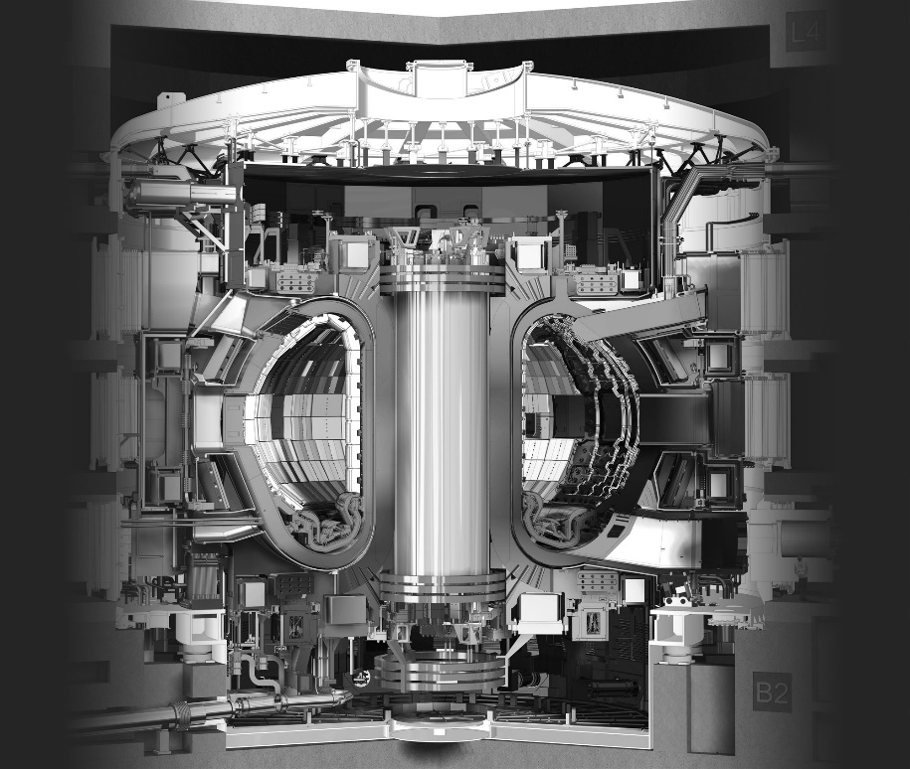
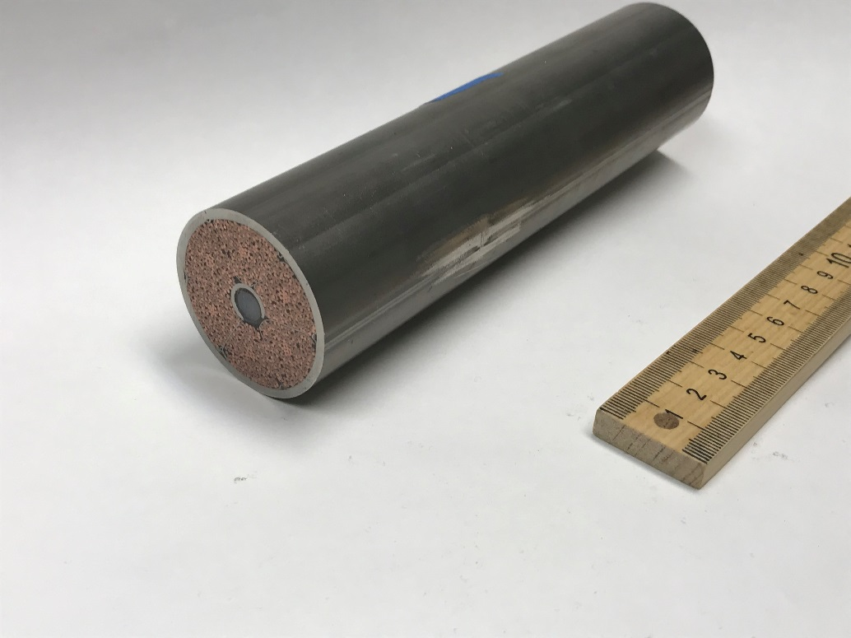
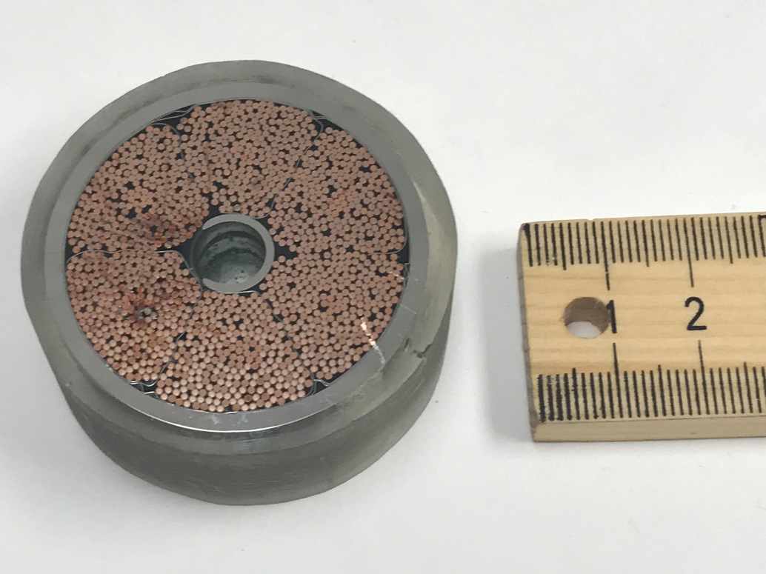
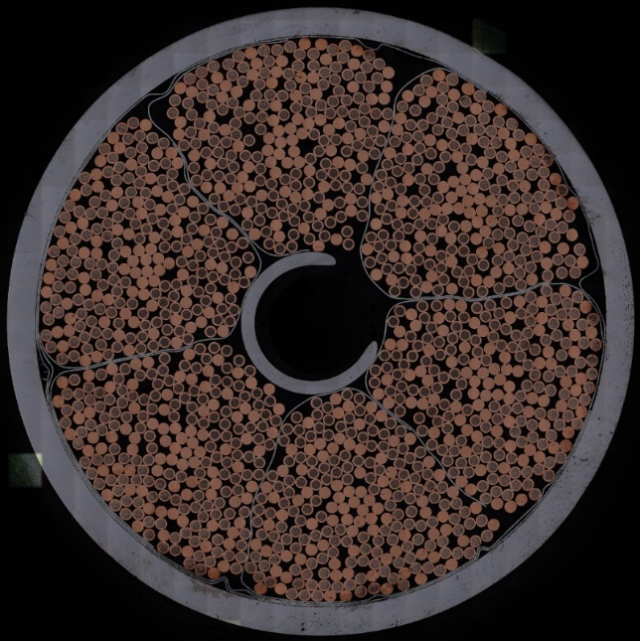
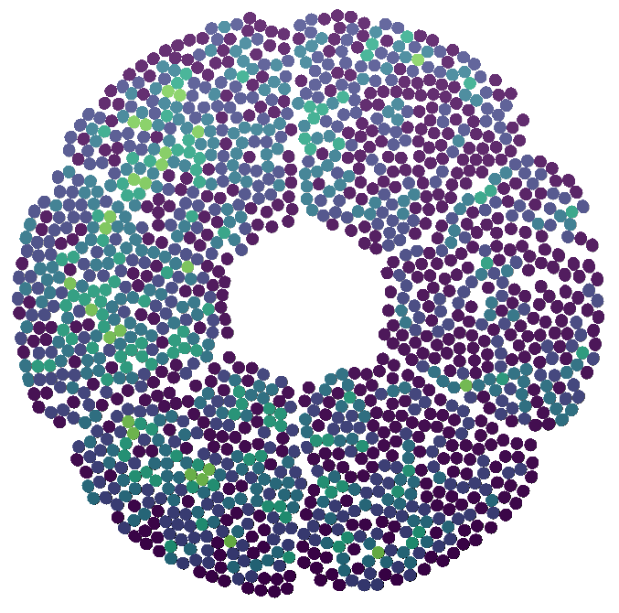
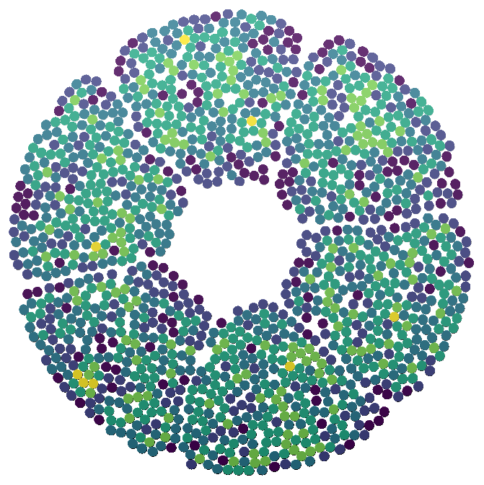
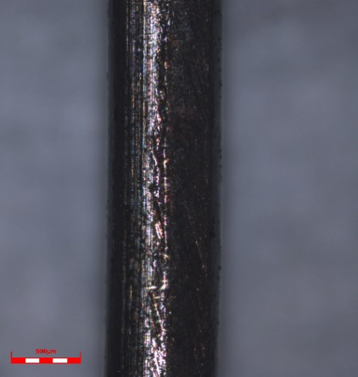
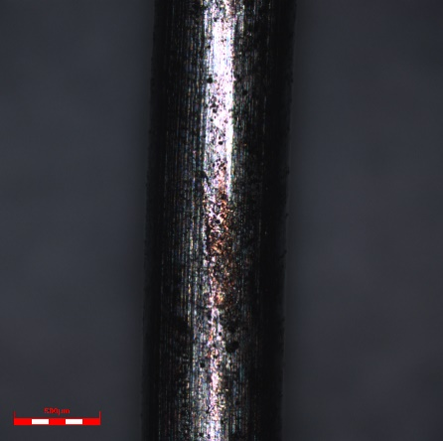
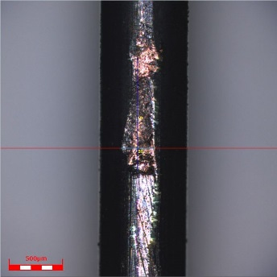
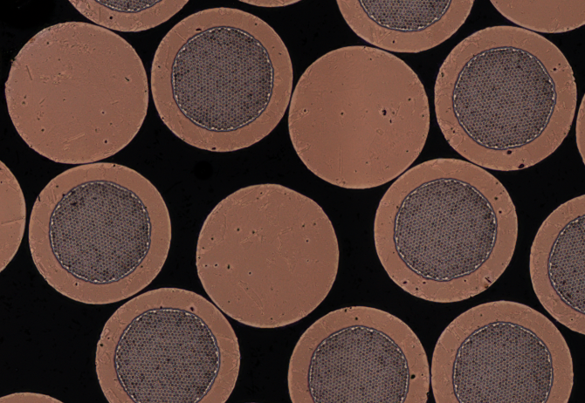
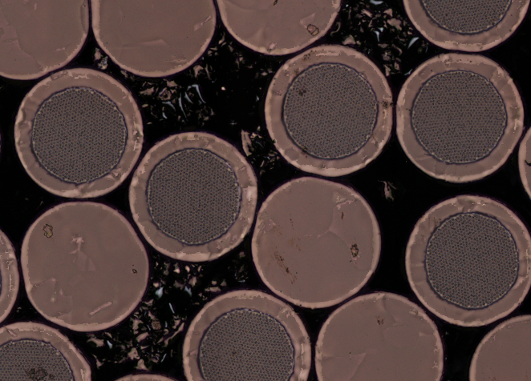
WIRE POSITIONING AND DEGRADATION IN SUPERCONDUCTING CABLES SUBJECTED TO ELECTROMAGNETIC CYCLING
Colin Fackler, Anthony Doan, Matthew C. Jewell
Materials Science & Engineering Program  University of Wisconsin – Eau Claire
Introduction
Procedure
What are we studying?
Niobium–tin (Nb₃Sn) is a low temperature superconductor, fabricated as a round wire for industrial use in magnets.
Why are we studying it?
Superconducting materials are a fast growing area of materials science as they have a wide range of important applications. The experimental
ITER fusion reactor uses Nb₃Sn as part of a superconducting magnet system to levitate and contain the plasma.
Nb₃Sn is extremely brittle, which means the magnets can degrade with time, as they are subject to very large magnetic forces.
What's the goal of this research?
The goal of this research is to use image analysis
techniques to understand the mechanical impact of
electromagnetic cycles on superconducting
cable-in-conduit conductors for fusion reactors
that contain brittle Nb₃Sn superconducting wires.
We wish to identify a set of ideal operating conditions
that will minimize the mechanical and electrical
degradation of the superconductor. In order to accomplish this goal, we must first develop a baseline to compare tested versus untested samples.
Wire Analysis in Transverse Cross-Section
To obtain a transverse cross-sectional image, the cable is filled with a conductive epoxy and cut into “cookies” using electrical discharging machining (EDM).
Next, the cookie is polished until there is a clear image free of scratches.
Once polished, the sample is imaged using the Confocal microscope to produce 400 individual images which are subsequently stitched using FIJI software.
From the stitched image we use FIJI to make a clear image threshold for subsequent analysis.
2. Dent Deformation
To characterize the plastic deformation in the wires, we first disassembled a baseline conductor sample using electrical discharging machining (EDM) to section the conductor.
We proceeded to separate individual wires based off the level of damage presented on the wire.
We use Laser Scanning Confocal Microscopy (LSCM) to measure
the cross-section and height of the dents.
Transverse cross-sectional image of a polished cookie
Acknowledgements
Cut length of a sample that has been filled with epoxy
Thresholded image produced from the color image using FIJI
This work was funded by ITER contract 43-1665 and benefited from the support of the Materials Science & Engineering Center and Learning Technology Services at UW-Eau Claire.
“Cookie” that has been polished to a 0.05 micron finish
Evidence of Wire Movement and Damage from Cross-Sectional Images and Dent Analysis
Types of Degradation
Dent Deformation
Wire Movement and Shape Change
The primary source of damage comes from the Lorentz force. The Lorentz force is a force that is created by the electric field and magnetic field. In this case, the Lorentz force acting on the cables is perpendicular to the wires.
The Lorentz force from the operation of the reactor is strong enough to move the wires within the cable, which could cause damage to the wires.
In this project, we look at several
parameters to compare an untested sample
and a fully tested sample for evidence
of degradation as a result of the Lorentz force.
The fully tested sample was not tested in the
ITER reactor as it is still under construction, but
was tested in similar conditions offsite with a
total force on each superconducting wire for
each electromagnetic peak of 814 N = 183 lbs.
Dents form in the wires as they collide due to movement from the Lorentz force.
The level of damage is determined through a 0 - 2 scale with 0 indicating no damage and 2 indicating extensive damage.
Level 0 – No copper visible with allowed possible chromium scratches
Level 1 – Damage has penetrated the chromium in at least one location with visible copper
Level 2 – Damage covers a wide length with a variety of dents or long copper scratches
After separating the wires, we use the LSCM to image and measure the length, width, and height of the dent.
As they undergo testing, the wires are expected to move in the direction of the Lorentz force. We can visualize this movement by use of a color-coded image that displays the number of other wires each number is in contact with. A color-coded image of each sample is given below:
Untested
Tested
SC Data in Level 1
Average Width: 422 µm
Average Length: 1070 µm
Average Height: 121 µm
Level 0
Level 1
Level 2
Lorentz force direction
SC Data in Level 2
Average Width: 426 µm
Average Length: 1090 µm
Average Height: 186 µm
In the untested sample, each petal (the six groups the wires are divided into) has a similar amount of contact between wires.
In the tested sample, the petals towards the direction of the Lorentz force have more contact between wires than the other petals. This is evidence of large-scale wire movement towards the direction of the Lorentz force.
Visual Evidence of Damage
Another parameter that was measured is the aspect ratio (ratio of width to height) of the wires. As the wires are moved around the cable, wires near the edge can become “squished”, increasing their aspect ratio. The graphs to the right compare x position with aspect ratio.
Without doing any specific analysis, it is clear from looking at cross-sectional images of the untested and tested samples that damage has occurred. Images comparing sections of the untested and tested samples are given below:
Dent Deformation Numerical Results
Untested
Tested
Among the tested samples, there are consistently more wires exhibiting deformation compared to the untested sample.
For both Cu and SC wires, we found there to be greater than twice the amount of dents compared to the untested sample as shown in the graph below.
Summary
We expect an increase amount of dents in the tested sample as the wires experience strain due to the Lorentz force.
In addition seek to find the level of deformation corresponding to the number of superconducting filament cracks.
Further investigation will be to image and analyze the dimensions of the dent to characterize the extent of deformation.
The area between the wires of the untested sample is very clear and free of debris.
In the tested sample, many smaller particles of copper and chromium can be seen between the wires. These likely exist as a result of the wires scraping against each other as they move around the cable.
In the untested sample, the aspect ratio of the wires is slightly higher near the sides of the cable since the wires are twisted in the cable, creating a more ovular cross-section for wires that are nearer to the edges of the cable.
In the tested sample, the aspect ratio of the wires is significantly higher near the sides of the cable because the wires become “squished” as they are pushed against the inside of the outer jacket by the other wires. There is also a slight trend of slightly increased aspect ratio in the direction of the Lorentz force.
Key Result: The wires have degraded, likely due to the movement of wires and contact between wires
Key Result: A greater amount of deformation in the tested sample due to the strain and “rubbing” of the wires from the Lorentz force.
Key Result: The wires have moved through the cable, and the movement is mainly in the direction of the Lorentz force
Celebration of Excellence in Research and Creative Activity (CERCA) April 29-May 3, 2019
The authors thank the UWEC Office of Research and Sponsored Programs for student support at CERCA 2019.

