Slide 1

Mapping Our World:
The Art of Cartography
An Elementary Art Unit in Six Lessons

Slide 2
Unit Summary
Teacher Overview

Slide 3
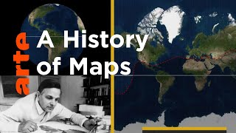

Slide 4
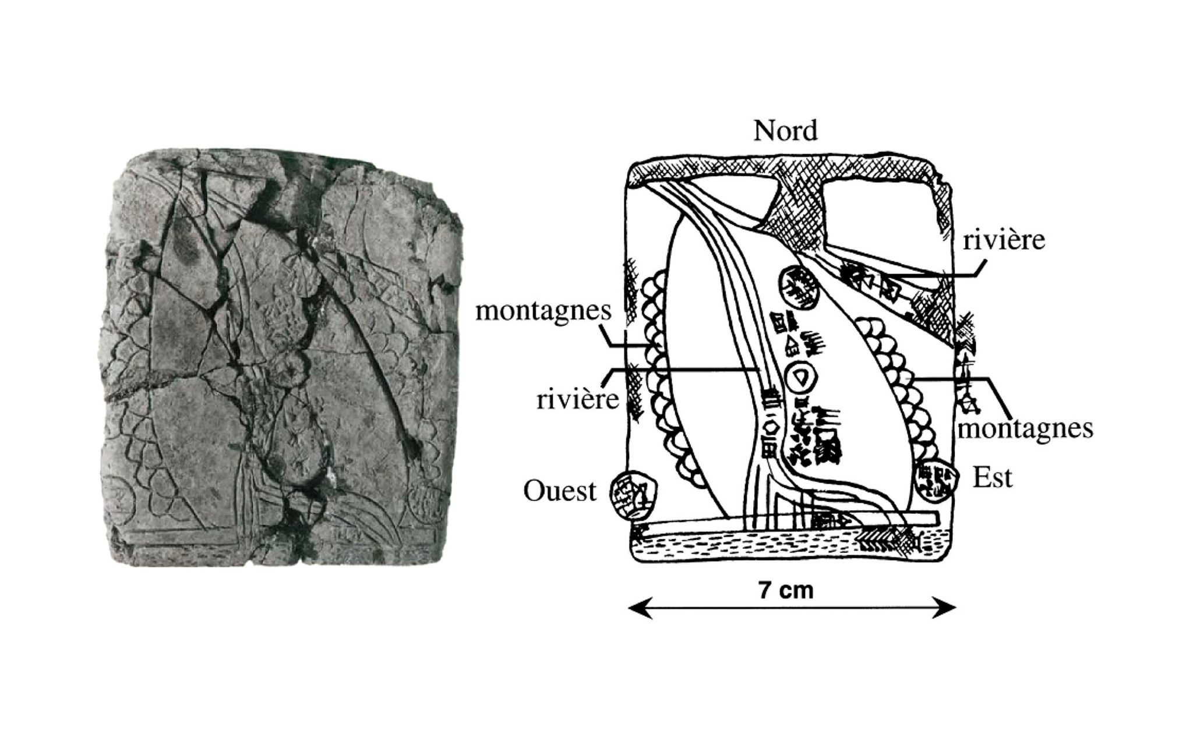
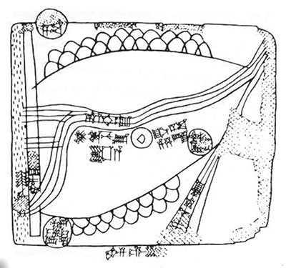
Lesson One: The History of Cartography
Students are introduced to cartography through an exploration of early maps, including the Gasur Tablet, pictured here.
Students learn about relative location and review basic clay skills as they create clay-slab maps showing a few familiar places.
Gasur Tablet
Image: Harvard Museum of the Ancient Near East

Slide 5
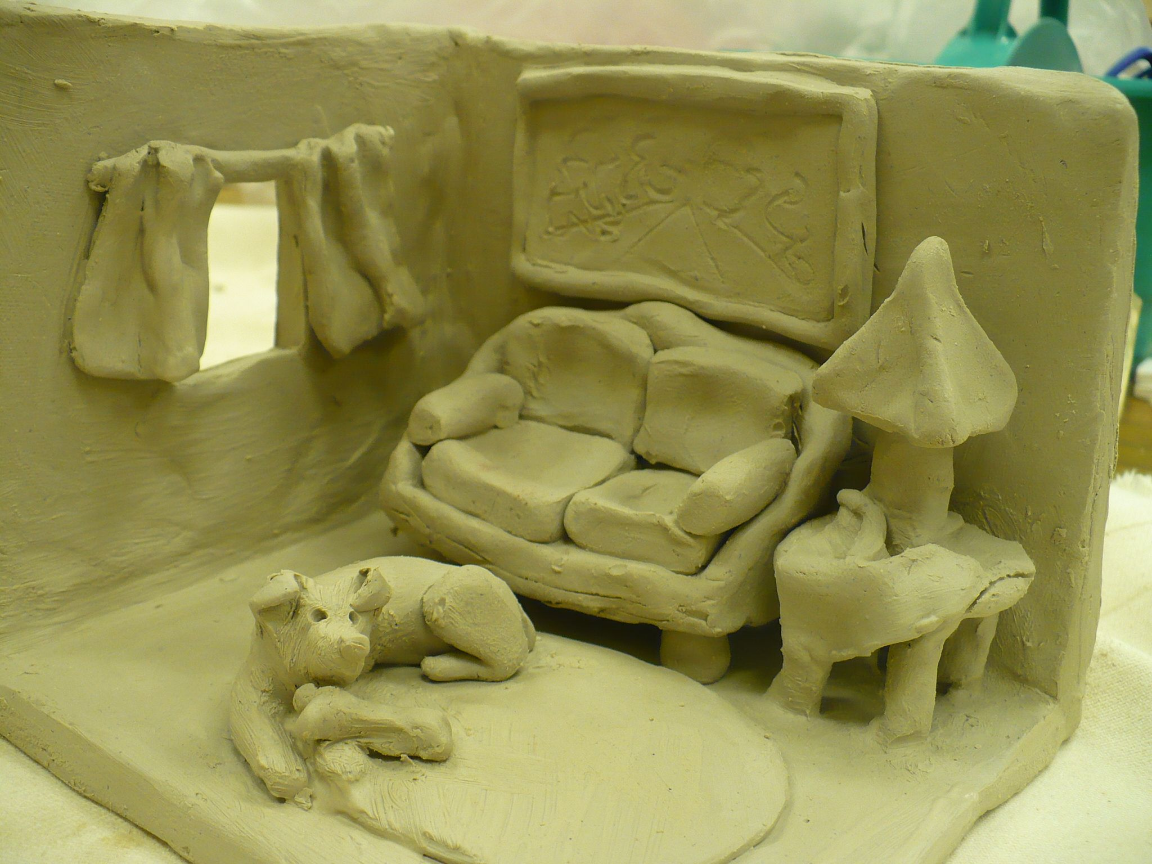
Lesson Two: 3D Representations
Students are introduced to the language of maps and explore grid lines, absolute location, and perspective.
Using pre-strung physical grid lines, students create clay models showing the absolute location of major features of the classroom. Then, students explore perspective as they create simple aerial-view maps of their classroom models.
Clay Diorama
Image: Helene Mitaur via Pinterest

Slide 6
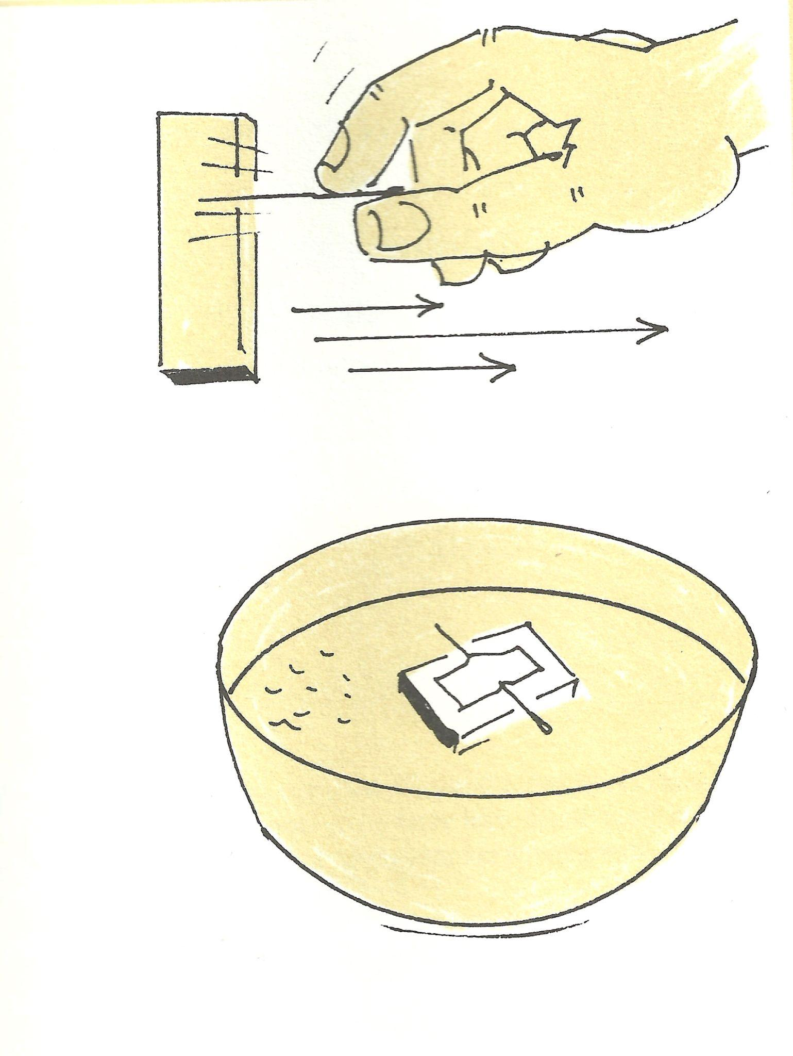
Lesson Three: Orientation and Scale
Students are introduced to the cardinal directions, orientation, and scale.
Working in groups, students create simple compasses, then head out to their playground to orient their maps, label a compass rose, and use pacing to complete their map’s scale bar.
Compass
Image: Harvey Weiss

Slide 7
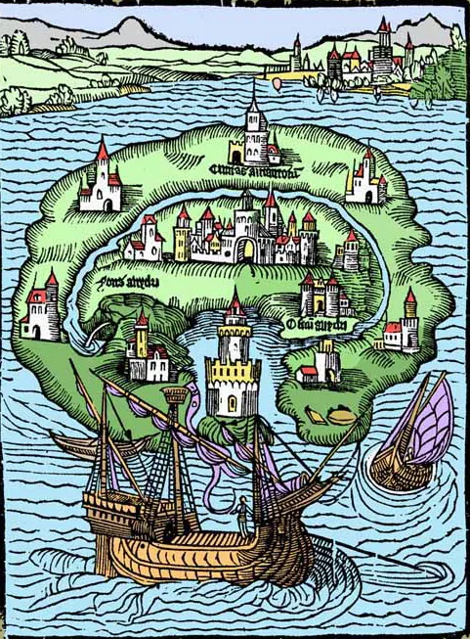
Lesson Four: Imaginary Place Maps
Students expand upon their understanding of the language of maps and refine their cartography skills as they create imaginary place maps to show a make-believe world of their own invention or from their readings.
Their maps will feature a map legend and a variety of landforms. They also consider how three principles of design – contrast, balance, and emphasis – can help create visually appealing maps.
Utopia
Image: Thomas More's Utopia, frontispiece

Slide 8
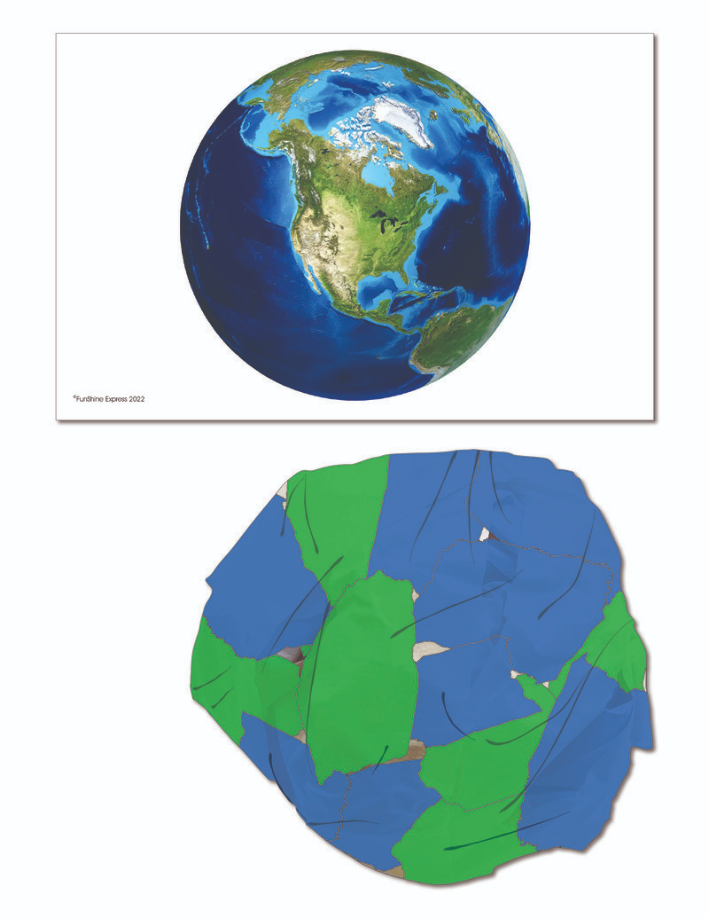
Lesson Five: Global Distortion
Students zoom out to a global perspective as they create papier-mâché globes featuring the continents, the Equator, and the Prime Meridian.
After completing their globes, students are given scissors and challenged to convert their three-dimensional globes into two-dimensional maps, thereby discovering that distortion is inevitable in any attempt to represent the world on a flat piece of paper.
Papier-Mâché Globe
Image: HiMama Activities

Slide 9
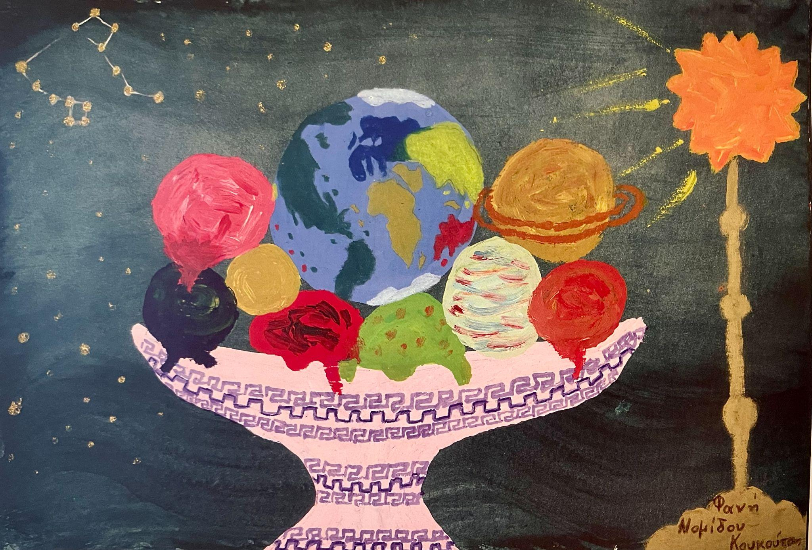
Lesson Six: Mapping the World
In this culminating lesson, students use what they have learned about cartography to tell a story about the world through maps.
Students use cartographic content and the principles of design to create an artwork that tells a compelling story about their future world.
Ice Cream Special by Fani Nomidou-Koukoutsi
Image: Barbara Petchenik Children’s World Map Competition

Slide 10
A document with detailed lesson plans and additional resources are available for download on the American Geographical Society Library’s website.
Look for it in the K-12 Resources tab.

Slide 11
Mapping Our World:
The Art of Cartography
Student Slides

Slide 12
Early Cartography:
Making a Clay-Slab Map
Lesson One

Slide 13
Learning Objective:
Today I am learning that maps are a way to record and share information.
Success Criteria:
I will know I am successful when I create a clay-slab map showing the relative locations of three familiar places.

Slide 14
Thousands of years ago, early cartographers created maps by drawing on slabs of clay.
Can you find the symbol that shows a mountain range?
Can you find the symbol that shows a river?
Where is the river located?
Gasur Tablet
Image: Harvard Museum of the Ancient Near East

Slide 15
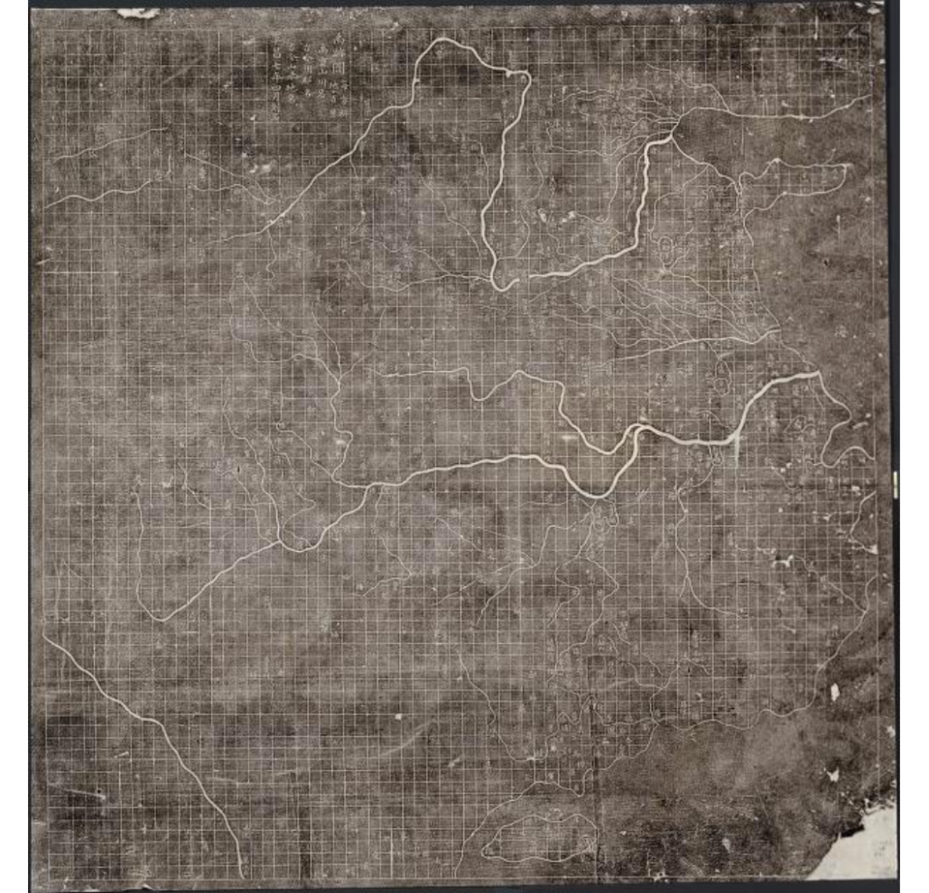
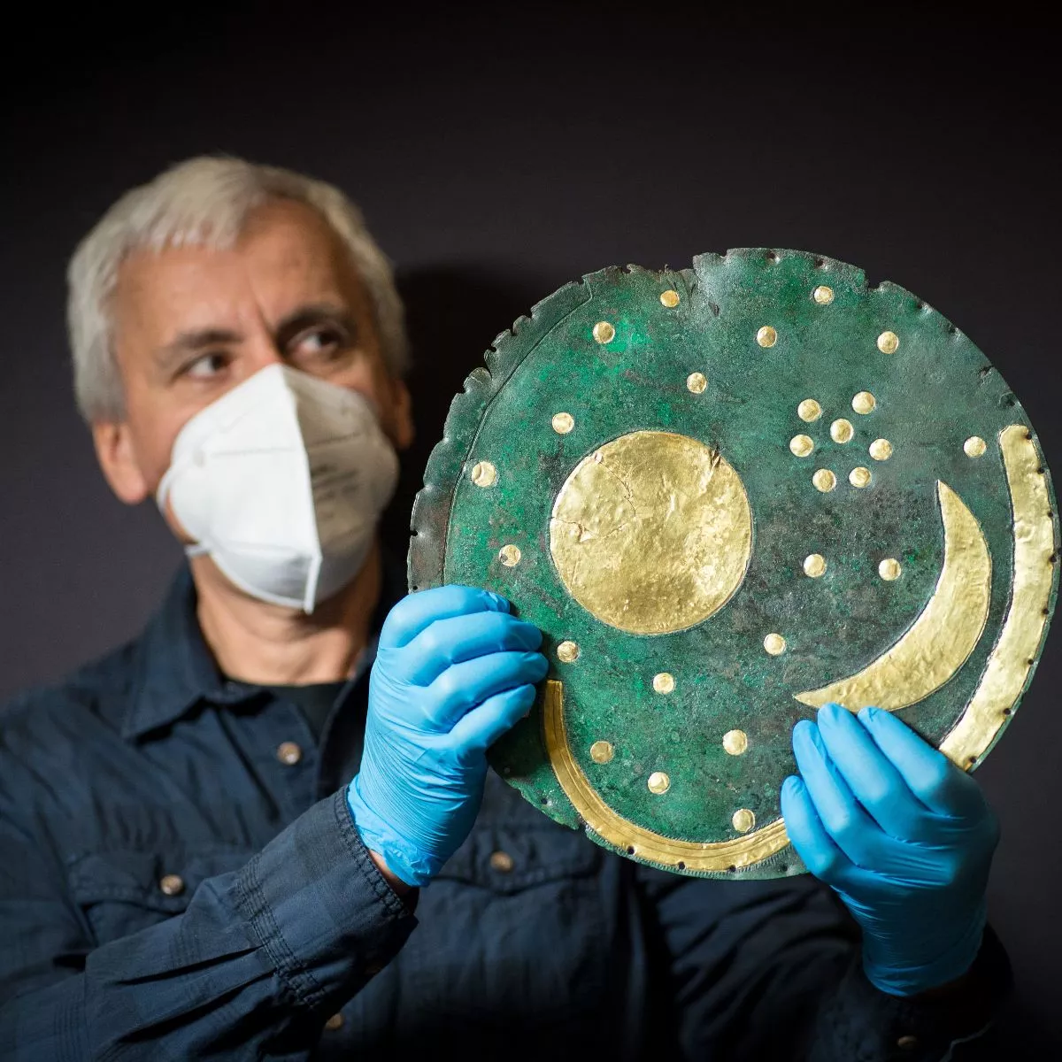
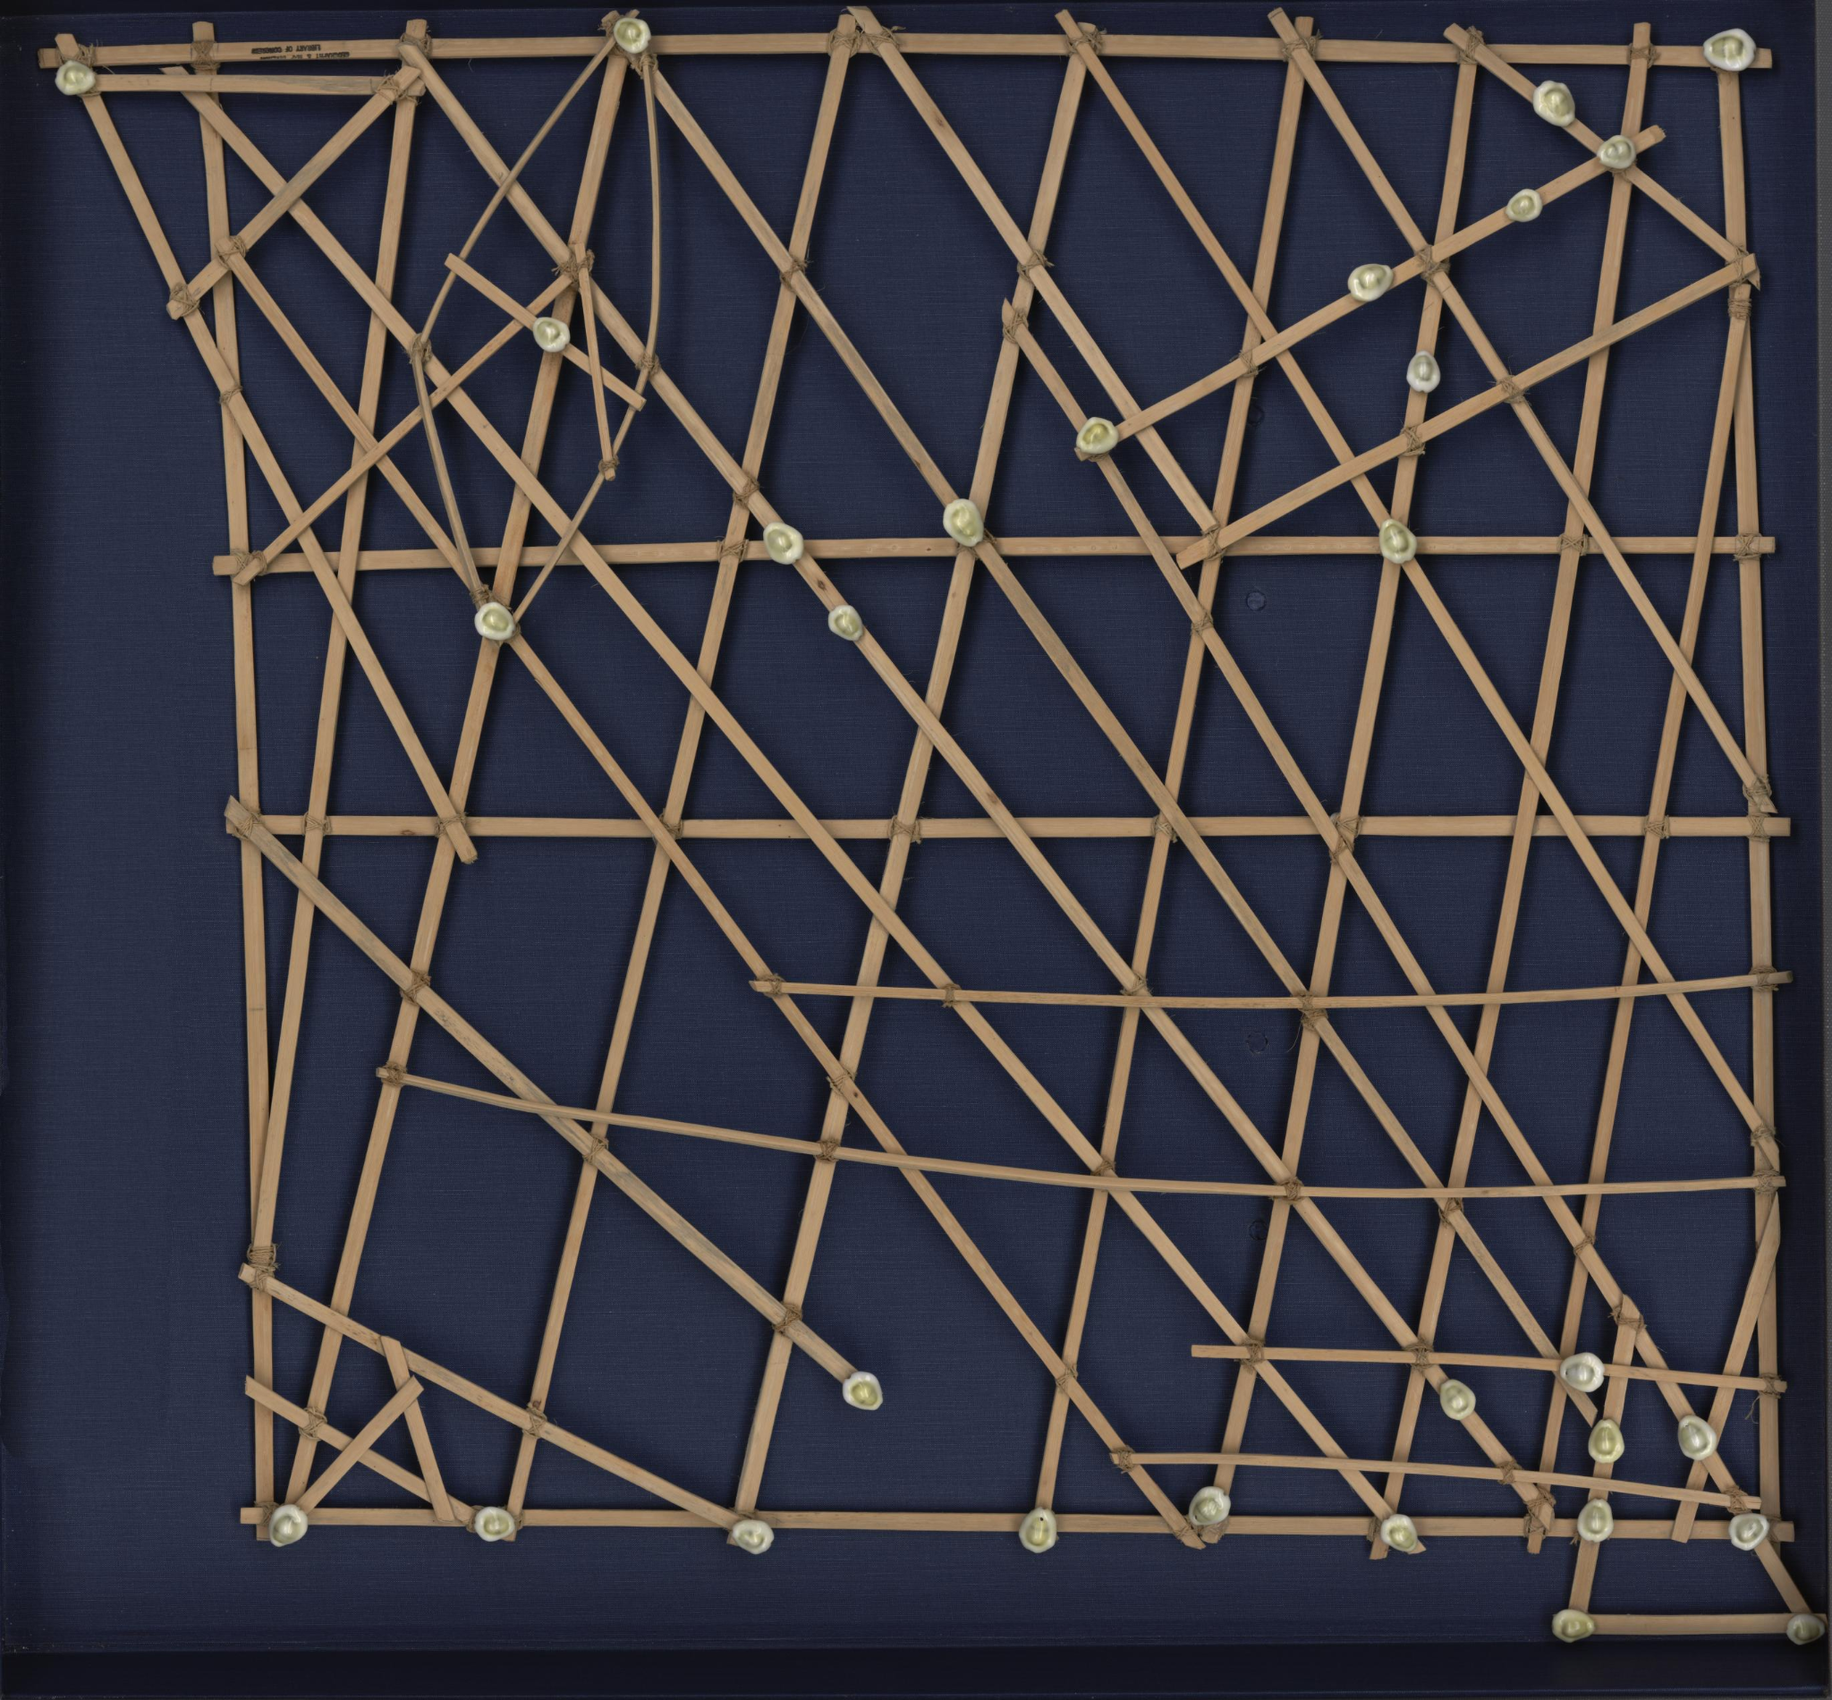
Maps help record and share information.
Yu Ji Tu / Map of the Tracks of Yu Gong Image: Library of Congress
Nebra Sky Disk
Image: PA Images
Marshall Islands Stick Chart / Rebbelib
Image: Library of Congress

Slide 16
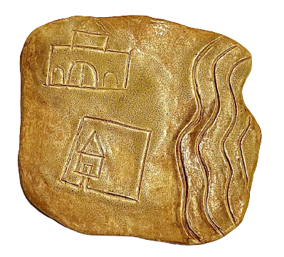
Now it’s your turn!
Create a Clay-Slab Map
You can show the relative location of three familiar places.
Which places will you show?
What symbols will you use to show your places?
Use a rolling pin to flatten your clay slab.
Add your symbols to show where they are located.
Clay Slab Map
Image: Hodna Nuernberg

Slide 17

Clean Up
quickly and quietly

Slide 18
Using Grid Lines:
Mapping My Classroom
Lesson Two

Slide 19
Day One

Slide 20
Learning Objective:
Today I am learning that maps use grid lines to identify the exact location of every place on Earth.
Success Criteria:
I will know I am successful when I create a clay model of my classroom using scoring and slipping.

Slide 21
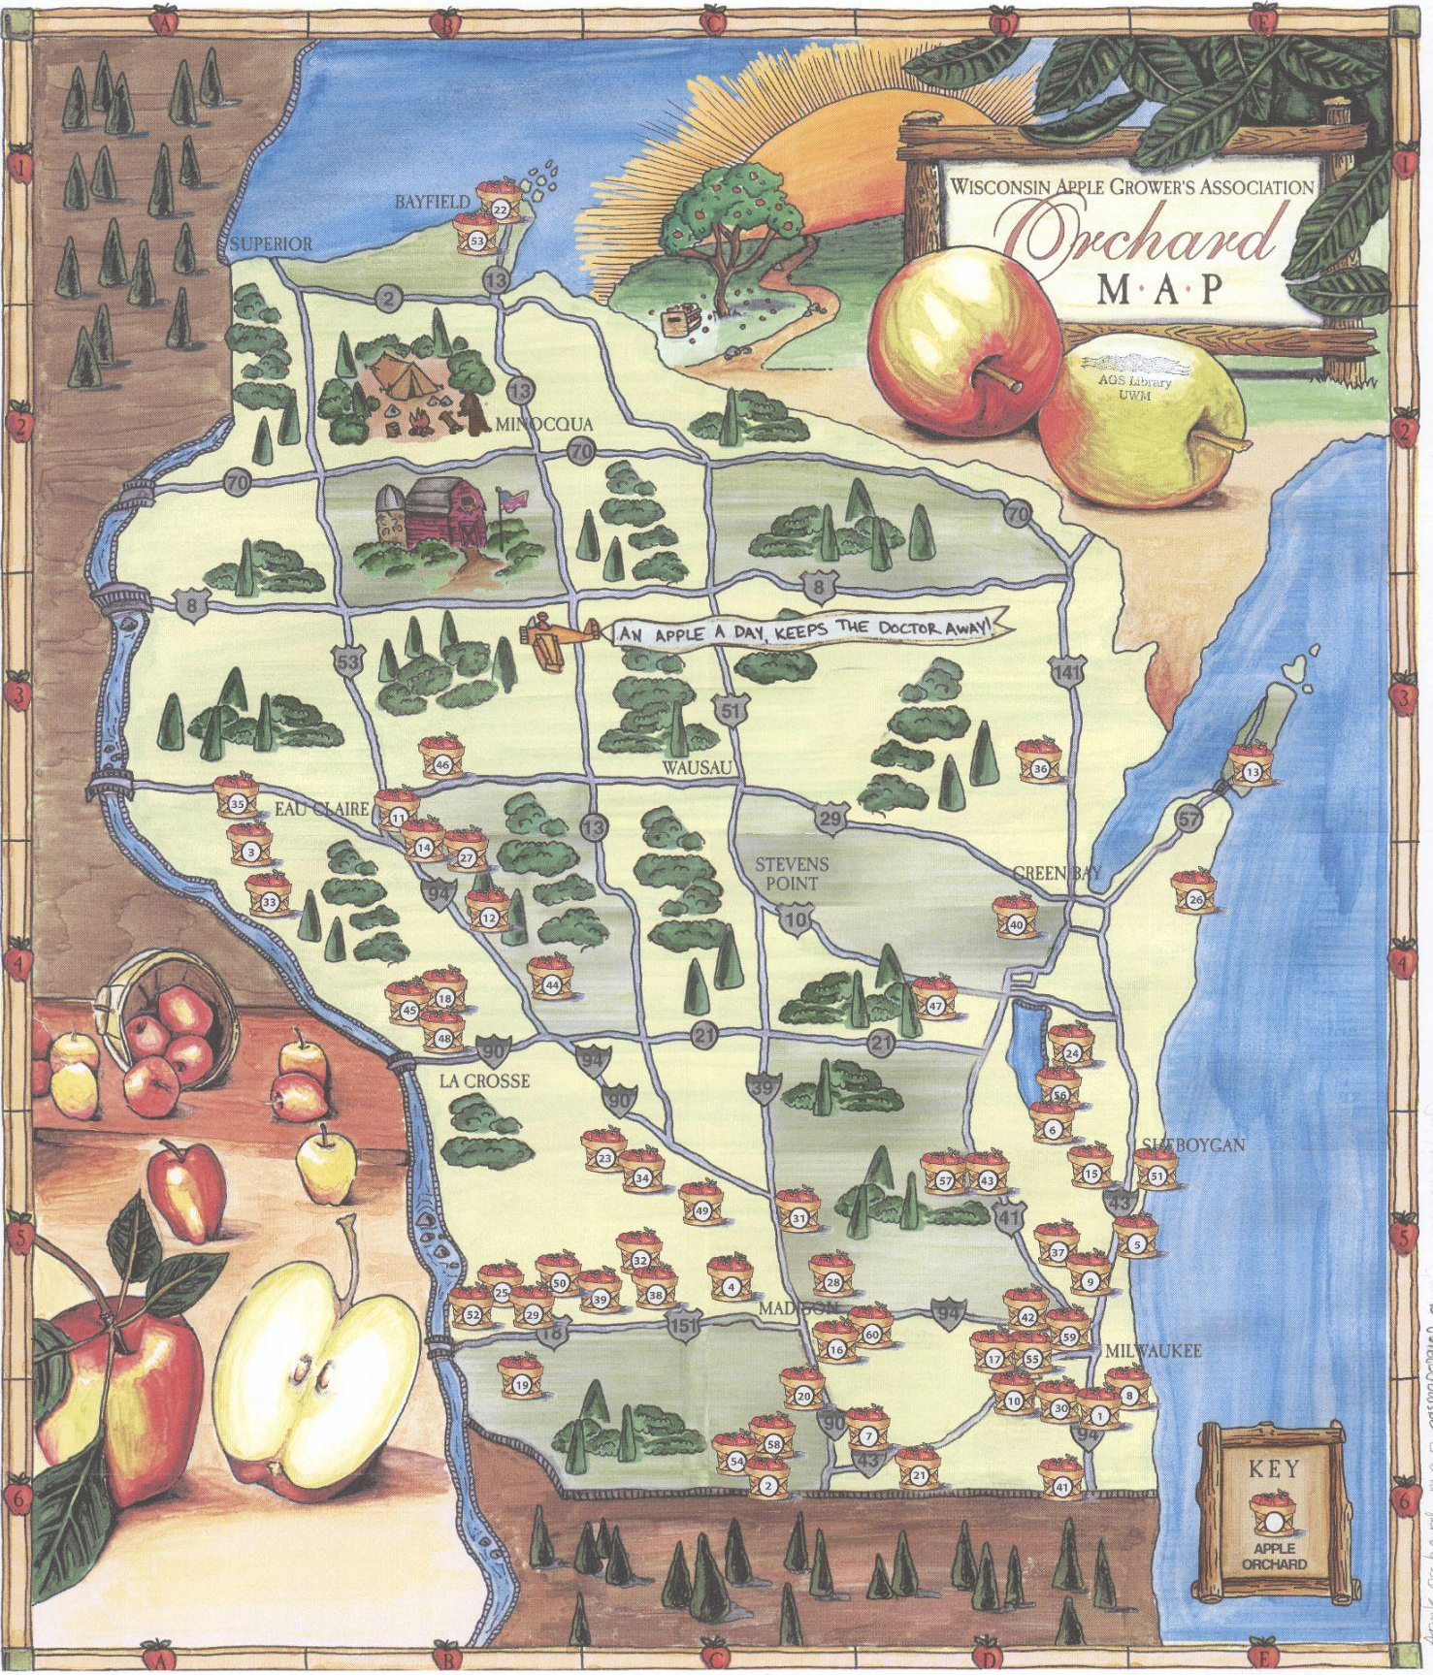
Cartographers use imaginary lines, called a grid, to divide space on maps.
Can you find the imaginary line labelled A?
Can you find the imaginary line labelled 3?
What is located at A3?
Wisconsin Apple Growers Association Orchard Map
Image: American Geographic Society Library

Slide 22
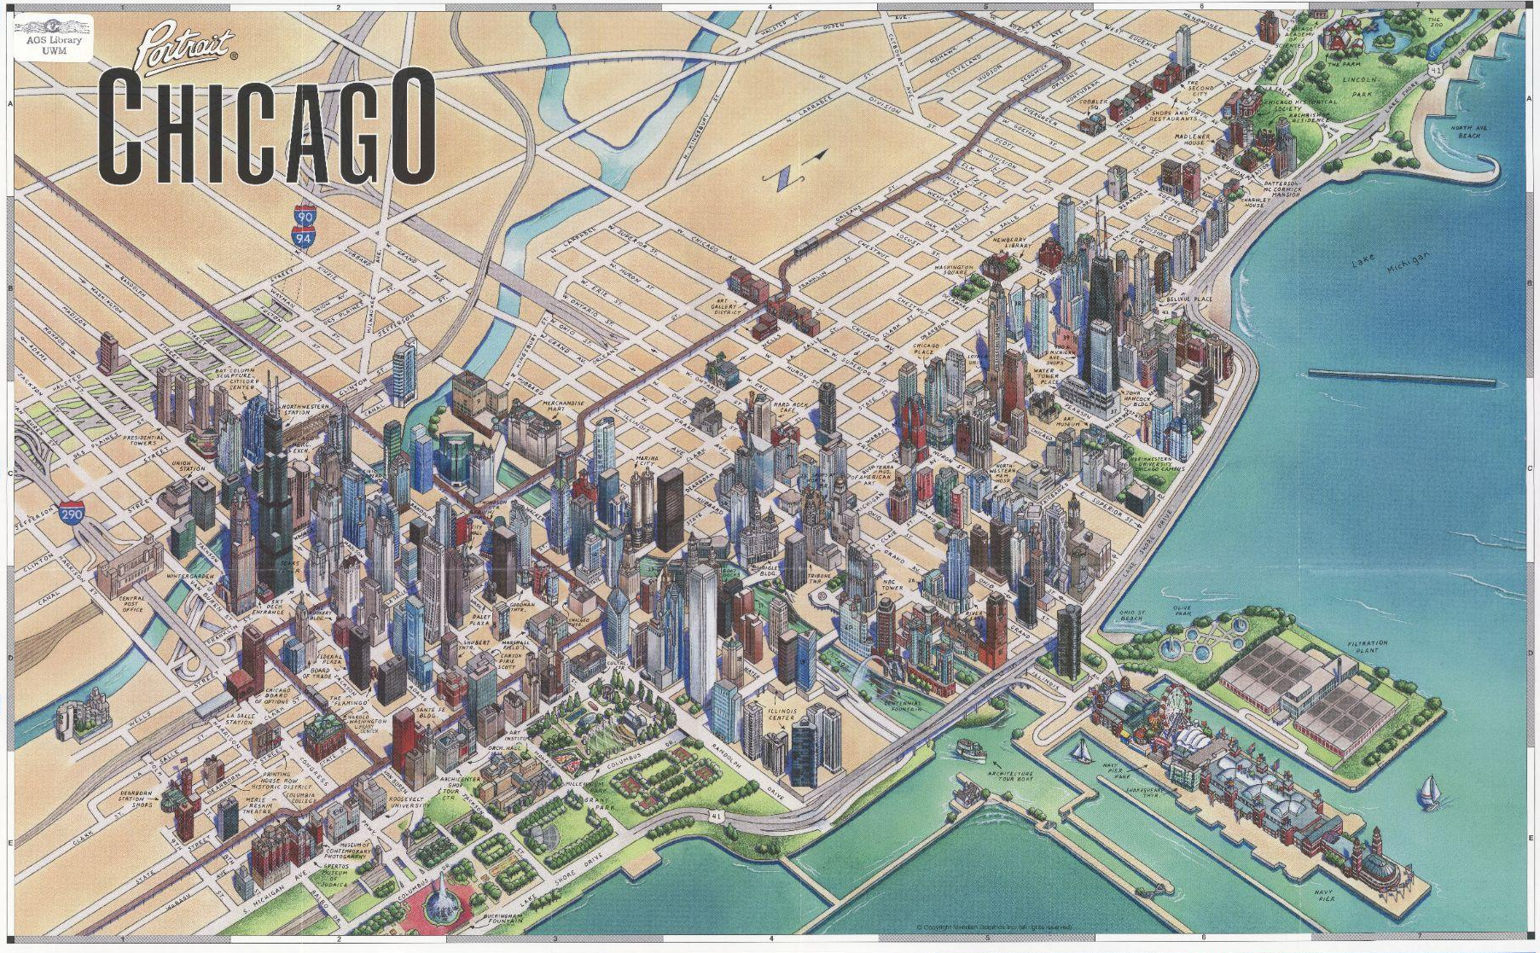
Grids help divide space on a map and make it easier to describe a place’s absolute location.
Portrait Chicago: The Picture Perfect Travel Companion
Image: American Geographic Society Library

Slide 23
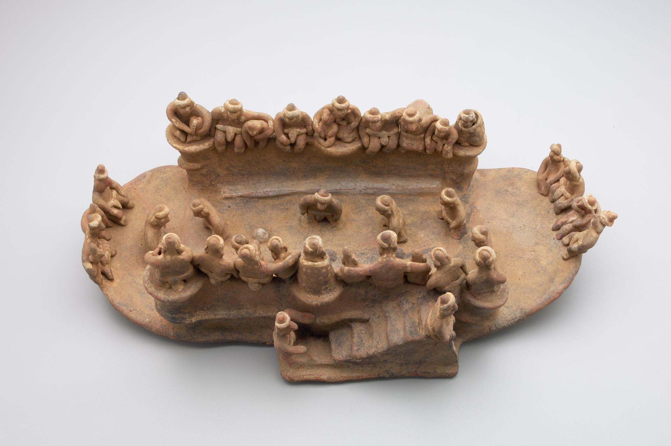
Now it’s your turn!
Create a Classroom Model
You can show the absolute location of things in our classroom.
Which classroom objects will you show?
Where will each object go?
Use scoring and slipping to join clay parts together.
How will you make sure all the objects fit on the base?
Model of a Ballgame With Spectators
Image: Yale University Art Gallery

Slide 24
Clean Up
quickly and quietly

Slide 25
Day Two

Slide 26
Learning Objective:
Today I am learning that maps use aerial perspective to show places from above.
Success Criteria:
I will know I am successful when I create a bird’s-eye view sketch of my classroom model.

Slide 27

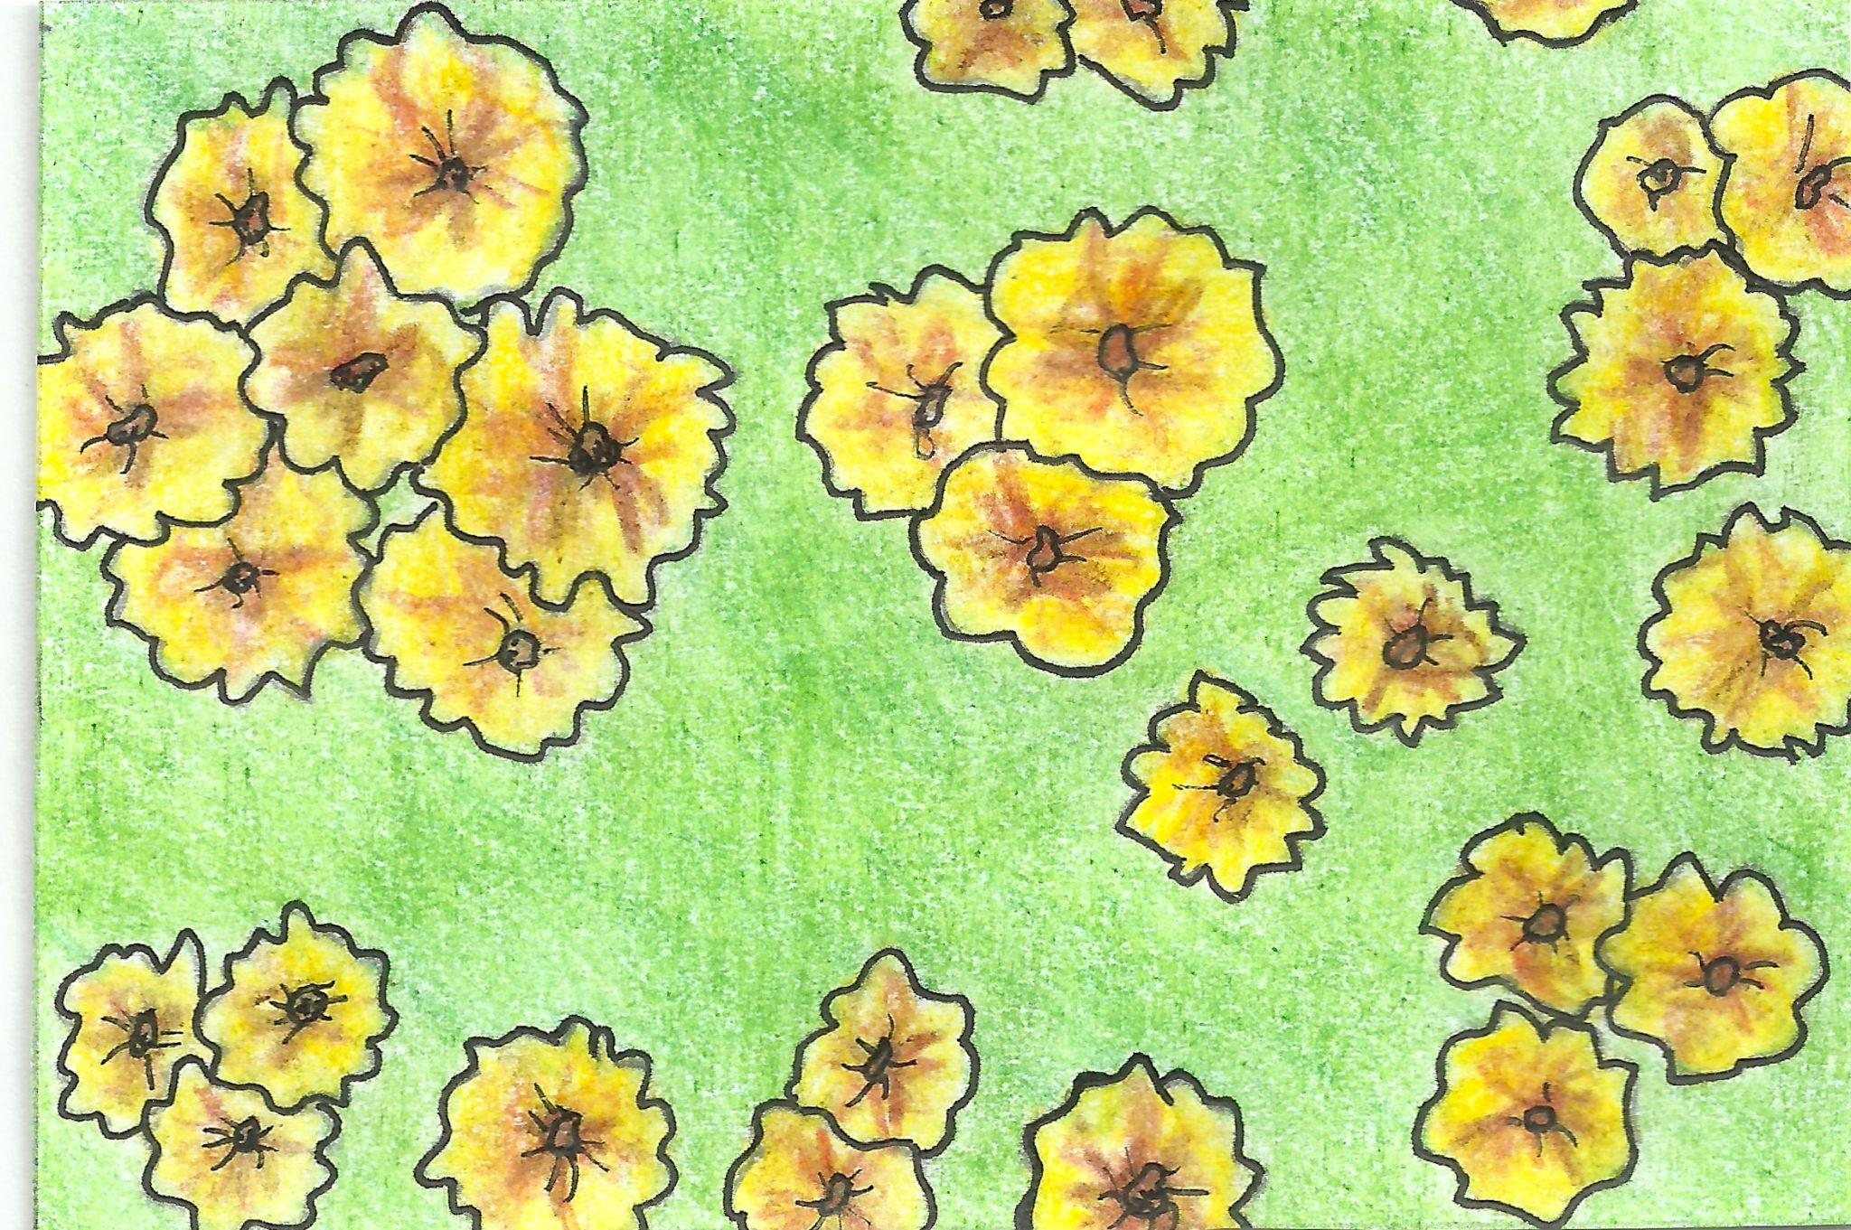
Cartographers use aerial perspective to show a place from above.
Aerial perspective is also called bird’s-eye view.
Perspective
Image: Hodna Nuernberg
What would a flower look like if you were a worm?
What would that same flower look like if you were a bird?

Slide 28
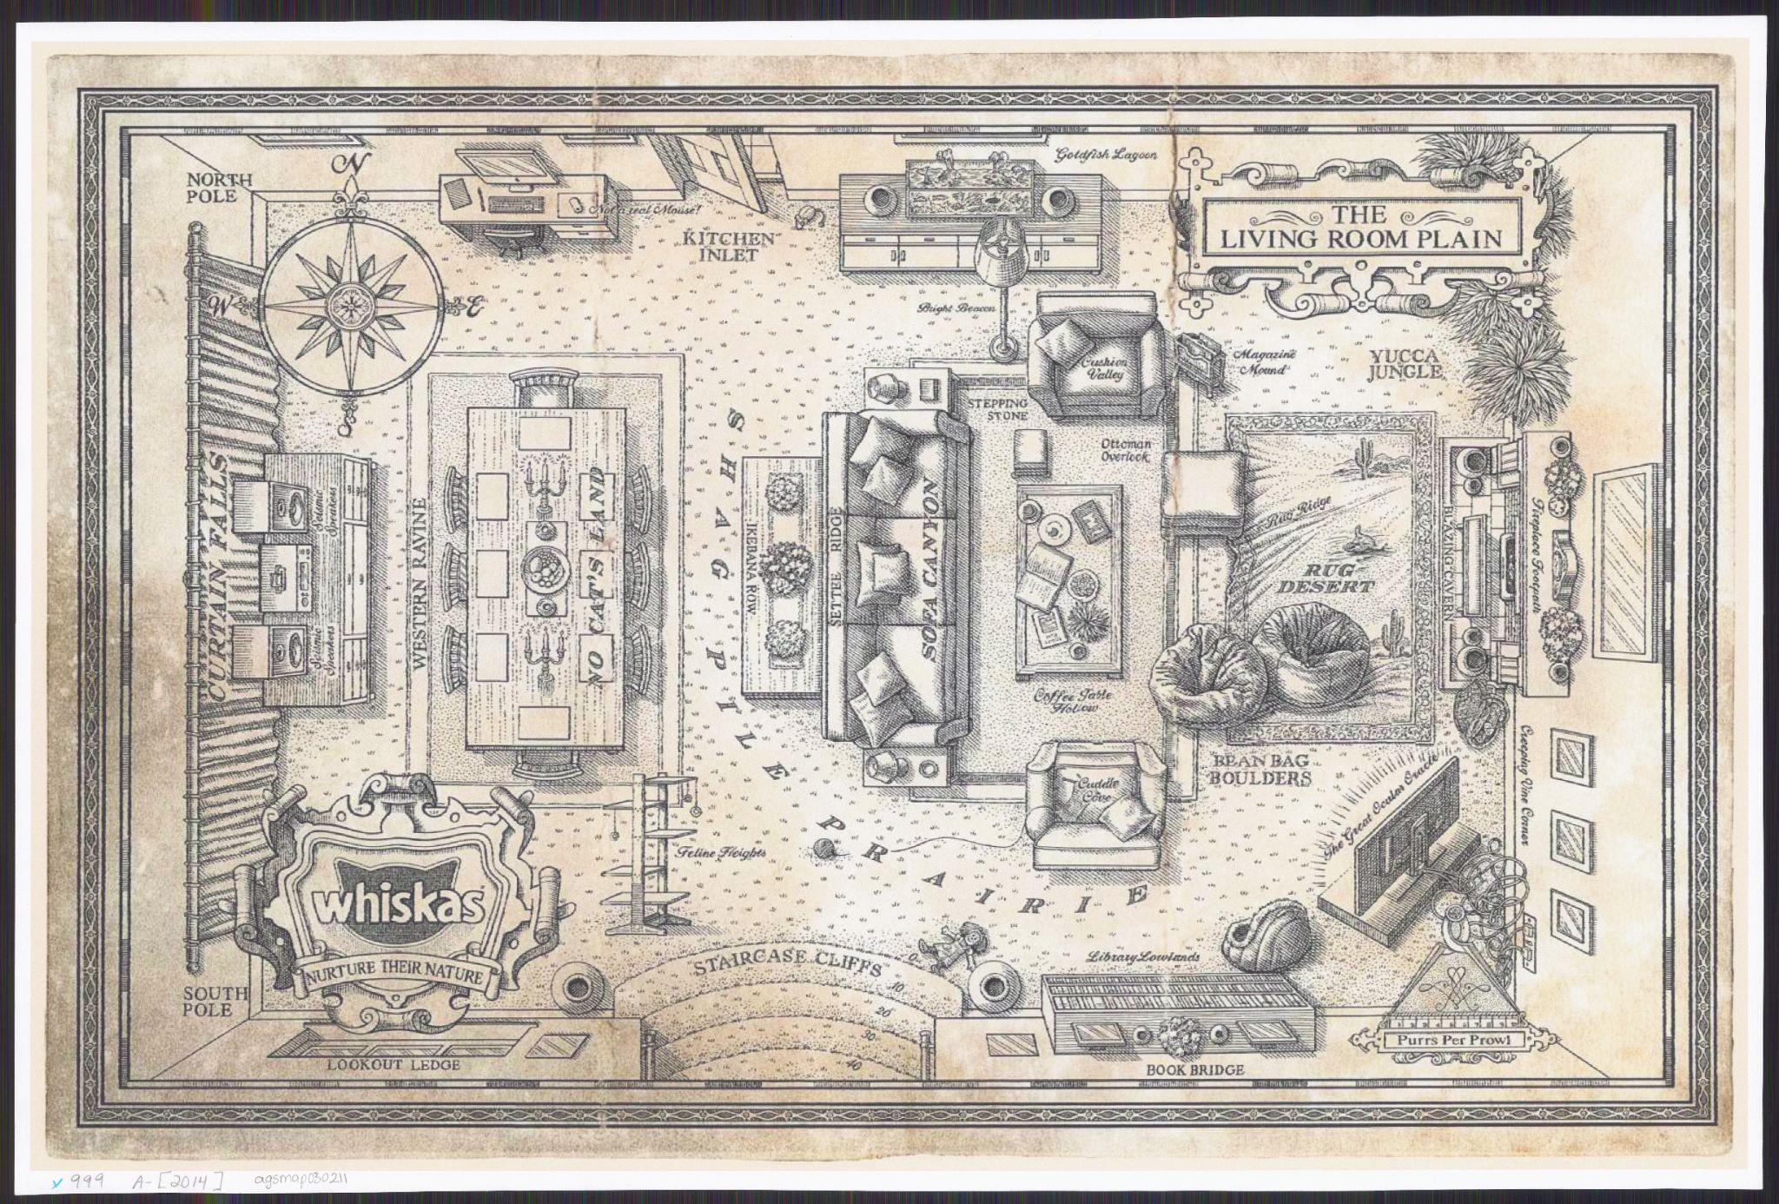
Things look different from above!
What can you see in this bird’s-eye view map?
The Living Room Plan
Image: American Geographic Society Library

Slide 29
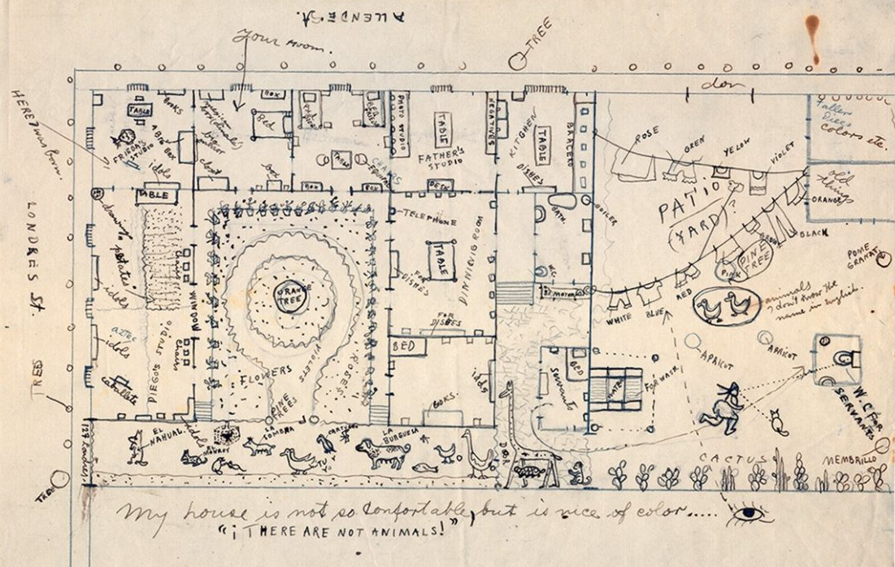
An artist named Frida Kahlo drew this map of her home.
She used symbols to show some of the things in her home.
Can you find these things?
a bed
a table
an orange tree
flowers
My House Is Not So Comfortable …
Image: Diego Rivera and Frida Kahlo Archive

Slide 30
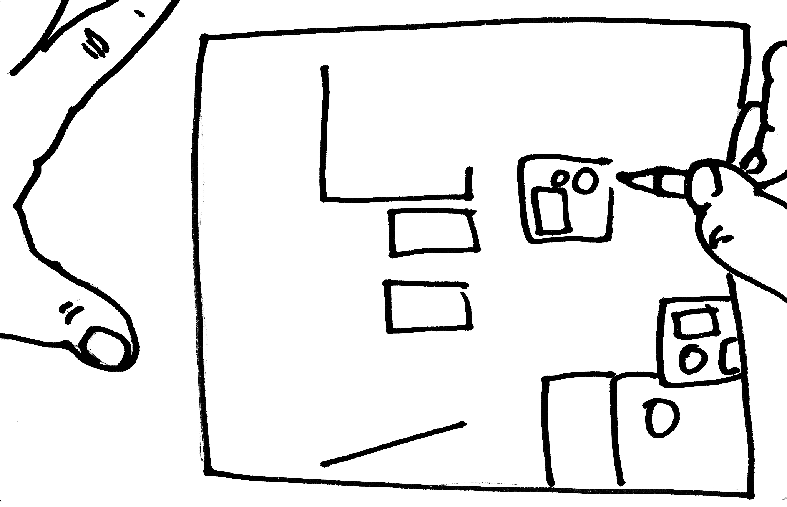
Now it’s your turn!
Create a Bird’s-Eye-View Map
You can turn your classroom model into a map.
Look at your classroom model from above. What do you see?
Draw the shapes you see to create a bird’s-eye view map of our classroom.
Use the grid lines to help make sure everything goes in the right place.
Drawing an Aerial View
Image: Hodna Nuernberg

Slide 31
Clean Up
quickly and quietly

Slide 32
Orientation and Scale:
Charting Our Playground
Lesson Three

Slide 33
Day One

Slide 34
Learning Objective:
Today I am learning that maps have a special language of their own.
Success Criteria:
I will know I am successful when I can show orientation and scale on a playground map.

Slide 35
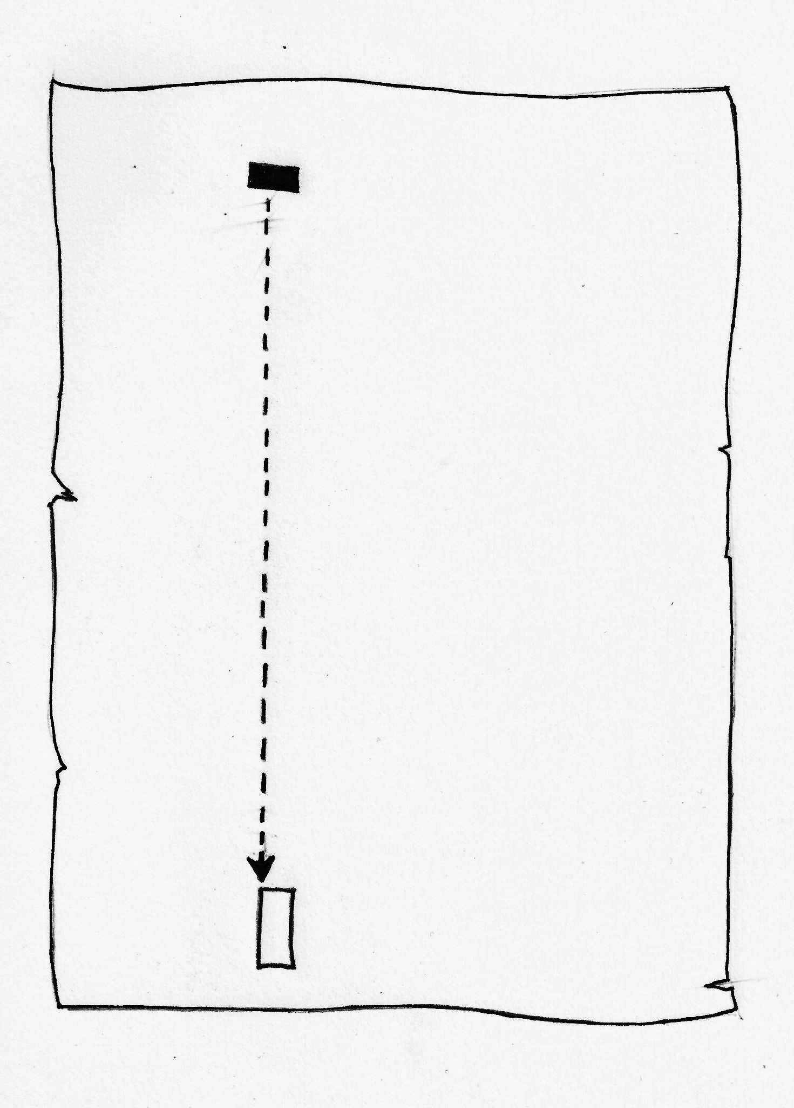
Maps can help us find our way.
How would you get from the house to the art museum?
Images adapted from Harvey Weiss

Slide 36
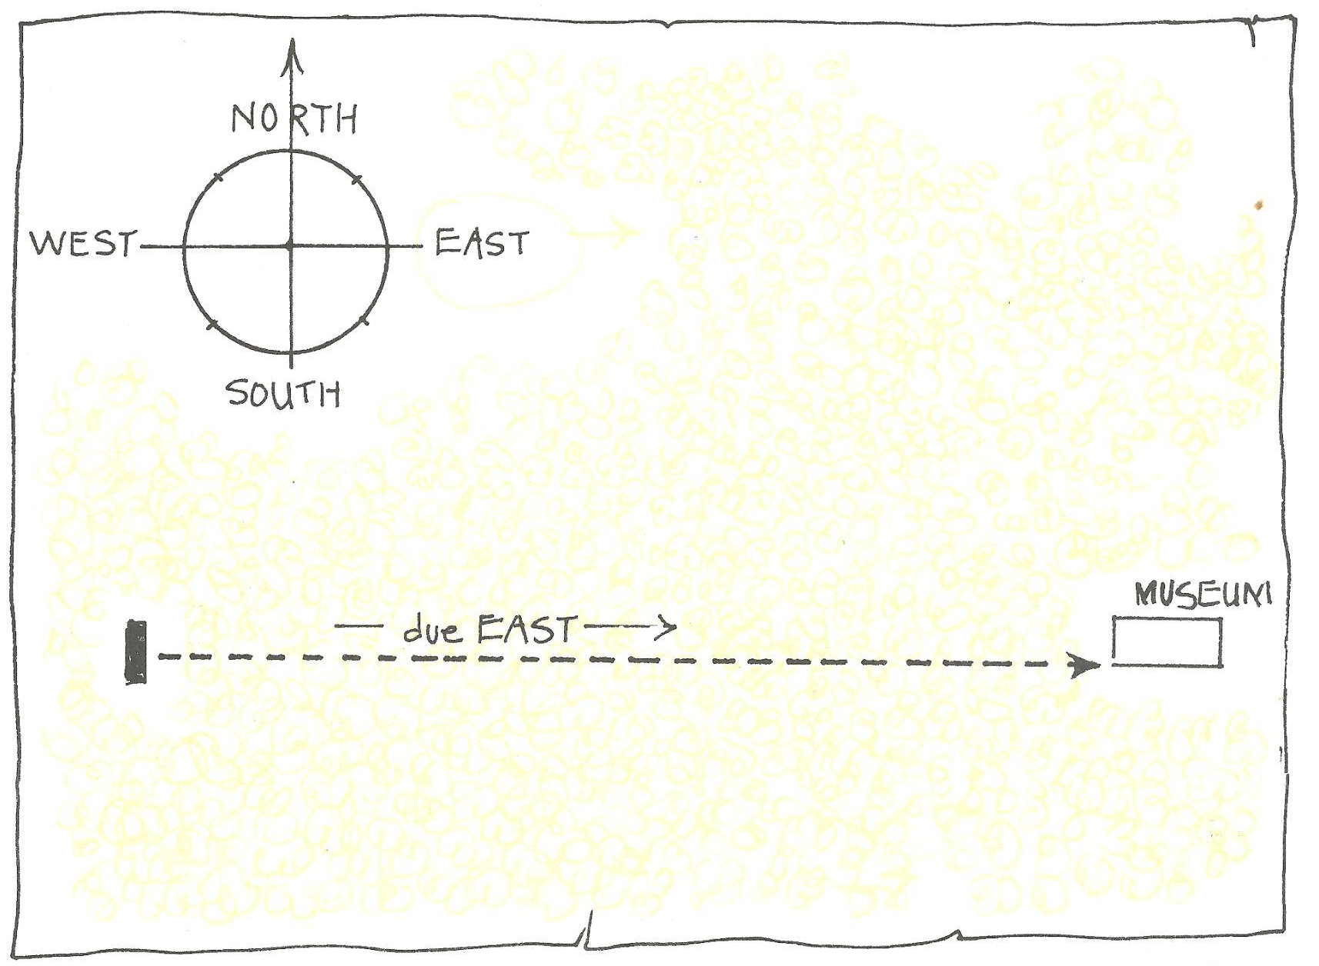
Map language begins with the four cardinal directions:
north
south
east
west
The compass rose shows us the directions on a map.
Image: Harvey Weiss

Slide 37
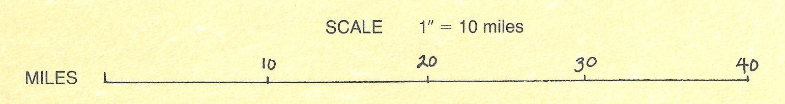
Scale is part of a map’s language, too.
Cartographers use scale to shrink everything on a map by the same amount.
The scale bar tells us how to read distances on a map.
Image adapted from Harvey Weiss

Slide 38
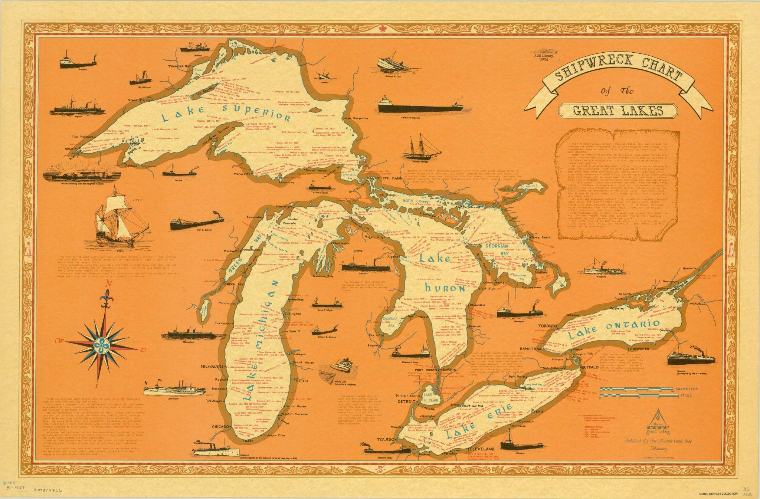
Can you find the compass rose?
Which way is north?
Can you find the scale bar?
How many miles on earth equal an inch on this map?
Shipwreck Chart of the Great Lakes: Mariner Chart Shop, Tobermory
Image: American Geographic Society Library

Slide 39


Now it’s your turn!
Create a Compass Rose and a Scale Bar
You can use map language to make a playground map readable.
Create a compass.
Use your compass to find north and mark it on the compass rose. Add the other directions.
Find something that is one inch long on your map. How many paces long is it in real life? Add this number to the scale bar to complete your map.
SCALE 1” = 12 paces

Slide 40
Clean Up
quickly and quietly

Slide 41
Building Worlds:
Mapping an Imaginary Place
Lesson Four

Slide 42
Day One

Slide 43
Learning Objective:
Today I am learning that cartographers use the principles of design when they make maps.
Success Criteria:
I will know I am successful when I identify contrast, balance, and emphasis in maps and use them as I begin to plan a map I will make.

Slide 44
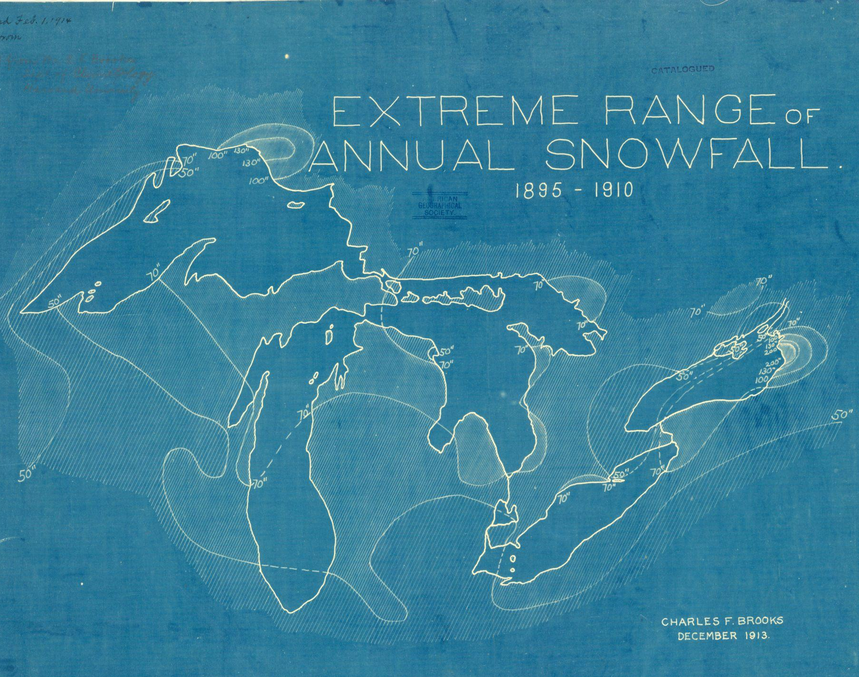
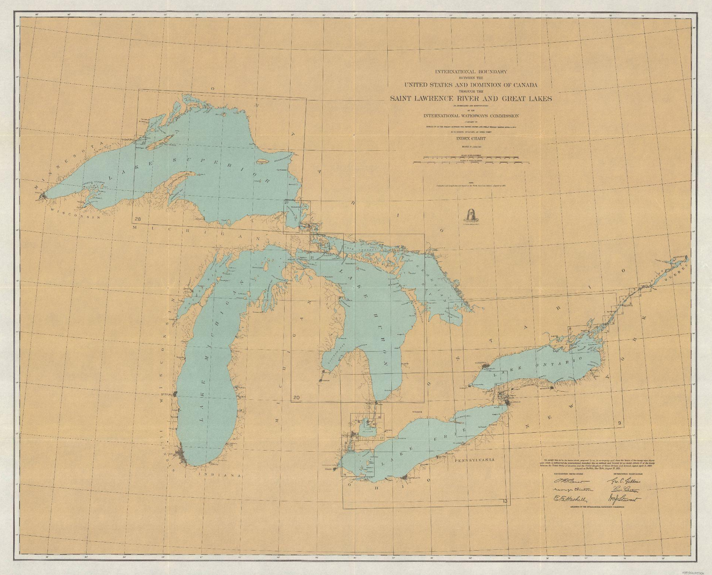
Contrast means opposite things are put together.
Which map uses color to create contrast?
Extreme Range of Annual Snowfall: 1895-1910
Image: American Geographic Society Library
International Boundary Between the United States …
Image: American Geographic Society Library

Slide 45

Balance means visual weight is distributed equally.
Visual weight means how much an object attracts your eye.
Which map is the most balanced?

Slide 46
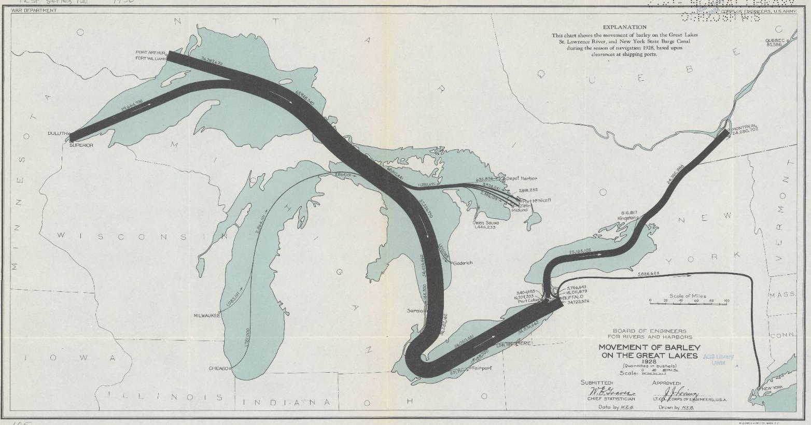
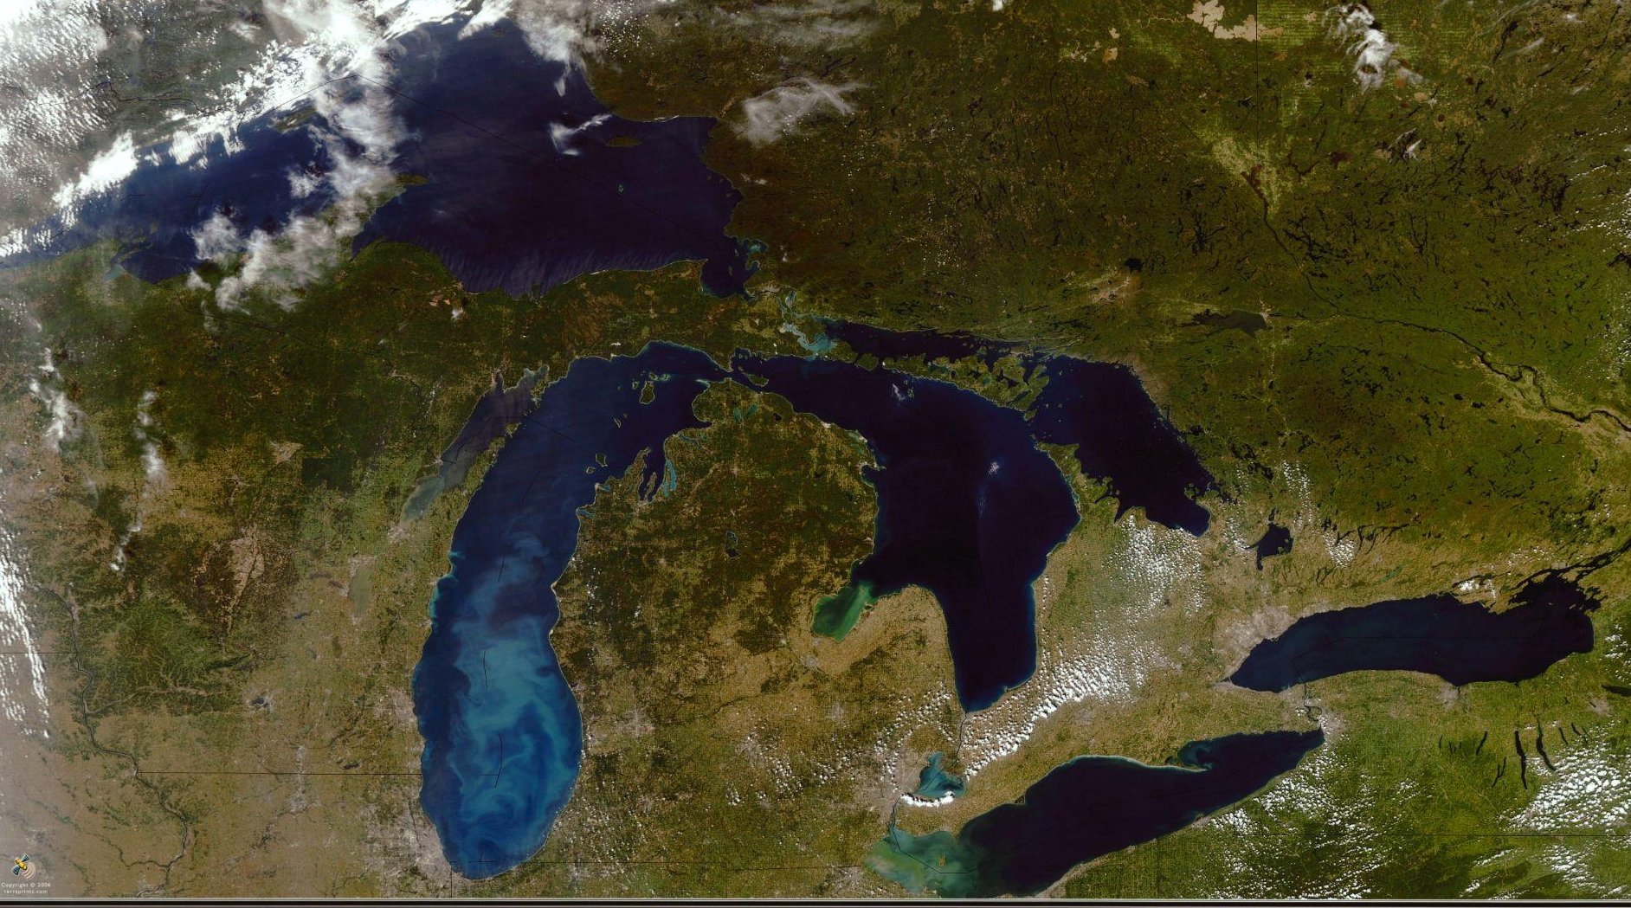
Emphasis means one thing is the center of attention.
Which map shows the most emphasis?
Movement of Barley on the Great Lakes
Image: American Geographic Society Library
The Great Lakes From Space
Image: American Geographic Society Library

Slide 47
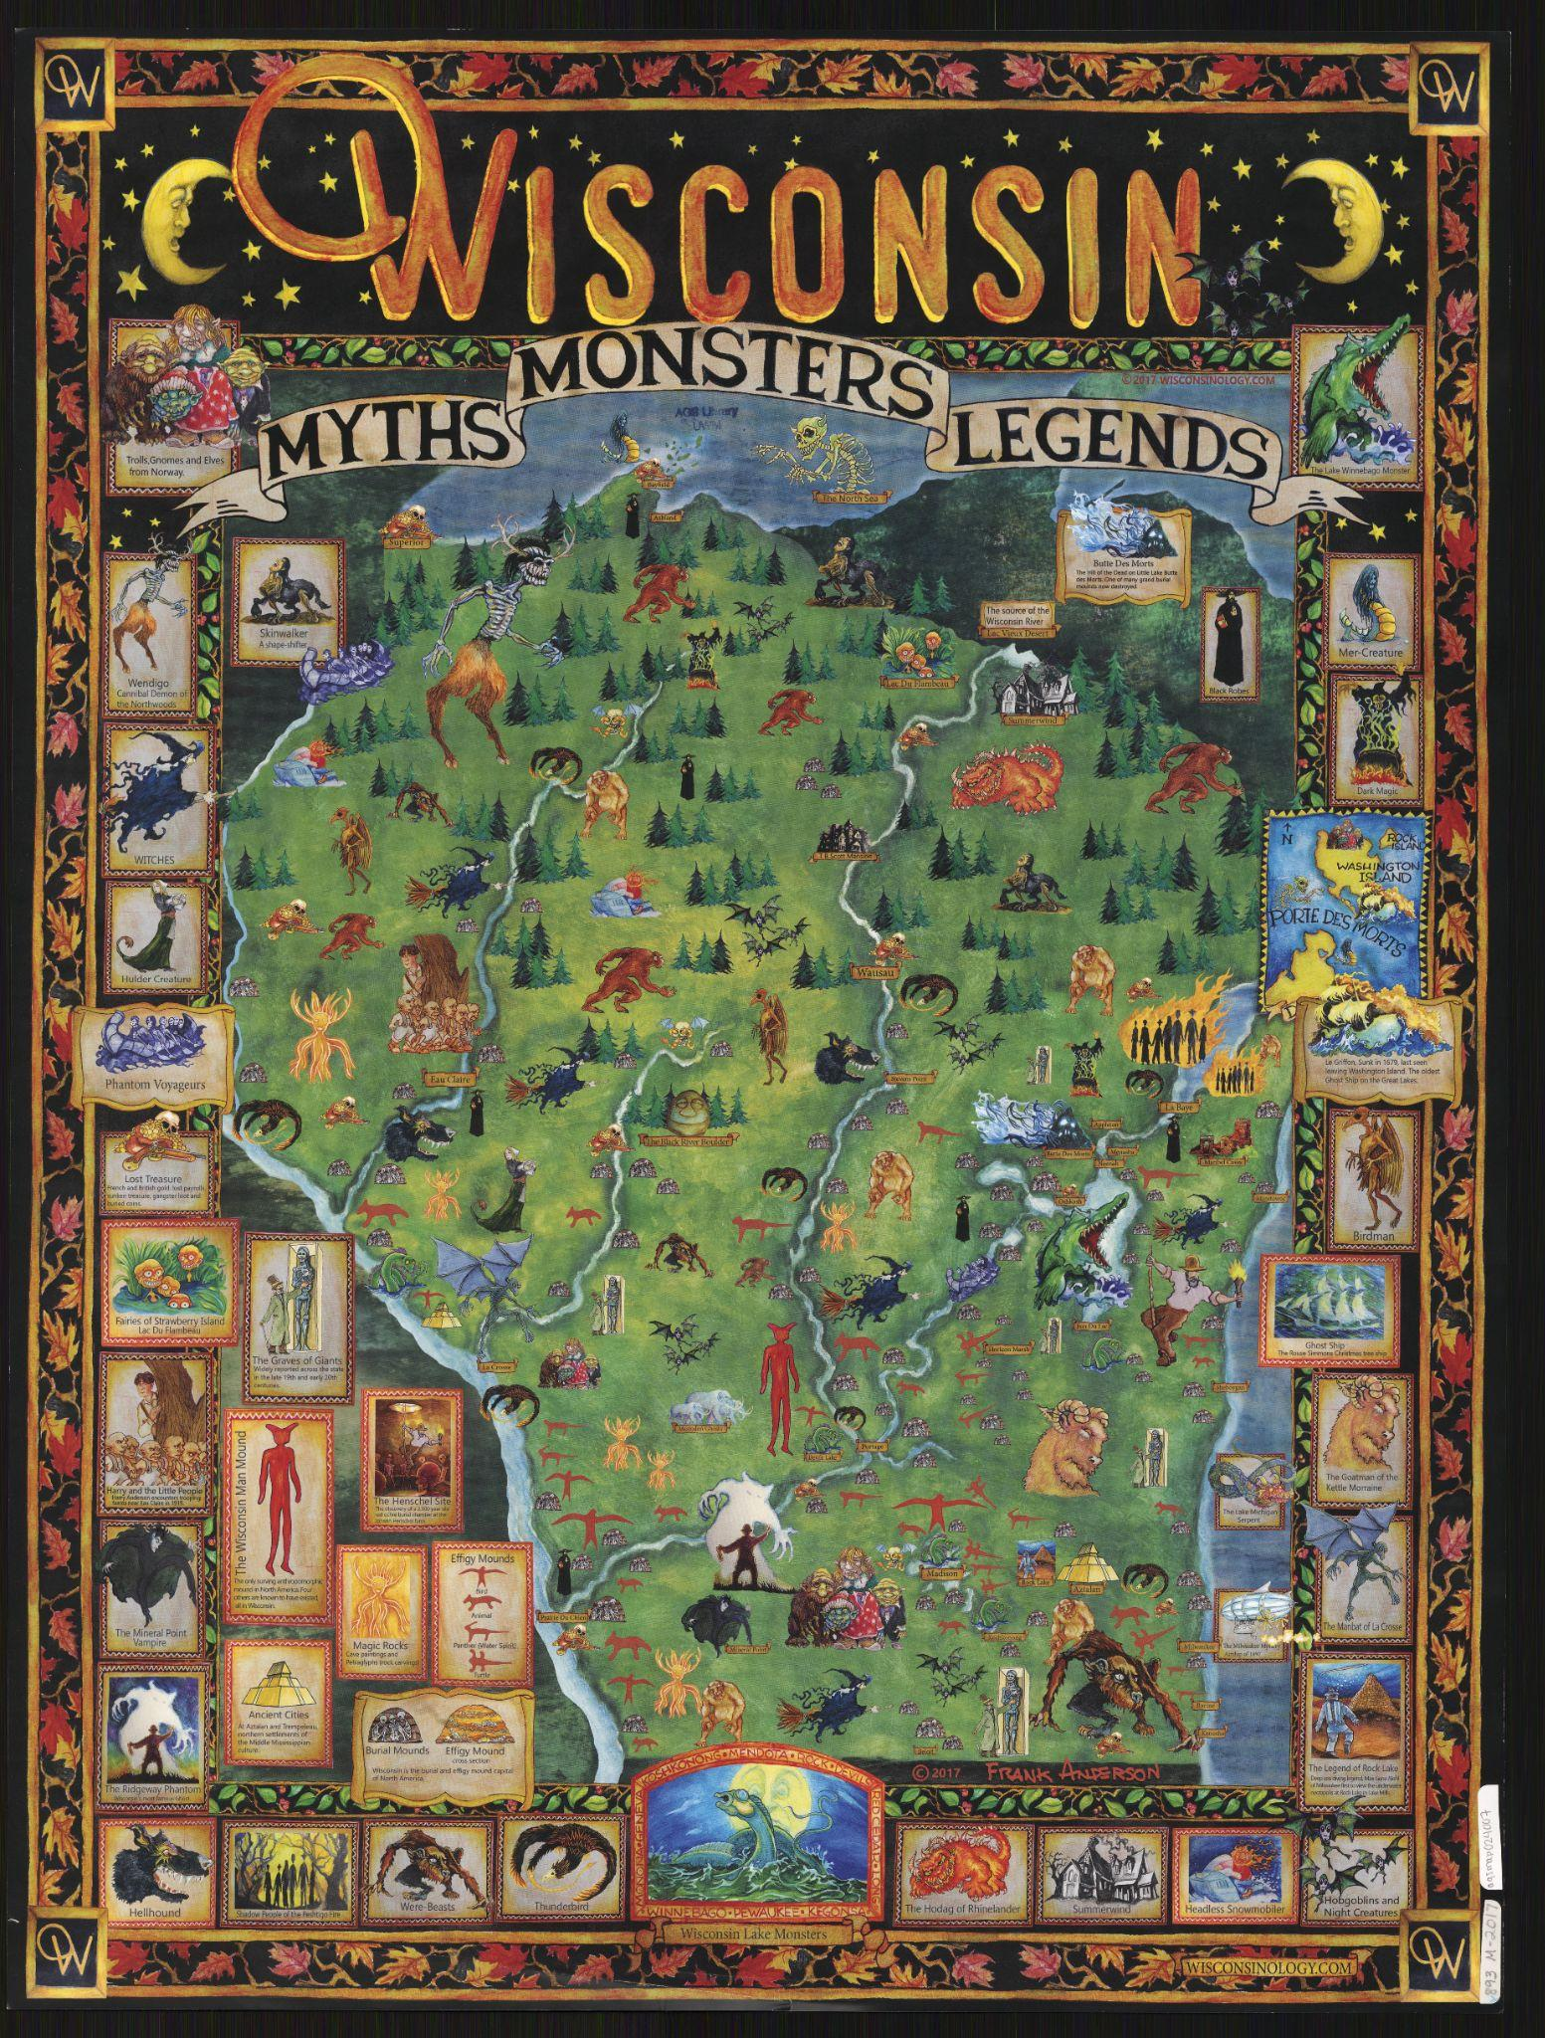
Does this map show a real place or an imaginary place?
Does this map use contrast, balance, or emphasis? How?
Does this map tell a story? What story does it tell?
What details make this map interesting?
Wisconsin: Myths, Monsters, Legends
Image: American Geographic Society Library

Slide 48
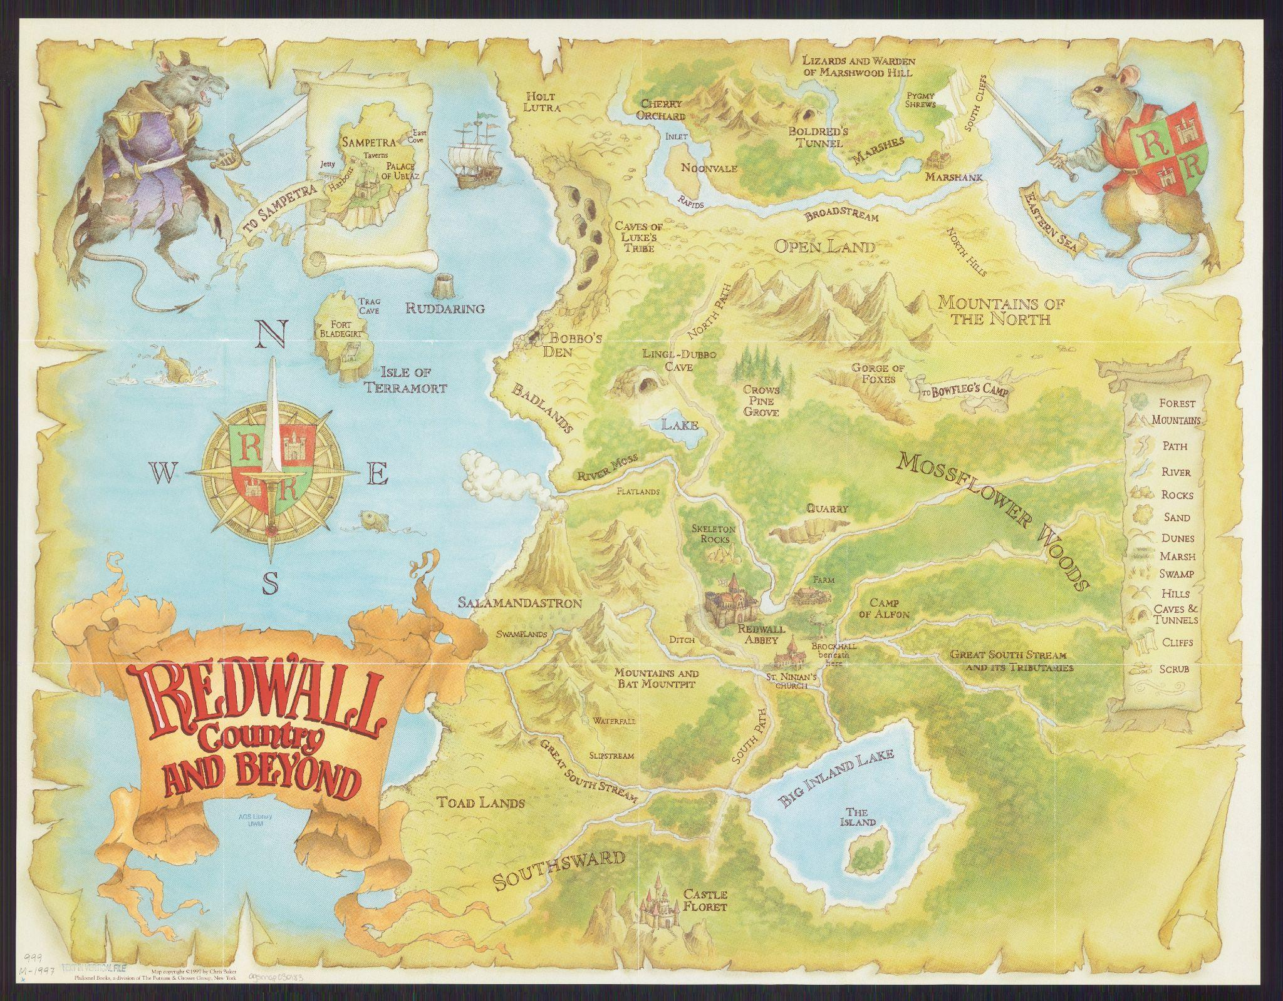
Does this map show a real place or an imaginary place?
Does this map use contrast, balance, or emphasis? How?
Does this map tell a story? What story does it tell?
What details make this map interesting?
Redwall Country and Beyond
Image: American Geographic Society Library

Slide 49
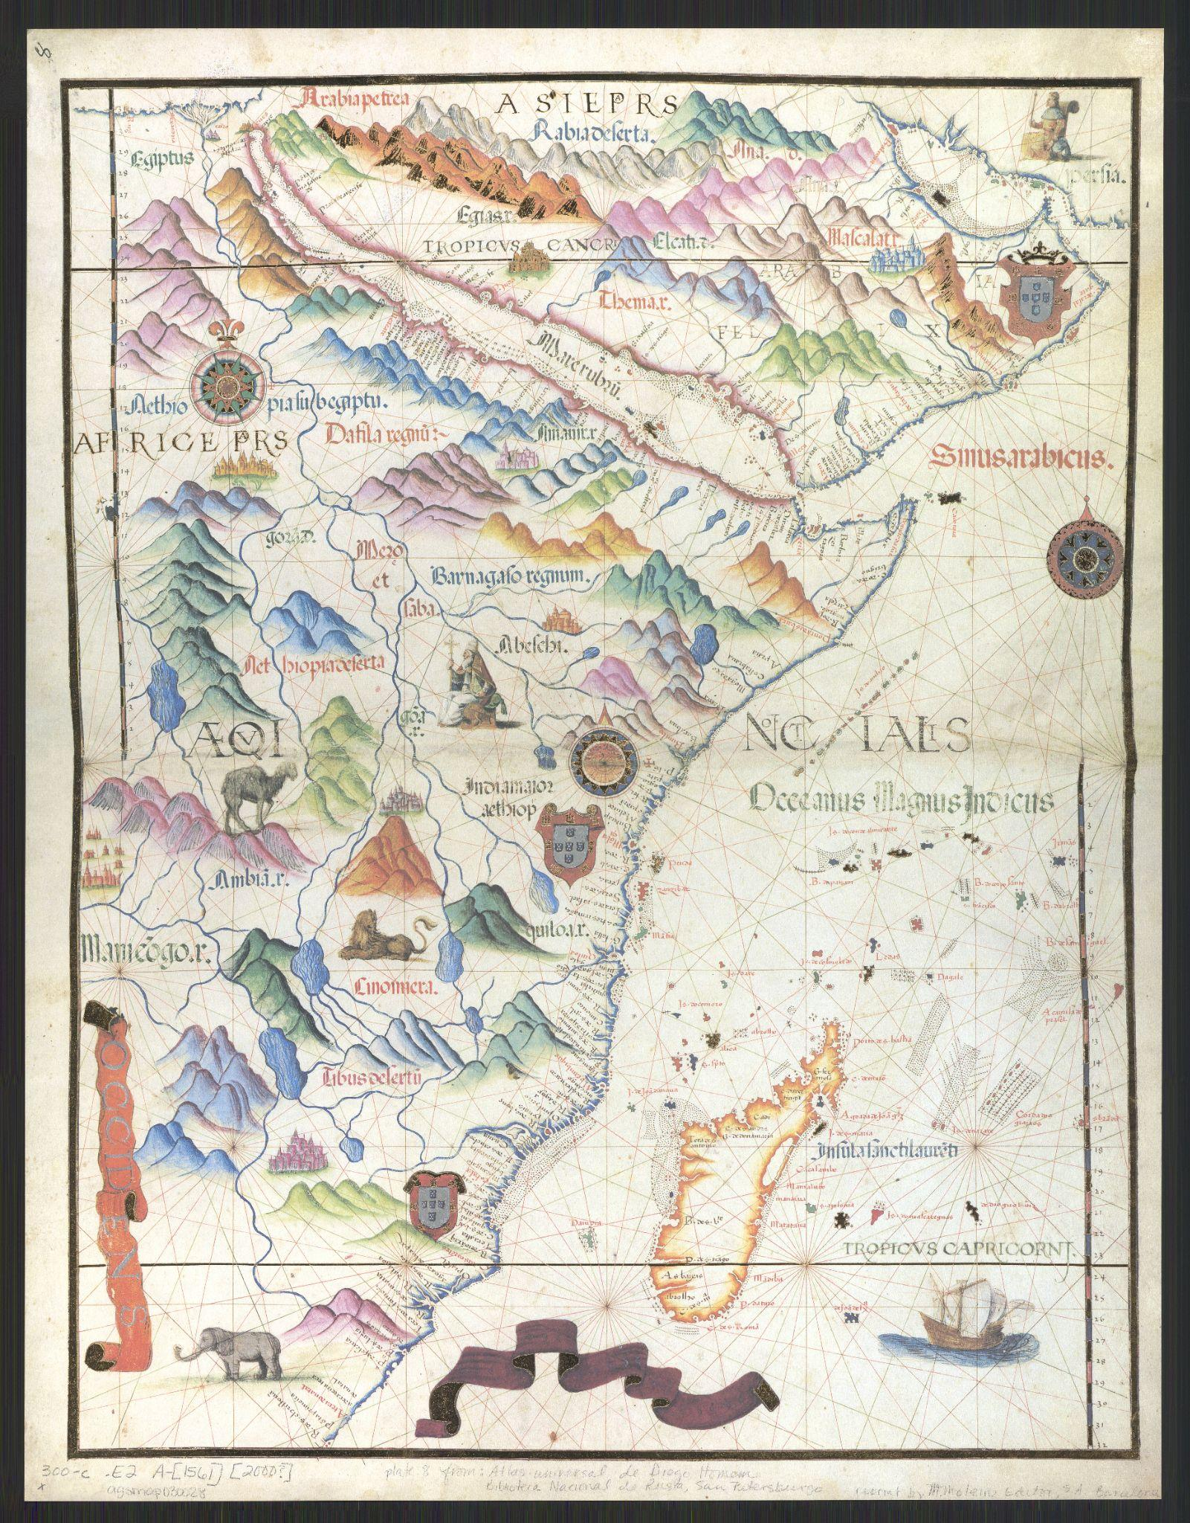
Does this map show a real place or an imaginary place?
Does this map use contrast, balance, or emphasis? How?
Does this map tell a story? What story does it tell?
What details make this map interesting?
Portolan Chart of Africa’s East Coast
Image: American Geographic Society Library

Slide 50
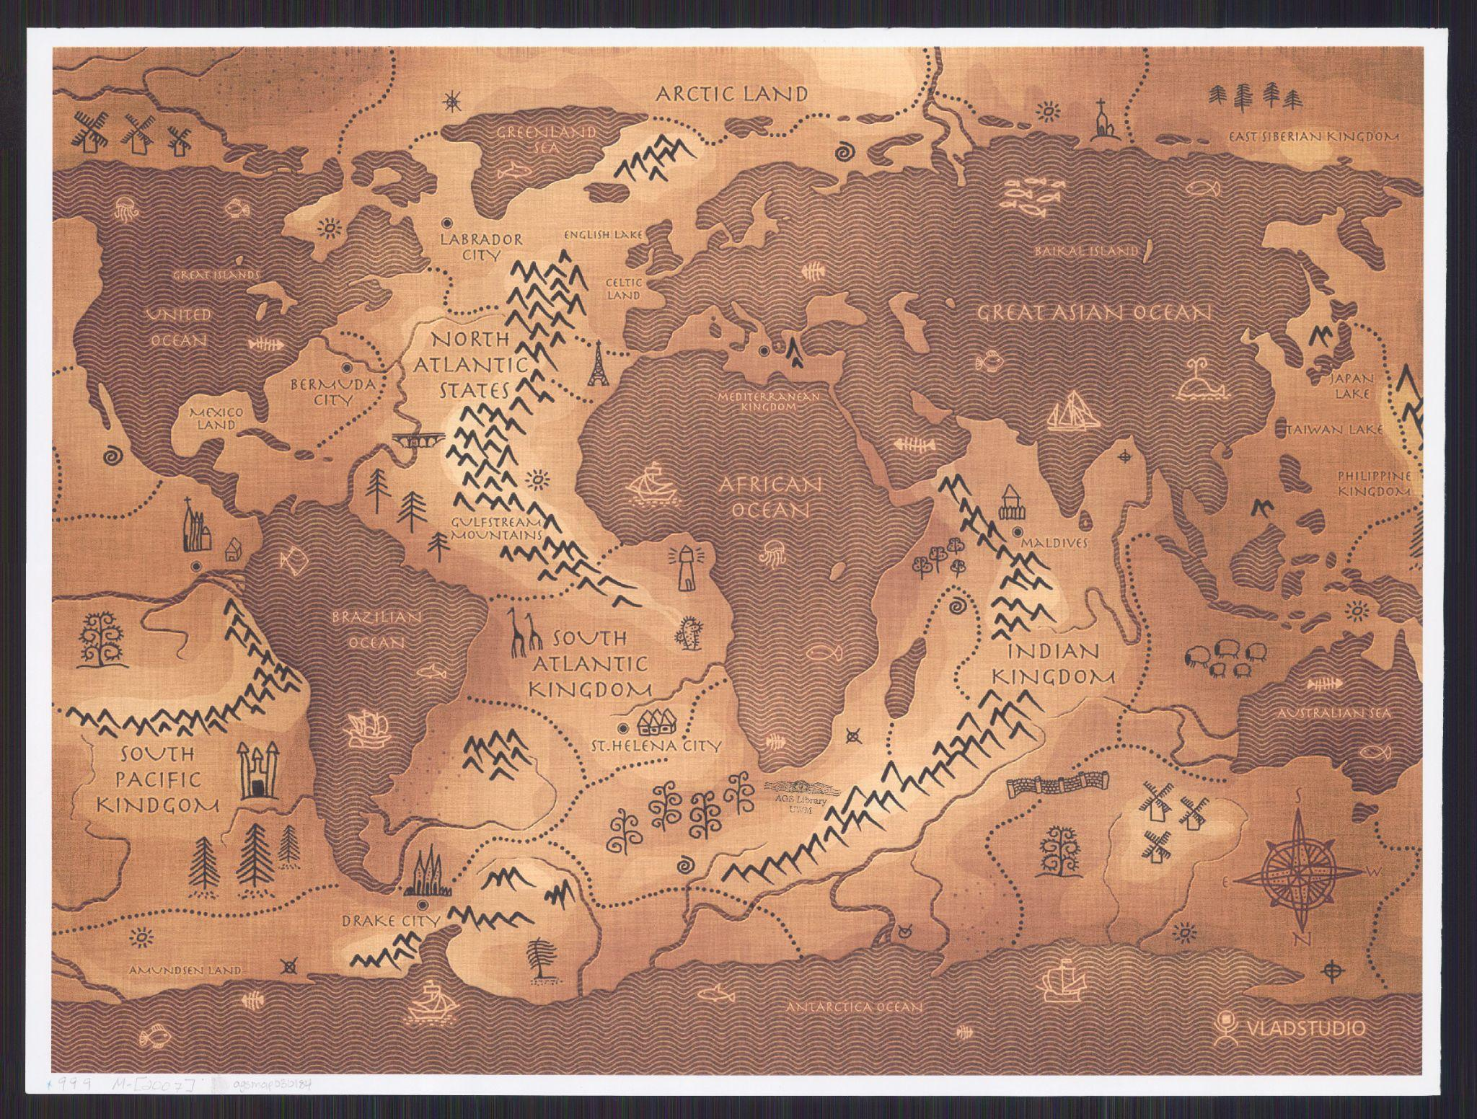
Does this map show a real place or an imaginary place?
Does this map use contrast, balance, or emphasis? How?
Does this map tell a story? What story does it tell?
What details make this map interesting?
Vlad Studio
Image: American Geographic Society Library

Slide 51

Now it’s your turn!
Plan Your Own Imaginary-Place Map
You can work by yourself or with a partner to brainstorm and sketch.
Will your map show a place from a story, movie, show, video game, or from your own imagination?
What are the important parts all maps should include?
How will you use contrast, balance, and emphasis to help tell a story with your map?

Slide 52
Clean Up
quickly and quietly

Slide 53
Day Two

Slide 54
Learning Objective:
Today I am learning that the cartographic process is a step-by-step way of making a map.
Success Criteria:
I will know I am successful when I define my imaginary world, add water, rivers, and forests, and draw water lines and shore lines.

Slide 55
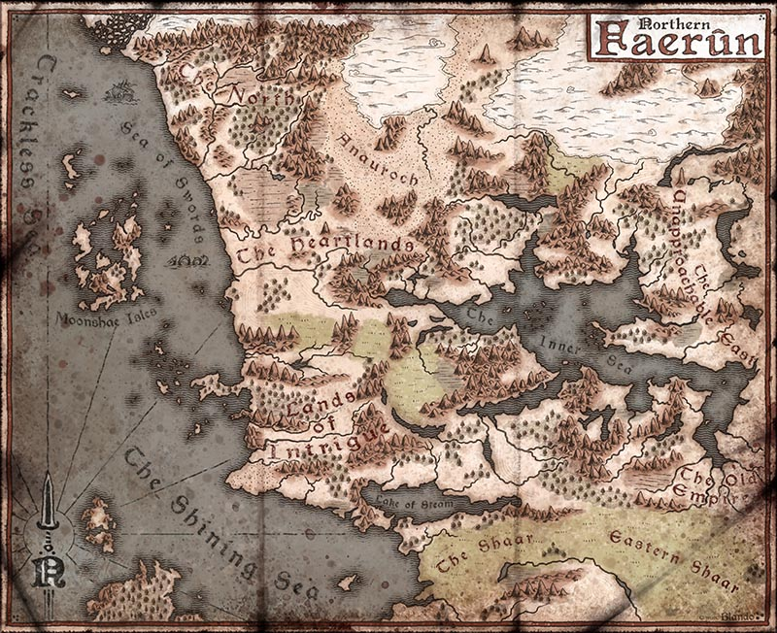
Does this map show a real place or an imaginary place?
Can you find these cartographic elements:
title
compass rose
scale bar
legend
What details make this map special?
Northern Faerūn
Image: Jared Blando

Slide 56
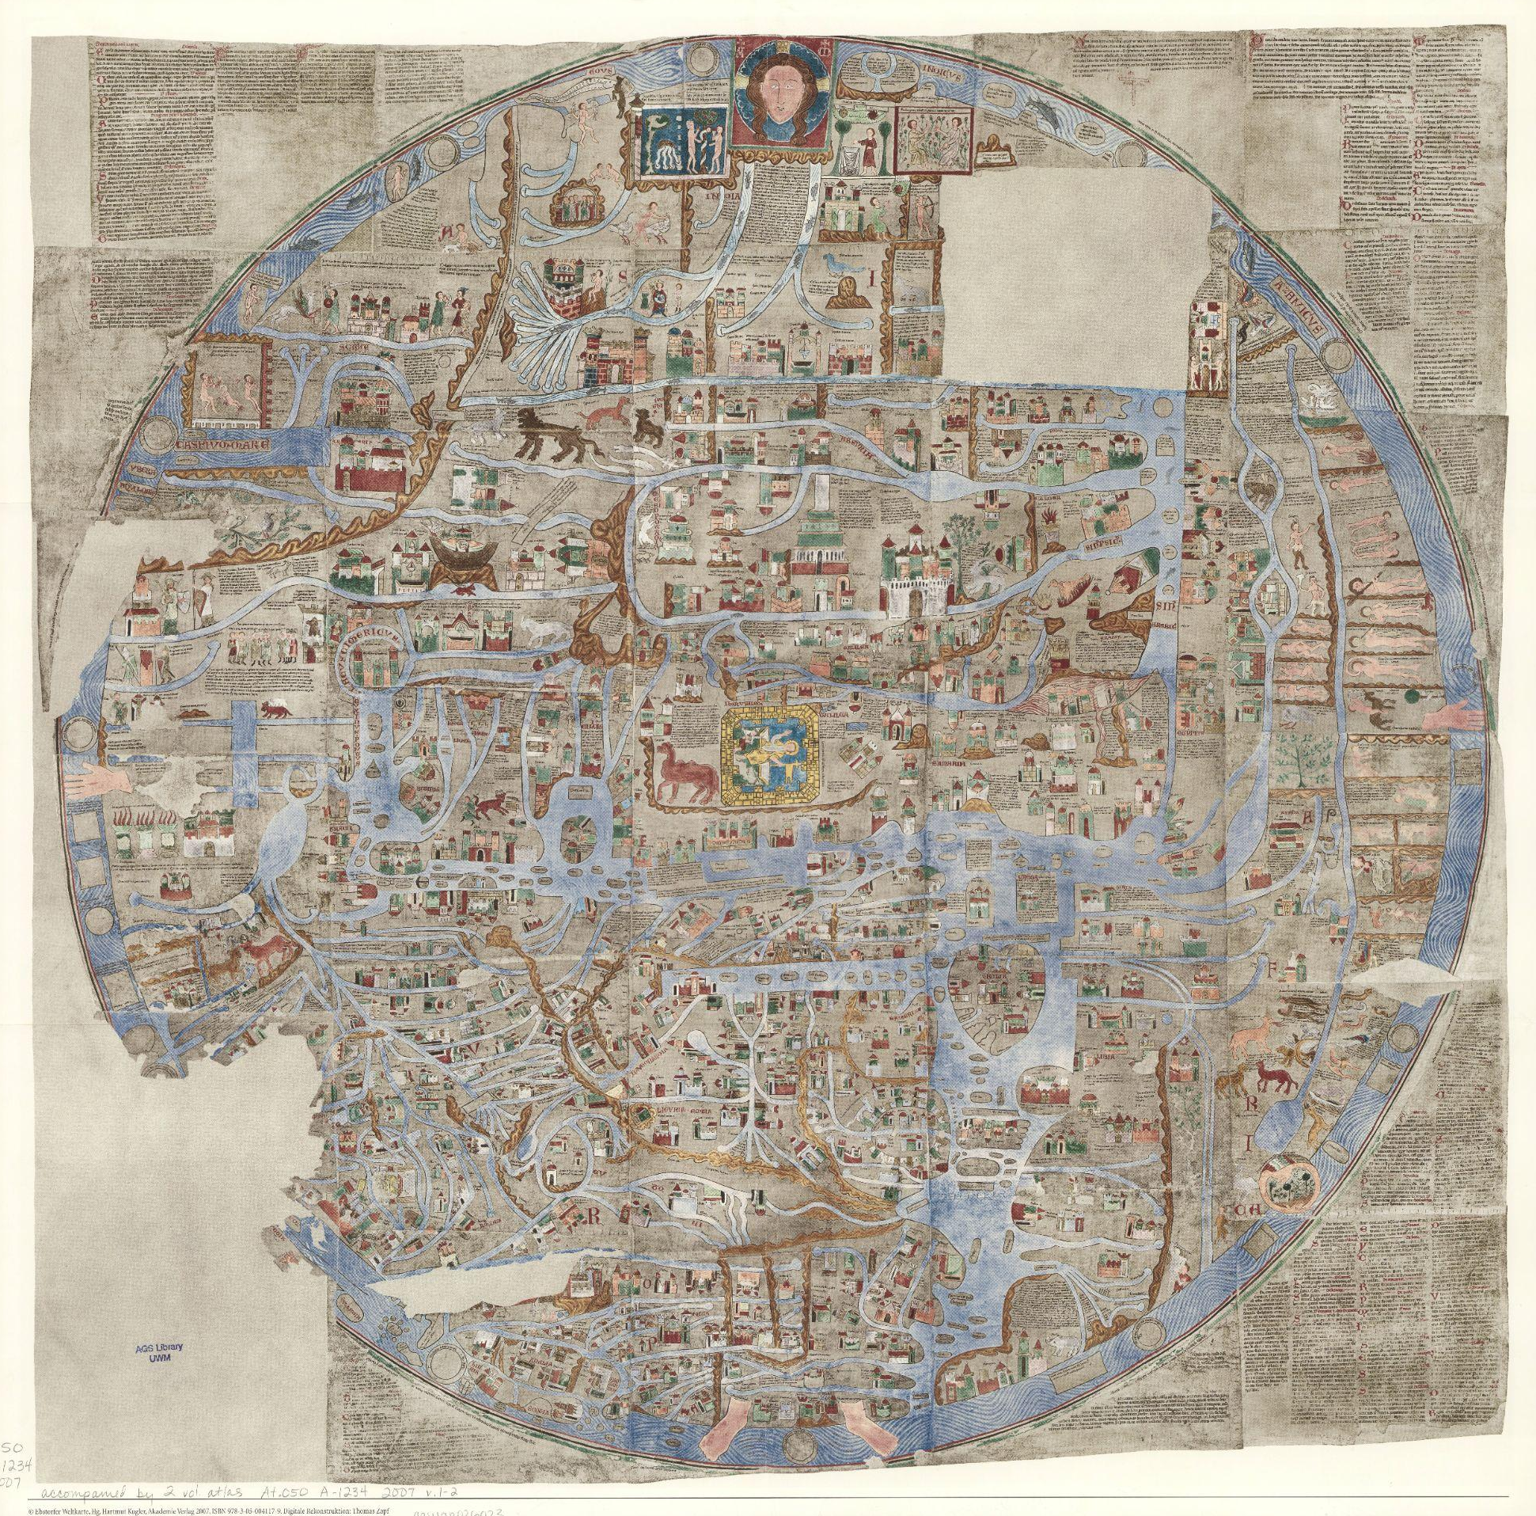
Does this map show a real place or an imaginary place?
Can you find these cartographic elements:
title
compass rose
scale bar
legend
What details make this map special?
Ebstorf Map
Image: American Geographic Society Library

Slide 57
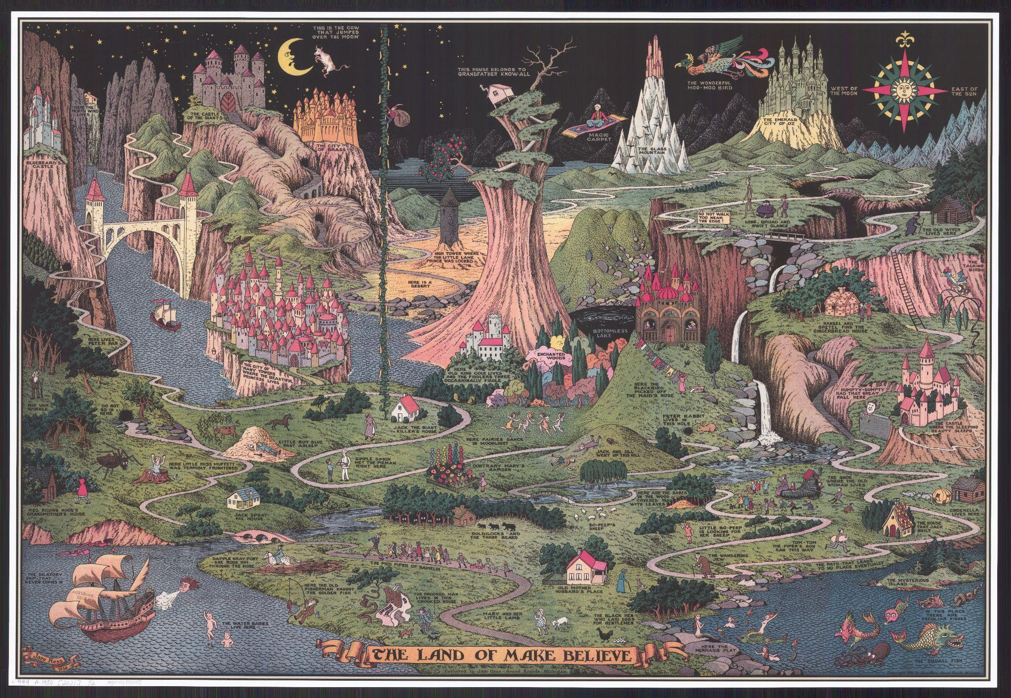
Does this map show a real place or an imaginary place?
Can you find these cartographic elements:
title
compass rose
scale bar
legend
What details make this map special?
The Land of Make Believe
Image: American Geographic Society Library

Slide 58
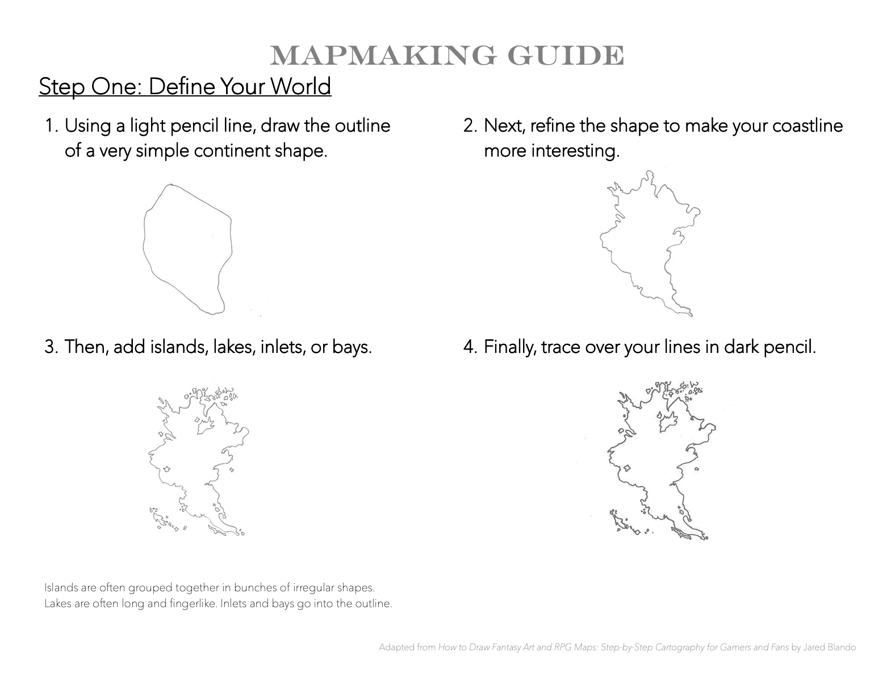

Slide 59
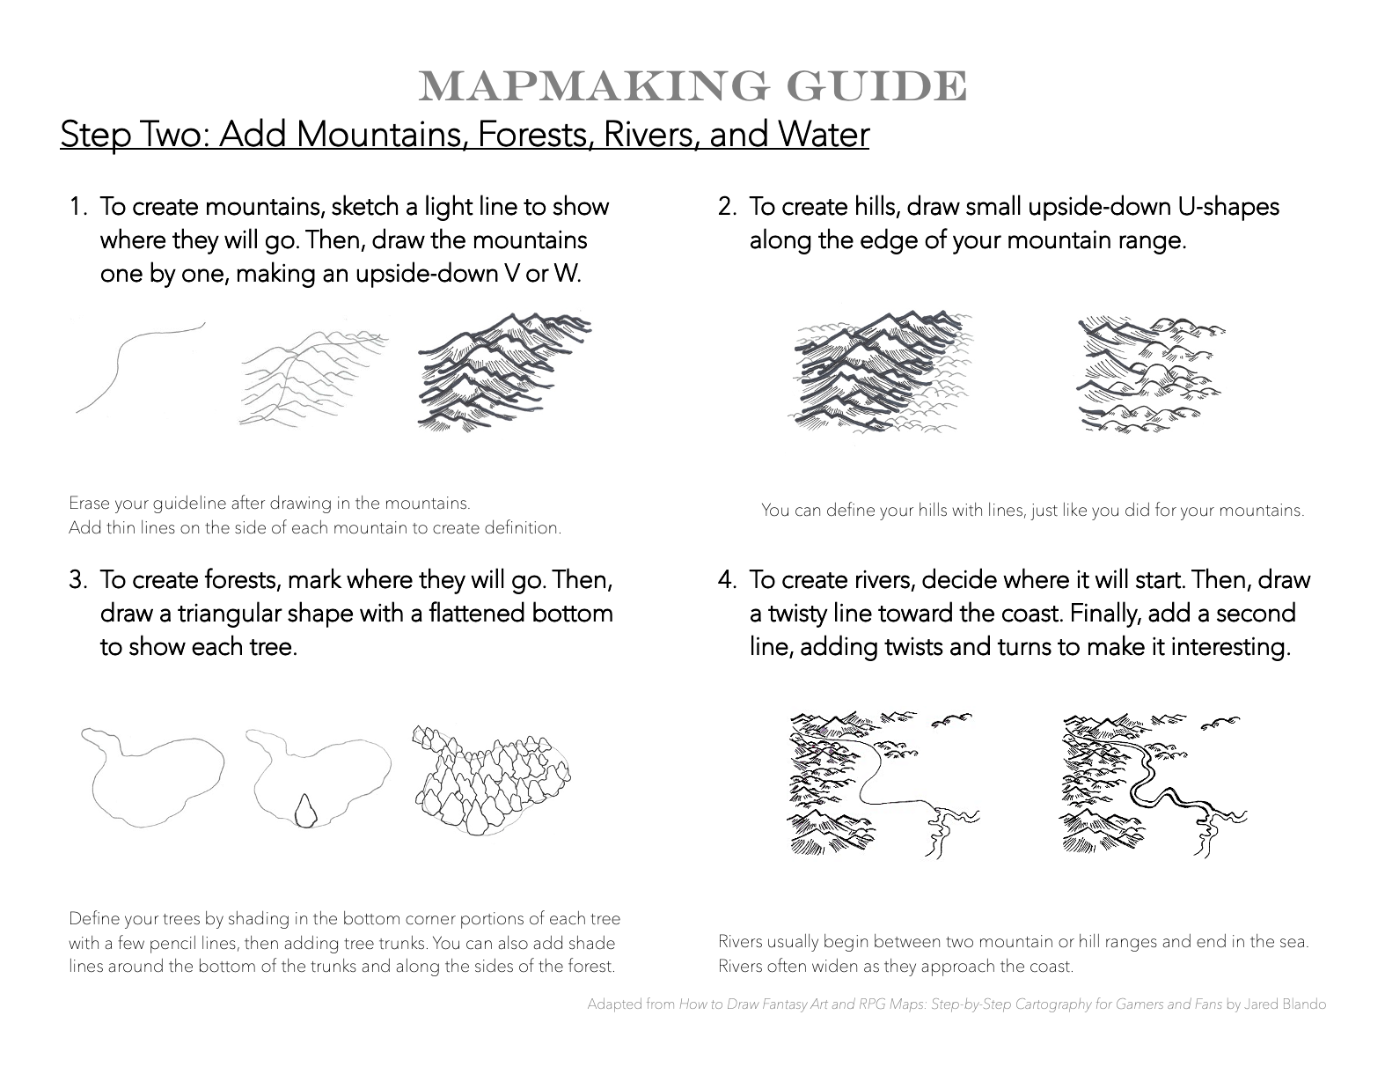

Slide 60
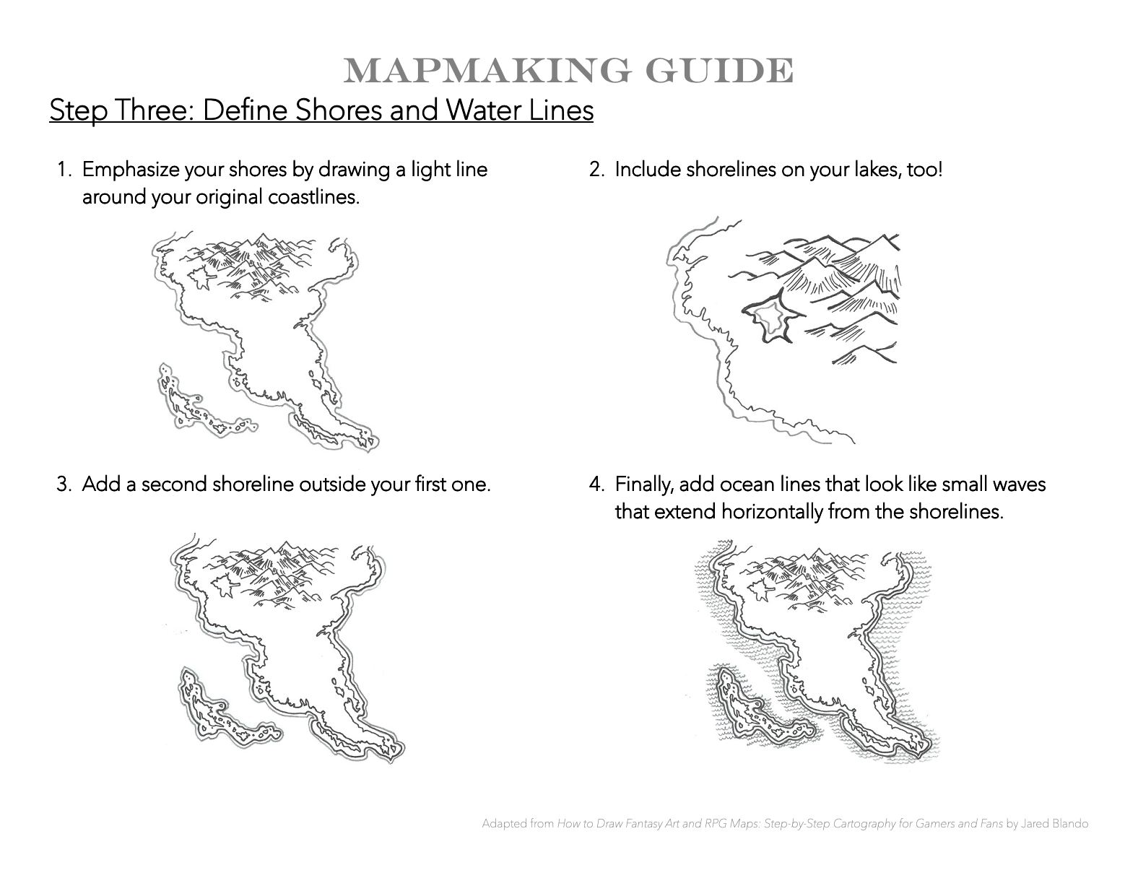

Slide 61
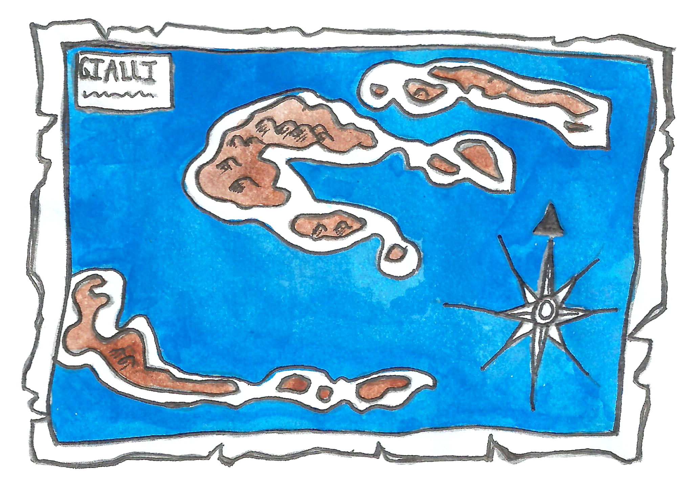
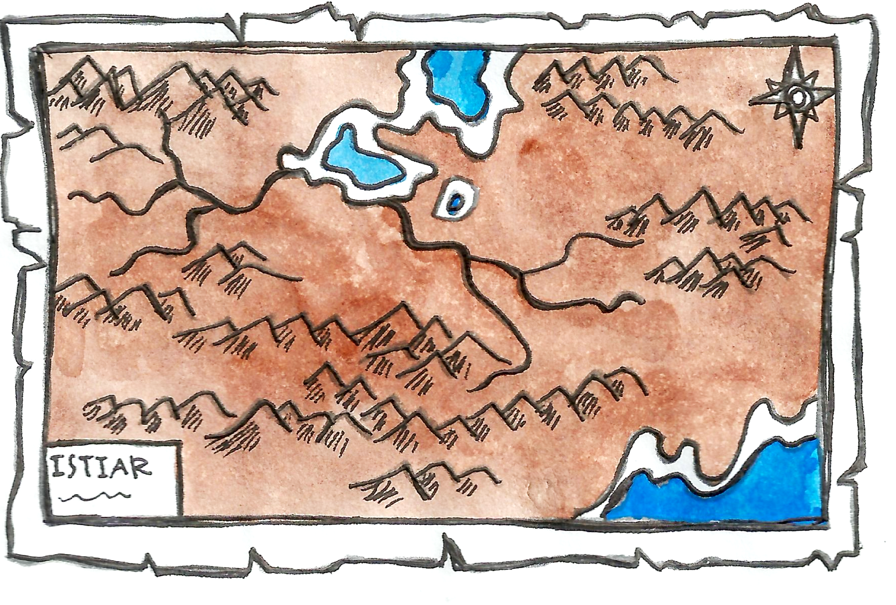
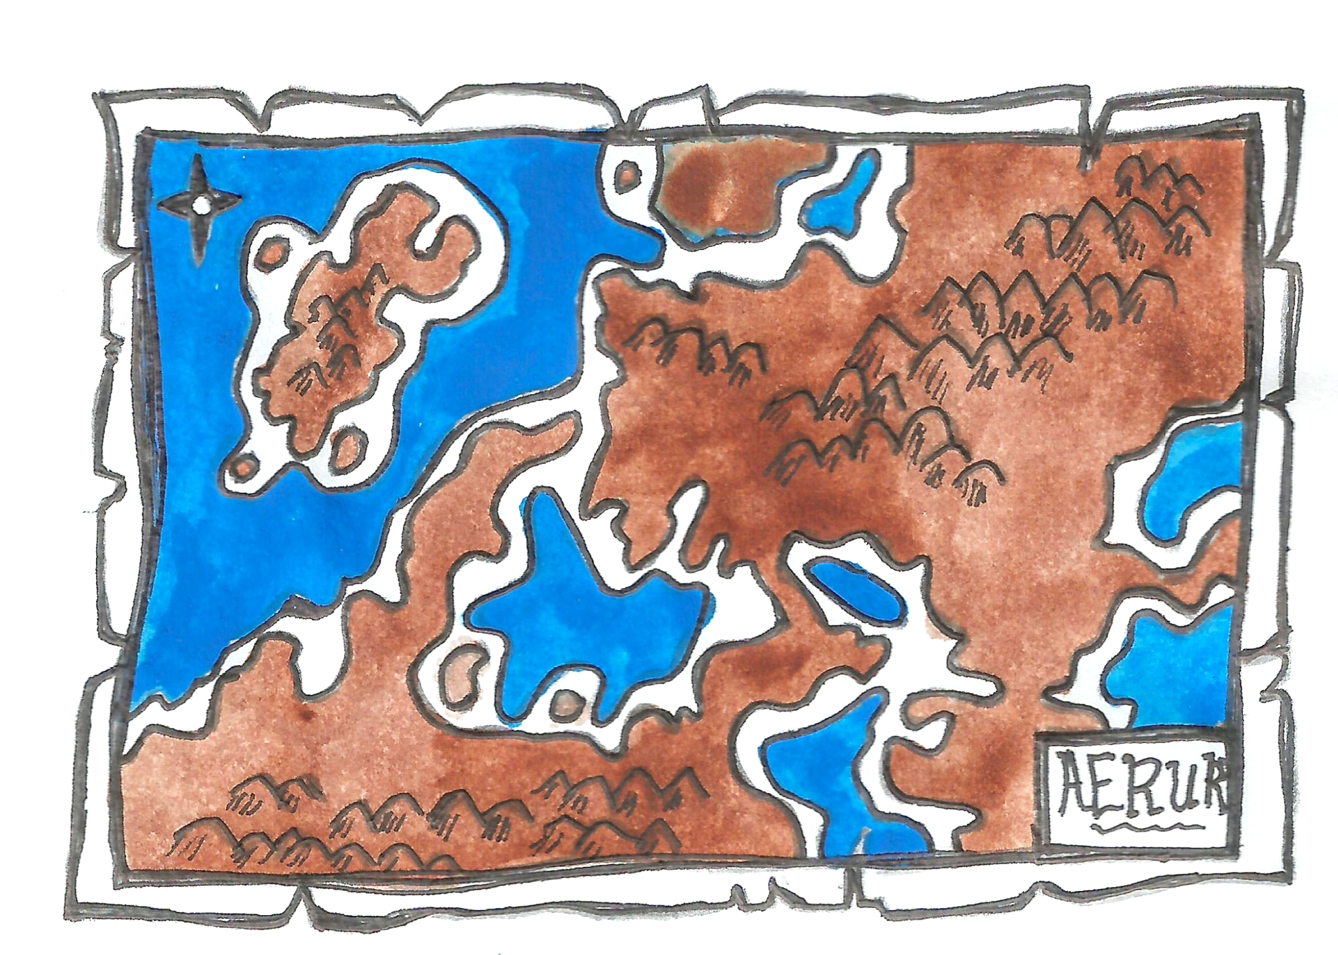
Now it’s your turn!
Make Your Own Imaginary-Place Map
You can use your cartographic knowledge to make a map.
Your map should show an imaginary place.
Your map should include:
land and water
a compass rose
a scale bar
a map legend
at least 3 different landforms
How will you use contrast, balance, and emphasis to help tell a story with your map?
ocean-heavy map
land-heavy map
balanced map
Maps adapted from Jared Blando

Slide 62
Clean Up
quickly and quietly

Slide 63
Day Three

Slide 64
Learning Objective:
Today I am learning that the cartographic process is a step-by-step way of making a map.
Success Criteria:
I will know I am successful when I add towns, a compass rose, a scale bar, a map legend, and labels to my imaginary-place map.

Slide 65
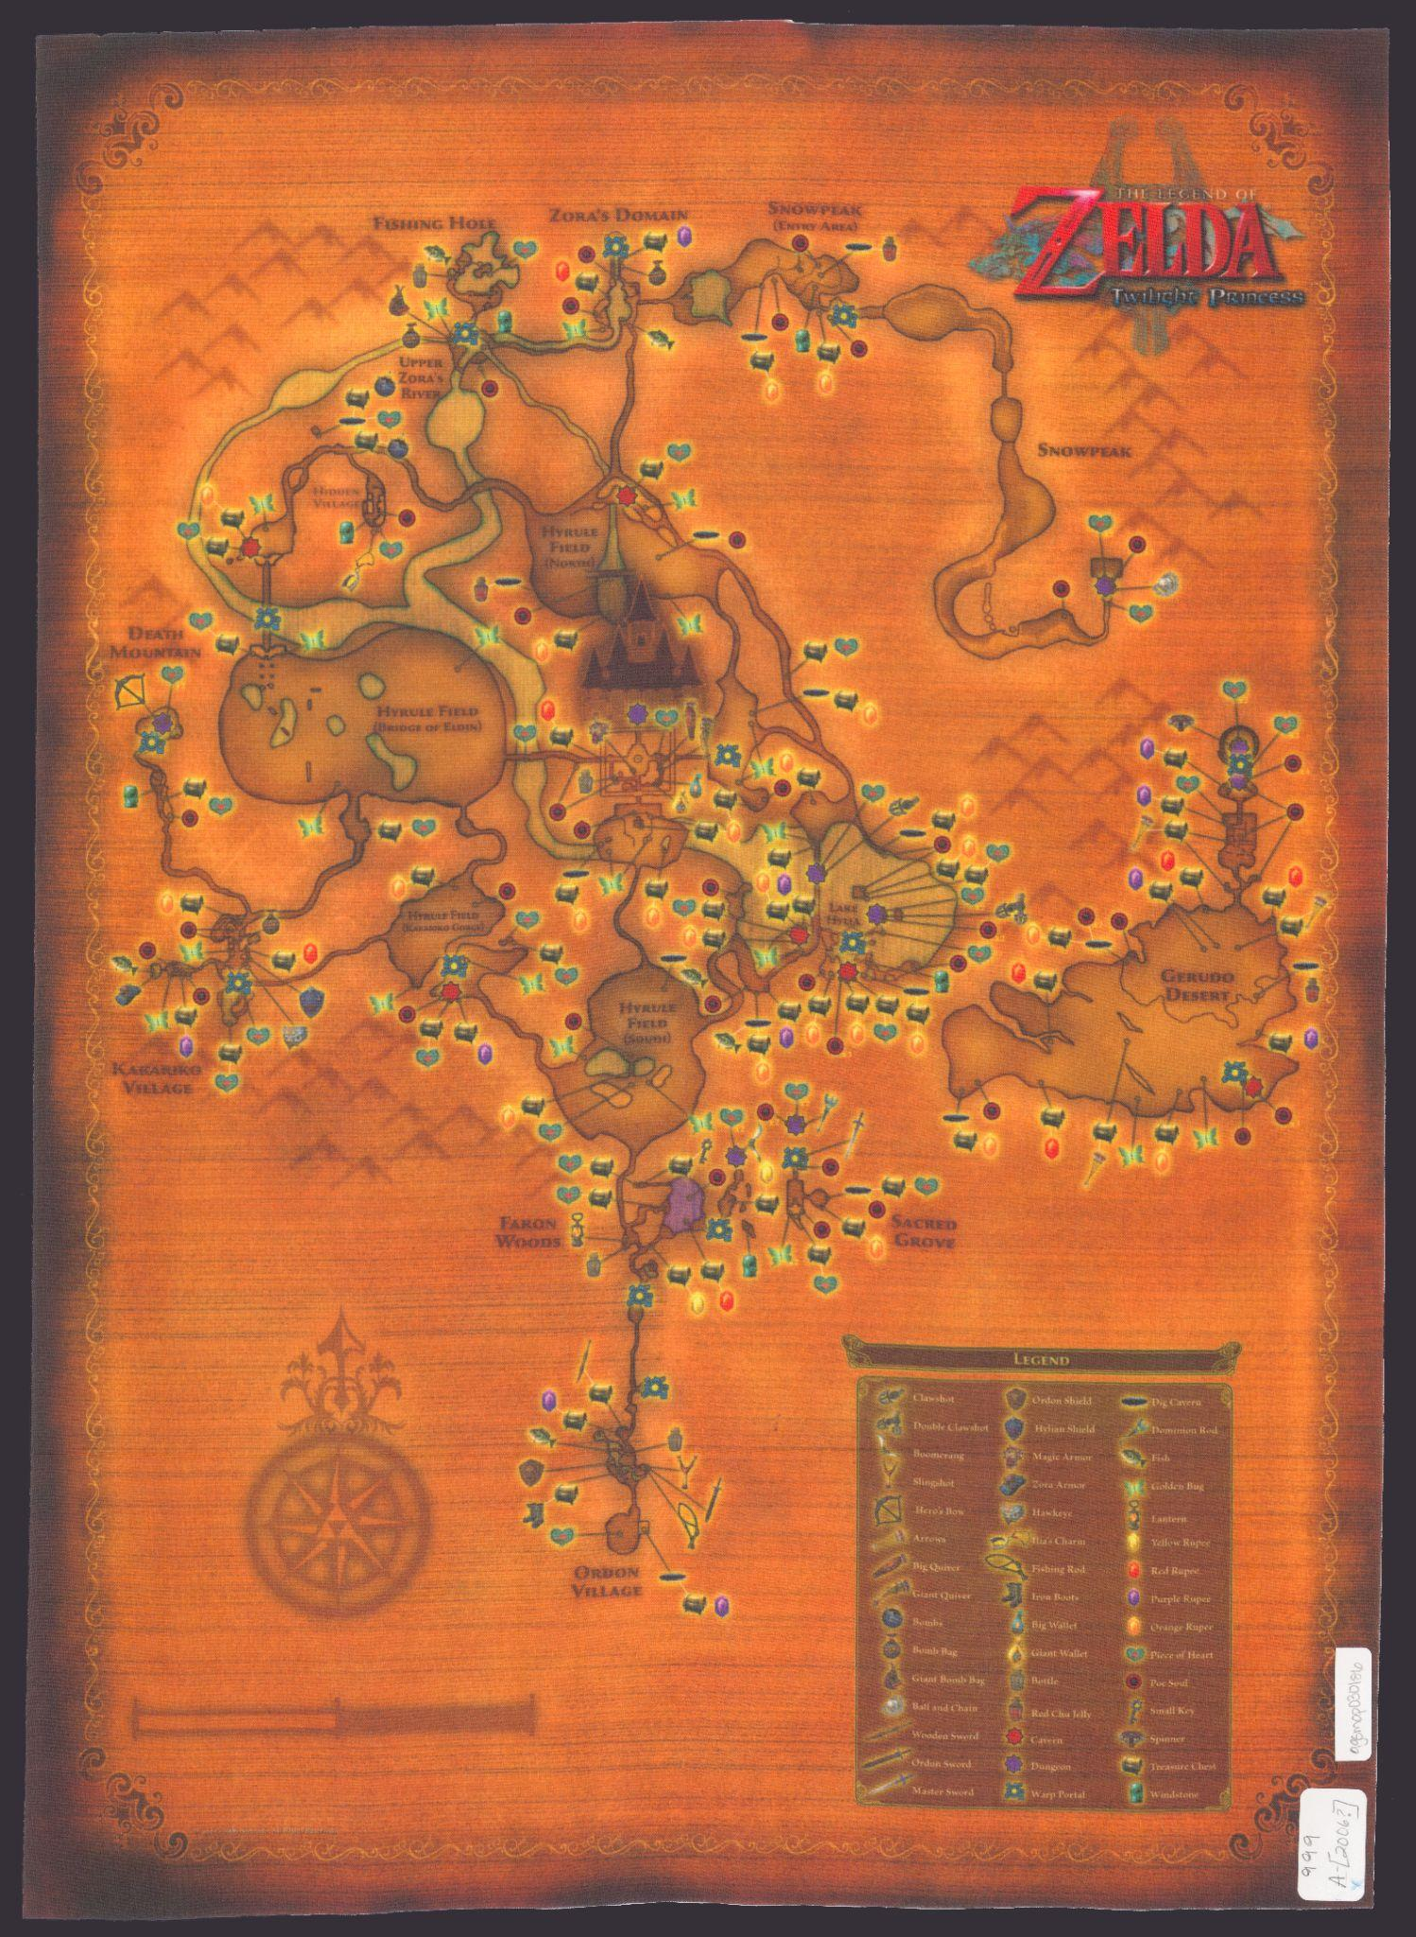
Does this map show a real place or an imaginary place?
Can you find these cartographic elements:
title
compass rose
scale bar
legend
What details make this map special?
The Legend of Zelda
Image: American Geographic Society Library

Slide 66
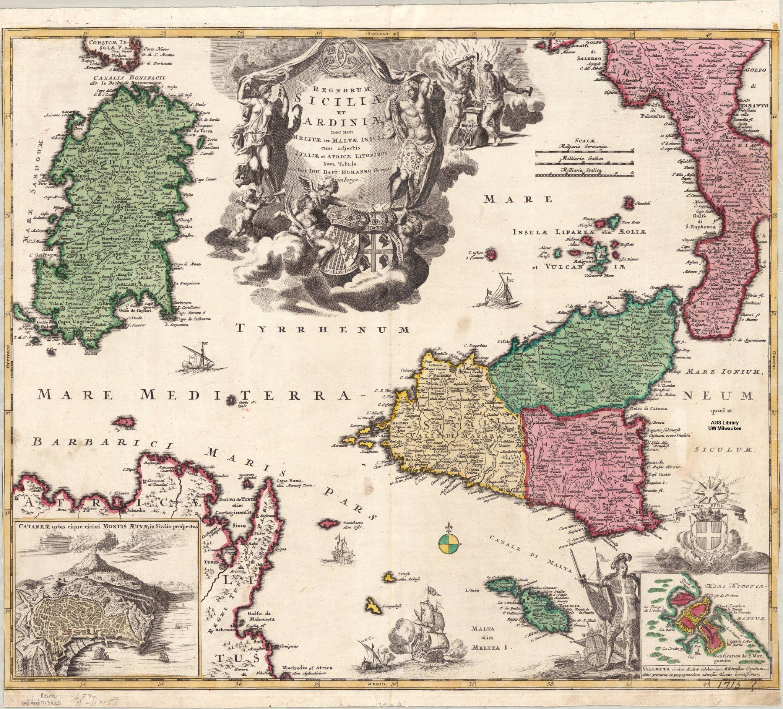
Does this map show a real place or an imaginary place?
Can you find these cartographic elements:
title
compass rose
scale bar
legend
What details make this map special?
Regnorum Siciliae et Sardiniae …
Image: American Geographic Society Library

Slide 67
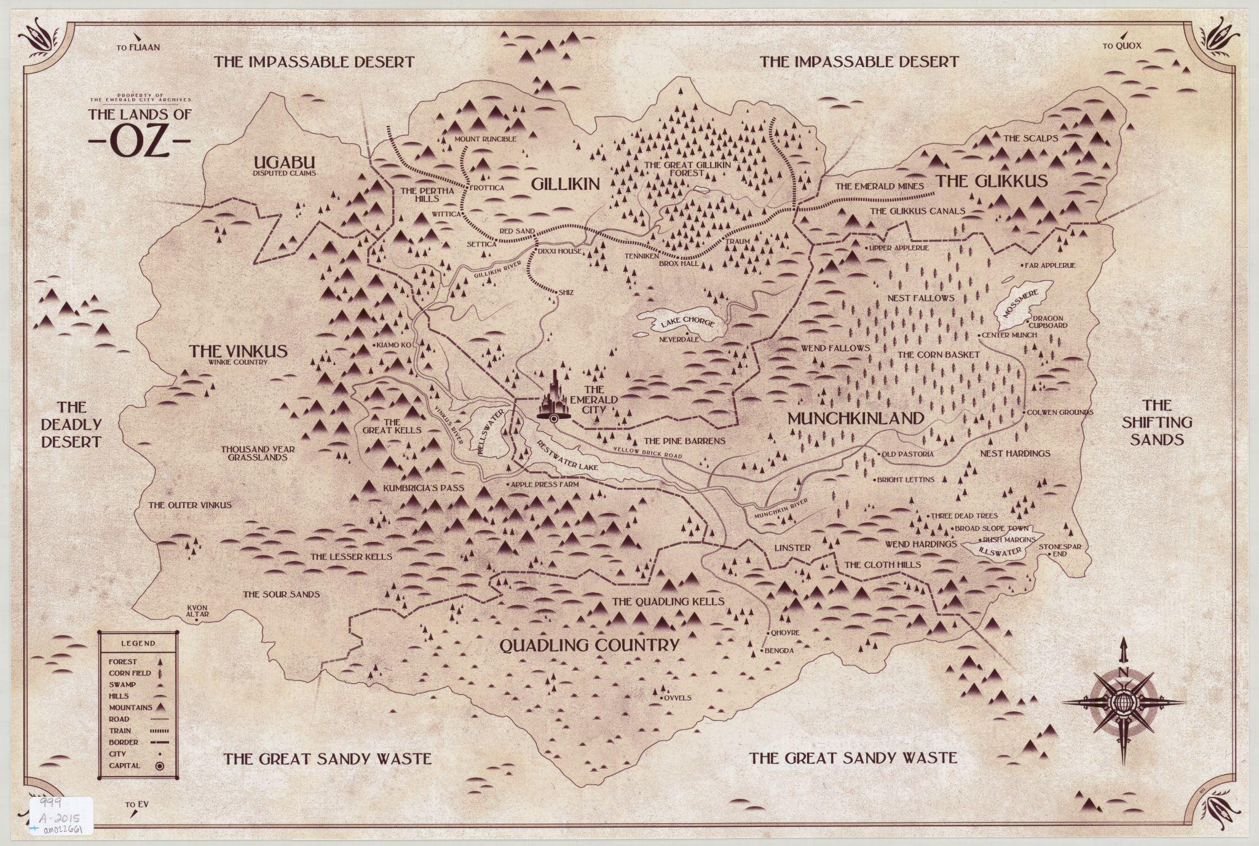
Does this map show a real place or an imaginary place?
Can you find these cartographic elements:
title
compass rose
scale bar
legend
What details make this map special?
The Lands of Oz
Image: American Geographic Society Library

Slide 68
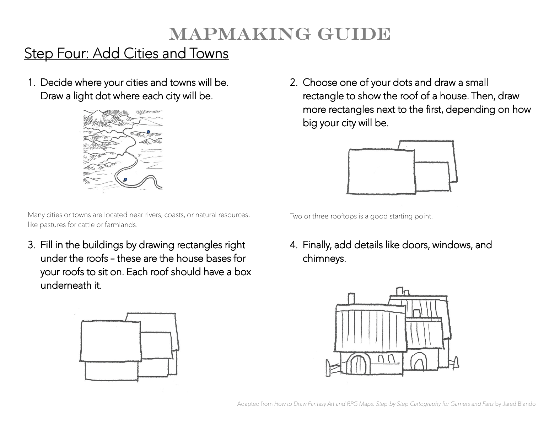

Slide 69
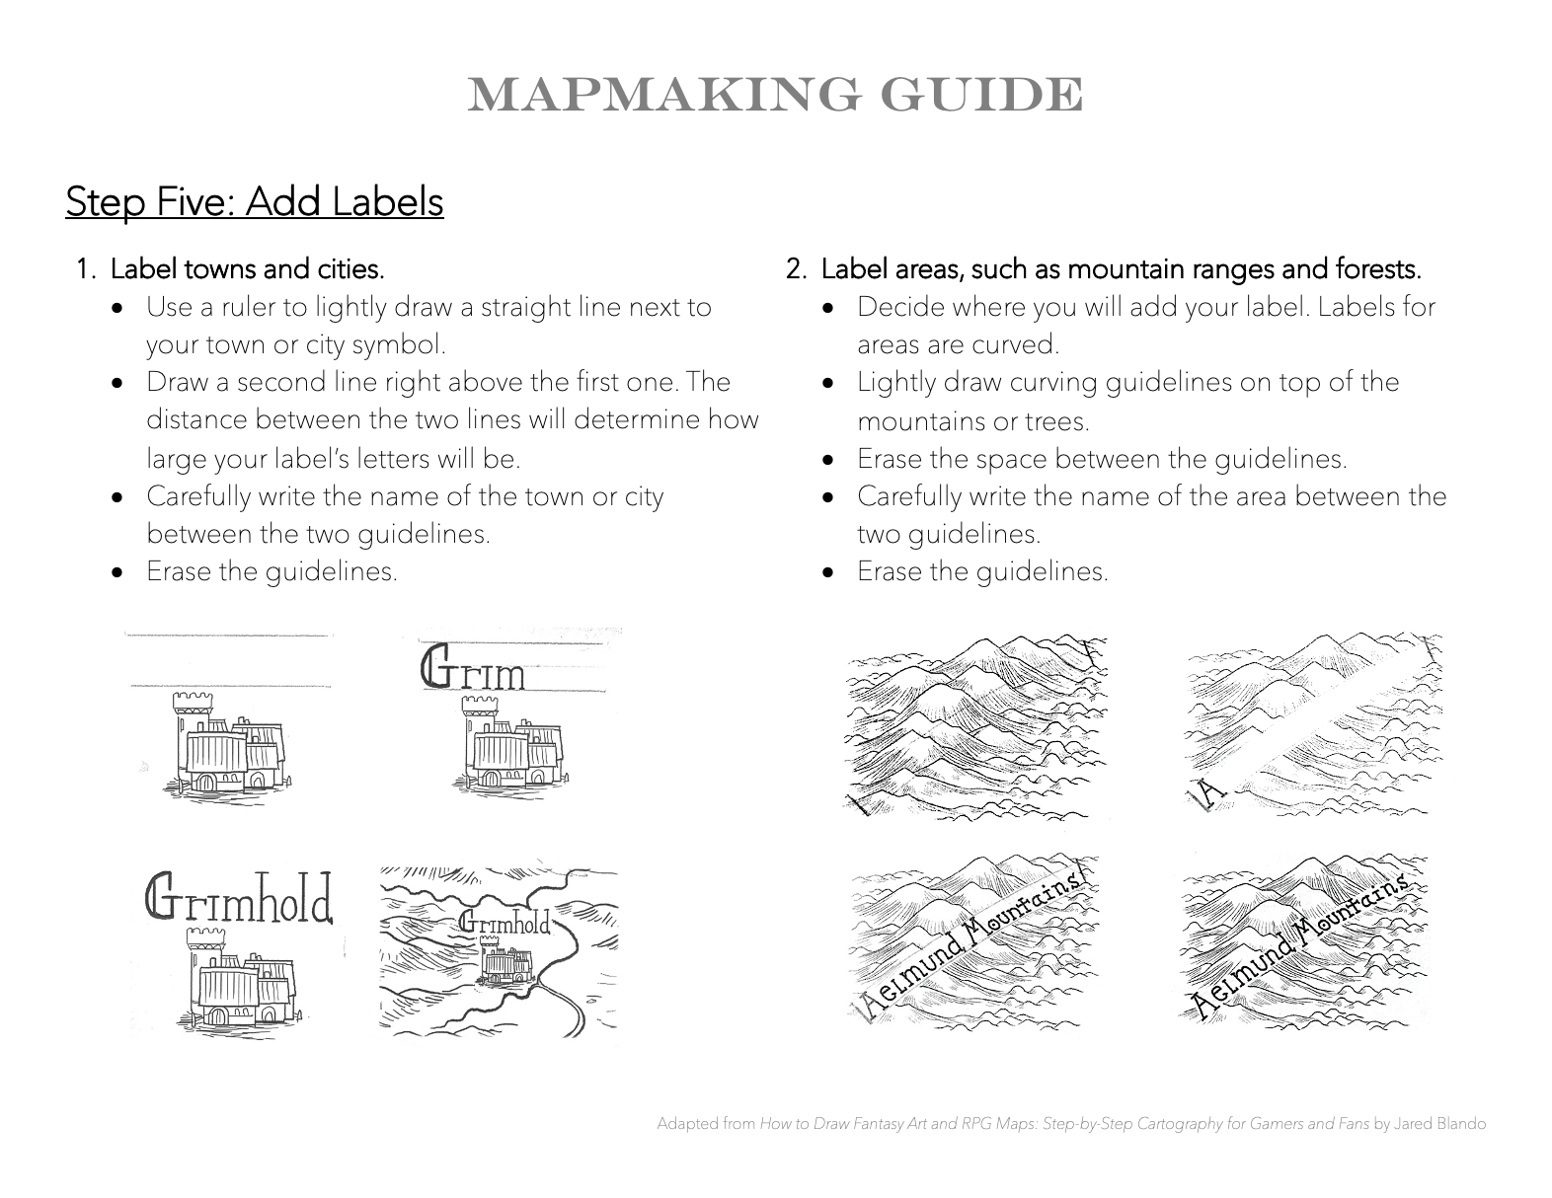

Slide 70
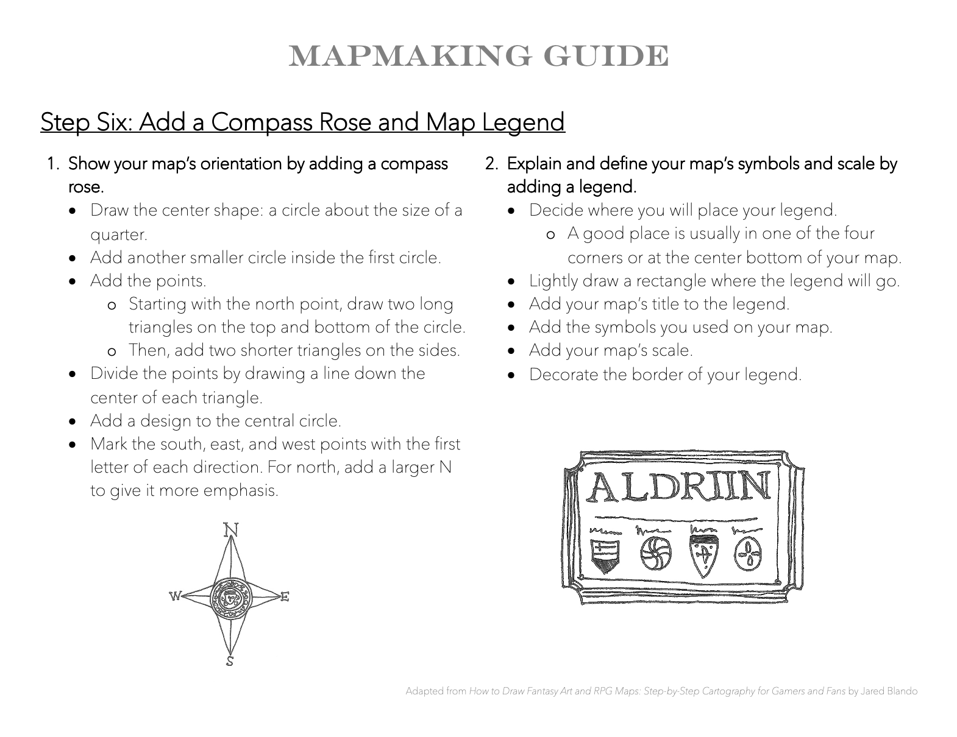

Slide 71
Now it’s your turn!
Make Your Own Imaginary-Place Map
You can use your cartographic knowledge to make a map.
Your map should show an imaginary place.
Your map should include:
land and water
a compass rose
a scale bar
a map legend
at least 3 different landforms
How will you use contrast, balance, and emphasis to help tell a story with your map?
ocean-heavy map
land-heavy map
balanced map
Maps adapted from Jared Blando

Slide 72
Clean Up
quickly and quietly

Slide 73
Day Four

Slide 74
Learning Objective:
Today I am learning that the cartographic process is a step-by-step way of making a map.
Success Criteria:
I will know I am successful when I finish my imaginary-place map.

Slide 75
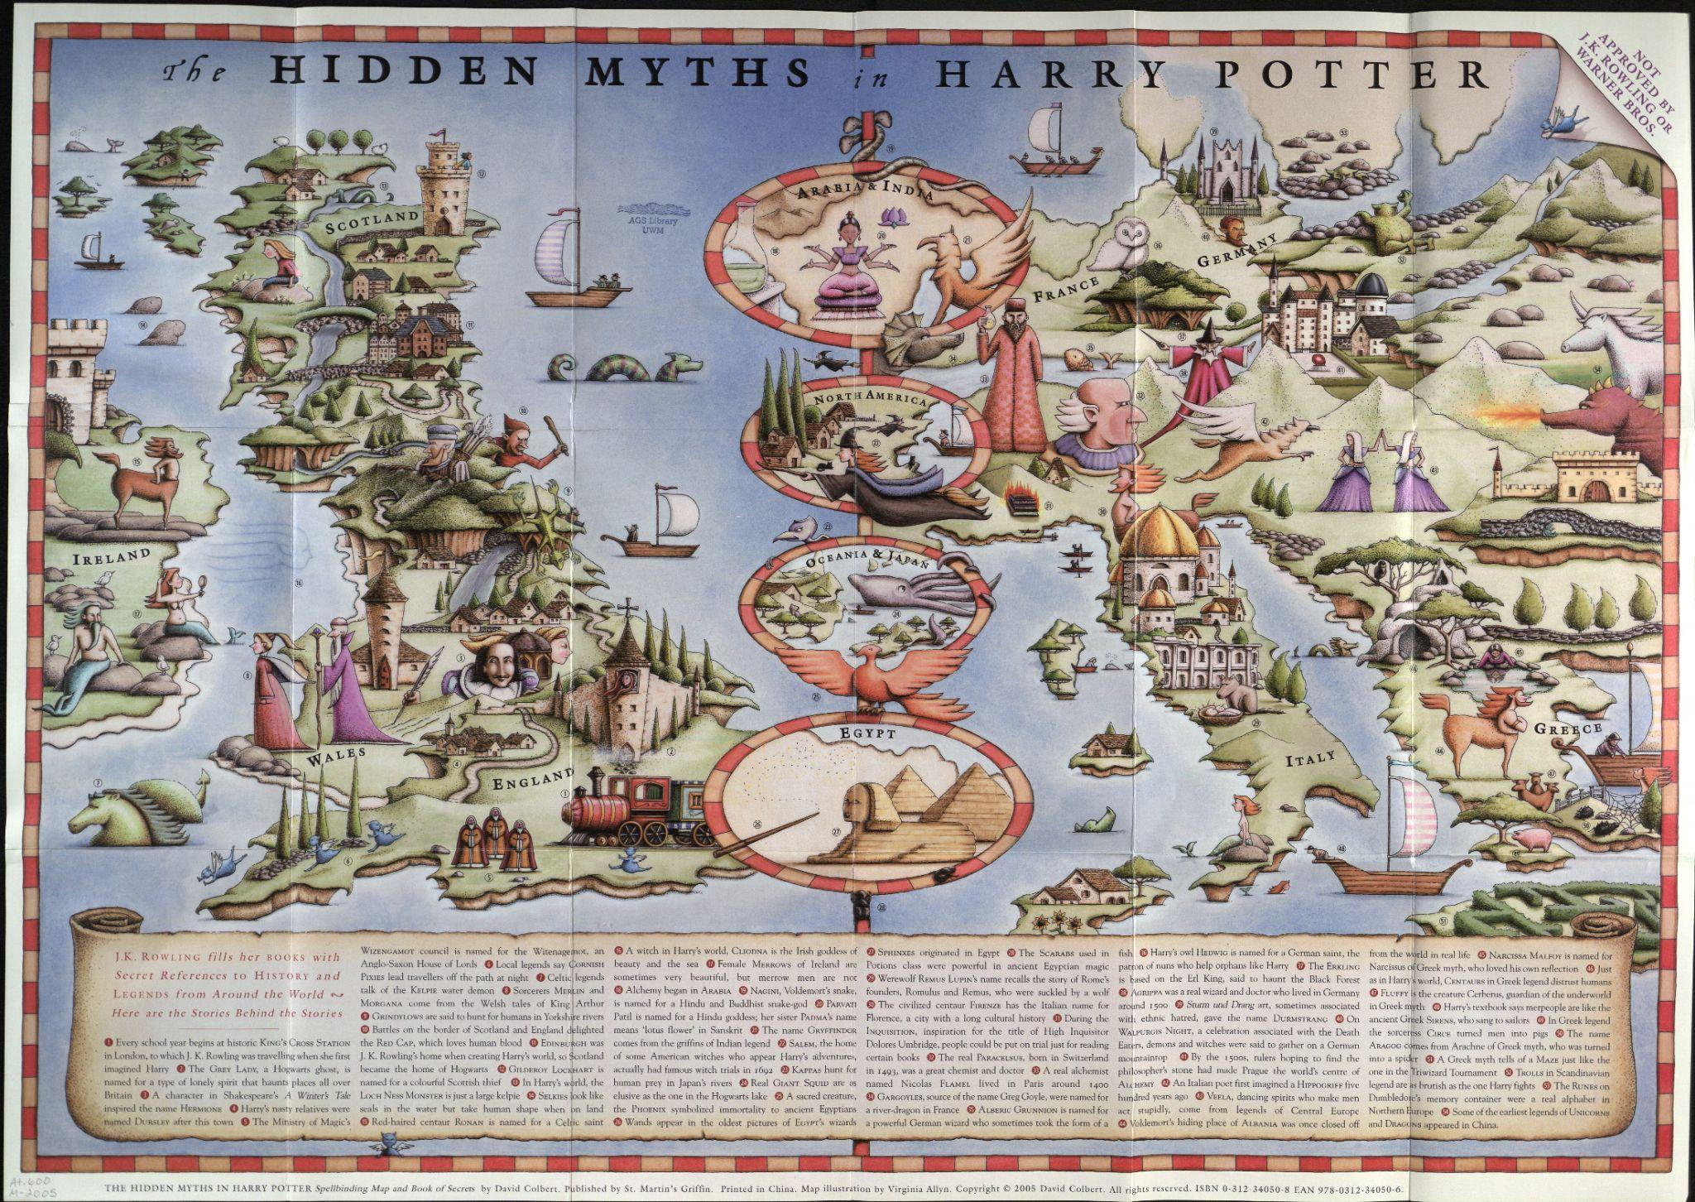
Does this map show a real place or an imaginary place?
What details make this map special?
How does this map use color to create contrast and emphasis?
The Hidden Myths in Harry Potter
Image: American Geographic Society Library

Slide 76
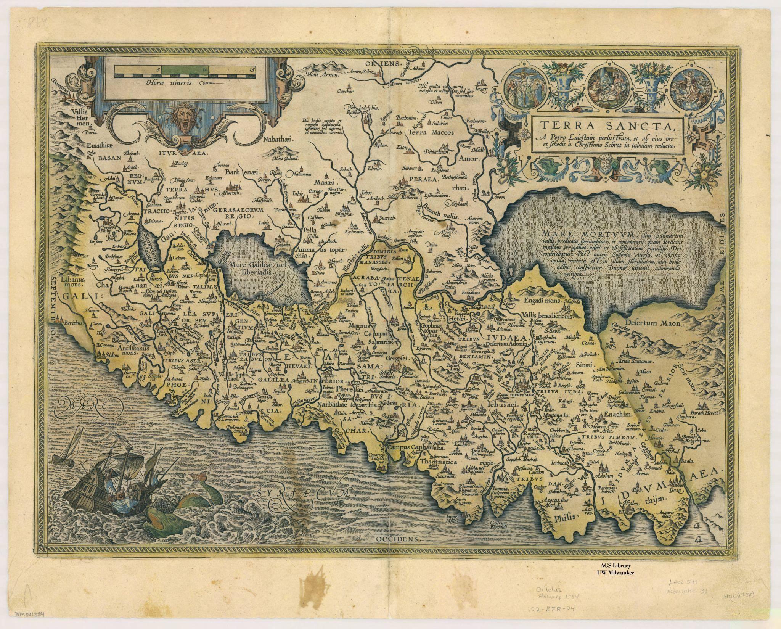
Does this map show a real place or an imaginary place?
What details make this map special?
How does this map use color to create contrast and emphasis?
Terra Sancta …
Image: American Geographic Society Library

Slide 77
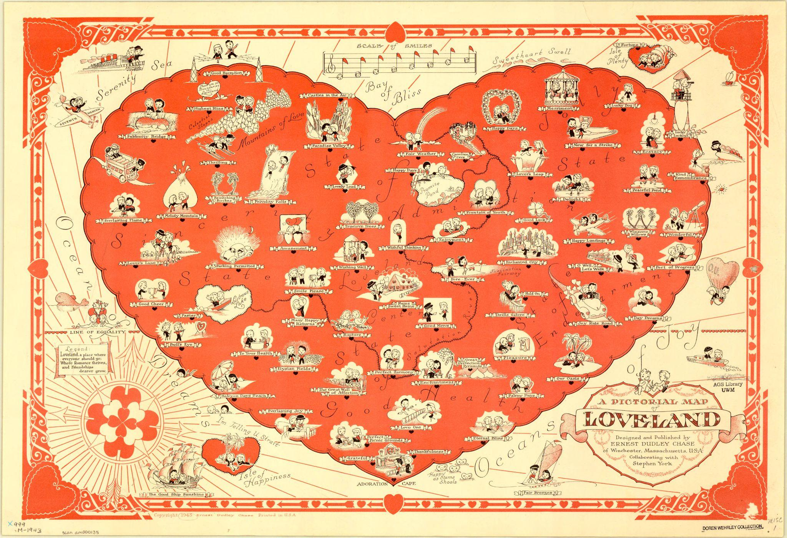
Does this map show a real place or an imaginary place?
What details make this map special?
How does this map use color to create contrast and emphasis?
A Pictorial Map of Loveland
Image: American Geographic Society Library

Slide 78
Now it’s your turn!
Make Your Own Imaginary-Place Map
You can use your cartographic knowledge to make a map.
Your will finish your imaginary-place map today.
Make sure you map includes:
land and water
a compass rose
a scale bar
a map legend
at least 3 different landforms
You can add color to your finished map to create contrast and emphasis.
ocean-heavy map
land-heavy map
balanced map
Maps adapted from Jared Blando

Slide 79
Clean Up
quickly and quietly

Slide 80
Projections and Distortion:
Making a Papier-Mâché Globe
Lesson Five

Slide 81
Day One

Slide 82
Learning Objective:
Today I am learning that globes give the truest possible view of the earth.
Success Criteria:
I will know I am successful when I use paper-mâché to create a sphere.

Slide 83
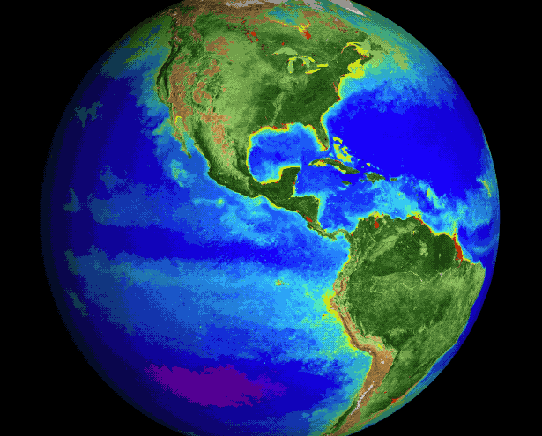
The earth is round.
Globes are round, too.
Globes are scale models of the earth.
That means they are miniature versions of the earth.
Plant Life Vintage GIF
Image: NASA

Slide 84

Latitude and Longitude of the Earth
Image: Wikimedia Commons

Slide 85


The Ostrich Egg Globe
Image: David Guam via Wikimedia Commons
Globi e plastici in relievo …
Image: American Geographic Society Library

Slide 86

Now it’s your turn!
Make a Papier-Mâché Globe
You can use papier-mâché to create a sphere.
Tear newspaper strips.
Dip a strip into the papier-mâché paste.
Stick the strip on your balloon.
Overlap the strips as you go around your balloon four times to make a strong globe.
Image: First Palette

Slide 87
Clean Up
quickly and quietly

Slide 88
Day Two

Slide 89
Learning Objective:
Today I am learning that cartographers use lines of latitude and lines of longitude to identify the exact location of every place on earth.
Success Criteria:
I will know I am successful when I paint my globe and color and cut out the seven continents.

Slide 90

Cartographers use lines of latitude and lines of longitude to divide the space on the globe.
Can you find the Equator?
Can you find the Prime Meridian?
Latitude and Longitude Visualized
Image: ArtStation

Slide 91

Now it’s your turn!
Make a Papier-Mâché Globe
You can paint your globe blue and color your continents.
Remove your balloon carefully without tearing your sphere.
Paint the entire globe blue.
Color each continent a different color.
Cut out your continents.
Remember to write your name on each of your cut-out continents!
Image: PBS Kids

Slide 92
Clean Up
quickly and quietly

Slide 93
Day Three

Slide 94
Learning Objective:
Today I am learning to locate the Equator, the Prime Meridian, and the continents on a globe.
Success Criteria:
I will know I am successful when I complete my papier-mâché globe by adding the Equator, the Prime Meridian, and all seven continents.

Slide 95

Azimuthal Projection
Image: NASA

Slide 96
Now it’s your turn!
Make a Papier-Mâché Globe
You can add the Equator, the Prime Meridian, and the continents.
Use your string to find the center of your globe and draw on the Equator.
Wrap your string around the globe from North Pole to South Pole and draw on the Prime Meridian.
Add your continents, paying attention to their location.
Plant Life Vintage GIF
Image: NASA

Slide 97
Clean Up
quickly and quietly

Slide 98
Day Four

Slide 99
Learning Objective:
Today I am learning that globes give the truest possible view of the whole earth.
Success Criteria:
I will know I am successful when I work with a partner to experiment with two different ways of turning a round globe into a flat map.

Slide 100




If you tried to peel the “skin” of the Earth and glue it down on a piece of paper, what would happen? Would it lay flat?
Martin Behaim's Erdapfel
Image: American Geographic Society Library

Slide 101


This map is a Mercator projection.
Imagine the Earth
as a hollow ball
with a light inside.
When the light
shines through the ball, ball, its image is
projected onto the sheet of paper around it.
The top and bottom are stretched.
Mercator Projection
Image: American Geographic Society Library
Maps: Getting From Here to There
Harvey Weiss

Slide 102

Cahill-Keyes Projection
Image: American Geographic Society Library

Slide 103

The World
Image: American Geographic Society Library

Slide 104

Every projection has limitations and advantages.
How do these two map projections compare?
Peters Projection vs. Mercator
Image: Ambrose Lyons

Slide 105

Now it’s your turn!
Turn Your Globe into a World Map
You can work with a partner to explore ways of flattening the globe.
Start by brainstorming and planning with your partner. How will you cut up the globe?
Use scissors to cut your globe into pieces.
Glue your globe pieces onto a piece of paper to create a flat world map.
Try another way!
Port of San Francisco: Strategic Center of World Trade
Image: American Geographic Society Library

Slide 106
Clean Up
quickly and quietly

Slide 107
Telling Stories With Maps:
Mapping the World
Lesson Six

Slide 108
Day One

Slide 109
Learning Objective:
Today I am learning that maps can tell stories about our world.
Success Criteria:
I will know I am successful when I brainstorm ideas for a map that shows my future world.

Slide 110
Is this a map?
What story does this artwork tell about our world?
Ice Cream Special
Fani Nomidou-Koukoutsi, Age 8, Greece (Barbara Petchenik Children's World Map Competition, 1999)

Slide 111

What story does this map tell about our world?
What details help tell the story?
Distribution of Endangered Wildlife Due to Environmental Pollution
Candice Winterboer, Age 14, South Africa (Barbara Petchenik Children's World Map Competition, 1995)

Slide 112

Is this a map?
Can you find the seven continents?
Why do you think the artist showed two white birds?
What story does this artwork tell?
The Birds
Dimitris Michos, Age 10, Greece (Barbara Petchenik Children's World Map Competition, 1999)

Slide 113

Les Oiseaux (The Birds)
Henri Matisse

Slide 114

Now it’s your turn!
Make a Map of Your Future World
You can make a map that tells a story about the world.
You may work alone, with a partner, or in a group of three.
Start by brainstorming and planning. What might your future world look like?
Come up with a title for your story idea and make a sketch to help plan your map.
What materials will you use?
My Future Is in Your Hands: You Choose
Barnaby Blampied, Age 11, New Zealand
(Barbara Petchenik Children's World Map Competition, 2021)

Slide 115
Clean Up
quickly and quietly

Slide 116
Day Two

Slide 117
Learning Objective:
Today I am learning to tell a story about my future world.
Success Criteria:
I will know I am successful when I use my cartographic knowledge to create a map that tells a story about my future world.

Slide 118

What story does this map tell about our world?
What materials do you think this artist used?
Can you think of a title for this map?
The Fragile World
Elmira Sabanchieva, Age 13, Russia (Barbara Petchenik Children's World Map Competition, 2021)

Slide 119

What story does this map tell about our world?
Who is playing chess?
What do you think the chess game represents?
The Most Important Game of Chess
Pavol Rybar, Age 8, Slovakia (Barbara Petchenik Children's World Map Competition, 2021)

Slide 120

What story does this map tell about our world?
Why do you think the artist chose to show the world this way?
Flower World
Jósef Bodor, Age 11, Hungary (Barbara Petchenik Children's World Map Competition, 1999)

Slide 121

Now it’s your turn!
Make a Map of Your Future World
Your map should:
Show what your future world might be like
Show all or a large portion of the world
Show the size, shape, and location of land and water
Use symbols, colors, and name labels to tell the story
Include a compass rose and map legend
Use contrast, balance, and emphasis to tell the story
Regenerate the Ocean in the World!
Takahashi Kanoko, Age 13, Japan
(Barbara Petchenik Children's World Map Competition, 2021)

Slide 122
Clean Up
quickly and quietly

Slide 123
Day Three

Slide 124
Learning Objective:
Today I am learning to tell a story about my future world.
Success Criteria:
I will know I am successful when I use my cartographic knowledge to create a map that tells a story about my future world.

Slide 125

What story does this map tell about our world?
Can you think of a title for this map?
Holographic Map of My Future World
Angela Waiman, Age 13, Indonesia (Barbara Petchenik Children's World Map Competition, 2021)

Slide 126

What makes this artwork a map?
What story does this map tell about our world?
Can you think of a title for this map?
Tie the Braids of the Earth Girl
Tang Yuwen, Age 10, China (Barbara Petchenik Children's World Map Competition, 2001)

Slide 127

What story does this map tell about our world?
Who are the people? Why did the artist show them?
I See the World
Lena Golubeva, Age 9, Russia (Barbara Petchenik Children's World Map Competition, 2003)

Slide 128

Now it’s your turn!
Make a Map of Your Future World
Your map should:
Show what your future world might be like
Show all or a large portion of the world
Show the size, shape, and location of land and water
Include a compass rose and map legend
Use symbols, colors, and name labels to tell the story
Use contrast, balance, and emphasis to tell the story
The Living Earth
Ekaterina Chernova, Yulia Tomilova & Sofia Vdovina Age 8, Russia
(Barbara Petchenik Children's World Map Competition, 2021)

Slide 129
Clean Up
quickly and quietly

Slide 130
Day Four

Slide 131
Learning Objective:
Today I am learning to tell a story about my future world.
Success Criteria:
I will know I am successful when I use my cartographic knowledge to create a map that tells a story about my future world.

Slide 132

What story does this map tell?
Can you think of a title for this map?
Solidarity
Julia Papp, Age 14, Hungary (Barbara Petchenik Children's World Map Competition, 1995)

Slide 133

What story does this map tell about our world?
Can you think of a title for this map?
Which symbols did the artist include in the map legend?
Time Is Ticking: The Present and My Future
Martin Njenga, Age 12, Kenya (Barbara Petchenik Children's World Map Competition, 2021)

Slide 134

What story does this map tell about our world?
Can you think of a title for this map?
What details make this map different from the first one?
The Planet of the Future
Magda Oswald, Age 12, Croatia (Barbara Petchenik Children's World Map Competition, 2021)

Slide 135

Now it’s your turn!
Make a Map of Your Future World
Your map should:
Show what your future world might be like
Show all or a large portion of the world
Show the size, shape, and location of land and water
Include a compass rose and map legend
Use symbols, colors, and name labels to help tell the story
Use contrast, balance, and emphasis to help tell the story
Where Did The Glaciers Go?
Lyyti Kalakoski Age 5, Finland
(Barbara Petchenik Children's World Map Competition, 2021)

Slide 136
Clean Up
quickly and quietly

