Slide 1


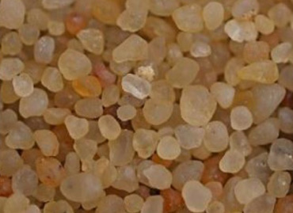
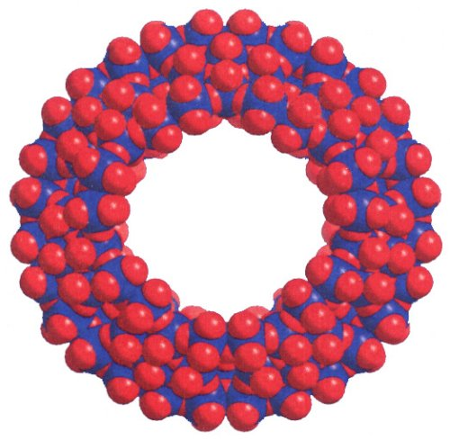
Optimizing the Sensitivity of Particulate Silica Quantification by Molybdenum Blue Absorbance Spectrometry
Emily Wagner*, Faculty Mentor: Dr. James Boulter*†
* Department of Chemistry & † Watershed Institute for Collaborative Environmental Studies
This research is supported by WiSys and UW System applied research funding programs (AR-WiTAG) and the UW-Eau Claire Office of Research and Sponsored Programs differential tuition funds (SREU and F/SRC grants). The views expressed herein are those of the authors and are not necessarily those of WiSys, UW-Eau Cliare, or UW System.
Introduction and Motivation
Factors Considered to Increase Analysis Sensitivity
We are seeking to design an instrument to quantify trace amounts of ultrafine airborne silica-containing particles in situ, using a novel yet robust chemical analysis technique. In this work, we seek to optimize a number of key variables influencing the chemical reactivity of silica, including pH, chemical additives, and reaction wait time. The aim is to enhance sensitivity and consistency of the analysis before designing and constructing the instrument. Eventually, we will also evaluate a range of chemical forms of silica to quantify their sensitivity, linearity, and limit of detection.
The Occupational Safety and Health Administration (OSHA) has recently proposed lower limits for airborne silica concentrations in industrial settings to reduce of a wide variety of severe health issues such as silicosis. [1] Existing methods for determining silica concentration cannot provide immediate results, have higher detection limits, or rely on filter collection with offsite analysis. [2]
Based on preliminary research results and the work of Fujiwara et al. [3], we estimate that the proposed analytical approach and instrument design will have a limit of detection of the order of 5 μg/m³. This limit compares favorably to the newly proposed OSHA personal exposure limit of 100 μg/m³, the 10-hour weighted NIOSH standard of 50 μg/m³, and the 8-hour weighted ACGIH standard of 25 μg/m³. [2]
Initial pH of Silica Suspension
The optimum initial pH (before addition of molybdate) for the dissolution of silica to form HPA is approx. pH 10
This may be due to the balance between enhanced silica solubility at high pH and the optimal (low) pH of the reaction to form HPA
As the acidic molybdate solution is added to the basic silica suspension to initiate the reaction, the initial solution pH quickly falls to approx. pH 1-2 for the formation of heteropoly blue.
Ionic Strength Adjustment and Addition of EDTA
It was initially believed that EDTA would increase analytical sensitivity due to how it chelates metals in solution, enhancing dissolution.
After multiple trials were carried out, it was observed that the absorbance at 820 nm decreased as more EDTA that was added to solution.
Ionic strength adjustment was also explored to see if higher ionic strength would increase silica dissolution.
Sodium Chloride was added to silica solution to see if absorbance would increase. This additive also proved to be ineffective.
Addition of Fluoride
Because hydrofluoric acid can dissolve silica, sodium fluoride was tested as an additive to increase analytical sensitivity.
~10 ppm F– was added to the silica suspension along with the acidic molybdate reactant at a highly acidic pH of 1 – 2.
After testing various amounts of fluoride in silica solution, it was observed that fluoride had no significant positive effect on absorbance. There may be a weak inhibiting effect for a range of reaction times from 30 to 50 minutes.
Conclusions and Future Work
Next steps…
In collaboration with WiSys a provisional patent has been filed for an instrument design utilizing a chemically similar analysis.
We have received an AR/WiTAG grant to build a prototype of this instrument and evaluate its analysis sensitivity to the respirable fraction of airborne particulate silica.
Contact Dr. Boulter if you are interested in working on this project.
Method and Objectives
A sample containing a known amount of silica (SiO₂) (Aldrich) in aqueous suspension is combined with an acidic molybdate solution to form heteropoly acid (HPA) over time. These compounds have been studied for decades [4].
The HPA is reduced for a specific time period by 1-amino-2-naphthol-4-sulfonic acid, which converts the HPA to the heteropoly blue complex, a compound with a very high absorption cross section.
Solutions are analyzed via visible absorption spectroscopy at 820 nm [5] to determine the amount of heteropoly blue and referenced to the amount of silica added initially.
All reactions are done in plastic to minimize any interferences from glassware; because no glass is used, all measurements are based on mass, not volume of solutions.
To maximize analysis sensitivity, we examined a range of factors and additives to optimize the reaction conditions in the conversion of silica to heteropoly blue and its visible absorbance.
Summary of Optimized Reaction Conditions and Conclusions
Analytical sensitivity is highest for aqueous suspensions of silica at pH 11 (previous work).
Additives such as ionic strength, EDTA and fluoride have no positive effect on analytical sensitivity.
Optimal reaction times for the analysis are: 15 minutes following addition of molybdate solution and 45 minutes after reductant is added (experimental studies not shown).
There is a consistent, positive correlation between silica concentration in solution and visible absorbance at 820 nm by the compound heteropoly blue.
We have optimized the reaction conditions to convert silica to heteropoly blue and maximize the analysis sensitivity of the procedure.
Works Cited
[1] Department of Labor, Occupational Safety and Health Administration, Occupational Exposure to Respirable Crystalline Silica, vol. 78, 2013, pp. 56274-56504.
[2] R. Key-Schwartz, P. Baron, D. Bartley, F. Rice and P. Schlecht, "Determination of Airborne Crystalline Silica," in NIOSH Manual of Analytical Methods, National Institute of Occupational Safety and Health, 2003, pp. 260-280.
[3] T. Fujiwara, K. Kurahashi, T. Kumamaru and S. H. , "Luminol Chemiluminescence with Heteropoly Acids and its Application to the Determination of Arsenate, Germanate, Phosphate and Silicate by Ion Chromatography," Applied Organometallic Chemistry, vol. 10, pp. 675-681, 1996.
[4] J. Woods and M. Mellon, "The Molybdenum Blue Reaction: A Spectroscopic Study," Industrial and Engineering Chemistry, vol. 13, no. 11, pp. 760-764, 1941.
[5] D. Boltz and M. Mellon, "Determination of Phosphorous, Germanium, Silicon, and Arsenic by the Heteropoly Blue Method," Analytical Chemistry, vol. 19, no. 11, pp. 873-877, 1947.

