Slide 1
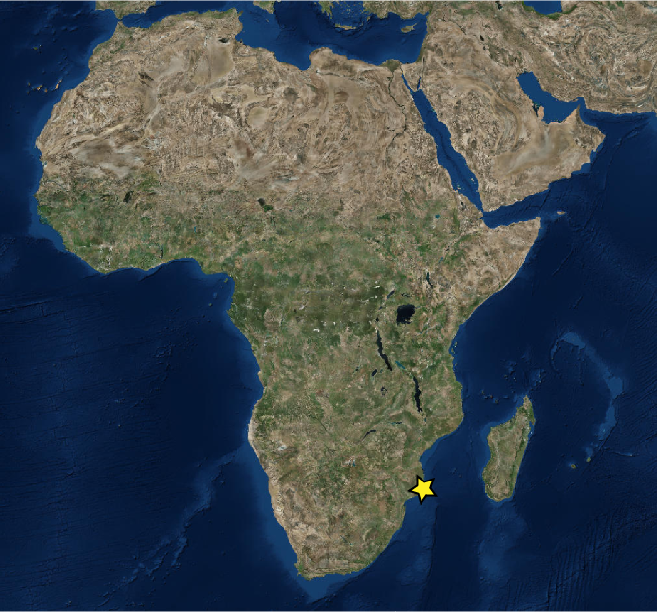
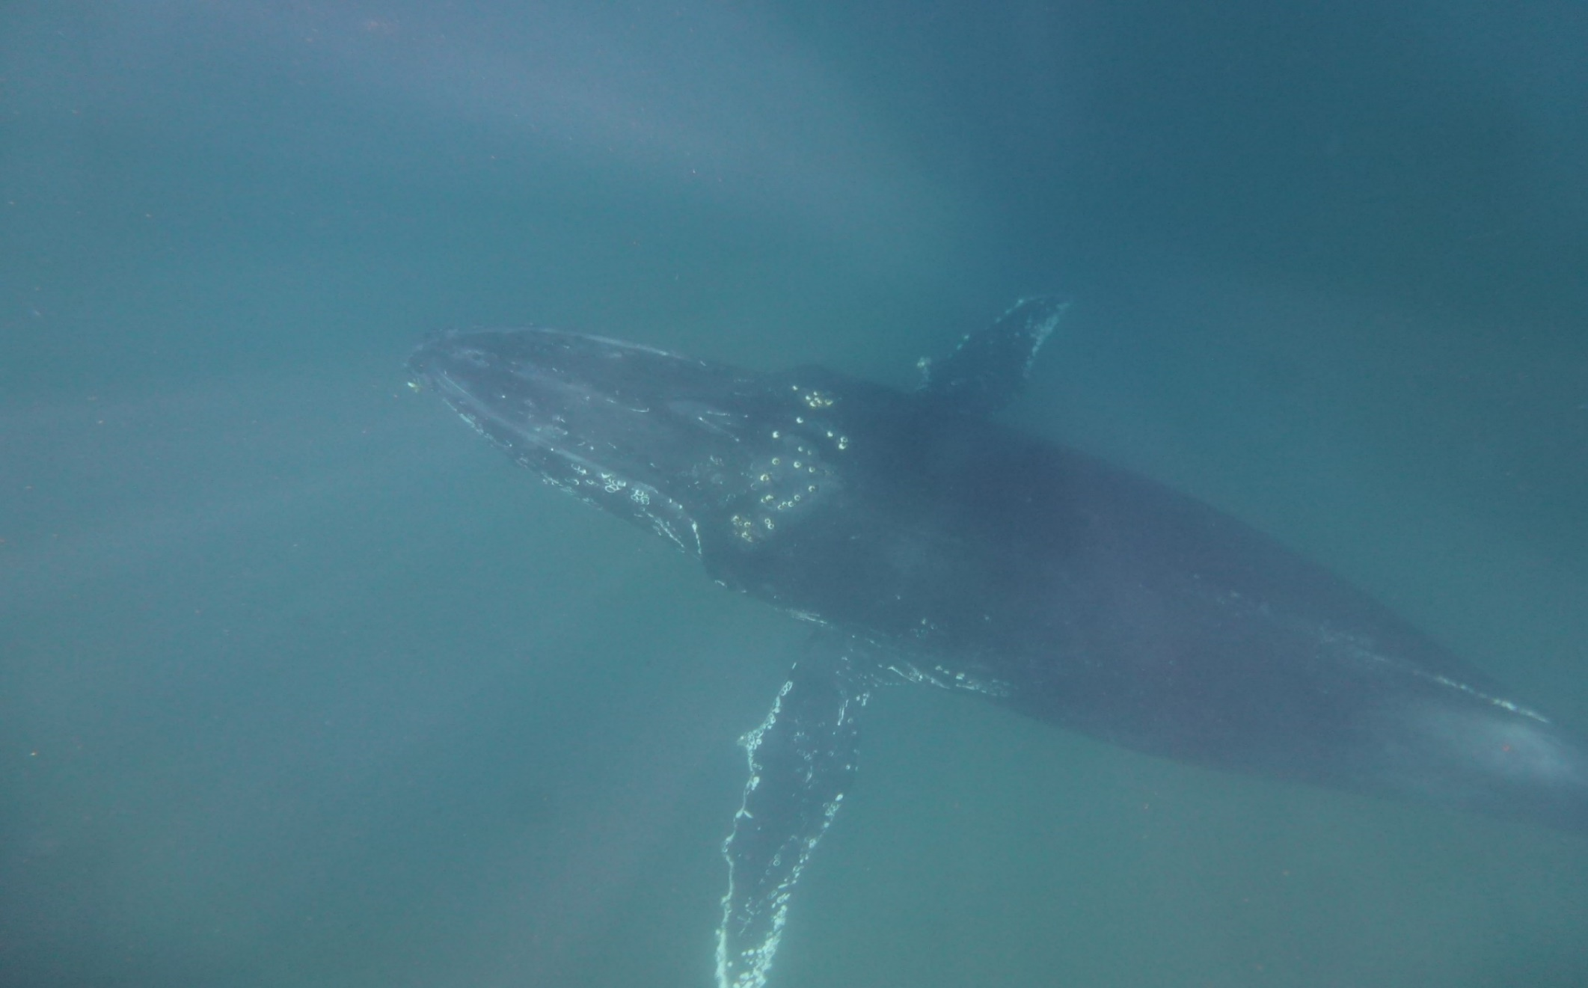
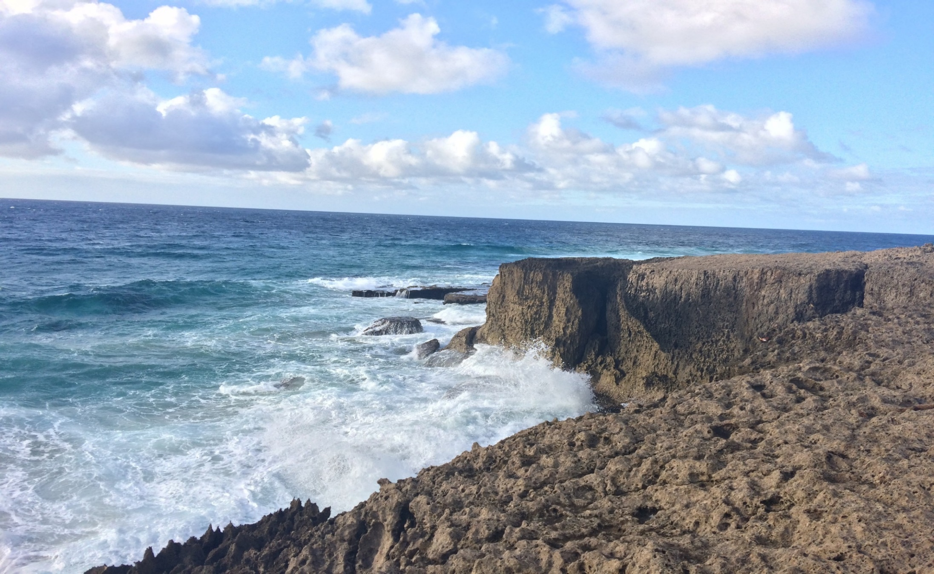
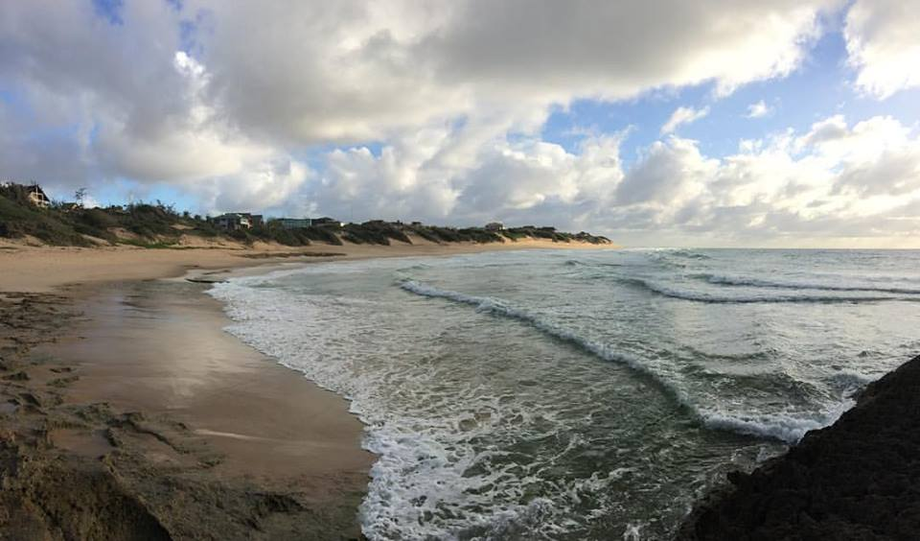
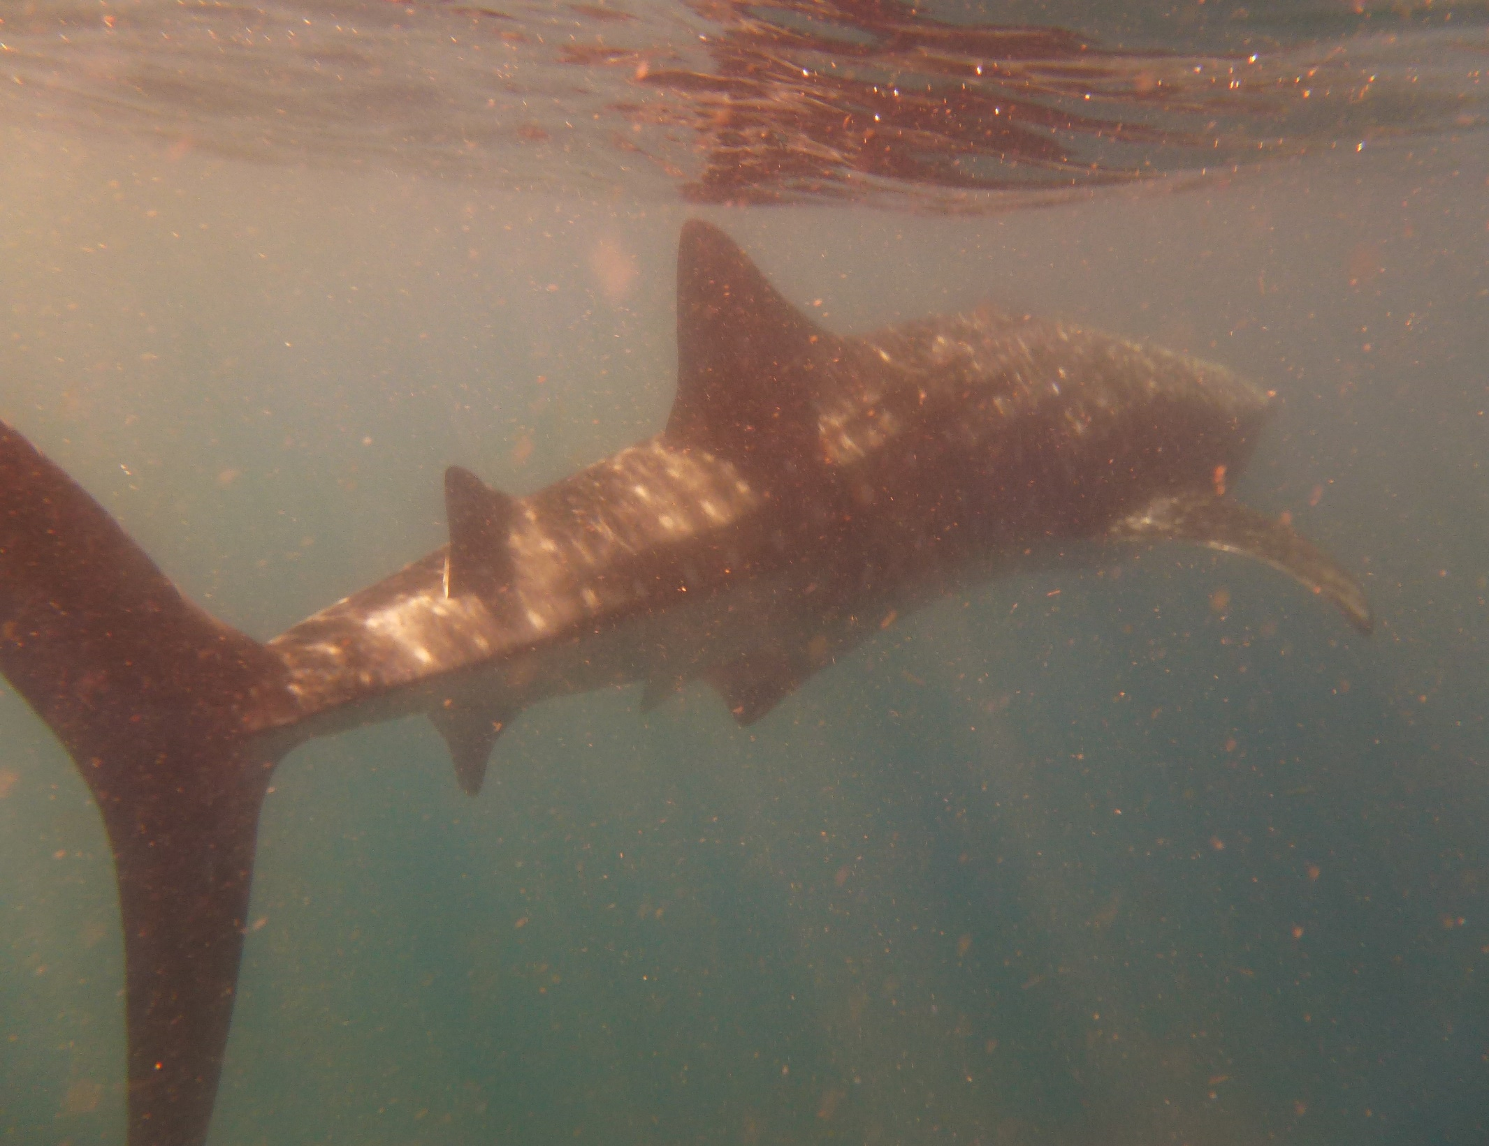
Tourism and Support for Marine Conservation in Tofo, Mozambique
Kyle Salek, Dept. of Geography, Katie Reeve-Arnold, Director of Marine Research and Conservation, All Out Africa, & Dr. Karen Mumford, Faculty Mentor, Watershed Institute
Introduction
Results
Discussion
A pilot survey of tourists visiting Tofo, Mozambique was conducted between July 10-31, 2017 to identify the types of activities tourists engaged in and their level of support for marine conservation. The survey was developed and completed in collaboration with All Out Africa, a consortium of organizations that provide volunteer, internship and tourism experiences.
By learning about the activities of tourists and their level of support for marine conservation in Tofo, steps can be identified to engage the local community and the tourism industry in the adoption of sustainable tourism practices.
Respondents
Tourists are spending money on local food and lodging. They appear to have varied interests and reasons for coming to Tofo, implying a multi-layered foundation for tourism. They also show very strong support for a Marine Protected Area and indicated a willingness to pay into the program.
Tourism in Mozambique is rising, including in Tofo specifically. Projections suggest a sharp rise in tourism and tourism related spending, therefore Marine Protected Areas need to be established soon to be effective. An MPA is necessary as the region’s unique marine wildlife are a significant part of why tourists are attracted to the area.
Interest in local food and culture suggests investments should be made to protect and support local cultural experiences in addition to the marine experience. There is emerging potential for eco-tourism in Tofo, however, a tourism industry cannot succeed without sufficient infrastructure and growth in supporting areas. Given tourism projections, policies to create an MPA are critical, and complimentary strategies to expand cultural experiences will add to a more robust tourism industry. Additional studies will help support responsible tourism.
Of those who completed the survey, 55 percent were males and 45 percent were females. Respondents ranged in age from 19-54 years and represented 14 different countries.
Juvenile Humpback Whale encountered on an Ocean Safari
Expenditures
Although the greatest percentage of respondents reported daily food purchases of $16 or less (lowest expense category), more were willing to pay higher prices for accommodations (Figure 4).
Length of Stay and Activities
The majority of respondents indicated staying between one and five days in Tofo (Figure 2). When asked about the primary reason for visiting Tofo, the top three reasons were SCUBA, snorkeling, and visiting the beach (Figure 3).
A rocky shoreline south of Tofo
Methods
Given that tourists primarily came to Tofo to experience the beach, SCUBA and snorkel, it is not surprising that their favorite attractions were beach/surf and marine life. However, tourists were equally attracted to the food and local culture (Figure 5).
Interview surveys were conducted among English speaking adults 19 years of age or older in July 2017. Surveys included 22 questions and were completed within about 10 minutes.
Both closed- and open-ended survey questions were developed to gather: tourist demographic information, purpose and duration of visit, activities while in Tofo, spending, perceptions and level of interest in local culture, marine fauna, and supporting marine protected areas.
Survey data were then entered into an excel spreadsheet and analyzed using SPSS statistical software.
Tofino Beach, south of Tofo
Limitations
Convenience sampling was used, and therefore the results are not generalizable to the broader population of tourists. In addition, the sample size is small. Data were collected during the winter season which is the low season for tourism. Future surveys need to be conducted across all seasons to account for variations in tourist demographics and behaviors.
Support for a Marine Protected Area
Support for a Marine Protected Area (MPA) in Tofo, Mozambique was very strong. In addition, nearly three-quarters of respondents were willing to pay $10 (USD) or more to support an MPA (Figures 6 and 7).
References
African Development Bank, New York University, Africa House, Africa Travel Association. Tourism Data for Africa, Tourism Country Profile http://tourismdataforafrica.org/ruiegwd/tourism-country-profile?Region=Mozambique Date Accessed April 9, 2018
ESRI, Geographics, CNES/Airbus DS, USDA, USGS, AeroGRID, IGN, and the GIS User Community. “World Imagery.” Scale Not Given.
Knoema. International Tourism, Number of Arrivals https://knoema.com/atlas/Mozambique/topics/Tourism/Inbound-Tourism-Indicators/Arrivals Date accessed April 9,2018
World Bank. International Tourism Data https://data.worldbank.org/indicator/ST.INT.ARVL Accessed
April 9, 2018
Whale Shark encountered on an Ocean Safari

