Slide 1


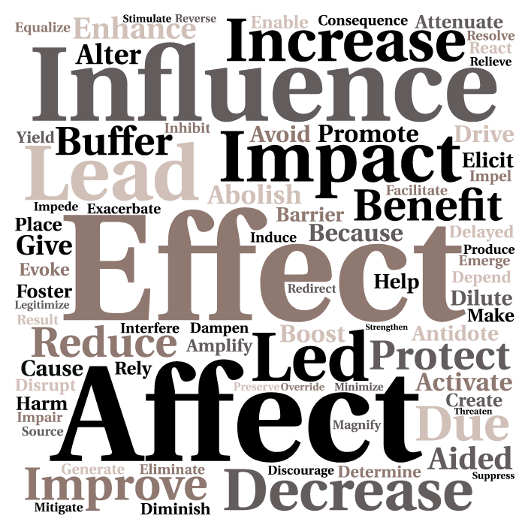
Spin:
Psychological Scientists Use Causal Language
to Describe Non-Causal Data
Michaela Gunseor
Mentor: April Bleske-Rechek  Psychology Department
Overview and Method
Results
Discussion
Journalists are often chided for misrepresenting correlational findings as causal.¹ However, researchers have shown that misrepresentation of scientific findings does not always start with the media, but instead can often be traced back to press releases^{2,3} and even the scientists’ own descriptions of their work.^{4,5}
Misrepresentation of data, or “spin,” comes in various forms and can be intentional or unintentional.^{6,7} One of the most prevalent forms of spin involves misleading interpretation – specifically, making causal claims that are not supported by the findings or research design.⁵ Researchers in the allied health disciplines,^{8,9,10} education,¹¹ and counseling¹² have voiced concern about unjustified causal claims and have encouraged researchers to match the language they use in their reports to the specific type of study they have conducted.¹³
Research Aim:
Here, we investigate the frequency with which scientists in psychology use unwarranted causal language in scholarly descriptions of their work.
In Study 1, we reviewed 660 accepted poster submissions from the 2015 Association for Psychological Science (APS) convention program.
In Study 2, we reviewed 651 empirical articles, most of them published in 2016, that were taken from 11 peer-reviewed journals that vary in subject area and impact factor:
Personal Relationships (PR)
Journal of Psychology: Interdisciplinary and Applied (JPIA)
Sex Roles (SR)
Social Psychology Quarterly (SPQ)
Personality and Individual Differences (PAID)
Journal of Sport and Exercise Psychology (JSEP)
Journal of Youth and Adolescence (JYA)
Journal of Consulting and Clinical Psychology (JCCP)
Journal of Personality and Social Psychology (JPSP)
Clinical Psychological Science (CPS)
Psychological Science (PS)
Procedure:
We followed the same general protocol for both studies. For each document, we recorded identifying information (e.g., title, authors). We then coded each document for use of causal language; if causal language was present, we recorded the specific words used and coded whether the language was warranted by the research design.
Coding Rules:
We established coding rules for two primary elements:
1. Inclusion of Causal Language
The document was coded as including causal language if it contained direct causal language¹⁴ (e.g., influence, produce) that was used to describe the primary study’s results.
The document was coded as not including causal language if there was no causal language, or if the causal language in the document was uncertain, posed in the form of a question, used to describe the rationale for the current study, etc.
2. Warranted Use of Causal Language
Causal language was coded as warranted if the study design allowed for causal inferences and the causal language pertained to the manipulated variable.
Causal language was coded as unwarranted if the study design did not allow for causal inferences (e.g., pre-post design without a comparison group) or the casual language pertained to a participant variable.
*For a full description of the coding rules, please see the supplementary handout.
Study 1:
660 APS Poster Submissions
Study 2:
651 Journal Articles
We have documented what we consider to be an alarming rate of unwarranted causal language in psychological scientists’ scholarly presentations and journal articles: In both poster submissions and peer-reviewed journal articles, about one-half of those that included causal language did not involve a research design that warranted the language causal.
Our values are likely conservative estimates of the frequency with which unwarranted causal language occurs, because we maintained conservative standards for classifying language as unwarranted. Specifically, causal words used to describe statistical patterns (“main effect of gender on ratings”) were not coded as unwarranted, nor were causal words presented as uncertain (“gender might affect ratings”) or in questions (“does gender affect ratings?”). In addition, if the causal language was used as part of the study rationale or to describe potential implications of the study results, we allowed it.
On one hand, our findings are not necessarily surprising, because a similar rate of unwarranted causal language has been documented in other disciplines like medicine and nutrition science.^{8,9,10} On the other hand, our findings are surprising. The distinction between correlation and causation is a bedrock of training in psychology at both the undergraduate and graduate levels, and students receive explicit training on research designs that allow for and don’t allow for causal claims. Why, then, is unwarranted causal language occurring in psychology?
There are several possible explanations, and they are not mutually exclusive. First, perhaps there are conventions of language, or shorthand ways of describing results, that muddy the exact meaning of researchers’ findings when they are used. Second, perhaps some researchers do not fully understand the distinction between correlation and causation, the limited inferential power of non-causal research designs, or the difference between measured and manipulated variables (research does suggest that people, in general, have a difficult time grasping these ideas^{16,17}). Third, another possibility is that researchers understand the distinctions but intentionally exaggerate their findings or don’t apply the distinctions in the context of their own research – perhaps their own commitment to a certain perspective hinders careful interpretation and reporting. We are currently designing research that might help us distinguish among these possible explanations.
The findings were essentially identical for the sample of posters (at left) and the sample of peer-reviewed journal articles (at right). In both samples, over half of the documents that included causal language were coded as unwarranted in their use.
The word cloud below displays the many different words used in the two studies to represent causality.
52%
Causal Language Unwarranted
52%
Causal Language Unwarranted
59%
Used Causal Language
54%
Used Causal Language
48%
Causal Language Warranted
48%
Causal Language Warranted
41%
Did Not Use Causal Language
46%
Did Not Use Causal Language
The table to the right shows the percent of articles, by journal, that were coded as including unwarranted causal language. We intentionally selected journals that varied widely in impact factor. In this small sample of journals, impact factor was not related to use of causal language, r(10) = .13 [95% CI: -.51, .68], but impact factor was related to use of unwarranted causal language. That is, unwarranted causal language was less common in journals of a higher impact factor, r(10) = -.68 [95% CI: -.91, -.14]. Perhaps contributing authors, reviewers, and editors for these journals better understand the differences between correlational and causal language, have more stringent standards for research designs that allow for cause-and-effect inferences, or pay more explicit attention to the subtle differences in meaning portrayed by different words (e.g., “increases the risk” versus “show increased risk”).
Notably, however, the rate of unwarranted causal language was well above zero for all journals from which we sampled.
Causal Language (CL) in Peer-Reviewed Articles, by Journal
 |  |  | Clear CL in either Title or Abstract
Journal | Impact Factor¹⁵ | Number of Articles | Percent Using CL Language | Of Those Using CL Language, Percent that are Unwarranted
PR | 0.75 | 58 | 40% (23) | 65% (15 of 23)
JPIA | 0.88 | 60 | 50% (30) | 63% (19 of 30)
SR | 1.66 | 60 | 52% (31) | 84% (26 of 31)
SPQ | 2.00 | 57 | 75% (43) | 63% (27 of 43)
PAID | 2.17 | 58 | 41% (24) | 83% (20 of 24)
JSEP | 2.68 | 59 | 54% (32) | 34% (11 of 32)
JYA | 3.04 | 59 | 53% (31) | 87% (27 of 31)
JCCP | 4.53 | 60 | 72% (43) | 19% (8 of 43)
JPSP | 5.38 | 60 | 70% (42) | 31% (13 of 42)
CPS | 5.75 | 60 | 30% (18) | 44% (8 of 18)
PS | 5.85 | 60 | 55% (33) | 27% (9 of 33)
Overall |  | 651 | 54% (350) | 52% (183 of 350)
Select References
*For the complete set of references, please see the supplementary handout.
Yavchitz, A., Boutron, I., Bafeta, A., Marroun, I., Charles, P., Mantz, J., & Ravaud, P. (2012). Misrepresentation of randomized controlled trials in press releases and news coverage: A cohort study. PLOS Medicine, 9, e1001308.
Adams, R. C., Sumner, P., Stonkute, S., Williams, A., Boivin, K., Chambers, C., & Bott, L. (2017). How readers understand causal and correlational expressions used in news headlines. Journal of Experimental Psychology: Applied, 23, 1-14.
Sample Cases of Causal Language in Poster Submissions and Journal Articles
Example |  | Rating and Explanation
In Titles:
The Influence of Eldercare Arrangement Characteristics on Work Accommodations |  | Unwarranted: In the study, eldercare arrangement characteristics were measured, not manipulated.
Increasing Character Size and Length of Presentation Improves Both Accuracy and Reaction Time of a Dynamic Visual Acuity Task |  | warranted: In the study, stimuli character size and length of presentation were manipulated.
In Abstracts:
“…examined the influence of culture on emotional and neuroendocrine responses…” |  | Unwarranted: In this phrase, culture refers to a self-reported, measured cultural orientation (individualistic or collectivistic).
“…these responses to victims are not closely related and are affected in different ways by victim culpability and misfortune severity.” |  | Warranted: The study used vignettes about a house fire, in which the researchers manipulated their portrayal of the target victim’s culpability and extent of fire damage.
Acknowledgments
This research is supported by the Office of Research and Sponsored Programs at UWEC. We thank LTS for printing this poster and members of the IDEP lab for their feedback on the development of this project.
Notes:
Highlighted: Still not sure why “do not” is highlighted and underlined
In the discussion I think it should say “correlational and causal language”
I feel good about the lines and box spacing, but if you could take a second look that would be great!
I doubled checked all of the numbers in the table.
Do you want the headings to be in Calibri instead of Century Gothic like the hindsight poster?
I shifted the table to be in the middle of the results box, do you like it better to the right where is was before?

