Slide 1

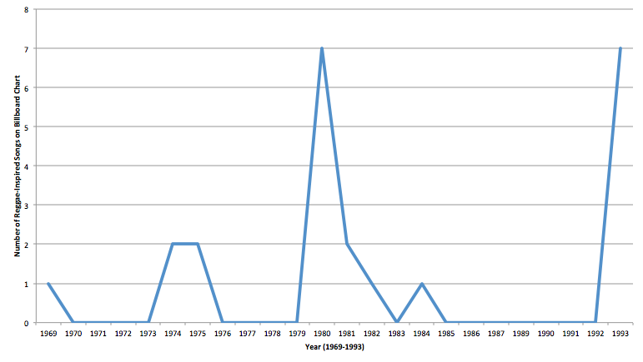
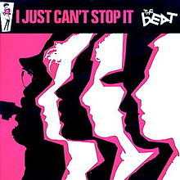
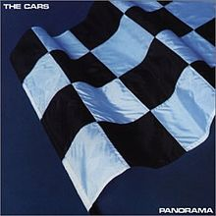

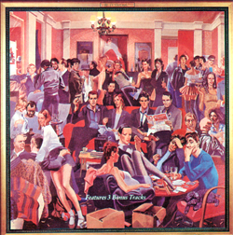
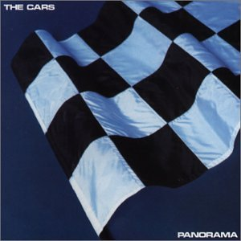
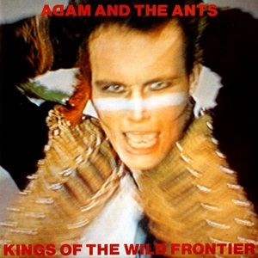


Reggae Infusions
Cataloging Mainstream Western Rock Appropriations of Jamaican Popular Music
Colleen Doubleday & Dr. Ryan Jones | Music and Theatre Arts, University of Wisconsin - Eau Claire
Project Goals
Through a detailed evaluation of source materials, this research project sought to document mainstream pop tunes that featured a reggae influence between the years of 1970-1990. Using The Police (band) as a model, this process attempted to identify other artists that used reggae characteristics during this time period to increase popularity of their songs and albums and capitalize upon this style. In order to create this discography, it was essential to measure the popularity of the songs in question. Most sources were found through a focused search of Billboard chart archives in categories such as: Pop, Adult Contemporary, and Rock. After reviewing the Billboard chart archives, an assessment was made based on general reggae characteristics. Potential sources were cataloged into a final discography of additional artists using significant reggae characteristics at this time.
Men at Work – Business as Usual (1981)
Defining Reggae Traits
Reggae as a musical style draws roots from Jamaican traditions and features several defining characteristics. Musically, reggae generally includes a strong, driving baseline, anticipatory off beats, and generally slow tempo. When searching for these characteristics, observations included the type and frequency of reggae characteristics. Most songs added to this discography included at least three of the above mentioned characteristics.
I Just Can’t Stop It – The Beat (1980)
Note: from 1979-1983, The Police added 15 additional reggae-inspired songs to the above data. See table below for more information.
Findings
General Trends
Implications of Popularity
Numerous additional sources assisted in the compilation of this discography. Detailed research showed that trends pointed toward a dramatic increase of reggae-inspired songs landing on the Billboard chart in the year 1980. Before and after this time, artists using the above mentioned technique showed increased popularity. Some did place on charts as early as 1969, however others did not place at all. Over time this trend once disappeared, only to resurface with additional tracks in 1993. Additional artists at this time continued to use reggae characteristics in their released music, but these songs did not register on Billboard’s charts. From research findings it is apparent that artists outside of The Police were using reggae characteristics to increase popularity of their songs as albums and songs featuring reggae-influenced songs charted generally well (example: Men At Work’s reggae-influenced tracks on Business as Usual charted at or near #1).
The fact that numerous artists were using reggae traits to make their music more commercially successful suggests telling trends of cultural appropriation. This research demonstrates that none of the successful bands actively marketed themselves as reggae bands, or had any direct ties to Jamaica. These conclusions also raise ethical concerns about ownership of musical style (or characteristics), and the authenticity of reggae-inspired tracks. Often, artists even chose to add additional reggae tracks to non-reggae albums to increase the popularity of an album – and ultimately to make more money. The use of a non-dominant culture’s musical style by a dominant culture for financial gain lies at the core of any investigation into musical style and its uses in mainstream Western pop music.
Panorama – The Cars (1980)
Validity of Billboard Charts
The Police
The Billboard association started publishing its “Hot 100” weekly since early August 1958. This chart chronicles the most popular 100 songs in the US during any given week. Data was collected from all radio stations playing current music, compiling a list of the 100 most popular songs in the US each week (calculated by factoring most-played and most-purchased tracks). The list is postdated to the following Saturday. Musical trends collected in this list are often reflected in the most popular songs for the following weeks or months. The Hot 100 archives were chosen as a primary research source for this project due to their far-reaching data pool and extensive archives.
As a mainstream pop group, The Police were active from 1977-1986. This group was the inspiration for this research because they were arguably the most popular and commercially successful group using reggae-inspired characteristics in their music. Police songs featuring reggae traits include ‘Roxanne,’ which reached #32 on Billboard’s Hot 100 in 1978, and ‘Don’t Stand So Close to Me,’ which reached #10 on Billboard’s Hot 100 in 1981.
May 1980: The Beat releases I Just Can’t Stop It featuring numerous reggae-inspired tracks. This album reaches 142 on the Billboard Hot 200 list.
December 1980: The Ruts release ‘Love in Vain’ on Grin and Bear It.
Police Album | Reggae-Inspired Songs
Outlandos d’Amour (1978) | 5
Regatta de Blanc (1979) | 4
Zenyatta Mondatta (1980) | 4
Ghost in the Machine (1981) | 2
Synchronicity (1982) | 0
1979
1980
September 1979: The Ruts release ‘Jah War’ on the album The Crack
August 25, 1980: The Cars release ‘Touch and Go’ on the album Panorama reaching 37 on the Billboard Hot 100.
November 3, 1980: Adam and the Ants release ‘Antmusic’ featuring reggae traits.
1981
November 9, 1981: Men at Work release Business as Usual featuring 3 reggae-inspired tracks that chart in the top 3 of Billboard’s Hot 100.
Notes:
Validity of Billboard Charts: The Billboard association started publishing its “Hot 100” weekly since early August 1958. This chart chronicles the most popular 100 songs in the US during any given week. Data is, and has been, collected from all radio stations playing current music. The data collected complies a list of the 100 most popular songs in the country each week (calculated by factoring in most-played and most-purchased tracks), and the list is generally postdated to the following Saturday (the Hot 100’s release day). Musical trends collected in this list are often reflected in the most popular songs for the following weeks or months. The Hot 100 archives were chosen as a primary research source for this project due to their far-reaching data pool, and extensive archives. Because this research sought to explore popular music during the designated time period, and to chart the popularity of reggae-inspired rock music, Billboard’s Hot 100 served as a timeline to accurately account for popular music during this time period.
Source: https://www.npr.org/sections/the record/2013/08/16/207879695/how-the-hot-100-became-americas-hit-barometer
Source: https://www.billboard.com/articles/columns/chart-beat/8071011/billboard-chart-magazine-dates-release-week-change
General Trends: Eight additional sources were found to add to this discography. Detailed research showed that trends pointed toward a dramatic increase of reggae-inspired songs landing on the Billboard chart in the year 1980. Before and after this time, artists using the above mentioned technique showed increased popularity. Some did place on charts as early as 1969, however others did not place at all. Over time this trend once again decreased, leveling out by 1993, however additional artists at this time continued to use reggae characteristics in their released music, but these songs place on Billboard’s charting system. From research findings it is apparent that artists outside of The Police were using reggae characteristics to increase popularity of their songs as albums and songs featuring reggae-influenced songs charted generally well (example: Men At Work’s reggae-influenced tracks on “Business as Usual” charted at or near #1).
Actual Abstract: This project researches and compiles an annotated discography of all mainstream Western popular music recordings that used or referenced reggae music stylistic traits from approximately 1970 to 1990. Annotations will include information regarding the artist or group, the nature of reggae usage within the tune in question, and the Billboard charts ranking associated with the tune. The research this project compiles will directly aid examining and questioning one of the many important and prominent stylistic cross-pollinations in modern popular music—the influence of Jamaican reggae upon mainstream rock composition, performance, marketing, and, ultimately, financial success. At its core, the significance of this larger investigation will consider the implications behind cultural and racial appropriation itself—in this case, the borrowing or adaptation of a Third World musical style by a Western music industry and the extent to which that borrowing refashions or changes the original source material (or its original aims) to suit its own agenda. The research process will begin by surveying first the definitive traits of reggae style and then canvasing the popular music charts of the decades under investigation for intentional crossover or intersection with reggae idioms by groups or artists hailing from places other than Jamaica.

