Slide 1
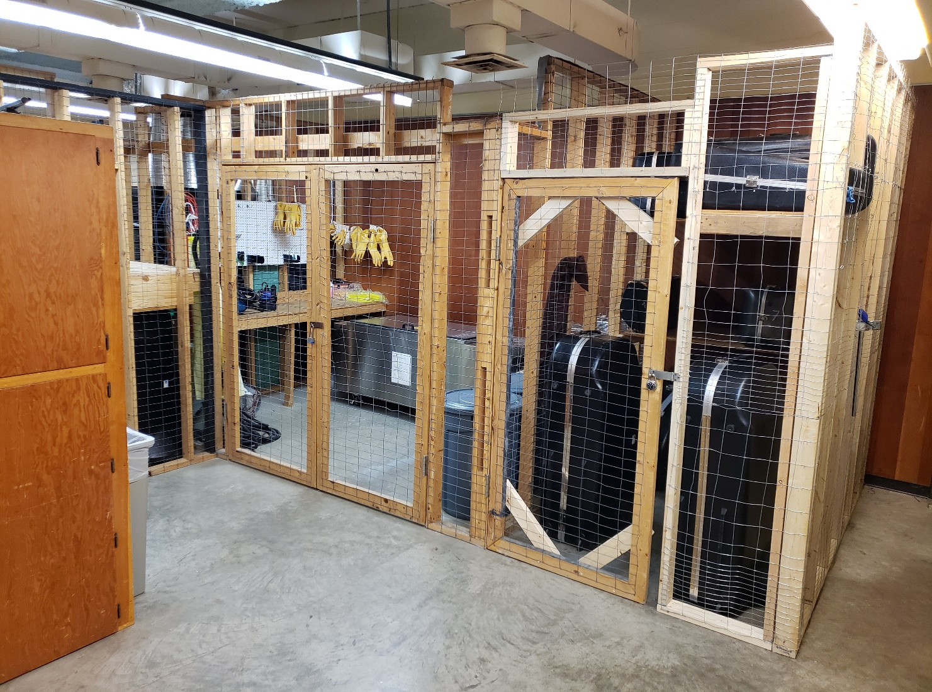
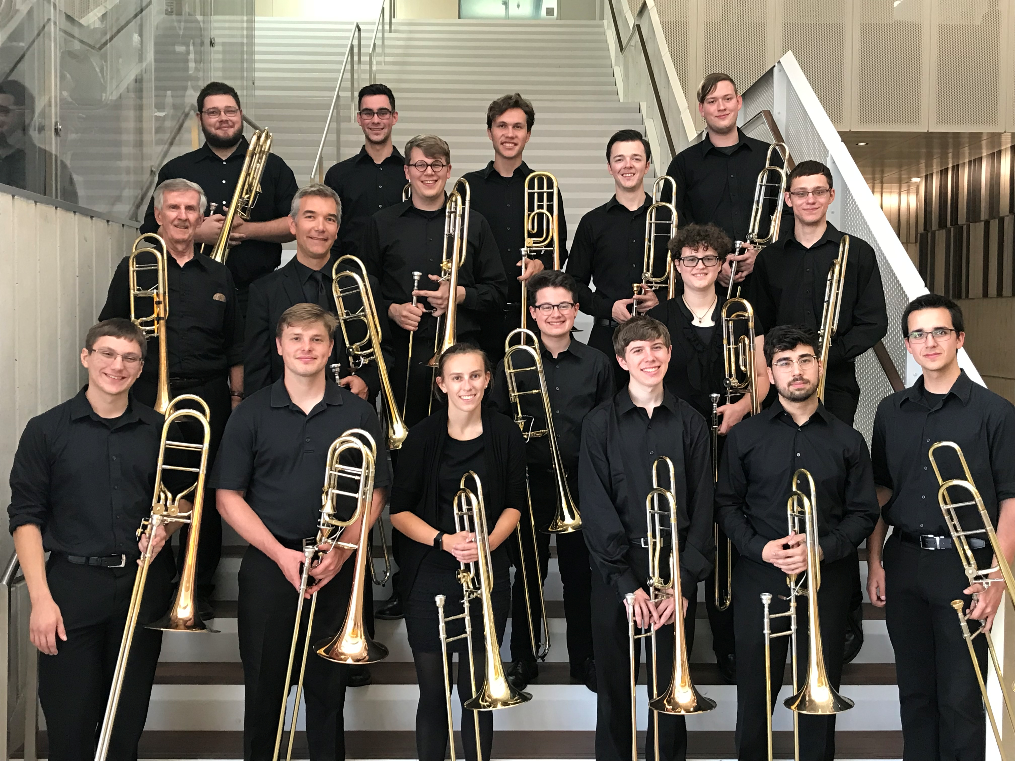
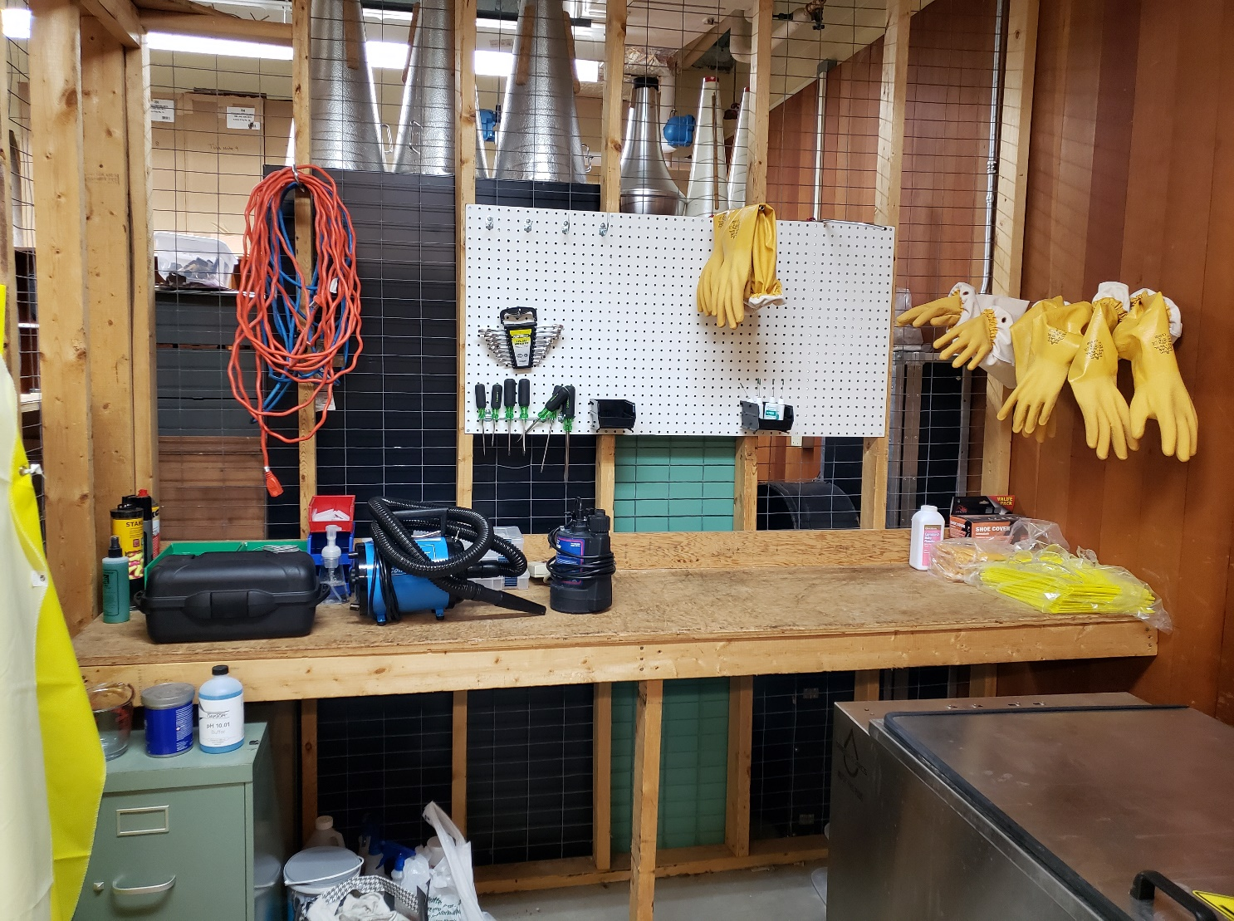
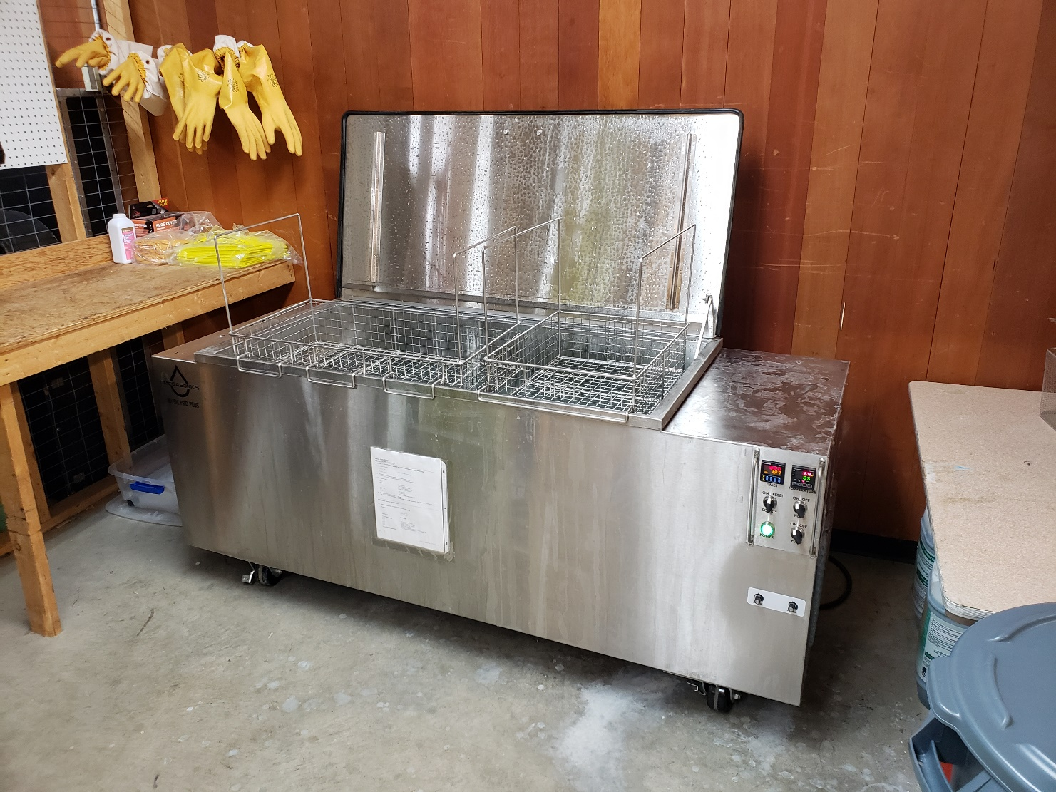
Creating an Instrument Maintenance Shop + Arranging Music From Diverse Sources
Leo C. Johnson, Dr. Phil Ostrander | Music & Theatre Arts | University of Wisconsin- Eau Claire
Introduction
The purpose of this project is twofold.
The first component was to create an economically and environmentally sustainable instrument maintenance and cleaning shop in Haas Fine Arts Center.
The second component involved developing music arrangement skills in order to expand the trombone ensemble repertoire in a more diverse direction.
Part One: The Shop
The workshop
PURPOSE
The music department at the university spends countless funds towards the upkeep of university-owned instruments, including professional level concert band equipment as well as specialized marching instruments for the Blugold Marching Band.
If we could cease outsourcing of this necessity to a third party and instead enable the department to conduct it right here at the university, this expense could be re-routed to more fruitful avenues in music education.
PROCESS
Workspace and related equipment
The project began with a setup of the workshop. As part of a total overhaul of the instrument room in Haas, a secure space was established to house the newly purchased Omegasonics Ultrasonic Instrument cleaner.
In previous years the standard for instrument maintenance involved chemical cleaning, producing hazardous waste that posed environmental damage through disposal. Recently however, Omegasonics produced a sustainable alternative utilizing recent technological advancements in the field. This is the machine that we are currently using.
UWEC Trombone Ensemble after performing at ITF
Part Two: Arranging
PURPOSE
CONCLUSION
Supersonic cleaner
It is no secret that the world of Western classical music is lacking in terms of diversity, and this is especially true of the composers who are most frequently programmed today. This is an issue that is starting to become acknowledged and addressed in many circles.
In an effort to contribute to this diversification effort, Dr. Ostrander and I committed to introducing more repertoire from diverse sources to the world of the trombone ensemble through high-profile performances.
The arranging process produced a number of works arranged for trombone ensemble sourcing from underrepresented cultures in the tradition of Western classical music.
One of these pieces is an arrangement of mine, done on the piece Fire Dance composed by Valerie Coleman. Valerie Coleman is an African American flute performer and educator.
This arrangement is anticipated to be performed at next year’s Trombone Summit – an event held at UW- Eau Claire hosting trombone players from high schools and colleges from around the Midwest.
Another work is titled Three Spirituals for Trombone Ensemble. An arrangement of Dr. Ostrander’s, the piece features melodies originating from the musical tradition of African-American slaves.
This piece was performed at the 2018 International Trombone Festival held in Iowa City in July. This is the single largest trombone-centric event held worldwide, and the work featured Tony Baker, a renowned instructor at one of the world’s premiere music schools in North Texas.
Both of these works serve to bring exposure to cultures underrepresented in Western classical music.
The room also functions as a workspace and stores other necessary equipment procured with some assistance from Keith Hilson, an Eau Claire alum who now is a manager of Schmitt Music in Brooklyn Center, Minnesota.
Once the space was established, its proper use needed to be ensured. Dr. Ostrander, myself, and a group of other colleagues met with Greg Beckwith – a repair technician and instructor based in Red Wing, Minnesota.
Greg walked us through the machine operation and the multi-step cleaning process outlined below for each instrument.
CONCLUSION
The new shop and knowledge gained was put into use this past summer and the first round of instrument maintenance was successfully executed.
Creating a workshop that offers the opportunity for professional-grade instrument cleaning and maintenance allows saved funds to be put to better use.
In doing so, the university has addressed an economic and environmental issue in a sustainable manner.
This information will be passed on and create a new branch of educational opportunity in the department, providing valuable experience to students desiring to work in instrument maintenance.
The continued instrument maintenance is now a paid position being pursued by a student with interest in the field.
PROCESS
Throughout two summers, Dr. Ostrander and I conducted a process of score study and piece arrangement organized by increasing difficulty – beginning with choral works, easily translatable to trombone ensemble, and culminating with full wind band scores and choirs of other instruments.
This process enabled me to gain fundamental skills necessary for successful arrangement of music to other instrumentations.
Ultimately music from a variety of cultural backgrounds was studied and arranged for the trombone studio at UW- Eau Claire.
1. Disassembly
2. Pre-cleaning
3. Simple Green Industrial Degreaser soak
4. Rinse & snake
5. Supersonic cleaning
6. Rinse & snake
7. Reassembly & oiling

