Slide 1
AN INTERACTIVE HEALTH DATA SCIENCE PLATFORM FOR EXPLORATORY ANALYSIS OF HEALTH OUTCOMES – A CASE STUDY WITH COLON CANCER
Master’s Thesis
Hemanth Kumar Alapati
Advisor: Professor Jake Luo, Professor Mukul Goyal
University of Wisconsin-Milwaukee ​
College of Engineering & Applied Science

Slide 2
Agenda
Objectives
Data Description
Data processing
Solution Architecture
Feature Selection
Machine Learning Models
User Interface
Output
Colon cancer – Case study
Conclusion
Future scope

Slide 3
Objectives
Create a generic disease prediction platform
Accessible to broader user community
Flexibility to try multiple scenarios and methods
Case study on Colon cancer

Slide 4
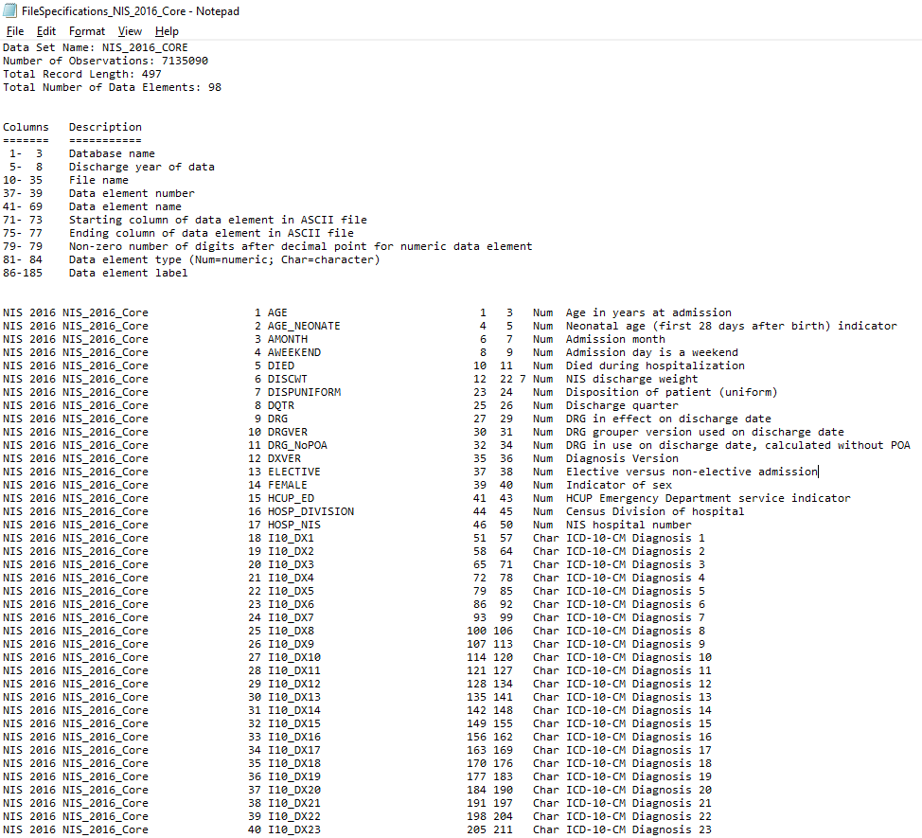
Data description

Slide 5
Data description
ICD10CM codes and description
Position | Length | Contents
1 | 5 | Order number, right justified, zero filled.
6 | 1 | Blank
7 | 7 | ICD-10-CM or ICD-10-PCS code. Dots are not included.
14 | 1 | Blank
15 | 1 | 0 if the code is a “header” –not valid for HIPAA-covered transactions. 1 if the code is valid for submission for HIPAA-covered transactions.
16 | 1 | Blank
17 | 60 | Short description
77 | 1 | Blank
78 | To end | Long description

Slide 6
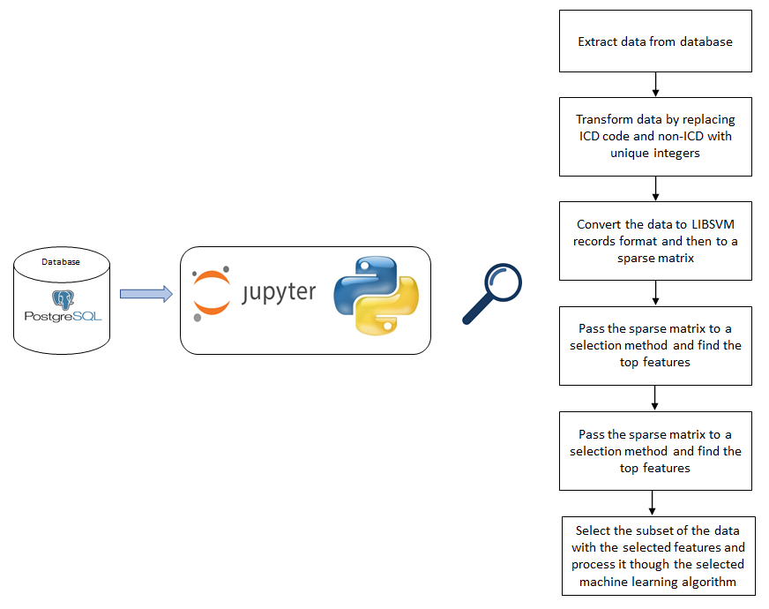
Data processing

Slide 7
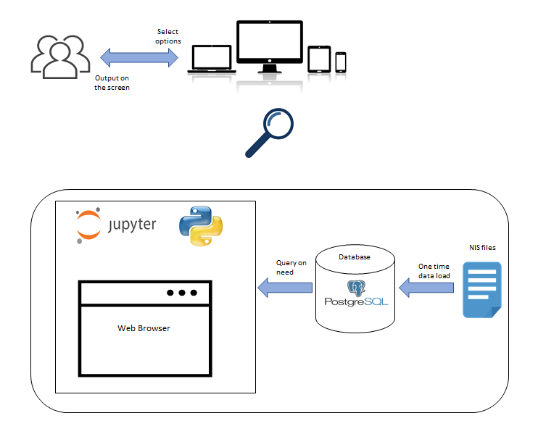
Solution Architecture

Slide 8
Feature Selection
Select K Best
Feature Importance

Slide 9
Machine Learning
Decision Tree
Logistic Regression
Random Forest

Slide 10
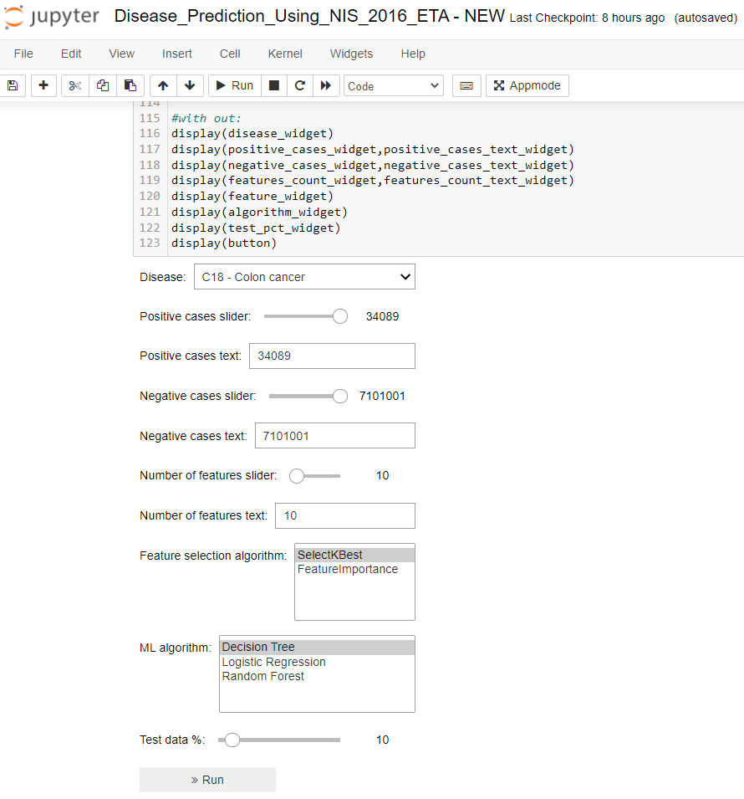
User Interface - ipywidgets

Slide 11
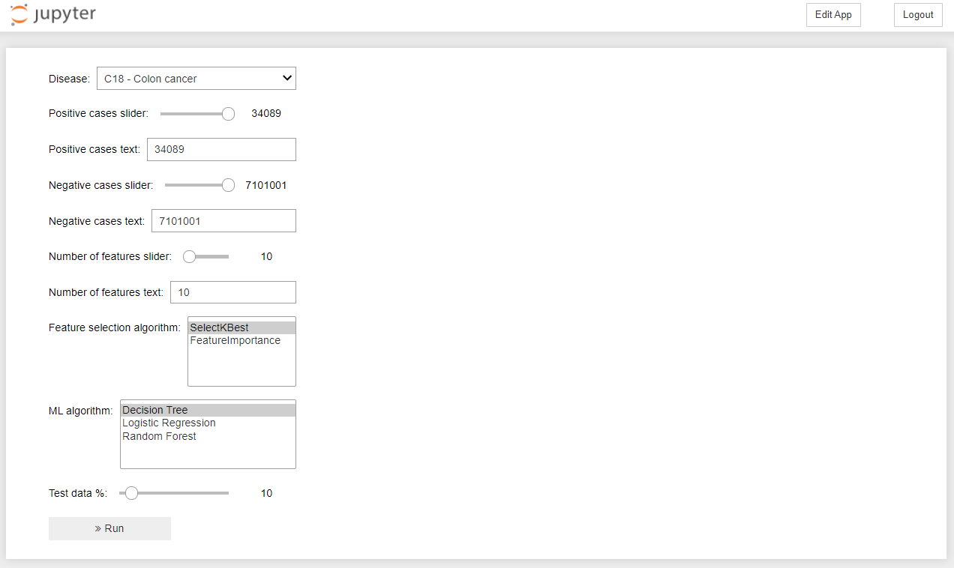
User Interface – AppMode view

Slide 12
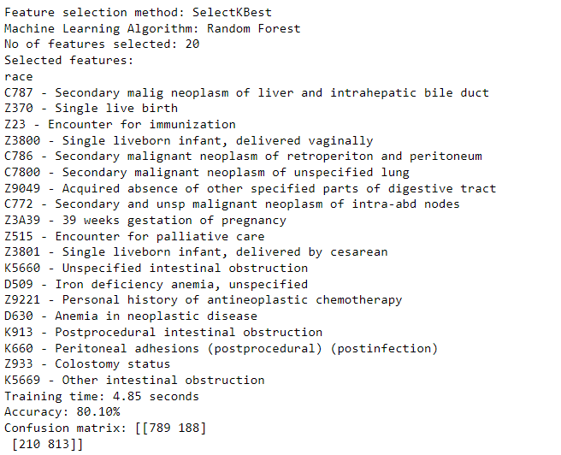
Output – Page 1

Slide 13
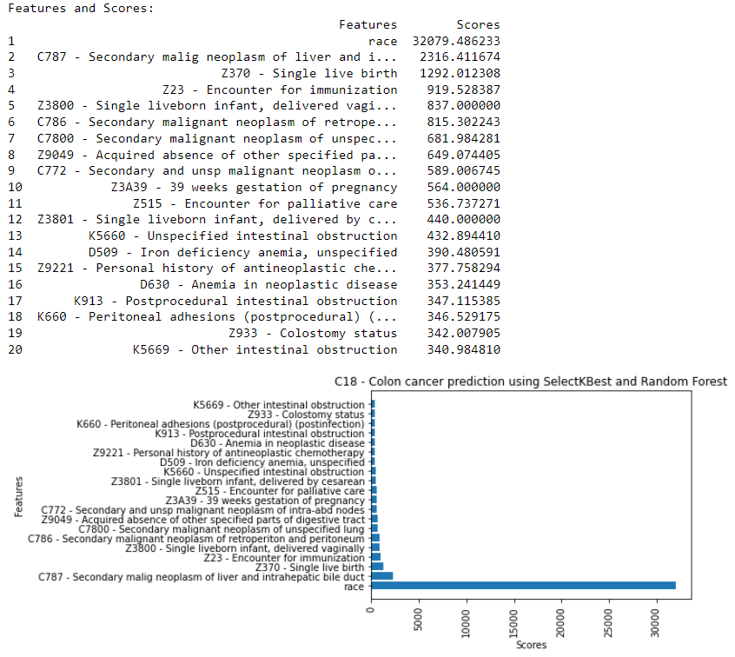
Output – Page 2

Slide 14
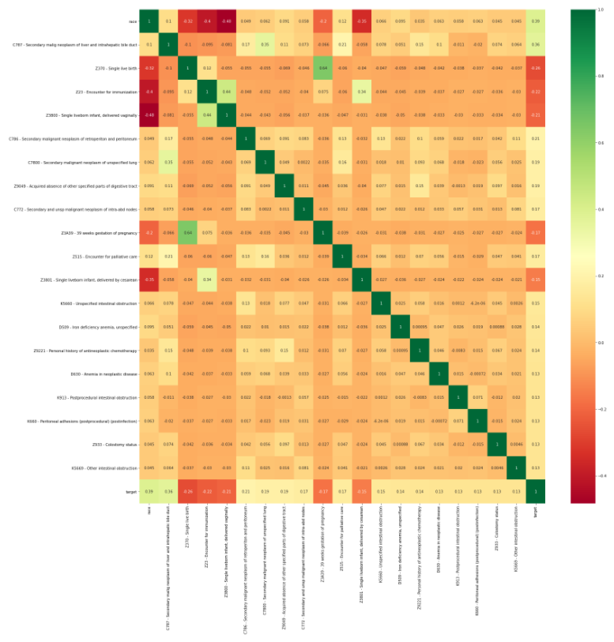
Output – Page 3

Slide 15
Case study – Colon cancer

Slide 16
Colon cancer - Feature selection using Select K Best with Chi²
No | Feature | Score
1 | race | 20481.787019
2 | C787 - Secondary malig neoplasm of liver and intrahepatic bile duct | 7986.015385
3 | C786 - Secondary malignant neoplasm of retroperiton and peritoneum | 6525.202963
4 | C772 - Secondary and unsp malignant neoplasm of intra-abd nodes | 6025.506305
5 | C7800 - Secondary malignant neoplasm of unspecified lung | 3688.020718
6 | D630 - Anemia in neoplastic disease | 3428.428736
7 | K5669 - Other intestinal obstruction | 3042.813102
8 | K913 - Postprocedural intestinal obstruction | 2879.670609
9 | K5660 - Unspecified intestinal obstruction | 2854.102364
10 | Z370 - Single live birth | 2849.583594
11 | Z9049 - Acquired absence of other specified parts of digestive tract | 2782.868982
12 | K660 - Peritoneal adhesions (postprocedural) (postinfection) | 2756.720466
13 | Z933 - Colostomy status | 2697.030743
14 | D500 - Iron deficiency anemia secondary to blood loss (chronic) | 2628.255751
15 | Z800 - Family history of malignant neoplasm of digestive organs | 2296.386377
16 | G893 - Neoplasm related pain (acute) (chronic) | 2165.093978
17 | Z515 - Encounter for palliative care | 2144.598389
18 | T451X5A - Adverse effect of antineoplastic and immunosup drugs, init | 2104.356476
19 | D509 - Iron deficiency anemia, unspecified | 2011.939061
20 | Z9221 - Personal history of antineoplastic chemotherapy | 20481.787019

Slide 17
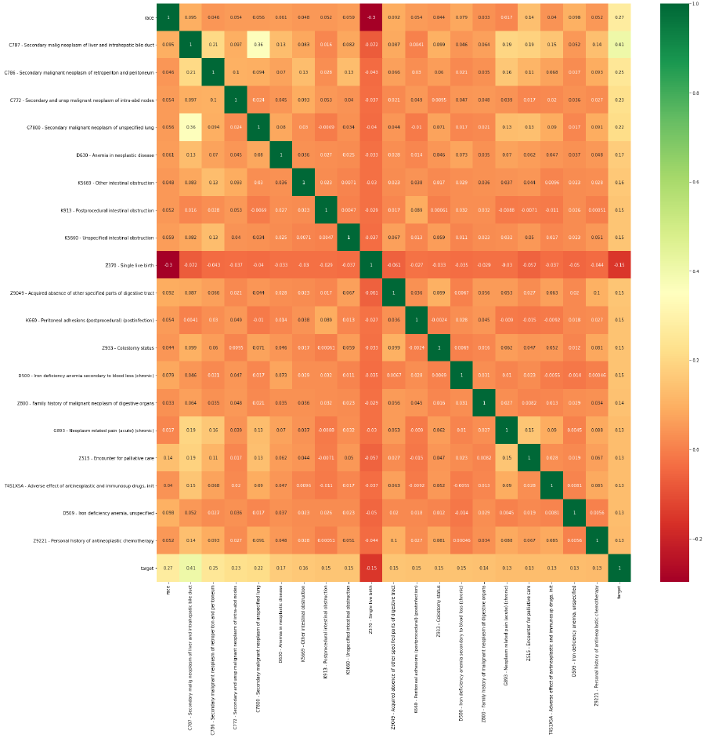
Colon cancer - Feature selection using Select K Best with Chi²

Slide 18
Colon cancer – Feature selection using Feature Importance
No | Feature | Score
1 | C787 - Secondary malig neoplasm of liver and intrahepatic bile duct | 0.067829
2 | race | 0.033172
3 | C772 - Secondary and unsp malignant neoplasm of intra-abd nodes | 0.022952
4 | C786 - Secondary malignant neoplasm of retroperiton and peritoneum | 0.020745
5 | C7800 - Secondary malignant neoplasm of unspecified lung | 0.014536
6 | female | 0.012065
7 | K660 - Peritoneal adhesions (postprocedural) (postinfection) | 0.010818
8 | K913 - Postprocedural intestinal obstruction | 0.009963
9 | D630 - Anemia in neoplastic disease | 0.009318
10 | K5669 - Other intestinal obstruction | 0.008566
11 | Z9049 - Acquired absence of other specified parts of digestive tract | 0.008354
12 | Z933 - Colostomy status | 0.008087
13 | Z800 - Family history of malignant neoplasm of digestive organs | 0.007681
14 | D500 - Iron deficiency anemia secondary to blood loss (chronic) | 0.007513
15 | K5660 - Unspecified intestinal obstruction | 0.007428
16 | D509 - Iron deficiency anemia, unspecified | 0.007115
17 | age | 0.006702
18 | K567 - Ileus, unspecified | 0.006696
19 | I10 - Essential (primary) hypertension | 0.006410
20 | Z370 - Single live birth | 0.005775

Slide 19
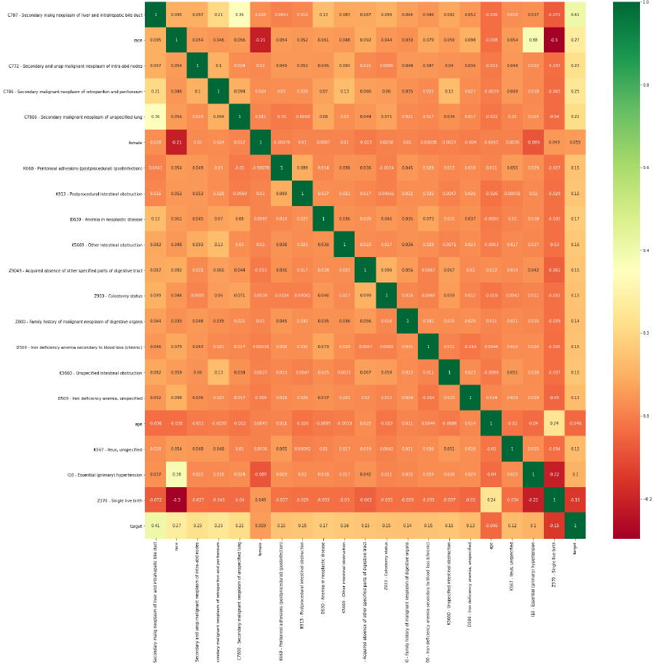
Colon cancer – Feature selection using Feature Importance

Slide 20
Colon cancer – ML algorithms comparision

Slide 21
THANK YOU!

