Slide 1
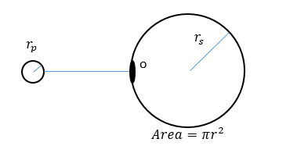
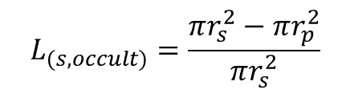
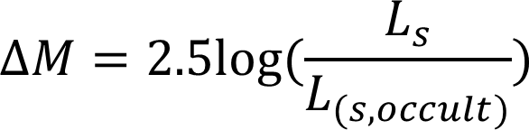
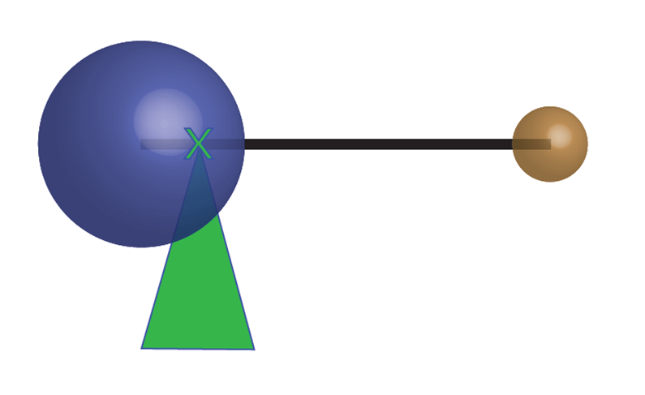
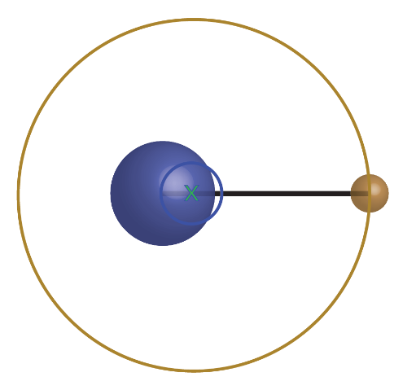
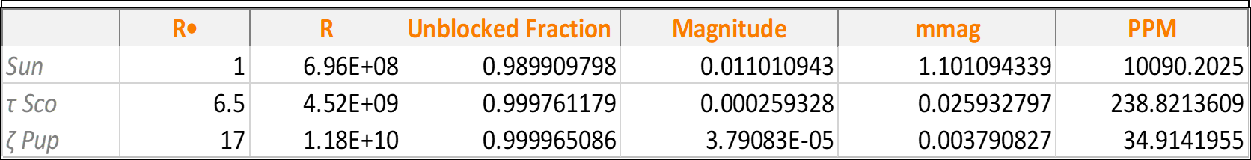
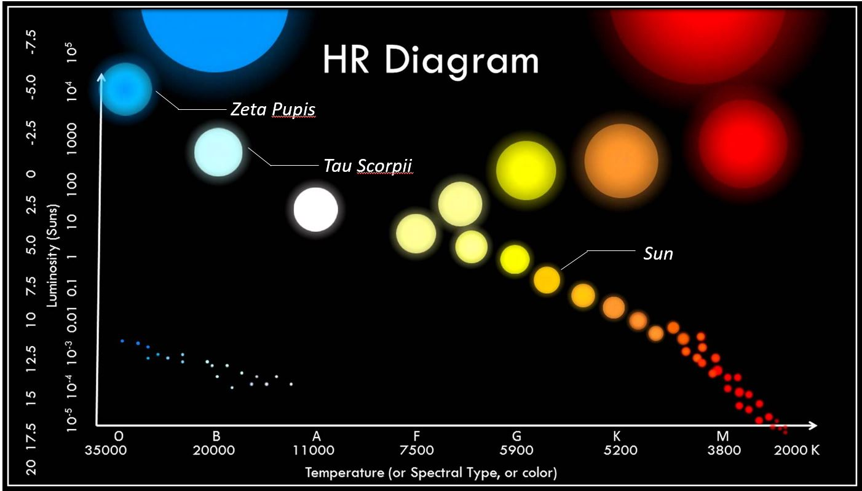
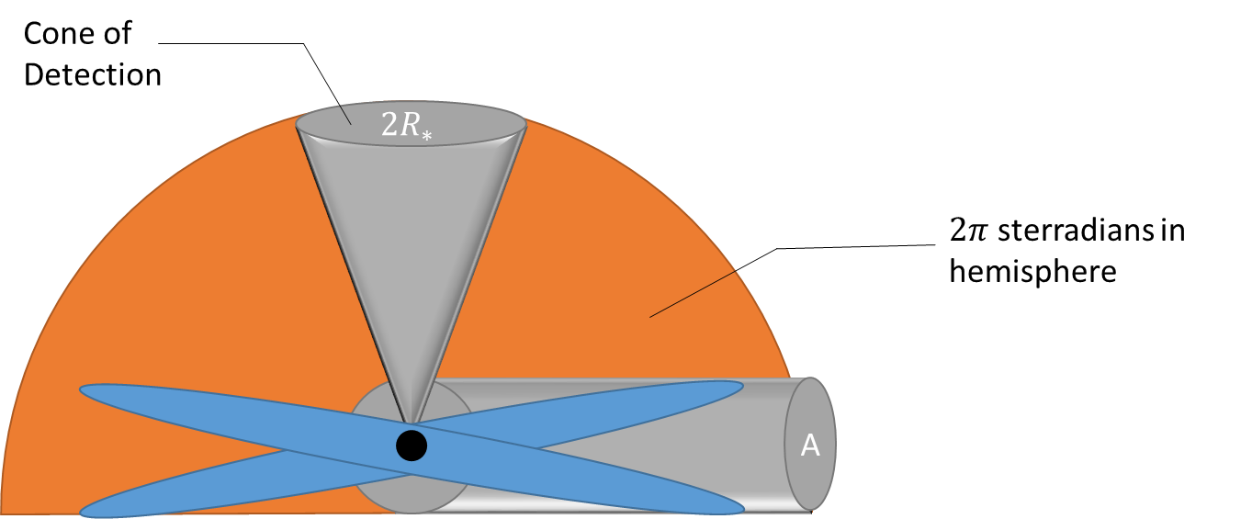
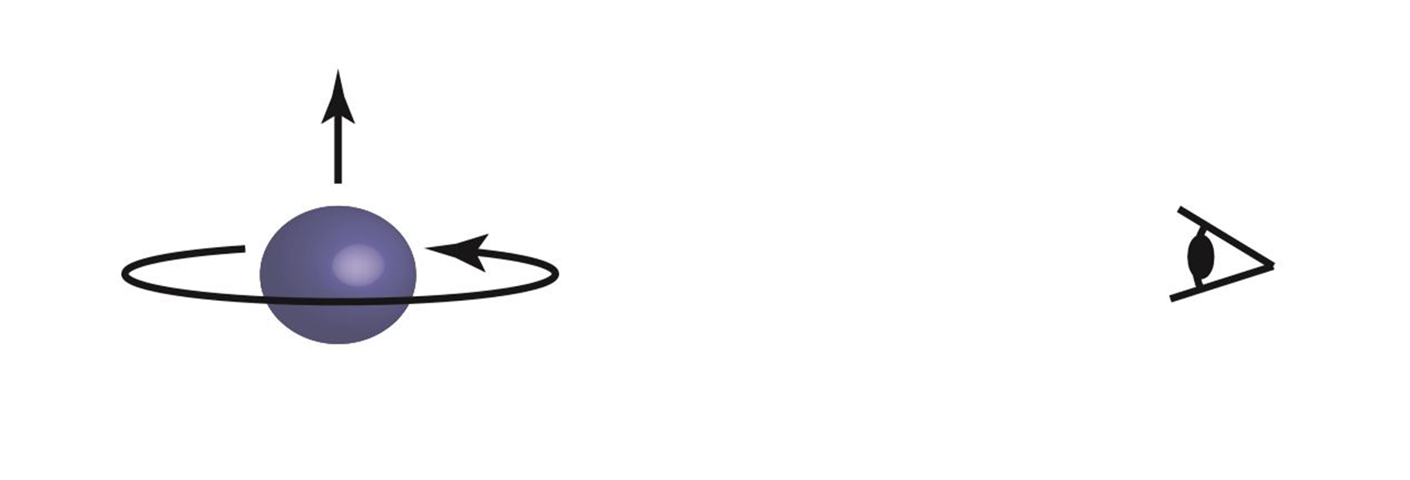
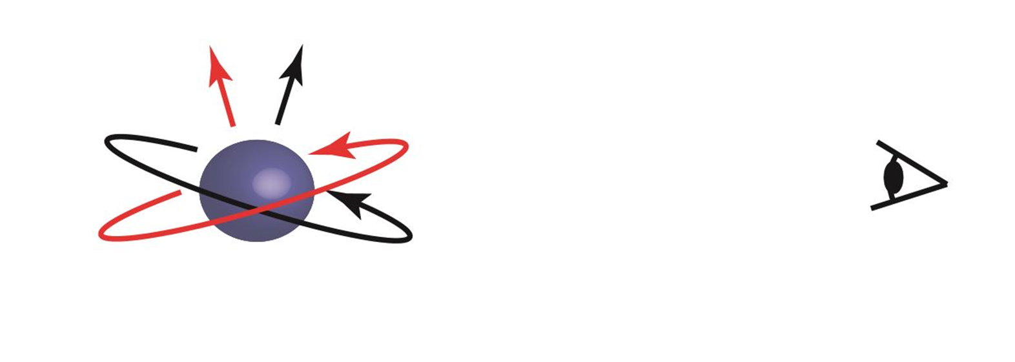
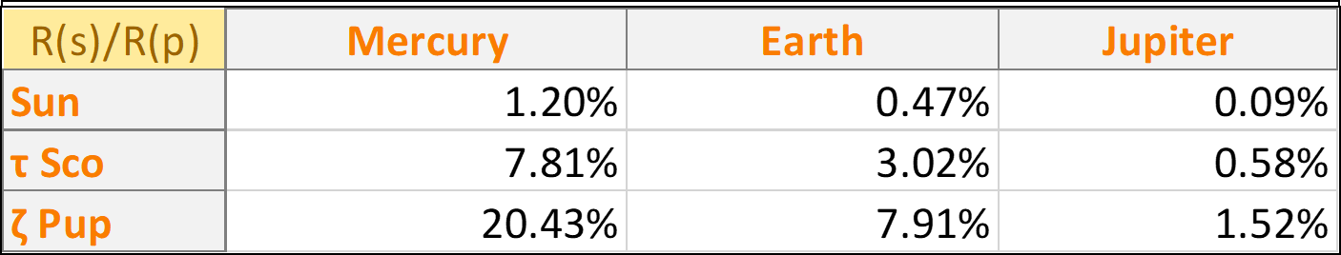
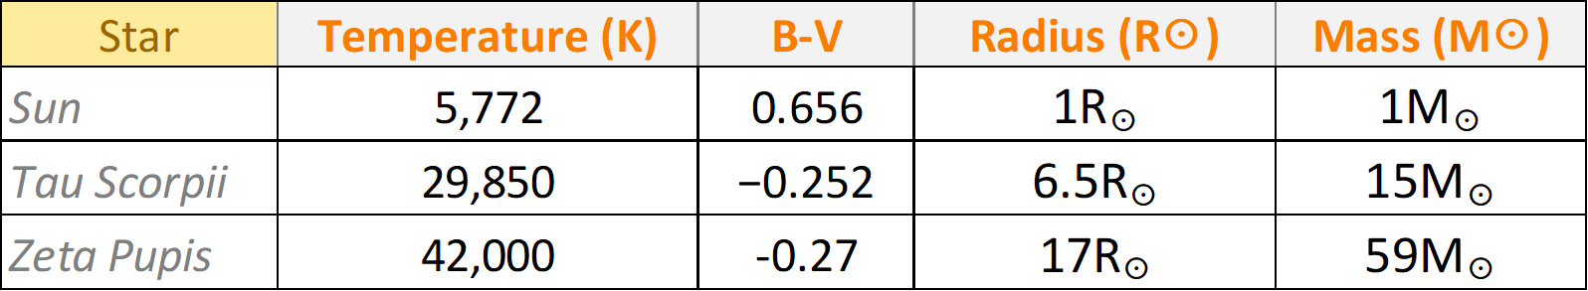
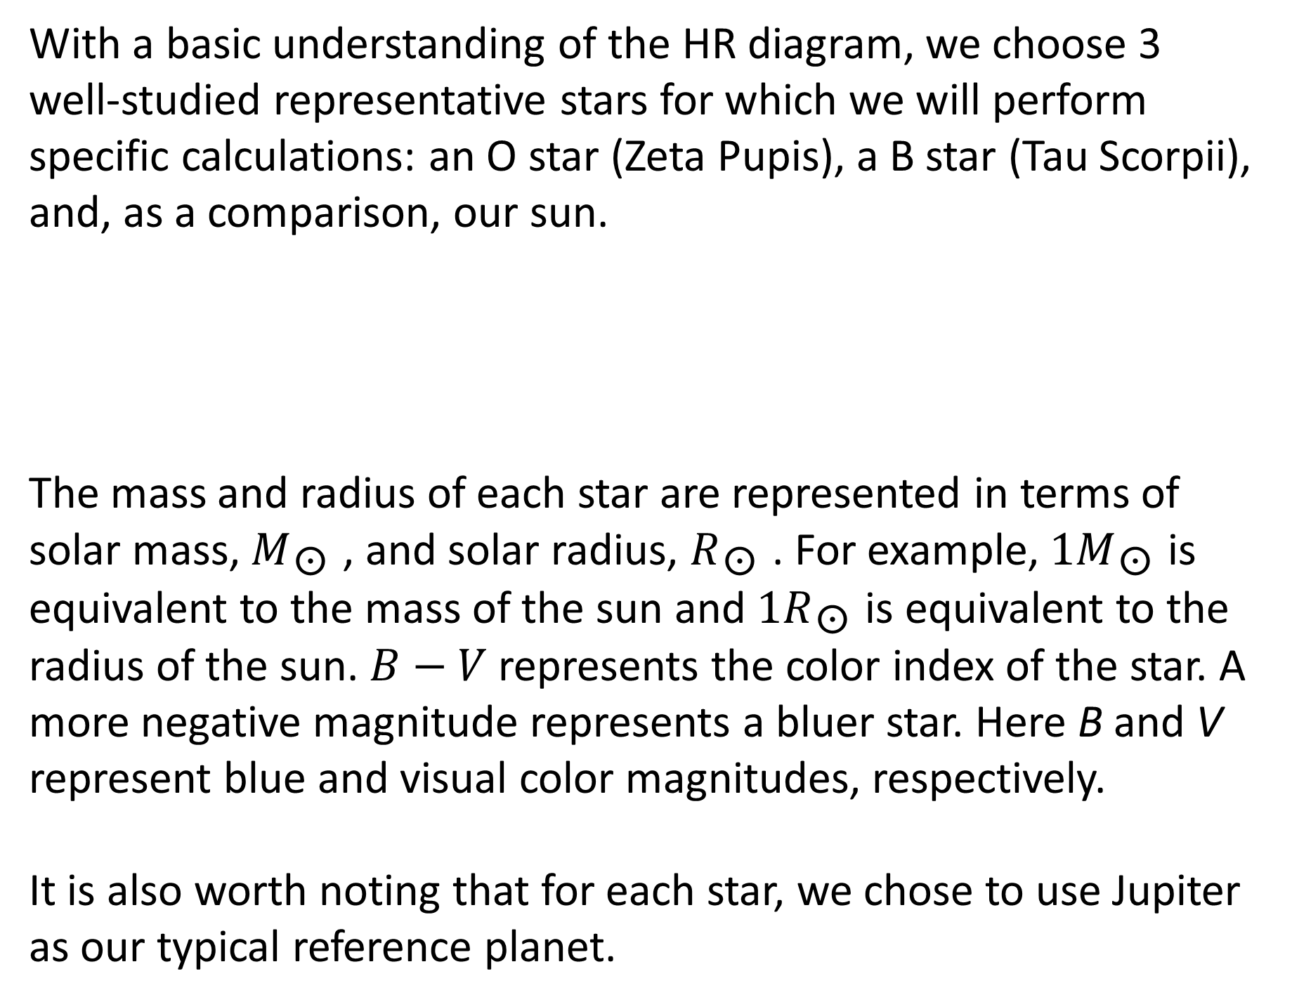
Hertzsprunging into the Unknown:
Understanding Current Detection Limits for Exoplanets around Hot Stars
Nathan Miller & Zachary Meredith | Physics & Astronomy
Abstract
Modes of Observation
Transit Photometry Method
The field of exoplanet research has rapidly grown over the past two decades, with more being discovered every day. There was a particular period of growth in the number of known exoplanets around the year 2009 with over four thousand likely new systems discovered through the Kepler mission. This research narrows the search to characteristics of planetary systems around hot (OB-type) stars. Unfortunately, we were unable to find evidence of any planets orbiting OB stars in NASA’s exoplanet database using a search by object type. By cross-referencing the NASA Exoplanet Archive and with the SIMBAD general database of astronomical objects, we confirmed that there were indeed OB stars in the field of view monitored by the Kepler spacecraft. This indicates there is a true deficit in the number of detected exoplanets around OB-type stars. To explain this deficit, we explored the sensitivity limits for the radial velocity and transit methods currently responsible for most exoplanet detections. We determined that due to the size and mass of OB-type stars, any planets orbiting them would be below the current levels of detectability.
Radial Velocity Method
When a planet crosses (transits) in front of its parent star, the observer can measure the brightness of the star drop a small amount. This depends on the relative size of the star/planet.
In conjunction with the Doppler effect, the radial velocity method uses red and blue shift of the star to indirectly determine whether an exoplanet is present or not.
Analysis: Transit Photometry
Using both equations, the unblocked fraction could then be calculated. Using Jupiter for the planet, a comparison of the magnitude differences against the Sun, τ Sco, and ζ Pup were calculated. It is also known that Kepler has been capable to show changes in magnitude down to 100 parts per million (ppm).
As seen above, the mass of the exoplanet orbiting the star causes the host star to “wobble” around the center of mass of the system. Notice how the star has the same orbital period as the exoplanet but with a much shorter path and therefore a much smaller measureable velocity.
WHAT ARE OB-TYPE STARS
Analysis: Radial Velocity
Stars are classified in terms of their luminosity and their temperature, or spectral type. Bluer stars, or higher temperature stars, have higher luminosity whereas redder, or lower temperature stars, have a much lower luminosity. A visual of this can be seen through the Hertzsprung-Russell (HR) diagram.
With a basic understanding of the radial velocity method, the next step is to calculate the maximum orbital radius of a star containing a Jupiter sized exoplanet. To do this, the minimum detectable orbital velocity must first be known. As determined by the LICK-CARNEGIE EXOPLANET SURVEY, the minimum detectable orbital velocity of a star is ~5 m/s. An orbital velocity versus orbital radius graph can then give further insight.
The next step was to calculate the probability that a planet, of varying sizes that orbits a star, would be detectable. Dips in luminosity are only visible if the transit of the planet crosses at a point on the star where we can actually measure it. This was found using an equation derived form spherical analysis.
Specific stars used for modeling
Where are we Interested
Database Comparison
With a basic understanding of the HR diagram, we choose 3 well-studied representative stars for which we will perform specific calculations: an O star (Zeta Pupis), a B star (Tau Scorpii), and, as a comparison, our sun.
The mass and radius of each star are represented in terms of solar mass, $M_{\text{☉ }}$, and solar radius, $R_{\text{☉ }}$. For example, ${1M}_{\text{☉ }}$is equivalent to the mass of the sun and ${1R}_{\text{☉ }}$is equivalent to the radius of the sun. $B−V$represents the color index of the star. A more negative magnitude represents a bluer star. Here B and V represent blue and visual color magnitudes, respectively.
It is also worth noting that for each star, we chose to use Jupiter as our typical reference planet.
Taking Kepler’s Field Of View (FOV), a data comparison was executed between the SIMBAD Astronomical Database and the NASA Exoplanet Archive. The purpose of this was to determine if OB-type stars were present in Kepler’s FOV and if these stars were measured by Kepler.
The relationship between the orbital velocity of the star and the mass of the star was also analyzed. This aligns logically with the fact that as the star gets larger in radius, to maintain equilibrium, the orbital radius would have to decrease.
Results
SIMBAD had shown that there were indeed OB-type stars in Kepler’s FOV, though none of them were directly measured by Kepler. The analysis, through radial velocity and transit photometry then showed that there were strict requirements that were needed to be met, in order to measure the presence of an exoplanet.
5 m/s current minimum detection limit
References
SIMBAD Astronomical Database. Retrieved from http://simbad.u-strasbg.fr/simbad/
NASA Exoplanet Archive. Retrieved from https://exoplanetarchive.ipac.caltech.edu/
Riedel, Adric (2013): Hertzprung-Russel Diagram. figshare. Presentation.
Lamers, Henny J. G. L. M, & Cassinelli, J. P. (1999). Introduction to stellar winds. Cambridge: G.B.
Vogt, S. S., Butler, R. P., Rivera, E. J., Haghighipour, N., Henry, G. W., & Williamson, M. H. (2010). The Lick-Carnegie Exoplanet Survey: A 3.1M⊕Planet In The Habitable Zone Of The Nearby M3V Star Gliese 581. The Astrophysical Journal, 723(1), 954-965. doi:10.1088/0004-637x/723/1/954

