Slide 1
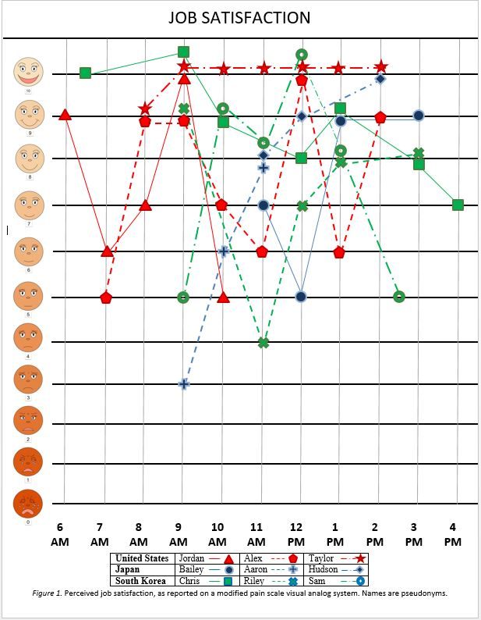
Secondary Physical Education Teachers’ Job Satisfaction in Japan, South Korea, and the United States
Joshua R. Stringer, Zoë Kapusta, and Daniel Stockhaus, with Adam Bielmeier and Elizabeth Krum
Faculty Mentors: Yoonsin Oh, Ph.D. & Saori Braun, Ph.D.
University of Wisconsin- Eau Claire, Eau Claire, WI
Abstract
Study Procedure & Analysis
Physical education (PE) teachers have high attrition rates worldwide, yet little cross-cultural research exists exploring the factors contributing to their job satisfaction/dissatisfaction. The purpose of this study was to qualitatively assess cross-cultural factors contributing to job satisfaction/dissatisfaction among secondary school PE teachers in Japan, South Korea, and the United States (U.S.). Nine secondary school PE teachers, three in each country, were observed during a full day of teaching in their respective schools, while researchers compiled field notes of their observations. After each class period, participants indicated their satisfaction on an 11-point visual analog scale. Afterwards, participants completed a semi-structured interview, in their native language, consisting of 16 core questions and additional questions relevant to the observed day. Four primary themes surrounding job satisfaction emerged: 1) student relations, 2) workload, 3) teaching, and 4) administration relations. The main theme of job satisfaction was student relations and job dissatisfaction was workload in all three countries. The U.S. teachers reported more satisfaction than dissatisfaction in their teaching, whereas the opposite relationship was observed among South Korean and Japanese teachers. Results of our study highlight the importance of understanding cultural values that constitute job satisfaction/dissatisfaction in finding ways to reduce attrition of PE teachers.
Observation (1-full day)
Field Notes
Job Satisfaction Graph
Interview
Semi-structured questions
Data analysis
Transcription
Thematic coding
Introduction
Using data from the Schools and Staffing Survey/Teacher Follow-up Survey (SASS/TFS), Ingersoll and Smith (2003) discussed rates of attrition (switching positions within the same career or leaving the career altogether) within the first several years of teaching and found that between 25-50% of all beginning teachers leave the teaching profession after just five years, citing poor compensation, student misbehavior, and lack of administrative support as primary attrition factors. Per the Wisconsin Budget Project report (2017), school districts in Wisconsin currently face extreme teacher shortages, with 46% of openings (1,153 job openings) including physical education teachers.
Brief & Roberson (1989) defined job satisfaction as an attitude based on the positive and negative disposition toward an employee's work. According to Carson, Hemphill, Richards, & Templin (2016), peer support greatly influenced job satisfaction, yet physical education teachers experience greater isolation from the other teachers in the school. Also, while PE teachers preferred less administrative oversight, Carson et al. (2016) also noted that this decreased oversight reduced their involvement in school decisions, which PE teachers also desired. Per Skaalvik (2012), the majority of teachers experience substantial disruptive behavior from students, which directly correlates with work-related stress and emotional exhaustion. Day, Sammons, Stobart, Kington, and Gu (2007) contend that understanding how daily experiences in schools can help relate to teachers’ feelings of satisfaction and dissatisfaction and can also help physical education teachers remain engaged and effective in their work with children.
While job satisfaction among teachers has been well researched, few studies have specifically examined physical educators’ (PE) satisfaction, and even fewer have examined this cross-culturally. The goal of this study, therefore, was to obtain a greater cross-cultural understanding of job satisfaction and dissatisfaction factors among PE teachers.
Results
“Most of my interactions are very positive with the kids. I try to get a feel for what their home life is like and what their weekends are like or what they are involved with. They have a story to tell every day, and just trying to listen to that the best we can.” (Alex, US)
“There are many students who cannot concentrate and are distracted. It is hard psychologically burdensome to make them concentrate in the class. I always feel a big burden before the classes.” (Sam, S. Korea)
“We have a couple of students in here that the interaction is very difficult with, and it’s more about managing behaviors than it is about teaching the class...we give out a lot of DRs -disciplinary referrals- in this class.”(Taylor, US)
Job Satisfaction
Students
Relationship w/students
Students’ Behavior, Attitudes, and Motivation
Workload
Admin.
Resources
Professional Development
Number of Classes
Additional Duties
Relationship w/administrators
Teaching
Teaching & pedagogy
Enjoyment of subjects taught
Curriculum
“Yes. I think the job, teacher, itself changes something. But I have a lot of difficulties in the process such as feeling disappointed when I cannot do things the way I want to.” (Riley, S. Korea)
“I believe my job, as a PE teacher shapes students’ social collaborative skills, group rules or manners as a people via group actions.” (Bailey, Japan)
“There is a national level curriculum, then it comes to Education Office.” (Aaron, Japan)
Relationship:
“The principal and the vice-principal are understanding and kind since they also previously had worked teachers at this school. They always take a democratic approach, so I feel comfortable to speak up during meetings or other speaking opportunities.” (Hudson, Japan)
Resources:
“For the other junior high school, the principal always direct teachers to buy cheapest one on the internet. We did not have enough budget either. But the principal of the school now is a good person.” (Sam, S. Korea)
“Some of the equipment that we have- it’s old and outdated, so we have this, you know, brand new space and we have old equipment that’s breaking and ragged and we need some new stuff and our budget just isn’t there… always wish we had more money to even for repairs, for equipment.” (Taylor, US)
Professional Development
“We try to go to conventions but unfortunately they’re always in when we’re teaching and our school district does not let us out unless people use a personal day which most people, we just can’t use a personal day” (Jordan, US)
“It is free to attend the training by Education Office.”
(Chris, S. Korea)
“I have 5 classes on Tuesday and I had 6 classes. In some cases I have 5 hours of classes, and on a special occasion there can be 6 hours of classes.” (Chris, S. Korea)
Jordan (US) has 5 classes a day starting at 6:30 AM plus a lifeguarding duty. Regarding an integrated class, Jordan states that it “is tough,” there is, “no support staff,” and that, “it’s a lot of work”.
“The majority of teachers at this school are in charge of supervising at least one club activity… I always work after I get back home. Some of the teachers have been questioning the balance between their workload and salary.” (Hudson, Japan)
Methods
Discussion/Conclusions
Participants
References
Using a purposive sampling (Patton, 2015), nine secondary physical educators (<30->40 years-old) in Wisconsin, Japan, and South Korea were recruited. These teachers varied in years of teaching experience (3-25 years), and taught PE in either middle or high school.
The main theme of job satisfaction was student relations and job dissatisfaction was workload in all three countries.
Curricular and value differences in three countries may have influenced participants’ perceptions on their job satisfaction and dissatisfaction.
The implications of this study for administrators would be to continually evaluate teachers’ needs for healthy workload, provide support for their professional development, and advocate for employee wellness to decrease attrition rates and minimize burnout.
Brief, A.P., & Roberson, L. (1989). Job attitude organization: An exploratory study. The Journal of Applied Psychology, 19, 717-727.
Carson, R. L., Hemphill, M. A., Richards, K. A. R., & Templin, T. (2016). Exploring the job satisfaction of late career secondary physical education teachers. Journal of Teaching in Physical Education, 35(3), 284-289.
Day, C., Sammons, R, Stobart, G., Kington, A., & Gu, Q. (2007). Teachers matter: Connecting lives, work and effectiveness. New York, NY: McGraw Hill.
Ingersoll, R. M., & Smith, T. M. (2003). The wrong solution to the teacher shortage. Keeping Good Teachers, 60(8), 30-33.
Patton, M.Q. (2015). Qualitative research and evaluation methods (4th ed.). Thousand Oaks, CA: Sage.
Skaalvik, E. M., & Skaalvik, S. (2011) Teacher job satisfaction and motivation to leave the teaching profession: Relations with school context, feeling of belonging, and emotional exhaustion. Teaching and Teacher Education, 27(6), 1029-1038.
Wisconsin Budget Project (2017) Budget cuts and teacher shortages: with fewer resources, schools struggle to find educators. Retrieved from http://www.wisconsinbudgetproject.org/wp-content/uploads/2017/01/Budget-cuts-and-teacher-shortages.pdf
Acknowledgements
We kindly thank our participants and faculty mentors, the International Fellows Program for funding our project, and Learning & Technology Service for printing services.

