Slide 1
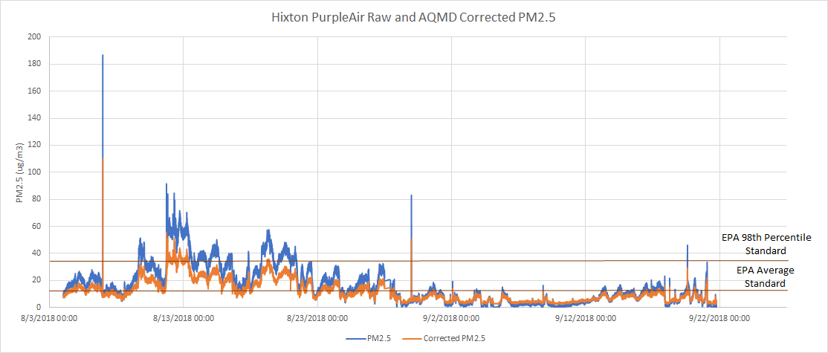
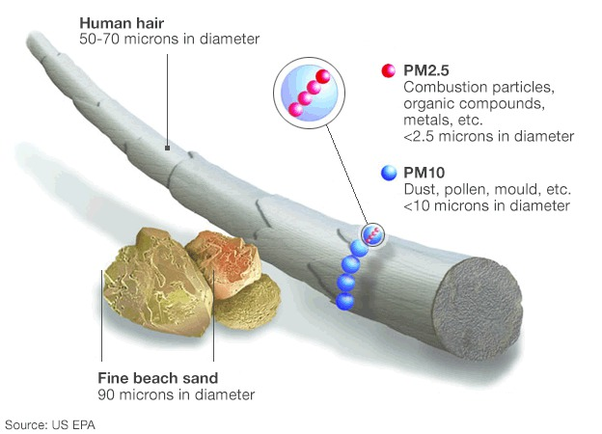
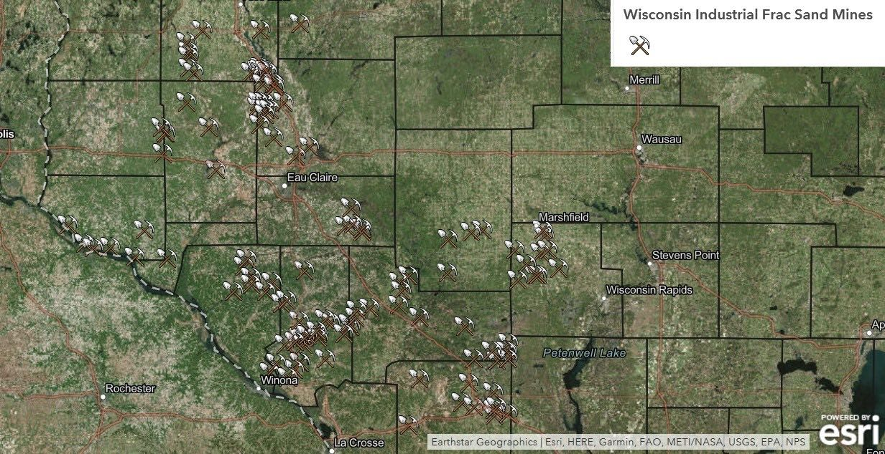
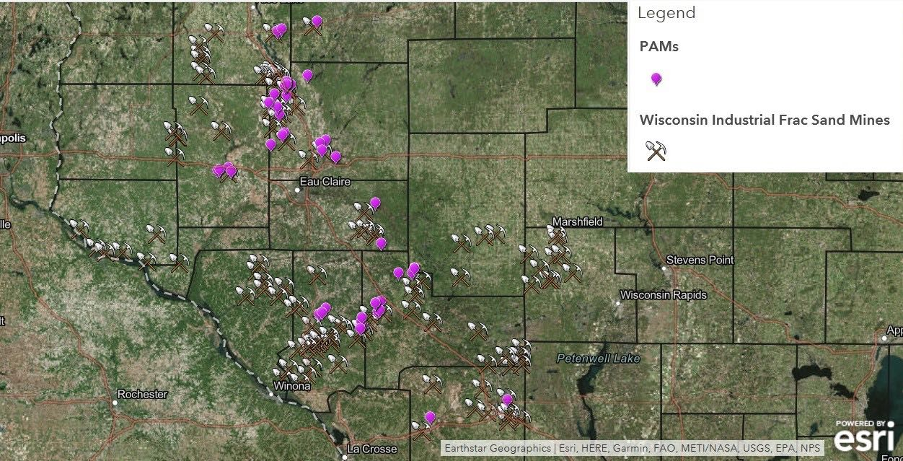
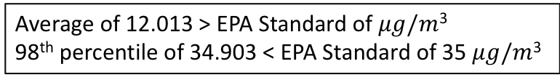
Particulate Air Quality Around Wisconsin Silica Sand Mines
University of Wisconsin – Eau Claire
Crispin Pierce PhD, Orion Allgaier, Connor Barnes, Aleah Gmeiner-Anderson, Josephine Killoren, Alexandra Larson| Watershed Institute
Abstract
PurpleAir Correction
The act of mining and processing quartz for hydraulic fracturing generates particulate matter (PM), as well as crystalline and amorphous silica through blasting, loading, and hauling; processing activities such as crushing; and the transportation of processed and waste sand. The purpose of our research is to quantify the risk of ambient exposure to airborne particulates around industrial silica sand operations. In past work, EPA-certified dichotomous samplers were calibrated before and after sampling, and pre and post filter weights recorded. Over a two-year period, we observed increases in average PM_{2.5} concentrations of 2.6 and 16.1 ug/m³ over concurrent DNR background levels near industrial sites in Bloomer and New Auburn, WI, respectively. Using published studies, we estimate this increase in PM_{2.5} exposure to cause a loss of life expectancy of one day per year of exposure in Bloomer and three days in New Auburn. In Albertville, WI, we conducted yearlong background air quality monitoring where mining operations are planned to begin. Here we found average PM_{2.5} concentrations of 11.8 ug/m³ using our EPA-certified dichotomous sampler and 15.0 ug/m³ using a spectroscopy based DustTrak II monitor. Collaborating with the DNR, industry representatives, academic colleagues, and community organizations such as Save the Hills Foundation, future research will include the use of affordable PurpleAir monitors to quantify particulate exposure using corrected formulas derived from the California South Coast Air Quality Monitoring District. In doing so, we strive to provide object information about air quality in Wisconsin, and in Sierra Leone where a monitor was recently installed next to an iron ore mine, in hopes of empowering individuals, communities, and underrepresented minorities.
Tested alongside two Federal Equivalent Method (FEM) instruments, the California South Coast Air Quality Monitoring District (South Coast AQMD) evaluated three PurpleAir PA-II monitors to compare their reliability to accepted FEM GRIMM and BAM instruments; and to compare the intra-model variability among PurpleAir monitors themselves. Over the 49-day testing period, PM_{2.5} sensor data correlated with corresponding FEM GRIMM and BAM values of R² > 0.93 and R² > 0.86, respectively.³ While further testing is needed to evaluate the performance of these monitors over different and more extreme conditions, we believe PurpleAir monitors, with the use of correction factors, pose a promising future in particulate air quality monitoring.
Average of 12.013 > EPA Standard of $μg/m$³
98th percentile of 34.903 < EPA Standard of 35 $μg/m$³
Particulate Matter
Using regression line equations calculated by the South Coast AQMD, our research team created one singular corrective formula to provide more accurate data outputs for particulate matter concentrations. ³ The graph to the right depicts corrected PM_{2.5} concentrations ranging from August 3rd to September 22nd, 2019 in Hixton, WI. Over the seven-week period, average corrected PM_{2.5} concentrations at this site were 12.01 µg/m³ with a 98th percentile concentrations of 34.903 µg/m³.
Particulate matter is generally designated into two main size gradients, coarse particulate matter (PM₁₀) and fine particulate matter (PM_{2.5}).
Coarse particulate matter, particles 10 microns in size and smaller, may include larger dust and pollen particles that can get caught in the upper respiratory system and are generally coughed or sneezed out of the body. Fine particulate matter, particles 2.5 microns and smaller, may include fine dusts and combustion particles, as well as organic compounds, that are significantly more dangerous than PM₁₀ as they have the potential to be inhaled into the lower respiratory system and with enough exposure, absorbed into the bloodstream.¹
PurpleAir Results
While most of our PurpleAir PA-II monitors have only been installed and operational in the field for a matter of months, the capability of the PurpleAir PA-II to give data outputs every three seconds allows for continual, and real time particulate air quality monitoring. Taking the averages of these concentrations over the duration of 24 hours, or over a year, allows us to compare average PM_{2.5} concentrations to the 12 µg/m³ annual and 35 µg/m³ 24-hour standards for PM_{2.5} set by the EPA.¹
The graph to the right depicts PM_{2.5} concentrations ranging from March 19th to April 9th, 2019 in New Auburn, WI. Over the three-week period, average PM_{2.5} concentrations at this site were 18.42 µg/m³.
PM_{2.5} compared to PM₁₀, as well as the diameter of a human hair and a grain of fine beach sand (see photo above).
Location of Mines and PurpleAir Monitors
Health Effects
The operation of mining and processing quartz for hydraulic fracturing generates inhalable fine and coarse particles, as well as crystalline silica that can lead to negative health effects for both workers and residents nearby.² Coarse particles are larger dust and pollen particles that can get caught in the nose and throat and are typically coughed or sneezed out. Fine particles on the other hand are smaller and can get caught in the lungs where they can accumulate and pose a serious health risk. Increased exposure to coarse and fine particles has been associated with, but are not limited to, irritation of the airways, coughing, difficulty breathing and, in some circumstances, decreased lung function, aggravated asthma, irregular heartbeat, silicosis, and lung cancer. The focus of our research is to study the levels of fine particulate matter and the health risks for those exposed in areas near sand mining operations.¹
PurpleAir monitors
PurpleAir PA-II particulate monitor (see photo below).
Given their affordability, accessibility, and preliminary reliability, we believe PurpleAir monitors present a promising future in terms of real-time, affordable air quality monitoring. Utilizing dual laser technologies, PurpleAir monitors continuously sample PM₁, PM_{2.5}, and PM₁₀, as well as temperature and humidity, uploading data in real time to PurpleAir’s interactive map via wireless internet connectivity. Currently, our research team has implemented five monitors in New Auburn, two in Taylor, and one in Hixton and Chippewa Falls, WI. Future direction will include further PurpleAir implementation to quantify particulate exposure using corrected formulas derived from the California South Coast Air Quality Monitoring District.³
The X’s represent silica sand mine and processing plant sites and the purple icons are potential concurrent PurpleAir monitoring sites (see maps above).
Conclusion
References
Given that there is no completely safe level of particulate exposure, any increases in PM_{2.5} concentrations are likely to increase health risks above background levels.^{4,5} In past work, evidence indicates an increase above average background PM_{2.5} levels at sample sites near active mining (Bloomer) and processing/rail-transfer (New Auburn) as well as current work with PurpleAir monitors being done in Hixton and New Auburn, WI.⁶ We believe further PM_{2.5} monitoring is needed to ensure regulatory compliance, inform nearby communities, and protect the health of workers and residents around silica sand sites and facilities. Further research will continue the use of affordable PurpleAir monitors, and correction formulas, to provide Wisconsin and it’s decision makers with objective information about particulate air quality.
United States Environmental Protection Agency. Particulate Matter Pollution. https://www.epa.gov/pm-pollution
Wisconsin Department of Natural Resources. Industrial Sand Mining in Wisconsin: Strategic analysis for public review. 2016. https://dnr.wi.gov/topic/EIA/documents/ISMSA/ISMSA.pdf
South Coast Air Quality Monitoring District. Field Evaluation Purple Air (PA-II) PM Sensor. http://www.aqmd.gov/docs/default-source/aq-spec/field-evaluations/purple-air-pa-ii---field-evaluation.pdf?sfvrsn=2
Air Pollution and Mortality in the Medicare Population. 2017.
Reduction in Fine Particulate Air Pollution and Mortality: Extended Follow-up of the Harvard Six Cities Study. 2006.
Monitoring of airborne particulates near industrial silica sand mining and processing facilities. 2019.

