Slide 1



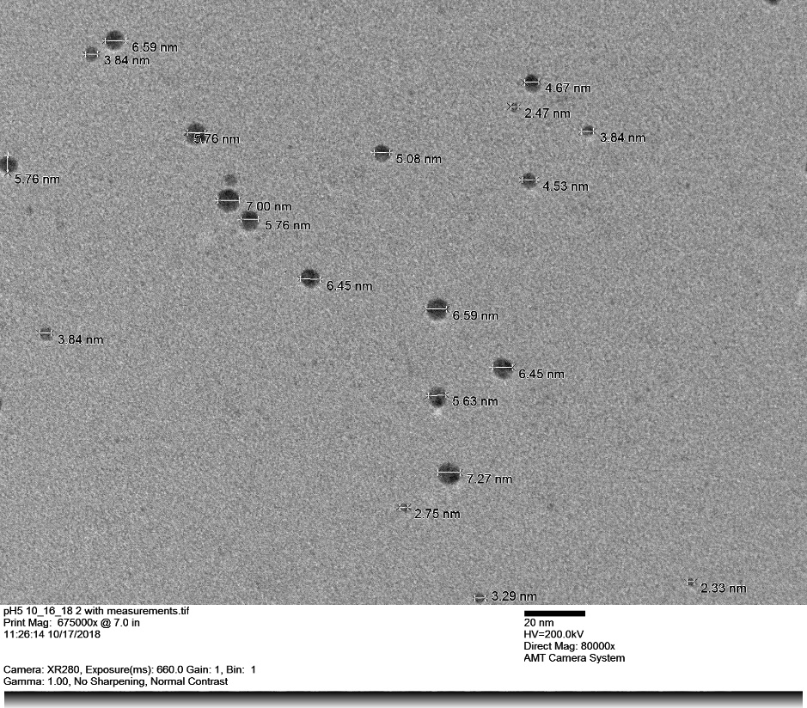
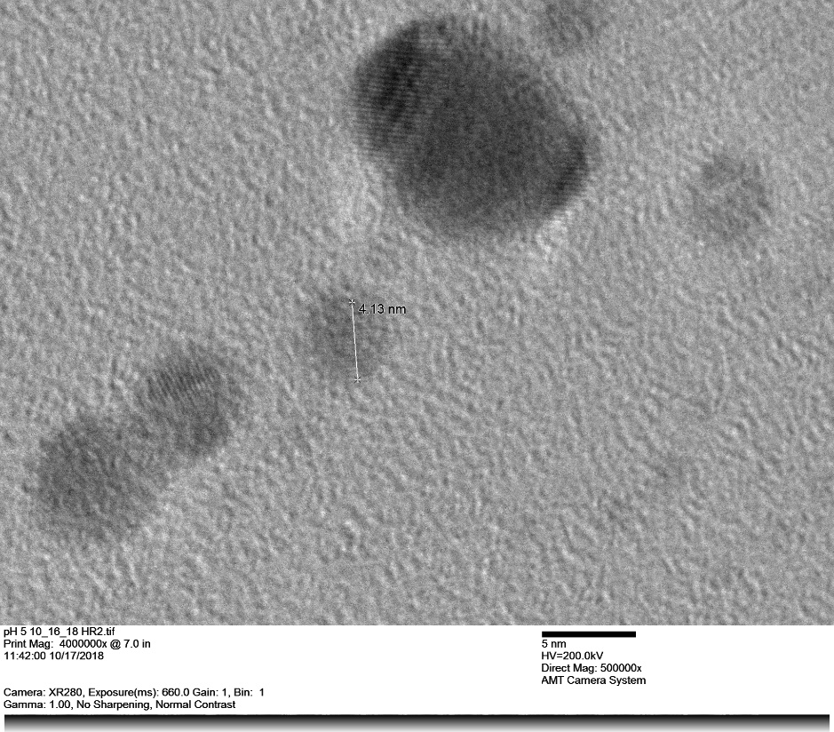
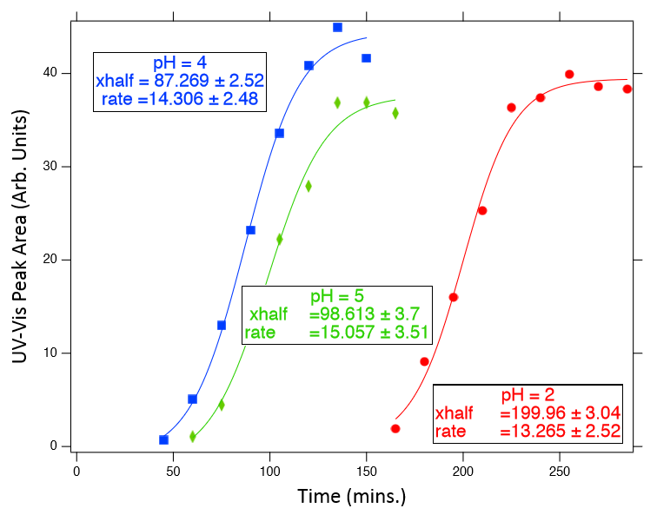
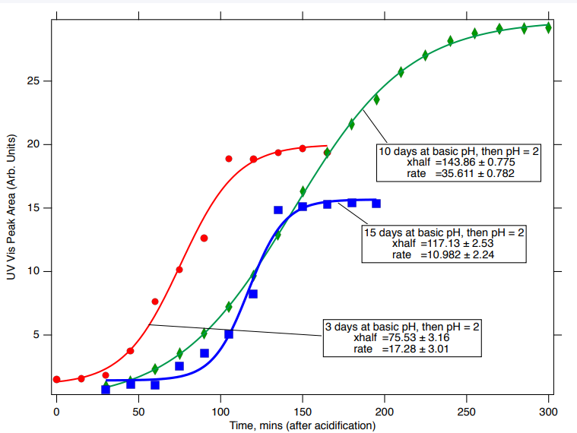
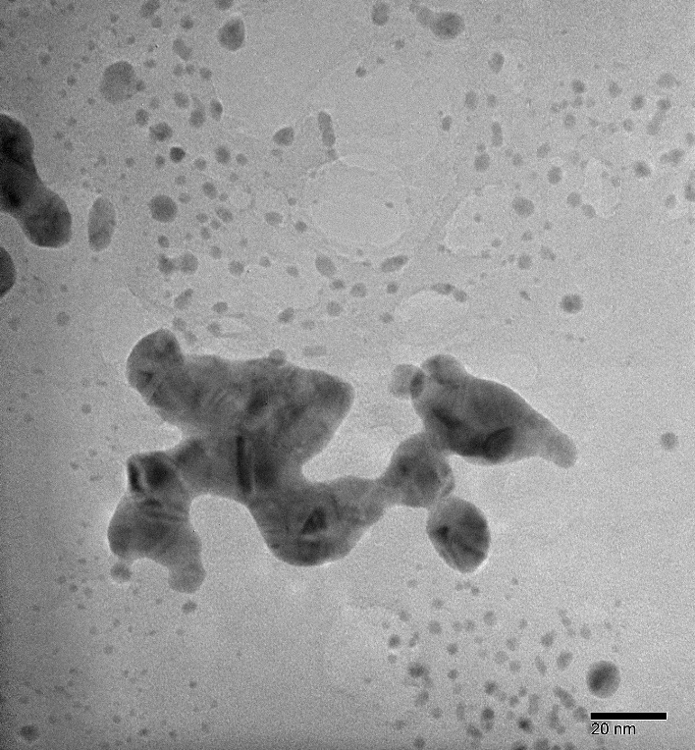
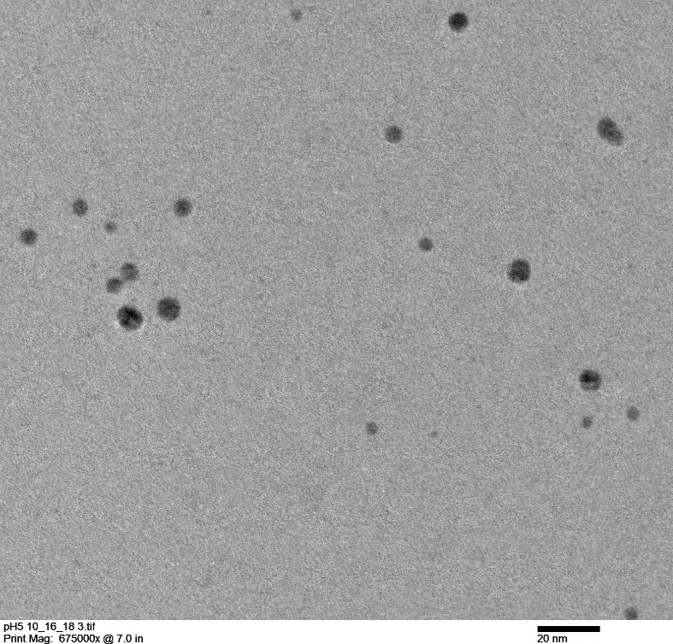
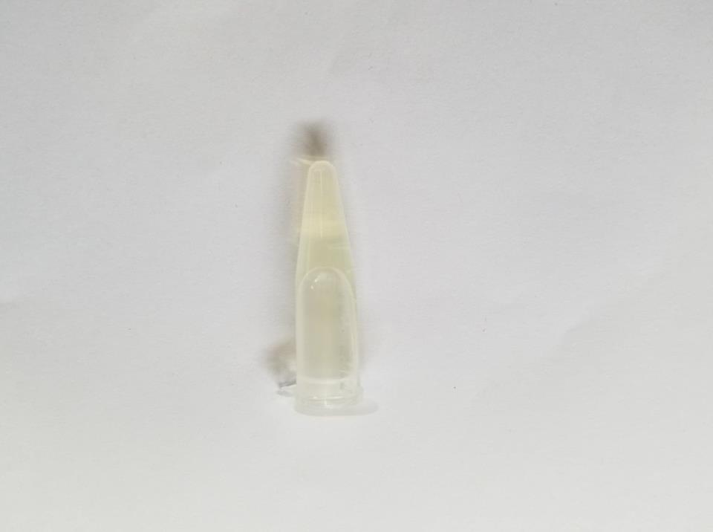
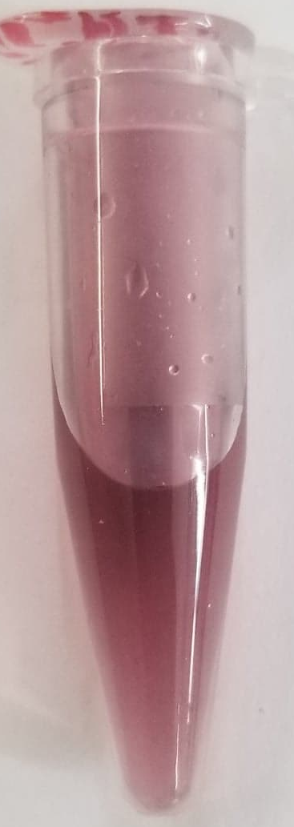
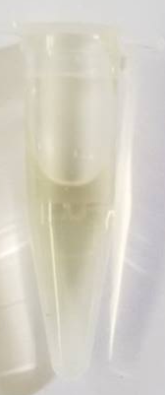
pH-Triggered Growth of Gold Nanoparticles
Andrea L. Hunger, Kao Z. Yang, Dr. Alan DiSpirito (Iowa State), Dr. Marcus McEllistrem
Materials Science & Engineering, University of Wisconsin-Eau Claire
Introduction
Transmission Electron Microscope (TEM) images
Fig. 4
Methanotrophs are bacteria that live exclusively on methane. They produce a small biomolecule called methanobactin (mb), an 11 amino acid “peptide”, which is found inside and outside the cell. Methanobactins are of interest because they are associated with enzymes (produced by methanotrophic bacteria) that show great promise in bioremediation and environmental applications since they can oxidize halogenated hydrocarbons; they also catalyze the conversion of methane to methanol.
Two types of methanobactin have been previously characterized: SB2 and OB3b, each isolated from a different strain of methanotrophic bacteria. This study focused only on OB3b mb. Methanobactin’s role is to bind copper (II) ions in the environment and chaperone the ions back inside the cell. We have previously found that methanobactin reduces copper (II) to copper (I) upon binding the metal ion.
In addition to copper, methanobactins have been shown to reduce several other metals, including gold. Specifically, it can reduce Au³⁺ (in solution in the form AuCl₄⁻) to Au⁰ (atomic gold). The atomic gold then aggregates to form gold nanoparticles which can be characterized using TEM and UV-visible spectroscopy.
Here we show how pH affects the reaction kinetics between AuCl₄⁻ and mb. This work has implications for biochemical oxidation-reduction reactions that likely have analogs in other organisms and for other metals. In addition, our results could improve our understanding of the metabolic pathway used by methanotrophs to oxidize methane to methanol.
Figure 2A Figure 2B
This sample was acidified to pH 5. Figure 2A shows the size distribution of the nanoparticles, and figure 2B shows the atomic lattice of the particles
pH as an On/Off switch
The reaction between mb and AuCl₄⁻ only produces a measurable amount of gold nanoparticles if the final solution (with all components added) is first basic, and then acidified to a pH lower than 5.5. The solution may be left basic for an extended period of time and the gold will remain dissolved. Our longest running trial was left at pH 11 for 15 days, and showed no nanoparticle growth when characterized by UV-Vis. It was then acidified to pH 2, and particle production began in about one hour.
Figure 4 Shows kinetic data (absorbance recorded by UV-vis vs time in minutes) for three different trials, each run at a different final pH value: 2, 4 and 5, respectively.
pH Effect on Shape and Size
Fig. 5A Fig. 5B
The gold aggregates in figure 5A were generated at pH 2 and appear to have self-assembled into platelets. In contrast, the aggregates in figure 5B were generated at pH 5 and self assembled into smaller, more dispersed nanoparticles.
Synthesis Method
1 mL of 210 µM methanobactin was placed in a 1.5 mL Eppendorf tube and brought to pH 11 by the addition of about 20 µL of 1M NaOH
103 µL of 10.2 mM HAuCl₄ (dissolved gold ions) was added to the methanobactin solution, producing an Au-to-mb ratio of 5:1
In order to prevent nanoparticle aggregation, 250 µL of 0.1M Polyethylene glycol was added to the Eppendorf tube
After incubating at RT for a specific time, the soluton pH was made acidic (using either 6M or 0.6M HCl) to achieve the target pH:
  Target pH values ranged from 2 to 9
  Incubation time (before acidification) ranged from 2 minutes to15 days
The solutions were then transferred into a quartz cuvette and the UV-Vis spectrum recorded using a Cary 50 every 15 minutes for 6 hours
Summary & Further Research
Solutions of methanobactin and dissolved gold ions are relatively shelf stable for at least 15 days when kept at pH 11. Nanoparticle production can then be triggered within 1 hour by adding a small amount of hydrochloric acid
The rate of nanoparticle production after acidification is similar for samples left basic for lengths of time between two minutes and 15 days (possibly even longer, the maximum length of time a solution can be held basic and still produce particles once acidified has not yet been determined)
The waiting period between sample acidification and quantifiable nanoparticle growth can be shortened from 2.5 hours at pH 2 by running the reaction at a higher pH value, up to 5.5 at which point nanoparticle formation no longer occurs (within 6 hours)
Currently, the source of electrons for the reduction of metal ions by methanobactin is unknown, and further study of the mechanism by which this occurs would be helpful in understanding how and why pH plays a role in nanoparticle formation
Future work using Transmission Electron Microscopy will characterize the nanoparticles made at pH 2 ,4, and 5 to determine the effect of pH and rate of formation on the size and shape of gold nanoparticles synthesized using methanobactin
Figure 3 Shows kinetic data (absorbance recorded by UV-vis vs time in minutes) for four trials. Each sample began at pH 11 and was acidified to pH 2 after a different amount of time. Trial 1 was basic for two minutes, trial 2 was basic for three days, trial 3 was basic for ten days, and trial 4 was basic for fifteen days. All samples were stored at room temperature and in a dark environment while at pH 11.
The graphs above demonstrate that the reaction can be “suspended” for at least 15 days and then be triggered to generate gold nanoparticles when acidified. While a well-defined trend is not evident, the nanoparticle growth rate is approximately the same, regardless of how long the solution is stored before being triggered by the HCl.
Methanobactin
NaOH
HAuCl₄
PEG
pH 11
HCl
pH 2
pH Effect on Reaction Kinetics
All reactions were made to be pH 11 with the addition of 20µL of 1M NaOH. We examined the effect when different amounts of added HCl were used to lower the pH of the final solution to a desired value.
Acknowledgements
Of the different final pH values that were studied, only those lower than 5.5 resulted in the production of gold nanoparticles. Successful trials were run at pH values of 2, 4, and 5. Lower pH values resulted in longer the induction periods, or wait times before the presence of nanoparticles was detected by UV-Vis. However, reactions run at higher pH values, such as pH 5, had shorter induction periods and finished producing particles sooner.
Adam D. LeGarde (UW-EC)
Dr. Hooper (Geology Department, UW-EC)
Materials Science & Engineering Center at UW-EC
Chemistry Department at UW-EC
NSF REU grant # CHE-1460728
Iowa State Biochemistry Program
Figure 1 Shows the process used to produce gold nanoparticles. The reaction can be paused if left at pH 11, and will only begin producing particles when it is acidified to a pH below 5.5. The longest time a solution remained basic in this study was 15 days.

