Slide 1
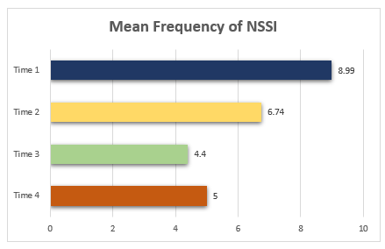
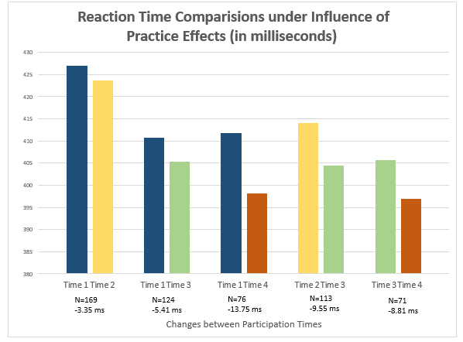
The Impact of Practice Effects on NSSI Stroop Task Reaction Times
Mckenzie Kostreva and Carley Owens
Faculty Mentor/ Collaborator: Jennifer Muehlenkamp and Christopher Hagan, Psychology Department
Introduction
Discussion
Non-Suicidal Self Injury (NSSI) is the deliberate harm to one’s body without the intent to die (Schade, 2013). College aged students experience high levels of stress and are prone to engage in NSSI (Muehlenkamp, et al., 2013).
The NSSI Stroop Task is a test that can be used to observe the attentional bias towards emotional stimuli by using stimuli specific words (e.g., alone) with neutral words (e.g., museum; Cha et al., 2010). The Stroop Task measures the time it takes an individual to respond to a target word when exposed to words related to a specific topic (Williams, Matthews, & Macleod 1996). The Stroop Task is measured by subtracting the time lapse for neutral words compared to stimuli specific words, in which the larger difference in time, is translated into greater interference (Cha et al., 2010).
Practice effects, or repeating a test, also impact the validity of a test by possibly improving exam score (Dodge et al., 2017) and/or decreasing response time (Roe, Wilsoncroft, & Griffiths, 1980).
This study will observe if practice effects impact the NSSI Stroop Task.
Participants
Our hypothesis was not supported between each time point as the decrease between time points was not statistically significant. However, the time difference between T1-T4 began to approach significance (p = .10). This may suggest that when more data are collected, these results may become significant.
This study suggests that practice effects do not have a significant effect on the NSSI Stroop Task. Those who utilize the Stroop Task in clinics or labs can administer the same questions, related to the NSSI Stroop Task, and observe reaction time. Reaction time may decrease if the test is administered consistently over many time points, however we did not observe a statistically significant decrease.
Further research is needed to determine if a longitudinal test composed of more than 4 time points would remain consistent with these findings. Research would also be needed to understand if administrations less than 6 months apart would significantly impact practice effects on the NSSI Stroop Task.
Results
Hypothesis
Those who complete the Stroop Task multiple times will have decreased reaction time due to practice effects.
Method
Students completed self report surveys about different images and words related to NSSI. Participants were chosen based on their results from a screening survey showing that they have engaged in NSSI previously and have not attempted suicide. Participants were asked to participate a total of four times (each session separated by 6 months) in this ongoing longitudinal study.
Participants
A survey was sent to all first and second year students at a Midwestern University via email. Students who had a history of NSSI, and did not have a history of suicide attempts, were offered an opportunity to participate. University students (n=243; mean age: 18.87, 83.5% female, 70.8% heterosexual, and 91.4% white) completed the computer administered study in a lab setting.
Measures
The NSSI Stroop Task measured reaction time of those who participated in NSSI.
Analytic plan
Paired t-tests were conducted to observe practice effects by using response time with the NSSI Stroop Task between each pairing of time points.
References
Cha, C. B., Najmi, S., Park, J. M., Finn, C. T., & Nock, M. K. (2010). Attentional bias toward suicide-related stimuli predicts suicidal behavior. Journal of Abnormal Psychology, 119(3), 616-622. doi:10.1037/a0019710
Dodge, H. H., Zhu, J., Hughes, T., & Snitz, B. E. (2016). Cohort effects in verbal memory function and practice effects: a population- based study. International Psychogeriatrics, 29(1), 137-148. doi:10.1017/S1041610216001551
Muehlemkamp, J. J., Brausch, A., Quigley, K., Whitlock J. (2013). Interpersonal Features and Functions of Nonsuicidal Self-injury. Suicide and Life-Threatening BEHAVIOR. doi: 10.1111/j.1943-278X.2012.00128.x
Roe, W. T., Wilsoncroft, W. E., Griffiths, R. S. (1980). Effects of motor and verbal practice on the stroop task. Perceptual and Motor Skills, 50(2), 647-650. doi:10.2466/pms.1980.50.2.647
Shade, L. C. (2013). Non-suicidal self-injury (NSSI): A case for using emotionally focused family therapy. Contemporary Family Therapy, 35(3), 568-582. doi: 10.1007/s10591-013-9236-8
Williams, J. M. G., Matthews, A., & Macleod, C. (1996). The emotional stroop task and psychopathology. Psychology Bulletin, 120(1), 3-24.
Comparison | T 1 - T 2 | T 1 - T 3 | T 1 - T 4 | T 2 – T 3 | T 3 – T 4
t value | t(168) = .42 | t(123) = .81 | t(75) = 1.69 | t(112) = 1.07 | t(70) = 1.11
P value | p = .68 | p = .42 | p = .10 | p= .29 | p = .27
Early mean reaction times (ms) | 427.04 | 410.77 | 411.85 | 413.98 | 405.68
Later mean reaction times (ms) | 423.68 | 405.37 | 398.09 | 404.43 | 396.87

