Slide 1


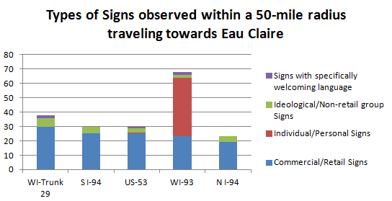
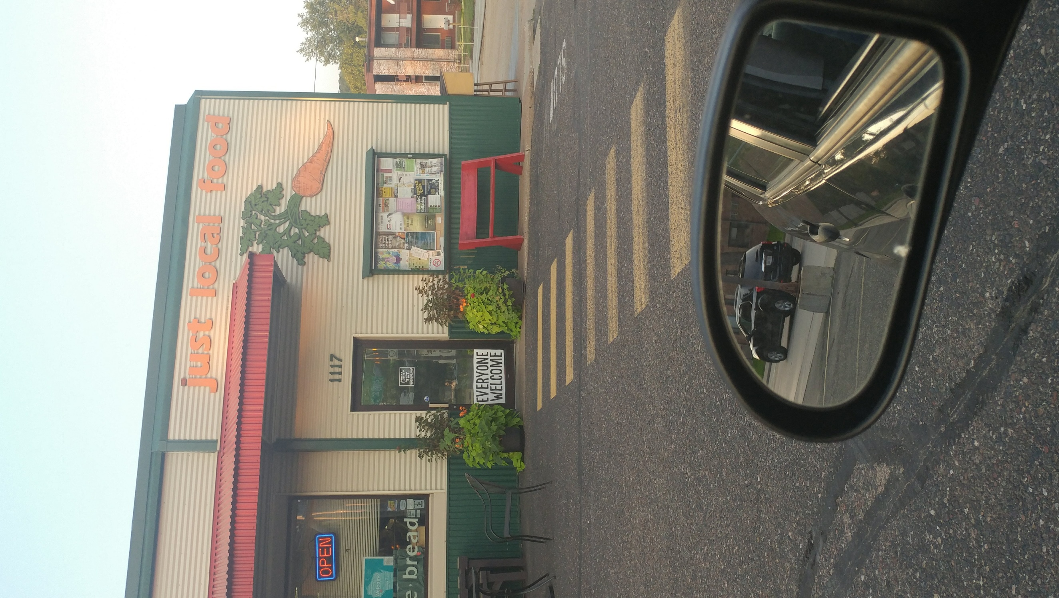
Billboards and Farmland
Semiotic Analysis of Western Wisconsin’s Landscape in terms of Welcoming Values
Carissa Dowden | Department of Geography and Anthropology
Introduction
Cameron
Study Area
Location of starting/stopping point
Highway routes
Results
A Semiotic Landscape refers to “any (public) space with visible inscription made through deliberate human intervention and meaning making” (Jaworski and Thurlow 2). Therefore, any landscape where humans have created some sort of meaningful image or sign, is a semiotic landscape, and can be interpreted through a visual semiotic framework and a semiotic landscape analysis. As defined previously in ‘“Is Tolerant Good Enough?” Eau Claire and the Practice of Welcomingess,’ welcoming places are where people feel they belong, have a stake and say, and don’t feel threatened (Dowden et al 2017). Continuation of this research resulted in questions of looking just outside Eau Claire: could welcomingness be viewed on the landscape? Could signs be interpreted as messages of inclusion or exclusion? This project seeks to analyze and evaluate messages shared on the driven landscape for welcoming (or unwelcoming) values, as signs on the landscape theoretically relate back to the values of an adjacent community or neighborhood. Inspired by cultural landscapes studies of the 1970s like Donald W. Meinig and Peirce Lewis, this research seeks to add to the literature on semiotic and linguistic landscapes. This study was completed during the months of July and August of 2018. As this research relied on site-specific data, many of the signs analyzed as a part of this study have since been replaced by new advertisements. Like other types of human landscapes, semiotic landscapes are continually changing, and can represent an interesting snapshot into a community consciousness.
During the months of July and August 2018, within a 50 mile radius traveling towards Eau Claire on the five most major highways, there were a total of 189 signs on the landscape. On WI-Trunk Highway 29, there were a total of 38 signs observed from Withee-Owen traveling west to Eau Claire, of which 30 were classified as commercial or retail signs, 6 as ideological or non-retail signs, and 2 as specifically welcoming with the selected language. On I-94, there were a total of 30 signs observed from Black River Falls going north to Eau Claire, of which 25 were classified as commercial signs, and 5 as ideological signs. On the same highway, there were a total of 23 signs observed from Baldwin going south to Eau Claire, of which 19 were classified as commercial, and 4 as ideological. On US-53, there were a total of 30 signs observed from Stanley going south to Eau Claire, of which 25 were commercial, 1 was a personal sign, 3 were ideological, and 1 as specifically welcoming.
US-53
Baldwin
I-94
WI-29
Lastly, on WI-93, there were a total of 68 signs observed from Arcadia going north to Eau Claire, of which 23 were commercial, 41 were personally erected signs, 2 were ideological, and 2 were specifically welcoming. As seen on figure two, WI-93’s route observation amount was more than twice the size of the other route observation amounts. The calculated routes for WI-Trunk Highway 29 and WI-93 had the highest amount of signs with specifically welcoming language at 2 each, found in the town welcoming signs of Thorp, Stanley, and Eau Claire, as well as a personally mounted sign in the door of Just Local Food Co-op claiming “Everyone Welcome.
There were a total of 9 signs observed within the study area with some sort of welcoming language featured. Signs that particularly called for people to visit or called for comradery were included (in addition to the previously identified welcoming signs), and signs with only commanding language or simple information were excluded (e.g. Visit Menominee vs. McDonalds Exit 79). An example of one of these welcoming signs can be seen in figure 5. WI-Trunk Highway 29 had the highest amount of welcoming language on the landscape, particularly in the use of the aforementioned Menominee tourism advertisements.
Withee
Eau Claire
Methodology
WI-93
N
Collection
Analyzation
Categorization
Cartographic visualization of the study area and approximate starting points.
Black River Falls
Discussion
Visual representation of a visual semiotic analysis process
Arcadia
Generally, all five study areas had similar sign categorization makeups: a large majority of advertising dedicated to commercial and retail opportunity in the area, and a very small minority as non-retail or ideologically driven signage. An even smaller minority of signage was specifically welcoming or had some sort of welcoming language utilized. While one may ask, “why isn’t there more specifically welcoming signage on the landscape?” the answer is purely economical: someone must pay for large billboard signage that can withstand the elements, and welcoming organizations most likely do not have the funds to support such messages on the landscape. Furthermore, as most signage is commercial in nature, the majority of signs advertising retail opportunities in an area were related to some sort of chain business, such as Culver’s or McDonald’s. Therefore, to answer the main research question of this study, signs theoretically relate back to the values of an adjacent community or neighborhood, especially in landscapes like I-93 south of Eau Claire, but this idealistic view of human environments exclude a narrative of capitalism on the driven landscape. However, that is not to say that most driven landscapes with advertisements are unwelcoming; put simply, it’s bad business to alienate potential customers, which is why every exit in rural America advertises a McDonald’s or Arby’s as the next right. The landscape between Arcadia and Eau Claire was dominated by individual/personally erected signs during the study period, and had a distinct lack of traditional highway advertising billboards during rural stretches of the route. Many yards and stretches of highway resembled the photo in figure 6, and featured many political yard signs or advertisements for local construction services.
There are many ways that the signs on the landscape within a 50-mile radius of Eau Claire could be interpreted. The experiences and background of this study’s author were controlled through primarily objective categorization process and denotation-connotation analysis structure, though bias can leak through in terms of what can be strictly classified as “welcoming” or just vaguely so. Therefore this research, like human geographical study, is not perfect, and is continually changing just as easily as putting a new Leah Vukmir sign in the sod.
In contrast to traditional LL and SL research, this study does not consider the use of different languages on the landscape, but still looks at the denotation, or the literal meaning of words, and connotation, or the emotional and imaginative association of a word, of signs shared on the landscape within a discourse of power relations between groups. This study considers only non-governmental signage, that is, privately-funded and/or erected signage, in the study area, which is defined as anything non-governmental written or posted on the landscape for the uses of this project. The study area was a 50-mile radius outside of Eau Claire using the five most major highways coming through the city: Interstate 94 (North and South), US Highway 53 North, Wisconsin Highway 93 South, and State Trunk Highway 29. Following the steps laid out by Barni and Barna, photos of signage were taken from an automobile driver’s perspective in the study area. Using Google Maps for ease of access, the center of Eau Claire and the end route point for all 5 study areas was determined to be at the intersection of E Grand Avenue and Farwell Street, and is the end point for all driven routes for this project.
After taking 250 miles worth of pictures, initial categorization began. Images were categorized into four basic topics; commercial group message, ideological group/non-retail messages, individually/personally erected messages, and signs that specifically “welcome” in its message (e.g. “Welcome to Eau Claire”). Next, after categorization, the denotation and connotation of the messages were evaluated, and connotation was specifically analyzed for subjectively negative messages concerning a person or group. Messages of with language intended to welcome individuals to a business, institution, or place were also singled out (e.g. “Visit Menominee”). These findings were organized in a stacked bar graph to compare the landscapes as a whole, the types of signs utilized on the landscape, and the total amount of signs on the landscape with welcoming language as a whole were organized into a pie chart.
Stacked bar graph showing the types of signs observed within the study area and comparing overall geographic totals.
Bibliography
Bashforth, Jo Anna, “Connotation and Denotation,” California State University-Northridge. Accessed April 4, 2019. https://www.csun.edu/~bashforth/098_PDF/06Sep15Connotation_Denotation.pdf.
Barni, Monica and Carla Bagna, “A mapping technique and the linguistic landscape.” In Linguistic landscape: expanding the scenery ed. by Elana Goldberg Shohamy and Durk Gorter (New York: Routledge, 2009), 126–154.
Dowden, Carissa, et al., “’Is Tolerant Good Enough?’ Eau Claire and the Practice of Welcomingness” (Poster Presentation), Celebration of Excellence for Research and Creative Activity 2017, May 2017, accessed March 19, 2019, https://minds.wisconsin.edu/bitstream/handle/1793/78022/DowdenSpr17.pdf?sequence=2&isAllowed=y
Jaworski, Adam and Crispin Thurlow, eds. Semiotic Landscapes : Language, Image, Space. London: Bloomsbury Publishing PLC, 2010. Kerry, Victoria J., “The construction of hegemonic masculinity in the Semiotic Landscape of a CrossFit ‘Cave,’” Visual Communication 16, no. 2 (May 2017): 209–37.
Landry, Rodrigue and Richard Y. Bourhis, “Linguistic Landscape and Ethnolinguistic Vitality: An Empirical Study,” Journal of Language and Social Psychology 16, no. 1 (March 1997): 23-49.
Lewis, Peirce K., “Axioms for Reading the Landscape.” In Material Culture Studies in America, ed. by Thomas J. Schlereth (Nashville: American Association for State and Local History, 1982), 174.
Scollon, Ron and Suzie Wong Scollon, Discourses in Place: Language in the Material World. London: Routledge, 2003.
Meinig, Donald W., "The Beholding Eye: Ten Versions of the Same Scene." In The Interpretation of Ordinary Landscapes: Geographical Essays, ed. by D. W. Meinig and John Brinckerhoff Jackson (New York: Oxford University Press, 1979), 33-42.
Yi-Fu Tuan, Topophilia: a Study of Environmental Perception, Attitudes, and Values. New York: Columbia University Press, 1990.
Tuan, Yi-Fu, Space and Place: The Perspective of Experience. Minneapolis: University of Minnesota Press, 2001.
Pie chart showing the total amount of signs with language intended to welcome individuals to a business, a place, etc. within the study area.
“Everyone Welcome” door sign from Just Local Food Cooperative; taken on WI-93 route.

