Slide 1
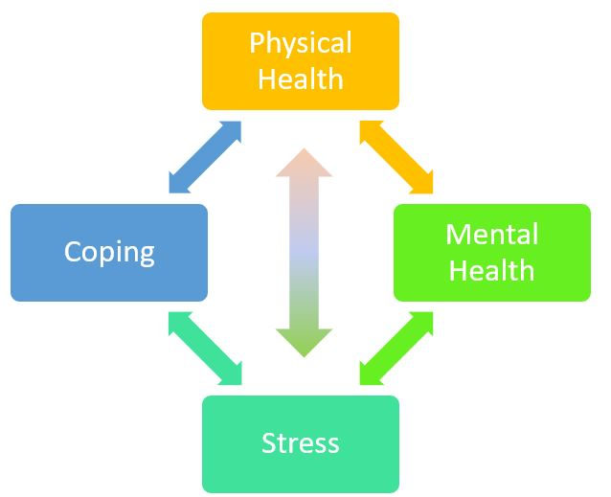
College Students’ Experiences with Stress, Coping Mechanisms, and Awareness of the Physical Effects of Stress
Independent mcnair research
Rebekah Damitz, Research Mentor: Dr. Mary Beth Leibham | Psychology Department
Introduction
Measures
Results
Stressful life events are inevitable. It is how we interpret and manage those events that determines the impact that they have on our bodies. Stress has been linked to negative consequences in each system in our body, including the endocrine, reproductive, gastrointestinal, and cardiovascular systems (American Psychological Association).
VARIABLES
CORRELATION MATRIX OF PEARSON’S R
FOR MEASURED VARIABLES
Stress experience
Perceived Stress Scale (PSS; Figure 2; Cohen, 1983)
Coping mechanisms
Coping Inventory for Stressful Situations (CISS-21; Figure 3; Endler & Parker, 1999)
Physical and mental health effects of stress
Brief Symptom Inventory (BSI; Figure 4; Derogatis, 1993)
Awareness of psychosomatic symptoms
Original measurement, Stress Awareness Scale (SAS; Figure 5)
PURPOSE
Column1 | PSS | CISS-T | CISS-A | CISS-E | BSI_Soma | SAS
Perceived Stress Scale (PSS) |  | -0.083 | 0.138** | 0.498** | 0.336** | 0.178**
Coping Inventory for Stressful Situations_Task Oriented (CISS-T) | -0.083 |  | 0.239** | -0.229** | -0.113** | 0.037
Coping Inventory for Stressful Situations_ Avoidance (CISS-A) | 0.138** | 0.239** |  | 0.48 | 0.030 | 0.077
Coping Inventory for Stressful Situations_Emotion Oriented (CISS-E) | 0.498** | -0.229** | 0.48 |  | 0.401** | 0.191**
Brief Symptom Inventory_ Somatization (BSI_Soma) | 0.336** | -0.113* | 0.030 | 0.401** |  | 0.242**
Stress Awareness Scale (SAS) | 0.178** | 0.037 | 0.077 | 0.191** | 0.242**
* p < .05 ** p < .01
Ample research has been done on types of stressors for college students. Few researchers have measured college students’ awareness of this topic and, consequently, we know little about their awareness of the physical effects of stress. By examining college students’ awareness of the physical effects of stress, in addition to their experiences with stress and various coping mechanisms, we can further understand the potential relationships among these variables, as predicted in Figure 1.
1 = Never 2 = Almost Never 3 = Sometimes 4 = Fairly Often 5 = Very Often
1. In the past month, how often have you been upset because of something that happened unexpectedly?
2. In the past month, how often have you felt that you were unable to control the important things in your life?
3. In the past month, how often have felt nervous and "stressed"?
4. In the past month, how often have you felt confident about your ability to handle your personal problems?
Figure 2
Figure 1
Example Questions from PSS
Intersectionality of
Health, Coping, and Stress
Figure 3
1 = Never 2 = Almost Never 3 = Sometimes 4 = Fairly Often 5 = Very Often
Rate how likely are you to utilize each of the following coping strategies in stressful situations:
1. Focus on the problem and see how I can solve it (T)
2. Blame myself for having gotten into this situation (E)
3. Treat myself to a favorite food or snack (A)
4. Feel anxious about not being able to cope (E)
Method
Example Questions from CISS-21
A Qualtrics survey was posted on UWEC's online psychology research participation system, Sona. The survey consisted of 4 questionnaires (the Perceived Stress Scale, the Coping Inventory for Stressful Situations, the Brief Symptom Inventory, and an original awareness of psychosomatic symptoms scale) and demographics questions.
After cleaning the data (N = 487) for participants who did not complete a majority of the survey, were not UWEC students, or who answered that they did not respond honestly to the questions, 481 participants were left.
1 = Not at all 2 = A little bit 3 = Moderately 4 = Quite a bit 5 = Extremely 6 = Prefer not to answer
During the past 7 days, how much were you distressed by:
1. Faintness or dizziness
2. Pains in the heart or chest
3. Nausea or upset stomach
4. Trouble getting your breath
5. Hot or cold spells
6. Numbness or tingling in parts of your body
7. Feeling weak in parts of your body
Discussion
Figure 4
Students who reported more stress were more aware of the psychosomatic relationships, more likely to utilize avoidance coping methods, more likely to utilize emotion-oriented coping methods, and experiencing more somatic symptoms.
Students who reported being more aware of the psychosomatic relationship were more likely to utilize emotion-oriented coping methods and more likely to experience somatic symptoms.
Students who reported utilizing more task-oriented coping methods were more likely to utilize avoidance coping methods, less likely to utilize emotion-oriented coping methods, and were less likely to report somatic symptoms.
Students who report utilizing more emotion-oriented coping methods report more somatic symptoms.
Example Questions from BSI
Demographics
Figure 5
Rate how much you agree with the following statements about stress and health.
My stress levels can impact my musculoskeletal system (muscles).
Strongly Disagree, Disagree, Slightly Disagree, Slightly Agree, Agree, Strongly Agree
2. My stress levels can impact my respiratory system (lungs & breathing).
Strongly Disagree, Disagree, Slightly Disagree, Slightly Agree, Agree, Strongly Agree
3. My stress levels can impact my cardiovascular system (heart & blood vessels).
Strongly Disagree, Disagree, Slightly Disagree, Slightly Agree, Agree, Strongly Agree
Most participants were White (90.3%), followed by Asian (4.1%), Hispanic (1.7%), Black or African American (0.6%), and the remainder did not indicate an ethnicity. This is comparable to other PWIs.
Most participants were female (83.4%) with 14.9% male, 1 participant indicated nonbinary and 1 participant indicated demi boy.
Most participants were born in 2000 (N=193), 1999 (N=152), and 1998 (N=49). This is logical based on traditional college students and that most were, presumably, in an intro psychology or similar course. Most participants reported a family income of $50,000-$80,000 (27.6%) followed by greater than $100,000 (25.8%).
Example Questions from SAS
Means, Std. Deviations, and Ranges for Measured Variables
Measure | Mean | SD | Range
PSS | 32.49 | 3.22 | 10-50
SAS | 5.17 | 1.17 | 1-7
BSI_Soma | 11.79 | 4.86 | 7-42
CISS_Task | 3.26 | 0.66 | 1-5
CISS_Avoid | 3.12 | 0.71 | 1-5
CISS_Emotion | 3.05 | 0.74 | 1-5
Future Directions
LIMITATIONS AND FUTURE RESEARCH
Hypotheses
Future research should expand with a more reliable and valid psychosomatic awareness scale. Also, I hope to expand the population from UWEC students to other college and university students.
H₁: Individuals with higher perceived stress levels will report more physical health symptoms, more awareness of psychosomatic symptoms, and more adaptive coping mechanisms.
H₂: Individuals with lower perceived stress levels will report less physical health symptoms, less awareness of psychosomatic symptoms, and less adaptive coping mechanisms.
references
American Psychological Association. Stress effects on the body. Retrieved from https://www.apa.org/helpcenter/stress-body.aspx
Cohen, S., Kamarek, T., & Merelstein, R. (1983). A global measure of perceived stress. Journal of Health and Social Behavior, 24(4), 385-396.
Derogatis, L. (1975). Brief symptom inventory (BSI). Retrieved from https://hazards.colorado.edu/nhcdata/chernobyl/ChData/ScalesInstruments/Scales%20and%20Indices/Scale%20Construction%20Instructions/BSI.pdf
Endler, N. S., & Parker, D. A. (1999). Coping Inventory for Stressful Situations (CISS): Manual (2nd ed.). Toronto: Multi Health Systems.

