Slide 1
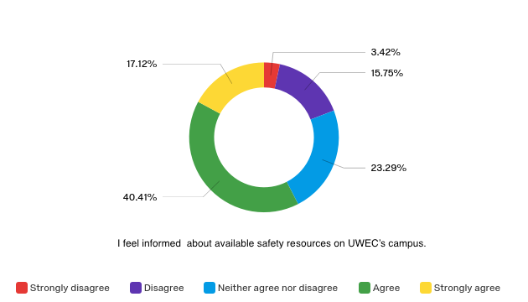
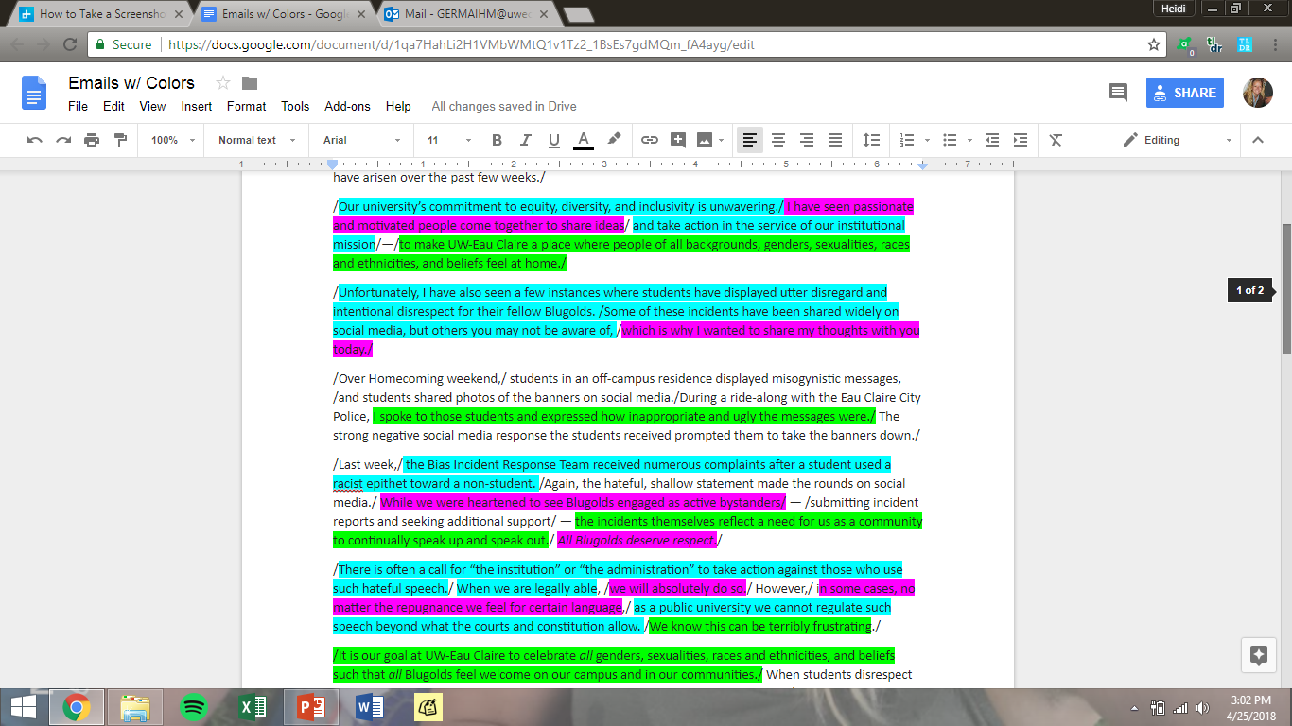
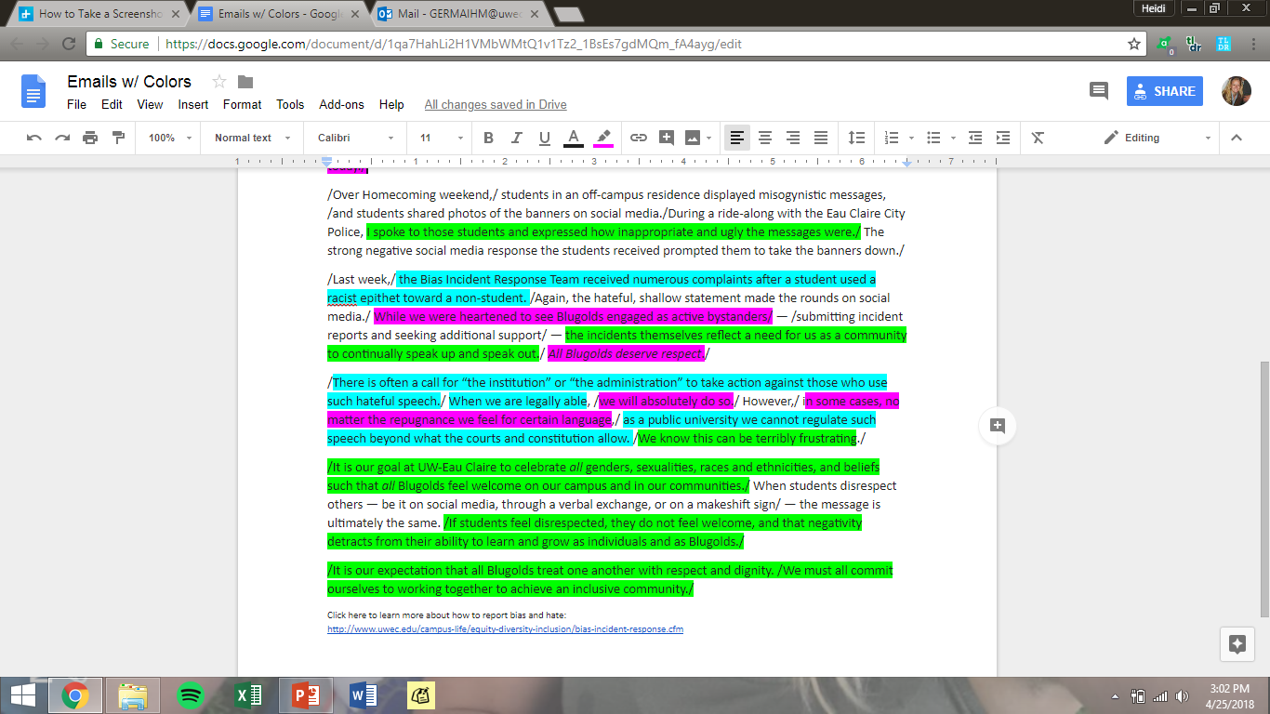
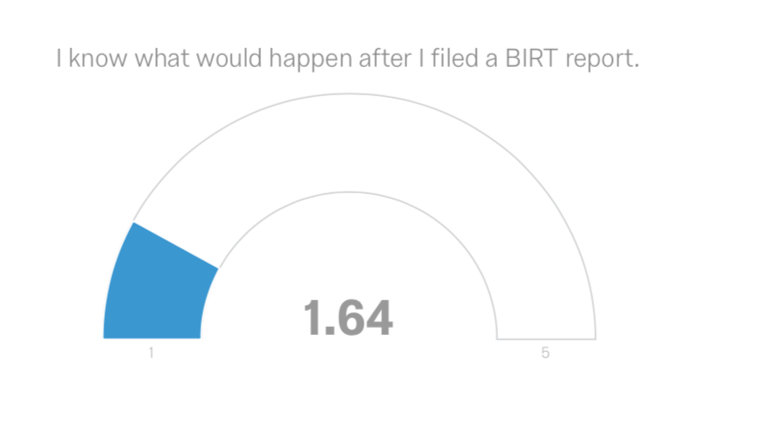
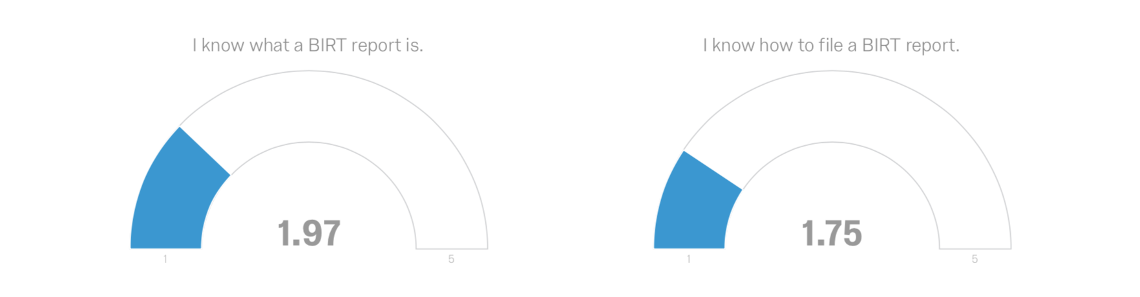
Framing, Awareness, and Communication Satisfaction of Safety Concerns At The University of Wisconsin- Eau Claire
Allison Bugel, Heidi Germain, Sara Klein, Kim North, Holly White
Faculty Mentor: Martha Fay Ph.D.| Department of Communication and Journalism
Abstract
Methods
Research questions & results
As an institution, the University of Wisconsin- Eau Claire has demonstrated concern for the safety of students. One way it has done this is through the Bias Incident Report Team (BIRT) reports, a specific process available to students that allows them to report safety concerns. Such processes are important because of the rising number of incidents on campuses across the nation. While safety and reporting efforts are important, if students are unaware of these processes then they are ineffective. Furthermore, whether students choose to report may be aligned with other factors such as general perceived campus culture and students’ satisfaction with communication from campus administrators. Using a survey that includes an adapted version of Downs and Hazen’s (1977) communication satisfaction questionnaire and an adapted Organizational Culture Survey from Glaser, Zamanou, and Hacker (1987), this study examines whether students’ perceptions of perceived campus culture and administrative communication are associated with awareness and utilization of safety resources, and analyzes the way that formal organizational messaging is framed as it relates to reporting sensitive safety concerns. Findings should generate discussion surrounding safety resources, while improving awareness and use of safety processes.
Quantitative analysis
RQ₁: Are students’ perceptions of perceived campus culture associated with awareness of safety resources?
Perceived culture is significantly and positively correlated with awareness of safety concerns, r= .34, p<.001.
The researchers created a qualtrics survey containing 22 questions. The survey was sent to students who are currently enrolled at the University of Wisconsin-Eau Claire. 126 responded to the survey: 16% male and 83% female.
Awareness: 11 questions were guided by research using the dialectics theory. A sample item is "I feel informed about available safety resources on UWEC's campus”; response format was SD to SA. The scale was reliable, α=.71, M=34.02, SD=5.56.
Communication satisfaction: Questions were developed using an adapted version of the Organizational Satisfaction Questionnaire (Downs & Hazen, 1977). A sample item is: “I am well informed by administrators about polices and goals of the University.” The scale was reliable, α=.93, M=53.71, SD=11.89.
Perceived campus culture: Questions were developed using an adapted version of the Organizational Culture Survey (Glaser, Zamanou, & Hacker, 1987). A sample item is “the administrators supply enough information about current events and changes on campus.” The scale was reliable, α=.79, M=52.57, SD=7.28.
Message analysis: Three hypothetical message scenarios reflecting personal, institutional, and combination messages were presented. Participants responded to three sample items: “I would be likely to report after reading this message,” “I would believe my safety was a concern of the administration,” and “I would believe my case would receive appropriate prioritization.” Scales were reliable.
Message One: α=.72, M=3.06, SD=.87. Message Two: α=.83, M=3.2, SD=.86. Message Three: α=.85, M=2.9, SD=.99.
Content analysis: Researchers selected four actual messages following real bias incidents on campus. Each message was separated into individual thought units, defined as “the minimum meaningful utterance having a beginning and an end.” (Hatfield & Weirder-Hatfield, 1978, p.46). Researchers coded messages framed as personal, institutional and a combination of both.
Figure 1: Awareness of campus resources
RQ₂: Is perceived campus culture associated with student satisfaction with administrative communication?
Perceived campus culture is significantly and positively correlated with student satisfaction with administrative communication, r=.43, p<.001
RQ₃: Is satisfaction with administrator communication associated with personal, institutional, or combination messages regarding bias incident reports?
We ran a Pearson correlation to analyze communication satisfaction with each individual message.
Communication satisfaction and combination rhetoric were significantly and positively correlated. r=.28, p<.01
Communication satisfaction and personal rhetoric were significantly and positively correlated r=.22, p<.05
Communication satisfaction and institutional rhetoric were significantly and positively correlated r=.30, p<.001
Message Coding Key
Blue: Institutional
Pink: Personal
Green: Combination
Institutional: Information is presented formally on behalf of the University’s Administration
Personal: Information is presented on a more caring and individual level
Rationale
Dialectics theory (Baxter & Montgomery, 1988) suggests that college administrators have to balance their use of personal and institutional messaging especially where student safety is concerned
University values should reflect a culture that promotes safety, and students should be aware of related resources available to them
Because, in other organizations, leadership and organizational culture have been positively correlated with job satisfaction of employees (Chang & Lee, 2007), these should be associated with student satisfaction in the University context
Organizational values have been shown to affect how organizations react in a crisis (Fitzgerald & Desjardins, 2004). Researchers used this concept in the context of university values in order to examine how culture and crises messages (safety, e.g.) might correlate
University administrators must manage their communication about crises and safety issues with messages that reflect both personal concern and institutional strength, an ongoing dialectical tension
Using framing as a lens, researchers analyzed student perceptions of culture and values, awareness of safety resources, and messages about real and devised safety scenarios
Additional Findings
Figure 2: Sample coding email
Qualitative analysis
While these reports show that awareness is generally high, the awareness of one specific safety process, BIRT, is low. This suggests that the University of Wisconsin-Eau Claire could benefit from outreach to further explain what this reporting process looks like.
Discussion/Implications
Based on findings for RQ_{1,} researchers concluded that the University is succeeding overall in creating a positive culture that makes students aware of safety resources available to them. The resources are essential to understanding and maintaining a positive perceived culture that is highly aware of available resources.
Based on findings for RQ_{2,} researchers conclude that the perceived culture is associated with student satisfaction with administrator communication. Despite this, the research shows that the communication between administrators and students could still be improved upon.
Based on findings for RQ_{3,} researchers conclude that students were more satisfied with institutional rhetoric, with regard to safety concerns; students were least satisfied with personal rhetoric from the University when regarding bias incidents. This may be because students feel safer when administrators take an authoritative stance, as has been shown in organizations (Deichmann, Dornelles, Hayek &Landry, 2013). Additionally, our content analysis found that UWEC is utilizing a majority of institutional messages with students, which suggests that administrators are effectively managing the dialectic of personal versus institutional views.

