Slide 1
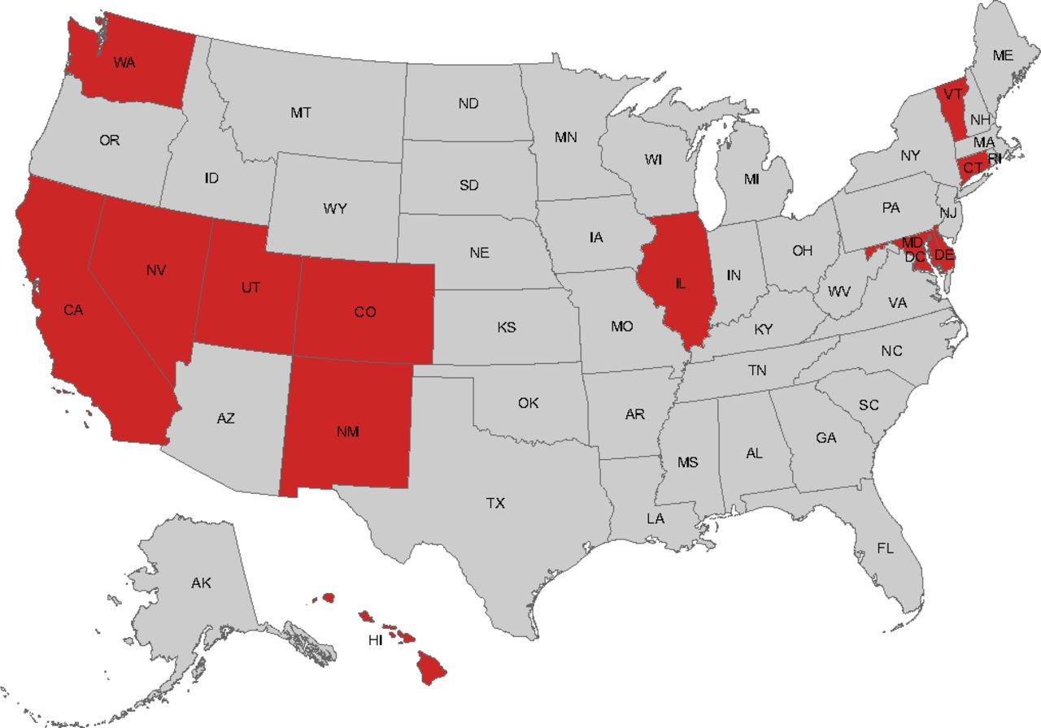
Cost-Benefit Analysis of Providing Driver’s Licenses to Unauthorized Immigrants
Increasing Public Safety and Revenue
Mirella Espino | Latin American Studies
Professor G. Licón | Latin American Studies
Introduction
Case Study: California Assembly Bill 60
The driver’s license application process aims to ensure all applicants receive basic training and are equipped to drive on public roads. Through the REAL ID Act of 2005, federal legislators standardized the driver’s license application process and created a de jure national identification card—morphing the purpose of driver’s licenses. REAL ID compliant driver’s licenses require the applicants birth certificate and Social Security Card, disqualifying unauthorized immigrants. Twelve states, as well as Washington D.C. and Puerto Rico, provide unauthorized immigrants access to non-REAL ID compliant driver’s licenses with the sole purpose of legalizing their driving. What would be the effects of reinstating unauthorized immigrants’ access to driver’s licenses in Wisconsin?
600,000 licenses issued in the first year
Legalized driving done by unauthorized immigrants
Effects:
Decline in hit and run accidents by about 4,000 per year (5)
Not-at-fault drivers avoided out of pocket expenses for car repairs (physical damage) of about $3.5 million (5)
Reduced emergency assistance delays
Reduced distortion on insurance markets and reduced average insurance premiums
Decrease in market inefficiencies by ~$17 million per year (5)
Policy Background
Lueders, Hans, Jens Hainmueller, and Duncan Lawrence. “Providing driver’s licenses to unauthorized immigrants in California improves traffic safety.” Proceedings of the National Academy of Sciences of the United States of America, National Academy of Sciences, 3 Apr. 2017, pp. 1-6, http://www.pnas.org/content/pnas/early/2017/03/28/1618991114.full.pdf
Driver’s Licenses
Up until 1990s: unauthorized immigrants could obtain driver’s licenses
1993: California first implemented restrictions and 45 states followed
2009: Wisconsin Act 20 added the “legal presence” requirement 2013: Trend shifted toward providing access to unauthorized immigrants
2016: 12 states, plus Washington D.C. and Puerto Rico provide unauthorized immigrants access to driver’s licenses
Wisconsin
Unauthorized Immigrant Population
Total estimated unauthorized immigrant population: 80,000
Estimated applicants within first three years
20,000-40,000 (FPI)
32,000 (Kids Forward)
The REAL ID Act of 2005
Expenses
Changes:
Administration done at the state level (rather than county level)
Photos taken at the start of the application process and retained as well as other information presented
All applicants must present birth certificate, Social Security Card, and proof of address
Effects:
Standardized driver’s license application process
Produced a de facto national identification card
Consequences of non-compliant licenses:
Denied access to federal buildings, nuclear power plants, boarding commercial aircraft
Invalid form of identification if used for voting
Other states with similar unauthorized immigrant populations did not require additional staff to process applications
Revenue
Applicants (within first 3 years) | 20,000-40,000 (FPI) | 32,000 (Kids Forward)
Driver’s License Fee ($34, renewable every 8 years) | $680,000-$1,360,000 | $1,088,000
Eye Exam Fee ($15) | $300,000-$600,000 | $480,000
Total | $980,000-$1,960,000 | $1,568,000
States Allowing Unauthorized Immigrants Access to Non-REAL ID Compliant Driver’s Licenses
Estimated revenue from driver’s license and eye exam fees of about $980,000 to $1.96 million
Additional indirect revenue:
Reduce insurance premiums by $16 million across the state for already-insured drivers (Kids Forward, 10)
28,000 new car insurance customers and $13 million in revenue annually (Kids Forward, 10)
Washington (1993)
New Mexico (2003)
Utah (2005)
Illinois (2013)
Puerto Rico (2013)
Maryland (2014)
Nevada (2014)
Vermont (2014)
District of Columbia (2014)
Colorado (2014)
California (2015)
Connecticut (2015)
Delaware (2015)
Hawaii (2016)
Kallick, David Dyssegaad and Cyierra Roldan. “Take-Up Rates for Driver’s Licenses: When Unauthorized Immigrant Can Get a License, How Many Do?” Fiscal Policy Institute (FPI). 31, Jan. 2017. http://fiscalpolicy.org/wp-content/uploads/2017/01/FPI-Brief-on-Driver-Licenses-2017.pdf.
“Widen the Road: Removing barriers to Driver License Eligibility Will Improve Safety, Support Families, and Boost Businesses.” Kids Forward. Nov. 2018. http://kidsforward.net/assets/Widen-the-Road-FINAL.pdf.
Conclusion
Overall, reinstating unauthorized immigrants’ access to driver’s licenses in Wisconsin would have a positive effect on the community by:
Increasing the safety of all Wisconsin drivers
Providing an additional source of revenue for the state through fees
Reducing hit and run accidents, translating into reduced insurance premiums for all drivers
Adding new insurance customers
http://www.ncsl.org/research/immigration/states-offering-driver-s-licenses-to-immigrants.aspx

